Slide 1

Starting School
at
Cheapside
An introduction
for new families

Slide 2
Welcome !
New and exciting stage in your child’s life.
Make new friends, enjoy new experiences.
Develop the skills they need to be effective learners.
Work with you as partners to help ensure your child has the best possible start to their school career.
A copy of this presentation will be uploaded onto the school website under the tab – Children – Class Pages – Wren Class Reception New Starters 2023-2024.
https://www.cheapsideschool.org.uk/wren-class-reception-new-starters-2023-2024/
Notes:
Introduce myself, Kate, Lisa, Clare, SENCO and PTA
Starting school is an exciting and one of the most important stages in your child’s life
It is a chance to make new friends, enjoy new experiences and learn important life skills
At Cheapside our aim is to instil a love of learning and develop the skills that children need to be active, inquisitive, confident and effective learners.
To do this we also need your help and need to work together with you as partners by sharing your child’s experiences and achievements both in and outside of school. Together we can try and overcome any problems that your child may have and ensure they have the best possible start to their school career.
If you would like to refer back to this presentation their will be a copy on the school website.

Slide 3
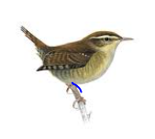
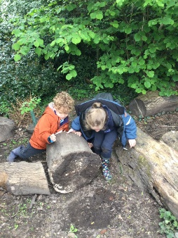
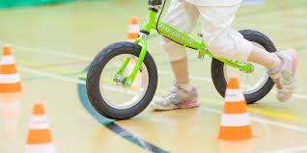
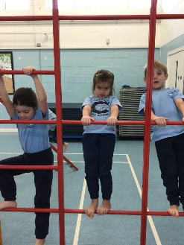
Wrens Class!
Your child will be based in Wrens Class for their reception year.
The class teacher will be Mrs Coe and will be supported by a teaching assistant.
Your children will also have the opportunity to visit our Forest School, take part in a PE lesson, practise riding a balance/pedal bike and enjoy our covered outdoor area.
Mrs Hignight is our SENCO.
We have an ‘open door’ policy. If you have any worries or concerns about your child, please speak to Mrs Coe or Mrs Hignight by making an appointment with the School Office.
Notes:
All our classes at Cheapside (7 altogether) are named after birds and Reception Class is known as Wren Class.
I will be your children’s class teacher and I will be supported with our experienced Teaching Assistant.
We try to encourage outdoor learning and have a covered outdoor space where the children can enjoy lots of different activities to stimulate them. The children will also take part in Forest School sessions (in all weathers!), balanceability and also have a PE lesson with our PE teacher Mrs Higgins.
Mrs Hignight is our SENCO and she is responsible, along with Mrs Searle, for implementing our school SEND policy. Liaising with parents, teachers and out of school professionals to ensure that our SEN children receive the support that they might need. This might include liaising with Speech and Language therapists, referring children who might need out of school help, giving advise to parents and dealing with Educational Health Care Plans.
We have an open door policy and are happy to discuss any queries or concerns that you might have. I am happy to arrange a meeting with you before or after school. After school is usually preferred as it can often be quite busy in the morning with children arriving to school. You can either arrange this with me when you pick up or drop off your child or by telephoning or emailing the school office.

Slide 4

“Is my child ready for school ?”
In Reception we like the children to be able to:
express their needs appropriately
Use the toilet independently, including being able to wipe themselves.
Wash and dry hands
Blow their nose
Sit up at a table
Understand how to use a knife and fork
Dress and undress themselves
Sit quietly to listen to a story or a piece of music
Wait patiently
Share and take turns
Tidy up things they have used
Say goodbye to their parents with a smile !!!!!!!!
Notes:
Read through these
Please do not worry if your child isn’t able to do all of these things as we will work with you to achieve them but it’s a good idea to practise over the summer holidays to help the children’s transition into school. It’s great for settling into school, if the children to feel confident and independent when they start.

Slide 5
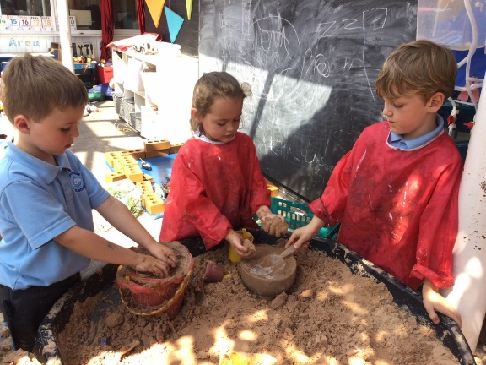
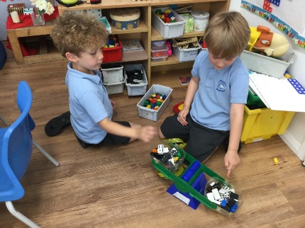
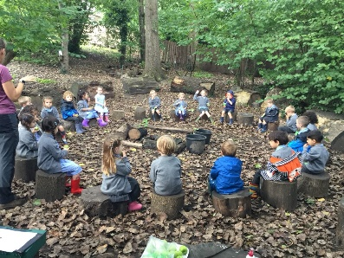
Foundation Stage
What is the Foundation Stage?
Foundation Stage 1 takes place in a pre-school or nursery between the ages 3 and 4. Foundation Stage 2 takes place in a Reception class of an Infant or Primary school between the ages 4 and 5.
The Foundation Stage Curriculum at Cheapside is based on the recognition that children learn best through play and active learning, alongside adult directed small group and whole class activities.
Although we have ‘topics’ throughout the year we change and adapt our EYFS curriculum to follow the interests of the children.
At Cheapside part of this learning will take place outdoors in Forest School sessions.

Slide 6

How will I know what my child is learning?
Regular newsletters will be published on the class page on our website.
We currently use a piece of educational software called ‘Tapestry’ to record your child’s ‘Wow’ moments and whole class activities. You will receive an email at the end of July asking you to activate your account. Please upload any photos of your child’s ‘wow’ moments or achievements over the summer holidays! There will be some optional activity ideas on Tapestry if you would like to have a go at them with your child.
We collect key pieces of children’s work to share with you in a Learning Journey and Topic Book.
Notes:
Please check your junk mailbox as sometimes the Tapestry email does disappear into it!
Show the Topic Books and Learning Journeys

Slide 7
The first few weeks..
Help your child settle, ensuring they feel safe and are happy, and encourage and support with exploring the new environment and with making new friends.
Be introduced to their Year 6 Buddy.
What do they already know? We use this information to help plan for the next steps for every child. This is what is generally referred to as the Reception Baseline Assessment (RBA) .
You will be invited to discuss your child’s progress & adjustment to school within the first term.
Notes:
settle. Explore, build confidence, make friends, feel safe and secure, build relationships with their teachers and make friends with their Year 6 buddy.
Baseline. NOT A TEST. Through play, observing and adult led activities we will be able to gauge where your child lies in their child development journey and set next steps for them so that they continue to make progress. There is no need to prepare your child in advance for this and each child will be at a different stage on this journey. Please try not to worry if your child is not doing what another child are already doing, for example, reading or writing their name. Each child achieves ‘milestones’ in their own time and not always in the same order as each other. They will achieve them when they are ready!
We have parents evening in the 2nd half of the Autumn Term, in the Spring Term and an Annual Report in the Summer Term. However, you are welcome to discuss any concerns about your child’s progress by arranging a meeting or telephone call.

Slide 8
Starting school in September – how does it work?
A Parent-teacher meeting will take place on Wednesday 6th September prior to your child starting school. This is to give you an opportunity to tell us about your child and discuss any worries or concerns you may have about them starting school.
Please ensure you have signed up for a time slot for this interview. We would love your child to accompany you to this interview. They will have an opportunity to play in the classroom whilst we meet. You are welcome to stay and play for a small while afterwards with your child.
We would also like to look at your child’s learning journal and any reports that the pre-school have given you so please bring these along with you.
Please return any outstanding forms to school before the end of the Summer Term.

Slide 9
Children invited to attend for the morning session
Your child will begin school for mornings only on Thursday 7th September 2022. We would like the morning children to arrive at 9.00am and be collected at 11.30am.
These children will be in school for mornings only until Friday 8th September.
We would like to invite your child to stay for lunch on Friday 8th September. On this day we would like you to collect your child at 12:30pm
Your child will start school full time on Monday 11th September. The school day will begin at 8.40am.

Slide 10
Why the phased start?
A calm and positive start to school
Smaller groups allow us time to really get to know your child
Some of your children might be anxious or tearful, they might have difficulty separating from you and settling.
The interview sessions are a good opportunity to let us know if you think your child will have difficulty settling.
Notes:
INTRODUCE READING WITH CLARE

Slide 11
What do I need to do now?
Make sure you have signed up for an interview time for your starting school interview. Details about how to do this have already been sent out.
Return any forms enclosed in your initial welcome pack, ensure the office staff have seen your proof of address paperwork.
Ensure your child has a school uniform for September. They may wear the summer uniform at the start of term, but they will need winter uniform by the end of September depending on the weather. Mrs Searle will send out a message to advise the date.
https://www.cheapsideschool.org.uk/uniform/ - deadline Saturday 22nd July
PLEASE NAME EVERYTHING!!!!!!!
Please ring or email the school if you have any questions or concerns about your child starting school – 01344 621112 or school.office@cheapsideschool.org.uk.

Slide 12

        Unity…
        I dreamt I stood in a studio
        And watched two sculptors there
        The clay they used was a young child’s mind
        And they fashioned it with care.
        One was a teacher, the tools she used
        Were books and music, art and play.
        One was a parent with a guiding hand
        And a gentle loving heart……………………
        ……..And each agreed they would have failed
        If they had worked alone
        For behind the parents stood the school
        And behind the teacher, the home.

Slide 13
Any Questions?

