Slide 1
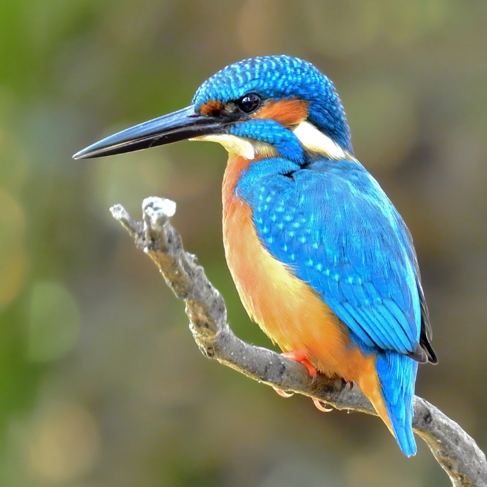

Welcome to Kingfisher Class
Thursday, 10th September 2026
Miss Grigulis

Slide 2

General Information
8:30am - School gate opens
8:50am - Registration closes
3:20pm - Pick up time
Notes:
I would say 9:00 and I’d also say that the register closes at 9:05

Slide 3
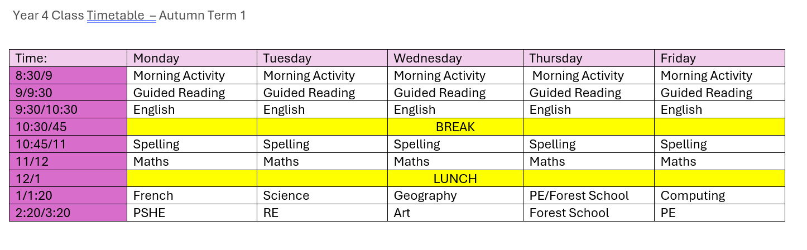
Weekly Timetable – Autumn 1
Important Information:
PE Thursday and Friday
Forest School Thursday
Reading books in every day with yellow reading record.
Free Reader’s: Please sign your child’s book once they have read it.
Phased reading books: To be read daily and parent signs off. Please read three times.
Notes:
I think perhaps don’t use quite so many colours – it’s not quite clear why the colours are different from each other and it’s a bit confusing. Also, focused has just one s. Thursday is Singing or Makaton Assembly – I would also add that Wednesday is vicar’s assembly.

Slide 4
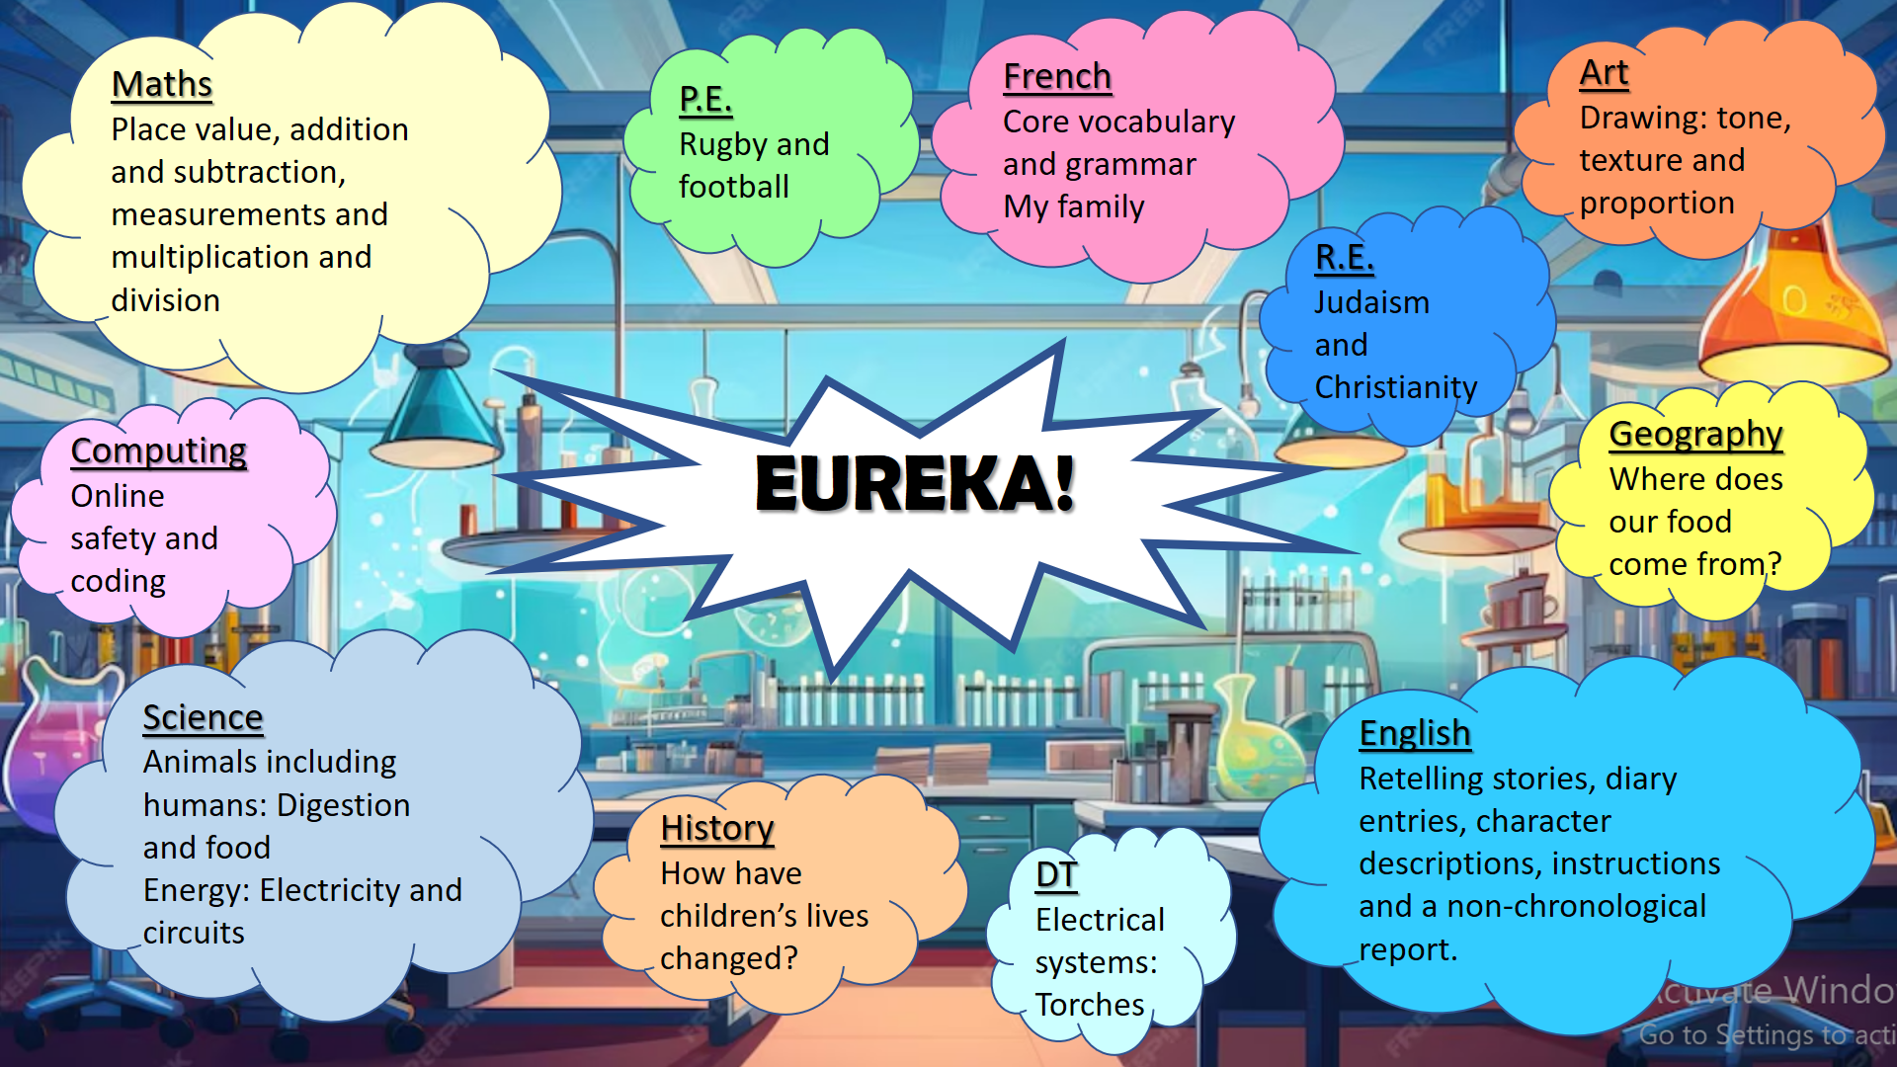
Year 4 Autumn Term Topic Map

Slide 5
Reading
When the children come in each morning they have the opportunity to change their reading book and take part in some independent reading
Guided Reading every day using VIPERS and meaning your child will read every day with me too!
They will be allocated a book from school according to their reading level. The children are also allowed to have a second book from the bookcase which they can bring home to read for pleasure. They can change these at school and we will keep track of these. Your child will also be read with at school, we keep a log of this in class
Reading is a great way of understanding the world and reading to your child is as important as listening to your child read. We’re already talking about fun ways to read.. Hot chocolate, outdoors etc Book Talk already happening in class too!
Notes:
Add that there is a second book they can bring home which is their reading for pleasure choice.

Slide 6
Writing
Key skills being covered through the ‘I am a Clever Writer’ scheme:
  Spelling, grammar and punctuation
  Story writing and descriptive writing
  Poetry
  Non-fiction writing
    Non-chronological reports
    Recount texts
    Information texts
    Instruction texts

Slide 7
Maths
Building on all skills through White Rose Maths, with a focus on:
  Arithmetic and number fluency (including times tables)
  Problem solving
  Space, shape and measure (including telling the time)
Any practical reinforcement you can do at home is greatly appreciated e.g. finding opportunities to tell the time or work out how long until tea-time; reciting times tables or counting in multiples of a given number when in the car. Playing on-line maths games. On the year 4 class pages will be KIRF’s for each term for you to learn with your children and an outline of the units of work that will be covered.

Slide 8
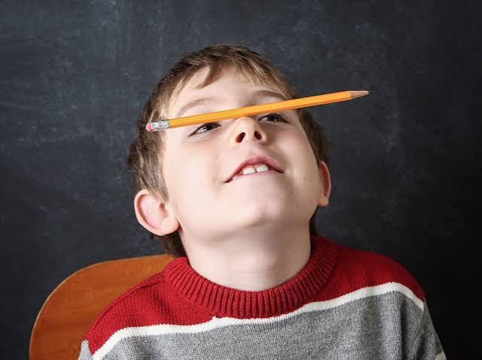


IMPORTANT INFORMATION TIME! Focus….
Main focus for year 4 is the Times Tables test.
What is it? The Year 4 Multiplication Tables Check (MTC) is a statutory, on-screen test administered to pupils in England during June to check fluent recall of times tables up to 12 × 12. Starts, Monday, 7th June 2027 and we have two weeks to test the children within this time period.
We need to live, breathe and eat times tables. I have already started testing them and you will have weekly times table test go home on Friday and then the children will be tested the following Friday. We will start with 2,5,10 x tables and then move on from there. Also, playing TTRS and the children know how to access and play this will be engaging for them along side the up coming national test.

Slide 9
Homework
Daily Spellings – children will be set given 10-12 spellings on a Monday and will be tested on the following Monday. The spellings are based on the spellings for Year 3&4 curriculum. You will receive a marked copy of the spellings and spellings that have been marked incorrect will be repeated. First test Monday, 21st September 2026.
Times tables Using the TTRS website, children have log-ins and are expected to engage with this website as often as possible. Hard copy test given out every Monday to practice for a test the following Monday. First test Monday, 21st September 2026.
Homework Buffet These will be creative activities, related to current learning in school. They can be done in any order! First one released on class pages 21st September 2026.
Notes:
You might want to explain what KIRFs are. They are given about 10-12 spellings not 4 or 5.

Slide 10
What’s needed in school each day:
Water bottles
Reading book – please make sure this comes back into school every day
Pencil case – please keep this small and try to avoid children bringing in anything too precious.
Pupils should have a pencil, ruler, rubber, sharpener and glue stick.
P.E. kits to be worn on Thursday and Friday and Thursday Forest school clothes will be needed too.
Notes:
I would add details of what exactly should be in the pencil case

Slide 11
Expectations in Key Stage 2 (Years 3-6)
Role models to the younger children
Uniform – neat and correct
Homework on time where possible.
Sensible, helpful and polite around the school
Hard work but lots of fun too
Achieving our best – in thought, in word, in deed

Slide 12
Any questions?
I am always here for a quick chat at the end of each day (it’s always tricky to talk at the beginning of the day – if you have something urgent to tell me please let the office know)
If you want to see either me for a longer chat please ask and we’ll set up a meeting. Staff meetings tend to happen on a Wednesday after school but any other day is available
I use the Class Page on the website so please do look there. All the information from today’s meeting will go onto the Class Page
Do you have any questions?

