Slide 1


Slide 2


Slide 3


Slide 4
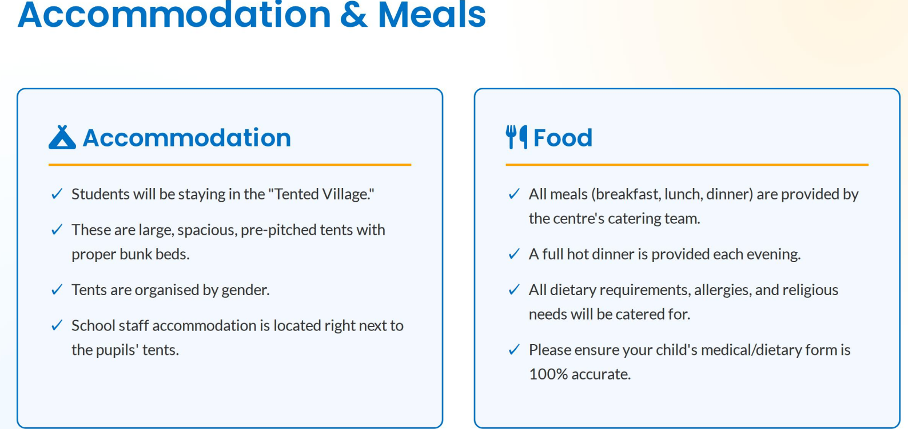

Slide 5


Slide 6
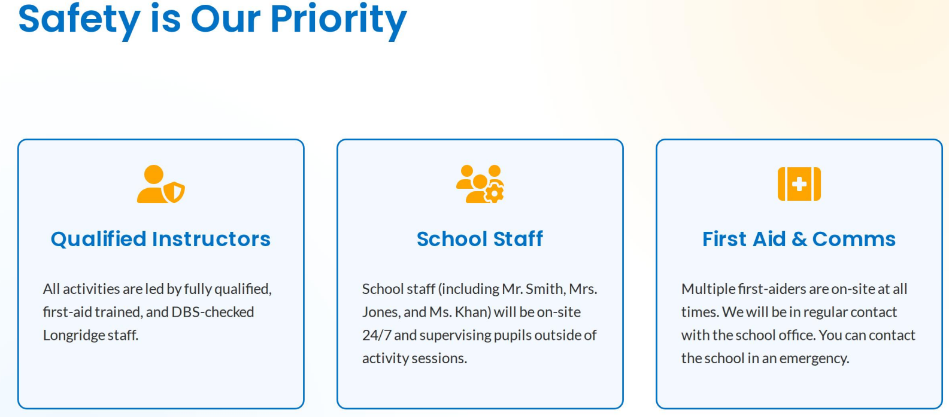

Slide 7
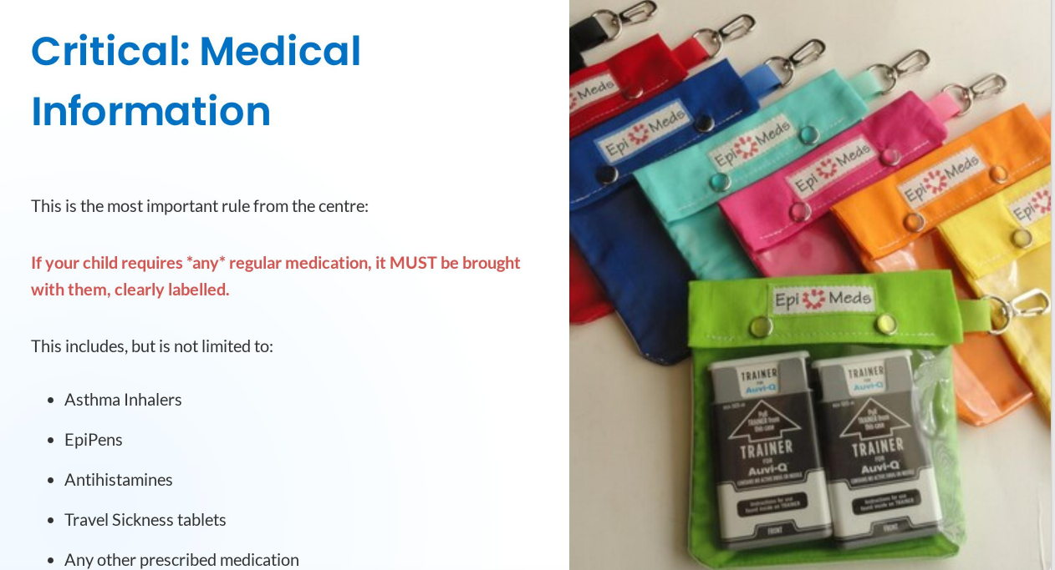

Slide 8
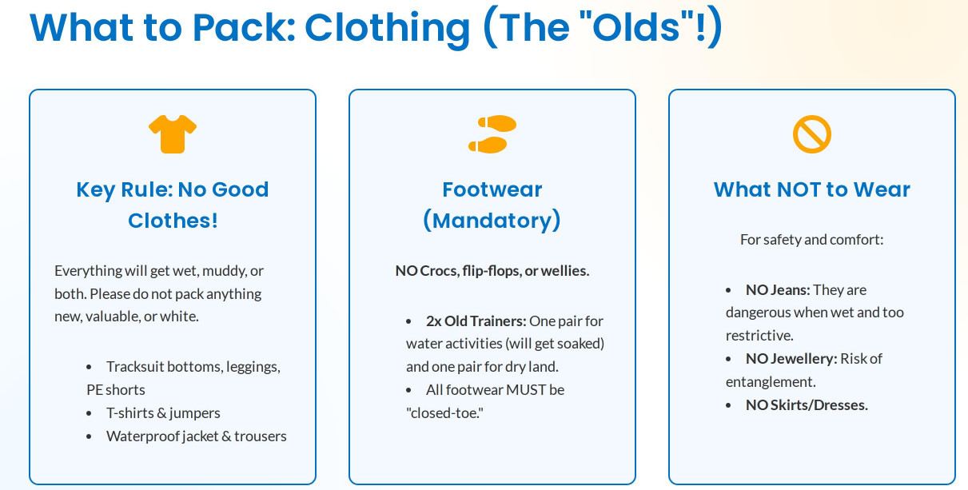

Slide 9
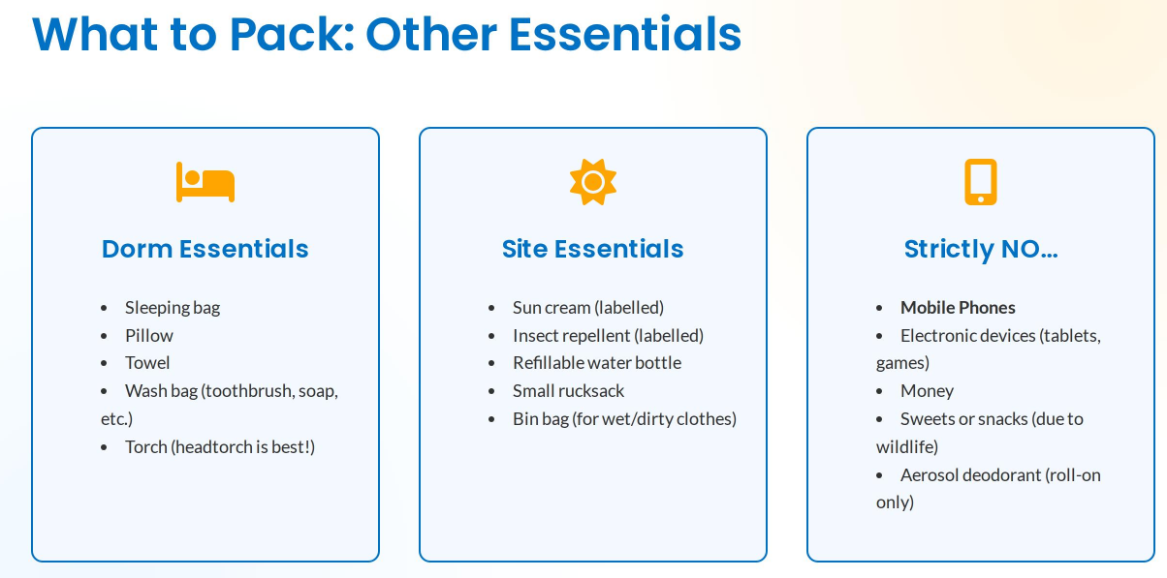

Slide 10


Slide 11
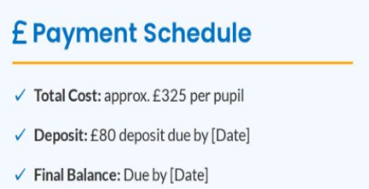

£375 per pupil
£50 due by Friday 9th January
(£325) Friday 30th January
If you wish to pay in monthly instalments, we ask for £65 to be paid every month for 5 months. These payments will be in: January, February, March, April and May.

Slide 12
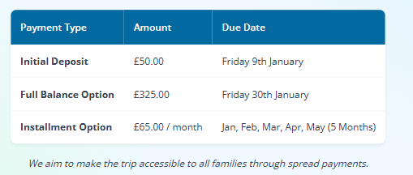

Slide 13

Cost comparison to last years trip

Slide 14

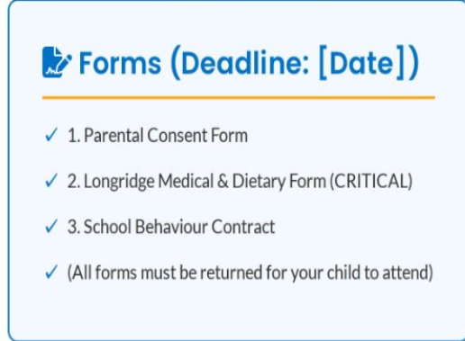
Friday 9th January

Slide 15


