Slide 1
Dia de los Muertos
(The Day of the Dead)

Slide 2
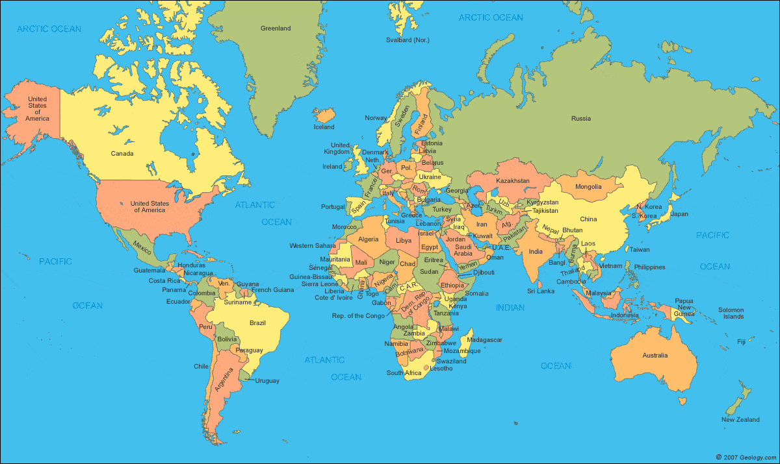

Slide 3
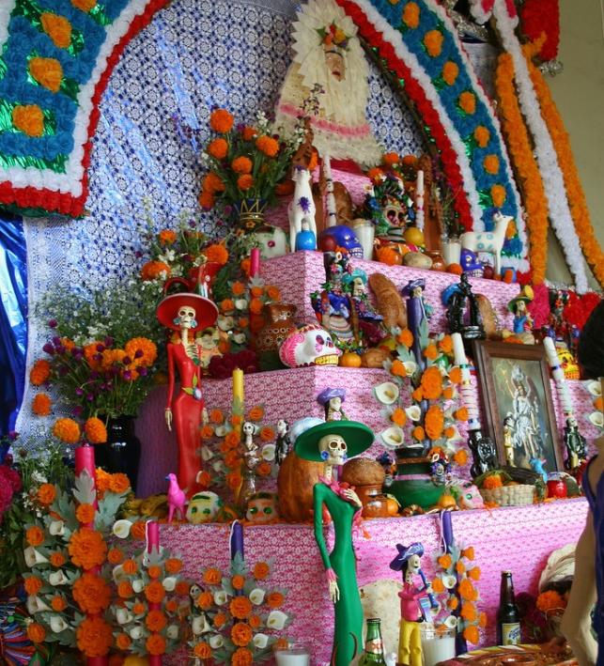
What is the Day of the Dead?
Day of the Dead (Dia de los Muertos) is a celebration during which the dead are honoured.
It is not a sombre and melancholy time, but a time of rejoicing and memories.
It is a day when people go to cemeteries and create altars to be with the souls of friends and relatives who have departed.
Photo courtesy of rainy city (@flickr.com) - granted under creative commons licence - attribution

Slide 4
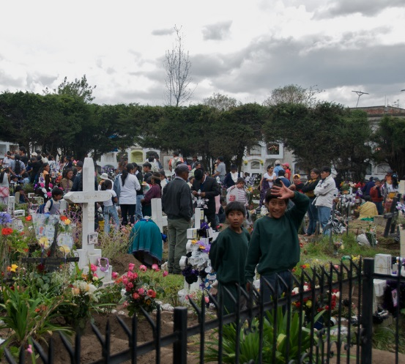
When is the Day of the Dead Celebrated?
Day of the Dead is celebrated across 3 days. The full three days is a fiesta of flowers, food, candles, parades, prayer and fun.
The first day is on the same day as Halloween, 31st October. On this day at midnight, the gates of heaven are opened.
The second day, 1st November, is when the spirits of deceased children (angelitos) visit.
The third day, 2nd November, is when the spirits of adults visit.
Photo courtesy of A.Davey (@flickr.com) - granted under creative commons licence - attribution

Slide 5
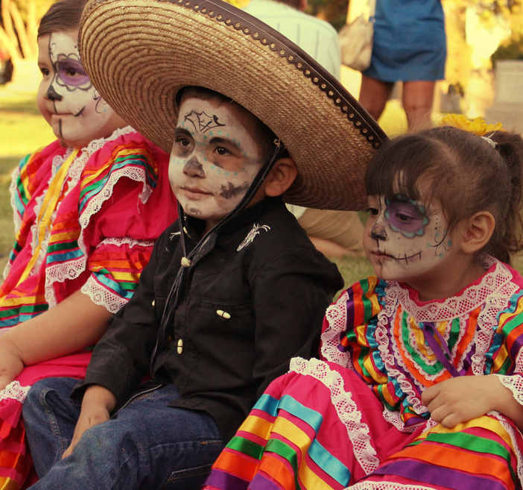
Where is the Day of the Dead Celebrated?
Day of the Dead is celebrated in Mexico, Ecuador, Guatemala and other areas in Central and South America, specifically those with the Latino ethnic background.
It is also celebrated in areas of North America, such as California and Texas, where the Mexican/American heritage exists.
Photo courtesy of Salina Canizales (@flickr.com) - granted under creative commons licence - attribution

Slide 6
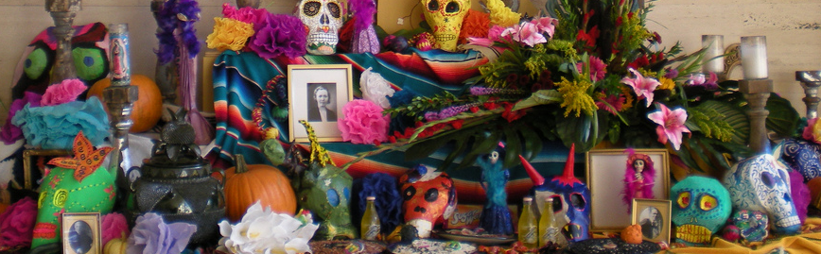
Ofrendas - Altars
People create ofrendas (altars) to honour the deceased.
The altars are a space to remember loved ones and light candles to guide the spirits.
The altars include:
• pictures of the deceased
• items they were fond of
• something to eat
• candles
• flowers
• gifts
Photo courtesy of genibee(@flickr.com) - granted under creative commons licence - attribution

Slide 7
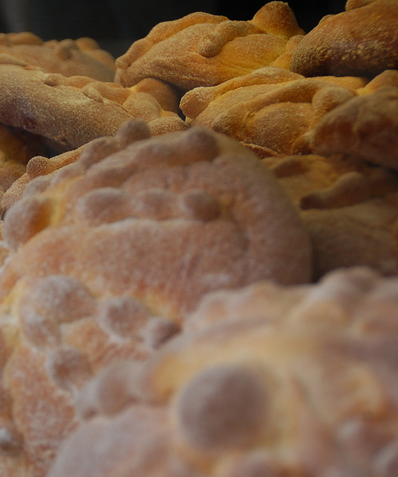
Pan de Muertos – Bread of the Dead
A special Day of the Dead bread called Pan de Muertos is eaten. This bread represents the soul of the departed.
The loaves are sometimes baked in the shape of skulls and sometimes are round loaves decorated with bones.
The bread is often decorated with frosting or seeds, which represent happiness in some areas of Mexico.
Photo courtesy of Zylenia (@flickr.com) - granted under creative commons licence - attribution

Slide 8
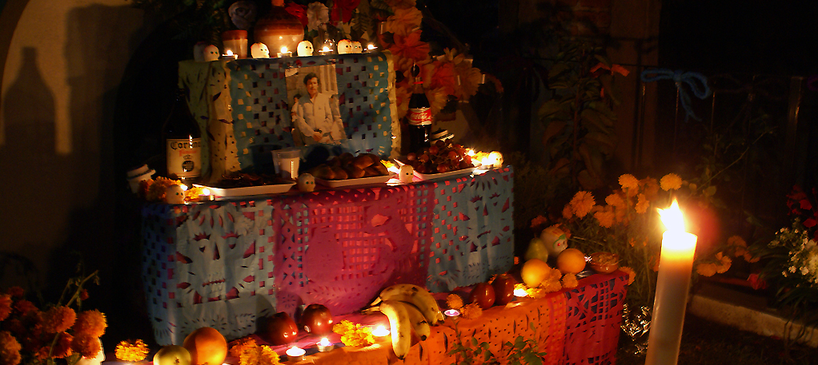
Food
Foods that the deceased enjoyed whilst alive are placed on the altar.
The dead have come back to visit when the food has spoilt. Fizzy drinks go flat, bread becomes hard and fruit softens.
Photo courtesy of uteart (@flickr.com) - granted under creative commons licence - attribution

Slide 9
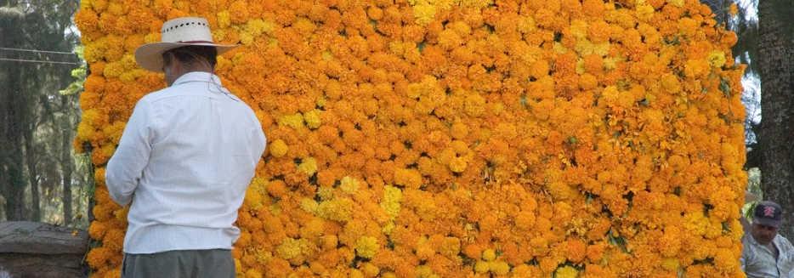
Flowers
Flowers adorn altars, crosses, costumes and grave sites.
Orange and yellow marigolds are symbolic of life whilst ruby coxcombs are used as enticement for the returning spirits.
The sweet smell of the flowers guide the souls back to their homes and altars.
Photo courtesy of Zylenia (@flickr.com) - granted under creative commons licence - attribution

Slide 10
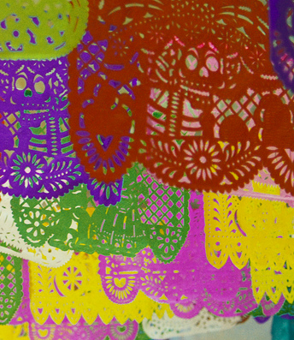
Papel Picado – Paper Decorations
Images are cut into thin colourful tissue paper and hung in repetitive patterns from length of string overhead and around altars.
These tissue paper decorations are called Papel Picado.
They adorn homes, businesses and markets too with depictions of skeletons and flowers.
Photo courtesy of jazbeck (@flickr.com) - granted under creative commons licence - attribution

Slide 11
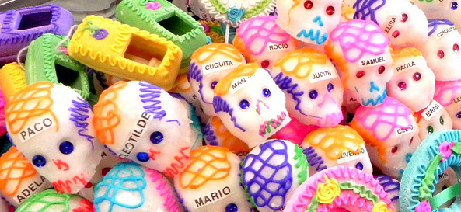
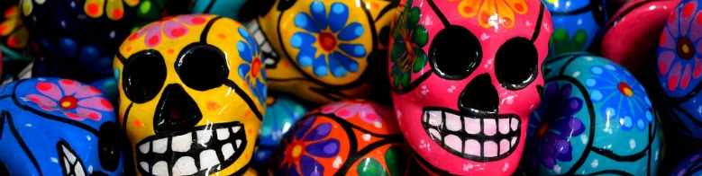
Calacas - Skeletons
Skeletons are a constant emblem during Day of the Dead.
Not only are skeletons seen in decorations but also in sugar skulls, chocolate skulls, figurines and toys.
These skull toys and figurines are called calacas and are used to introduce children to the idea of death so that they are not afraid of it.
Often, the calacas are grinning because they are laughing at death.
The calacas show an active and joyful afterlife often depicted as musicians, brides or on horseback.
Photo courtesy of logatfer (@flickr.com) and Marysol (@flickr.com) - granted under creative commons licence - attribution

Slide 12
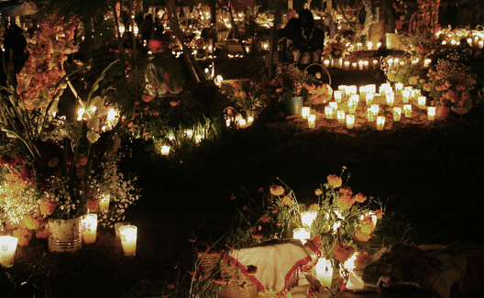
Las Velas - Candles
Candles (las velas) are lit during the afternoon at altars and grave sites to burn all evening.
The light of the candles guide the way for souls. Sometimes each candle lit represents a departed soul.
The candles are placed in the four cardinal points to make a cross.
Certain coloured candles have meanings:
• purple – pain
• white – hope
• pink – celebration
Photo courtesy of fAnyst (@flickr.com) - granted under creative commons licence - attribution

Slide 13
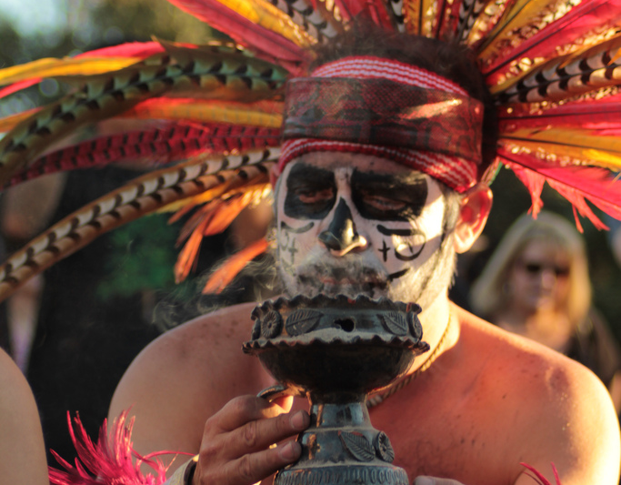
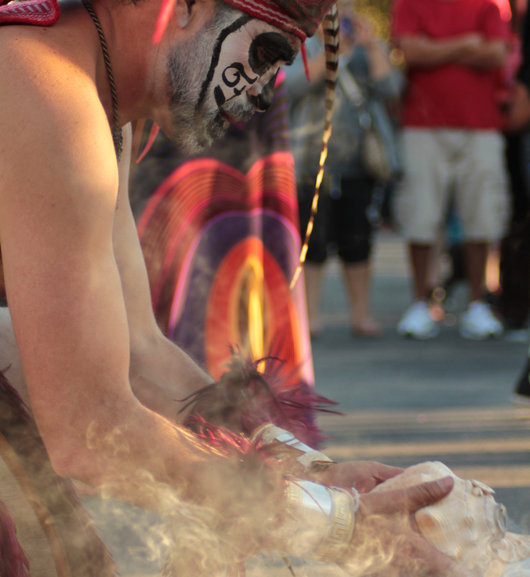
Copal - Insense
A special expensive incense is lit to attract souls.
The incense is put on the altar last.
Bright white incense is considered the best because it lasts longest.
Photo courtesy of Selina Canizales (@flickr.com) - granted under creative commons licence - attribution

Slide 14
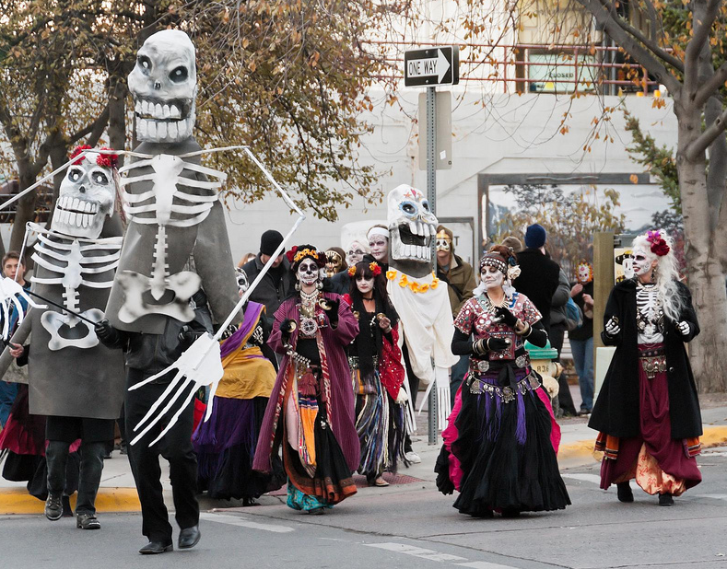
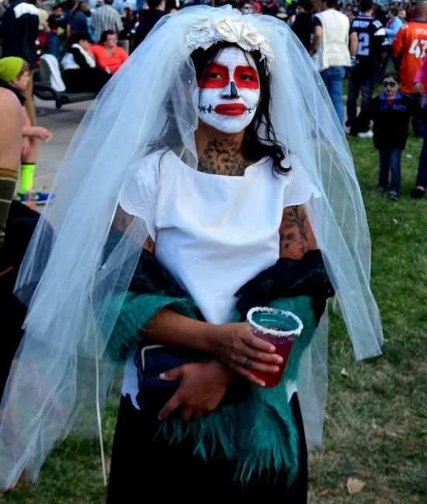
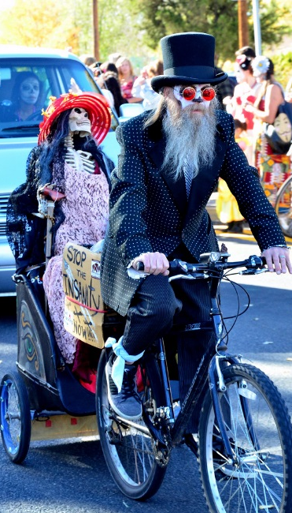
Parades, Masks and Costumes
Sometimes parades are held where people dress up as skeletons and wear elaborate costumes and masks.
The masks represent becoming another person or another being – alive or dead.

Slide 15
The End

