Slide 1
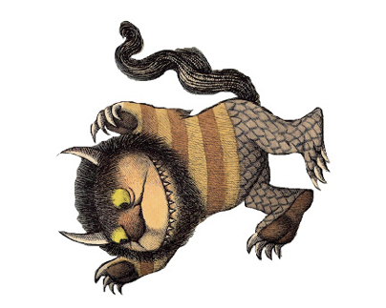
Personality:
Appearance:
Special Abilities / Adaptations:
Habitat:
Name:
Age:

Slide 2

Personality:
Appearance:
Special Abilities / Adaptations:
Habitat:
Name:
Age:

Slide 3
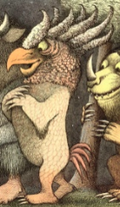
Personality:
Appearance:
Special Abilities / Adaptations:
Habitat:
Name:
Age:

Slide 4

Personality:
Appearance:
Special Abilities / Adaptations:
Habitat:
Name:
Age:

Slide 5
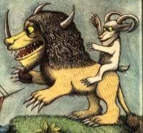
Personality:
Appearance:
Special Abilities / Adaptations:
Habitat:
Name:
Age:

Slide 6

Personality:
Appearance:
Special Abilities / Adaptations:
Habitat:
Name:
Age:

