Slide 1




Going Back to School After COVID-19 (corona virus)
By: Dawn Iannaco-Hahn, LCPC
Montgomery County Maryland
Department of Health and Human Services
Early Childhood Mental Health Consultation Program

Slide 2


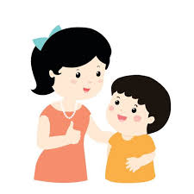
My mummy just told me that I am going to be going back to my school really soon.

Slide 3
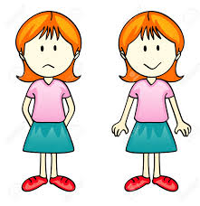
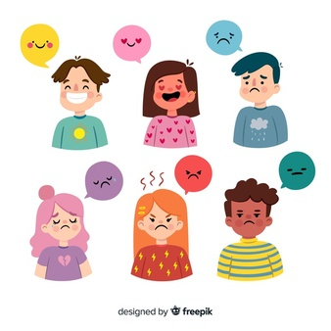
Actually, I’m having a lot of different feelings right now, but my mummy said that’s okay.
I’m excited, but also a little bit sad.
_______________

Slide 4


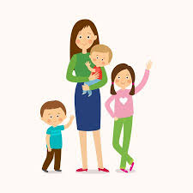
I have missed playing with my friends and seeing my teachers, but I like being at home with my family! I will miss them when I have to go back to my school.

Slide 5
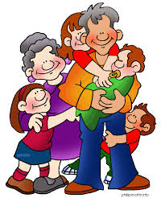
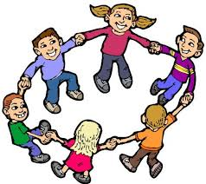
I know it will be fun being back with my friends and teachers, but I also love being with my family all day long!

Slide 6

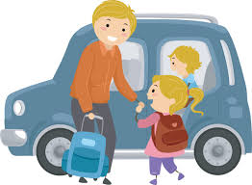
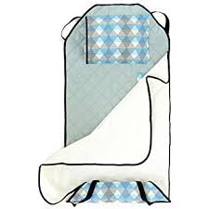
Mummy said that it will be just like before. She will drop me off at school and then pick me up again, but my classroom might look a bit different.

Slide 7
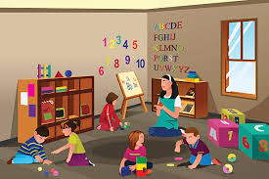
She also told me that my teachers and my friends will be there.
DHHS-Early Childhood Services

Slide 8

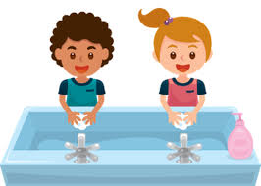
Mummy also told me that it will be just like home because I will need to wash my hands a lot and remember to sing the happy birthday song, or count to 20, while I do it to be sure I have washed long enough. She said my teachers will help me if I forget any of the letters or numbers.

Slide 9
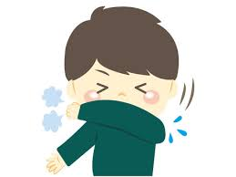
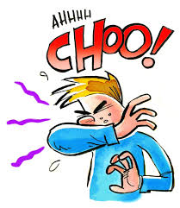

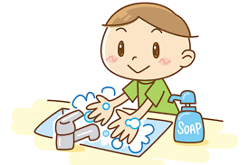
She also said that I need to remember to use my coughing cave and my sneezing sleeve and get tissues whenever I need them. And then go right to the sink and wash my hands after.

Slide 10

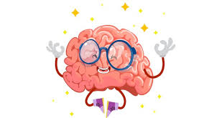
It will be strange to not be at home with my family all day like I have been, but I know I need to go to school so that I can learn and make my brain smart.

Slide 11

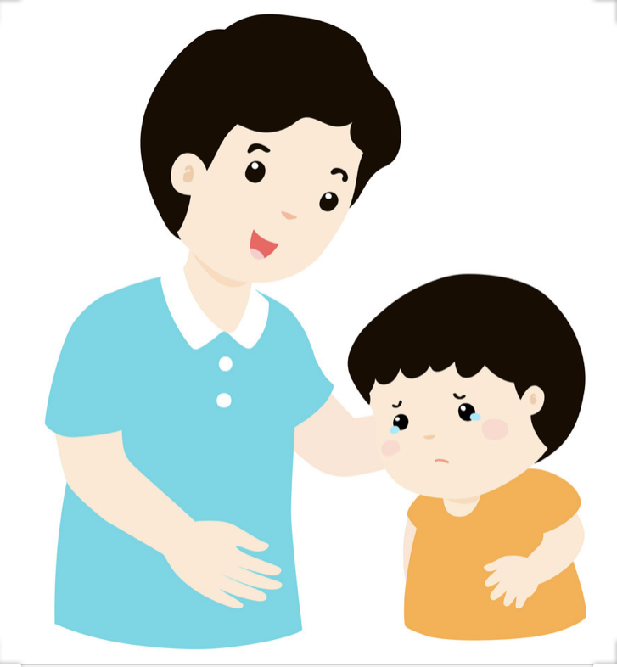
I really do like playing with my friends and my teachers, so I am going to be brave and try not cry when it’s time to go back to my school.

Slide 12



Now that I think about it, I am glad that I get to go back to school and grown-ups, including my teacher, get to go back to work because this makes everyone happy!

Slide 13

I have no reason to be sad because my family loves me, my teachers love me, and my friends will be just as excited to see me as I am to see them!

Slide 14


_______ THE END_______

Slide 15

Early Childhood Services of Montgomery County, MD www.MontgomeryCountyMD.gov
240-777-GROW │EarlyChildhoodServices@MontgomeryCountyMD.gov
ChildLink: Referrals to community resources for children birth to 5 in Montgomery County, MD
Child Care in Public Space: Provide management of public space process for child care programs in MCPS and County buildings
Commission on Child Care and Commission on Children and Youth: Support members of commissions, who advise the County Executive and Council on issues that impact children, youth and families in Montgomery County, MD
Child Care Resource & Referral Center: Provide technical assistance and training for current and prospective child care providers
Early Childhood Mental Health Consultation: Support positive social/emotional development to licensed child care programs
Infants and Toddlers Program: Free screening and early intervention to children birth to four years old with disabilities

