Slide 1

Eric Carle
Eric carle is an author, do you know what an author is?

Slide 2
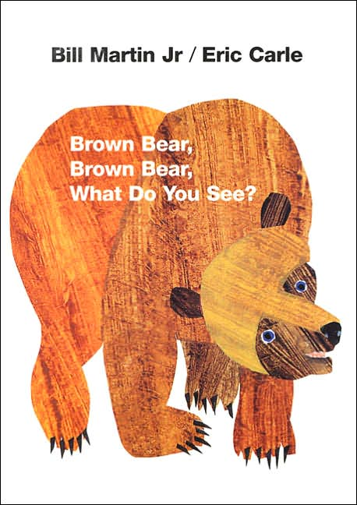
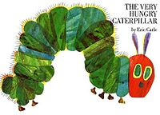
Do you know any of these Eric Carle stories?
BROWN BEAR
THE VERY HUNGRY CATERPILLAR

Slide 3
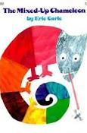
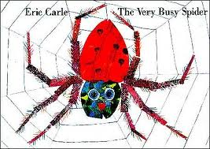
What happens in these stories?
The very busy spider
The mixed up Chameleon

Slide 4
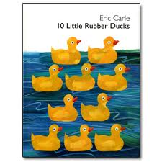

What can you see in the pictures?

Slide 5
Eric Carle uses lots of bright colours in his illustrations, what colours can you see on this page?

Slide 6
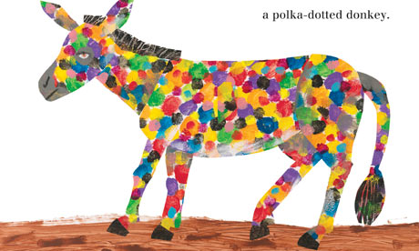

Slide 7


We have been reading The Very Hungry Caterpillar this week.
Can you remember what happened in the story?

Slide 8

Look at all the different patterns and colours. Let’s see if you can make your own caterpillar or butterfly or insect picture in the style of Eric Carle.

Slide 9
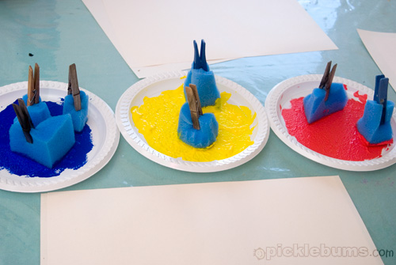
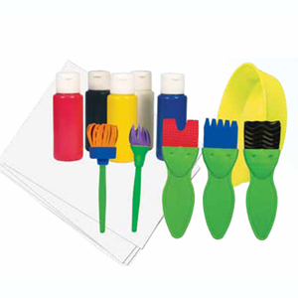
You will need to use lots of different tools to make patterns
Sponges and paint
Different brushes

Slide 10
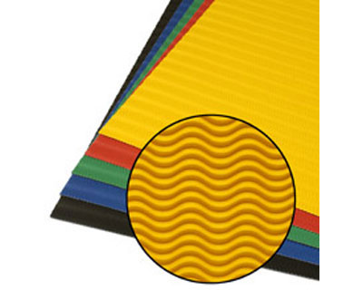
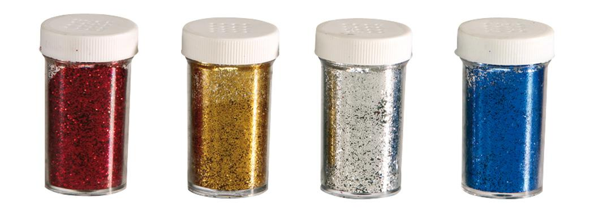
Different card and paper & tissue paper
Glue and Glitter

Slide 11
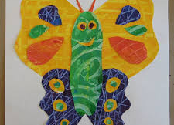
Let’s have a look at some Eric Carle inspired pictures and then watch the video to see how Eric Carle makes such amazing colours and textures.

Slide 12
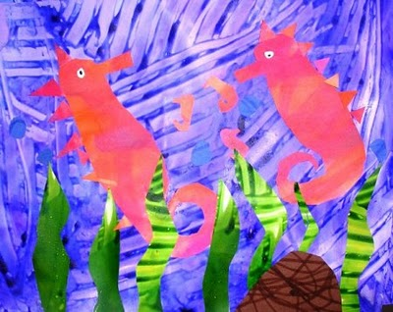

Slide 13
How to make your colourful textured paper.
Watch the video to see how to make an insect in the Eric Carle style.
https://www.youtube.com/watch?v=2XcVmNt-vEw

