Slide 1

A Parents Guide to Phonics in Reception at Cheapside
- Everything you need to know to decode the funny actions and noises your child comes home making after a day with us! ☺

Slide 2
What is Phonics?
Phonics (apart from being lots of fun) is the way we teach children how to read and write in an orderly way – it may sound complicated but children pick it up really quickly with lots of practise at school and at home.
Through phonics, children are developing their phonemic awareness. This means their ability to hear, identify and manipulate the sounds within words to read and write them.

Slide 3
Phonics Overview
‘Letters & Sounds’ is the government programme for teaching phonics and high frequency words. This is the programme we follow at Cheapside.
It is split into 6 phases with the different phases being covered in different years in Foundation Stage and Key Stage 1.
Phase 1– Nursery / Reception
Phase 2– Reception
Phase 3– Reception
Phase 4– Reception / Year 1
Phase 5– Year 1/Year 2
Phase 6– Year 2
http://www.letters-and-sounds.com

Slide 4
The Technical Stuff
Before we get going, there are a few words that you might like to know the meaning of:
Grapheme – A grapheme is a letter or a number of letters that represent a sound (phoneme) in a word e.g s and a
Phoneme – The sound that a grapheme (letter/letters) make.
Digraph – A two letter grapheme that makes only one phoneme (sound). (eg. ch or sh)
Trigraph – A three letter grapheme that makes only one phoneme. (eg. igh)
chip thing shop bath night catch

Slide 5
How do we teach Phonics?
Once a day
A new sound each day or every few days
Linked to action. Upper and lower case & formation of letters.
Lots of recapping
And lots and lots and lots!
Practise reading the sounds in words
Sounding out & blending. Using sound buttons. Real & ‘alien’ words.
Practise writing the sounds in words
Segmenting (or ‘Robot Talking’). Using phoneme frames. Using phoneme mats.

Slide 6
By the end of Phase 2
By the end of phase 2 children should be able to orally blend cvc words e.g. when you sound out c-a-t, they can tell you the word is cat.
They should also be able to orally segment cvc words e.g. when you say Mum, they can pick out the individual sounds m-u-m.
They should know all of the phase 2 phonemes and have begun segmenting and blending cvc words for themselves. They are now ready to start on books.

Slide 7
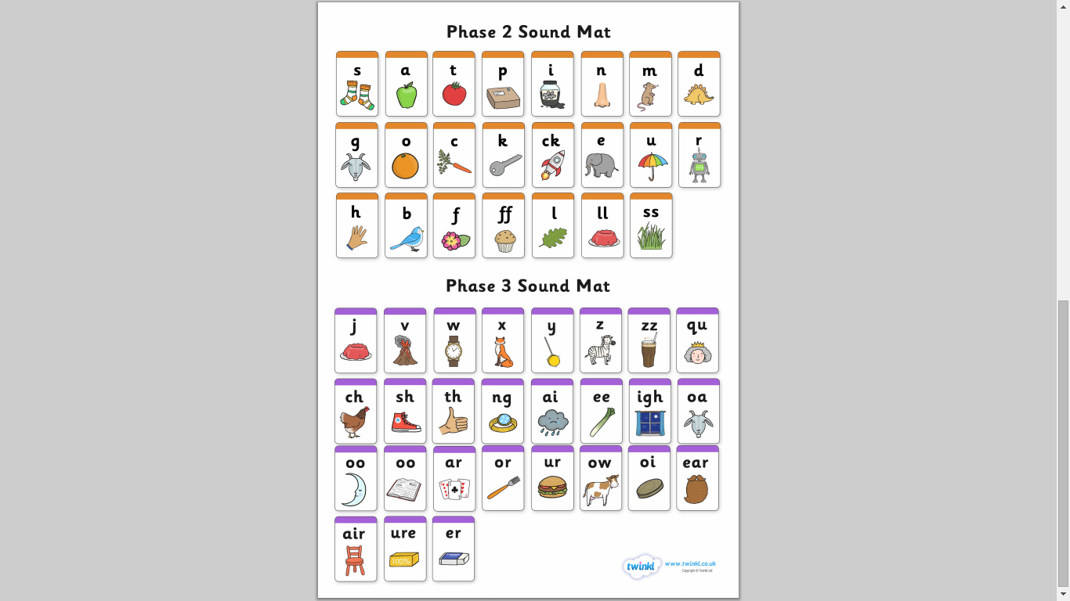
We start here and work our way through the sounds!

Slide 8
Important Stuff
Letters have names and sounds
Children need to know both but sounds should come first
Correct phoneme pronunciation
They have the same name and sound regardless of whether they are upper or lower case
Familiarising children with upper and lower case letters will help them with reading (plus, we need to know that all sentences begin with a capital letter!)
Each letter has its own way of being formed – it’s important!
REALLY IMPORTANT! – When writing at home, please encourage children to form all of their letters correctly – no exceptions! Please use the letter formation mat to help support this.

Slide 9
What can we do at home?
Hearing initial and final sounds (...and all the ones in between!)
Say a word – can your child robot talk it? Turn it into a game! You robot talk a word, can they blend it back together?
Read with your child - read their reading book but also read everywhere else too!
Recognise letters and sounds when out and about, sound them out and blend together.
Practise High Frequency Words
These are words which come up regularly within texts. They need to be able to recognise HFW’s by sight rather than by sounding out. This encourages fluency when reading.
When writing, encourage children to segment/ robot talk words.
We encourage children to spell a word how they hear it. It doesn’t mean it has to be spelled correctly – as long as they have a go on their own! Use phoneme mats to help them choose the graphemes.
Read the weekly newsletter to find out what sounds to work on.

Slide 10
What’s in the pack?
Letter formation sheet to help your child form letters correctly.
Tricky word flash cards – these are the words that children need to read on sight. (phase 2 and 3)
The phase 2 and 3 letter sound mat – in the order we will introduce them.
Ideas of games and activities to practice blending.
Ideas to support your child once they start reading.
Letters and sounds information booklet
When your child is secure with all phase 2 sounds and can blend phonemes in CVC words then they will be ready to start reading and will be given a book.
A copy of this presentation will also be on the class gallery page.

Slide 11
How do I make sure I am teaching sounds correctly?
www.phonicbooks.co.uk/2011/03/13/how-to-say-the-sounds-of-letters-in-synthetic-phonics/

Slide 12
Useful resources
www.phonicsbloom.com
www.phonicsplay.co.uk
Mr Thorne Does Phonics App go to http://itunes.apple.com/gb/app/mr-thorne-does-phonics-letters/id432883474?mt=8
Youtube – type in Mr Thorne/Geraldine Giraffe, followed by the letter sound – here is an example...
https://www.youtube.com/watch?v=sUmUpf-JNoU
A set of plastic letters/foam letters !
Whiteboard and pen –wipe and try letters
Playdough for making letters
Coloured sand for tracing letters in.

