Slide 1

Starting School
at
Cheapside
Getting ready for September

Slide 2
Welcome !
New and exciting stage in your child’s life.
Make new friends, enjoy new experiences.
Develop the skills they need to be effective learners.
Work with you as partners to help ensure your child has the best possible start to their school career.
A copy of this presentation will be uploaded onto the school website and can be found under the children>class pages>Wrens-Reception starters September 2020 tab along with additional support materials.

Slide 3
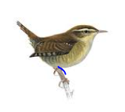
Wrens Class!
Your child will be based in Wrens Class for their reception year.
The class teacher will be Mrs Coe.
Your children will also be working with Mrs Summers every week in Forest School.
Mrs Summers is the EYFS lead and she will monitor the teaching and learning in the foundation stage to ensure your child is making a good level of progress and to support the teaching and learning taking place.
We have an ‘open door’ policy. If you have any worries or concerns about your child, please speak to Mrs Coe and/or Mrs Summers.

Slide 4
How can I prepare my child for starting school?
We know the beginning of school can feel scary for you and your child. These are also different times and the uncertainty of lockdown means you might be worrying that your child won’t be ready for reception. Don’t panic!
We want to share with you some things you can do with your child at home over the coming weeks to help make sure they’re just as ready to start reception as they would otherwise have been.
We’re not expecting you to become reception teachers and we understand that not everyone will find the time to do all of these activities – that’s fine. Equally, your child might not be ready for some of these activities and that’s fine as well ! Try to fit them where possible into your daily routines.

Slide 5
To help your child develop independence, get them used to doing the following at home:
Getting dressed independently every day – practise closing buttons, putting on socks and shoes on the right feet, putting coat on and zipping up
Going to the toilet and wiping their bottom on their own – simple clothing like elasticated waistbands are easier to get on and off
Cutting food using a ‘real’ knife and fork
Tidying up their toys and doing simple household chores – giving them responsibilities will help them to become more independent
Helping them to recognise their name in writing and to consistently respond to it verbally. Create a coat and shoe peg at home with their name on it to help get them used to having something similar at school – it seems like a simple thing but it’ll help when we ask your child to go and fetch their coat!

Slide 6
You can practise some of the activities your child would have done in early years in your own home to help make sure they develop the same skills and feel more ready when reception starts:
Do turn-taking activities such as playing with a toy – this helps them to get used to taking turns and also to understand the concept of sharing
Get your child used to eating with others even if it’s just a snack
Lots of the learning in reception happens through play. Get down onto the carpet so you’re at their level and enjoy some play with your child. Follow their lead with what they’re doing or how they’re playing. Then, try to get them to follow your lead and also create games together. This will help them to get used to playing and engaging with other children

Slide 7
As September approaches..
Routine and consistency helps children to adapt and this will help ease the transition into reception. About 4 weeks before the start of reception, try to set a morning routine with your child. You can start with small steps and gradually add to the routine:
Get up at the same time every day and have breakfast
Get dressed up in the school uniform and put on ‘school’ shoes
Look up the route to school and if it’s walking distance try it out – point to the school and tell your child they’ll be going there soon. Look through the transition booklet we’ve shared with you with yor child.

Slide 8
What else can I do?
On this web page, click on the pdf file ‘preparing your child for starting reception’ for a summary file of this information plus suggested online support webpages.
Click on the ‘Getting ready for September’ tab
On this page you will find additional activities to do over the summer holidays to help prepare your child for September. These activities are based around the areas of learning in the EYFS curriculum. We do not expect you to do every activity but use this as a resource to dip in and out off as you see fit. If you have any photos of your child having a go at some of these activities then we would love you to upload it to your child's tapestry page once this has been activated.

Slide 9

“Is my child ready for school ?”
We like the children to be able to:
express their needs appropriately
Use the toilet independently, including being able to wipe themselves.
Wash and dry hands
Blow their nose
Sit up at a table
Understand how to use a knife and fork
Dress and undress themselves
Sit quietly to listen to a story or a piece of music
Wait patiently
Share and take turns
Tidy up things they have used
Say goodbye with a smile !!!!!!!!
If you can support your child to master some or all of these skills before they start with us that would be great, but please do not worry if you don’t get there. It will be our job to support your child from where they are at.

Slide 10
Starting School
at
Cheapside
The Foundation Stage
Curriculum

Slide 11
Foundation Stage
What is the Foundation Stage?
Foundation Stage 1 takes place in a pre-school or nursery between the ages 3 and 4. Foundation Stage 2 takes place in a Reception class of an Infant or Primary school between the ages 4 and 5.
The Foundation Stage Curriculum is based on the recognition that children learn best through play and active learning.
At Cheapside part of this learning will take place outdoors in weekly Forest School sessions.

Slide 12
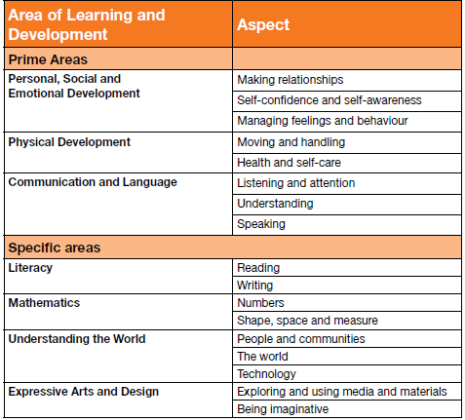
What does the curriculum look like in reception?
The Prime Areas are the foundations for children's success in all other areas of learning and of life. Strong foundations in these areas are essential for children and any future learning and development.
The specific areas provide the range of experiences and opportunities for children to broaden their knowledge and skills:

Slide 13
How will I know what my child is learning?
Regular newsletters will be published on the class page on our website.
A learning journal will be kept for every child. We use a piece of educational software called ‘Tapestry’ to record your child’s progress. More details on this are included in your information pack.

Slide 14
The first few weeks..
Help your child settle, ensuring they feel safe and are happy, and to encourage and support with exploring the new environment and with making new friends.
What do they already know? We use this information to help plan for the next steps for every child. This is what is generally referred to as a baseline assessment.
You will be invited to discuss your child’s progress & adjustment to school within the first term.

Slide 15
        Unity…
        I dreamt I stood in a studio
        And watched two sculptors there
        The clay they used was a young child’s mind
        And they fashioned it with care.
        One was a teacher, the tools she used
        Were books and music, art and play.
        One was a parent with a guiding hand
        And a gentle loving heart……………………
        ……..And each agreed they would have failed
        If they had worked alone
        For behind the parents stood the school
        And behind the teacher, the home.

