Slide 1
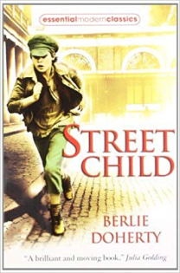
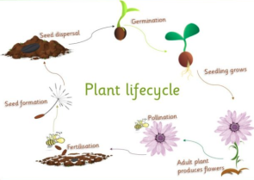
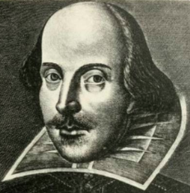
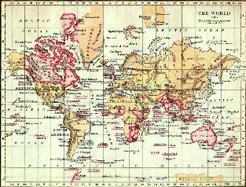
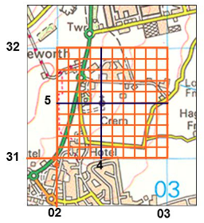
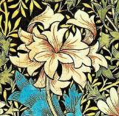
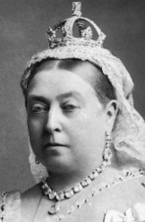
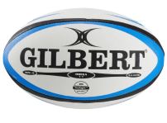

Science –
Plant (and animal) life cycles
Literacy –
Shakespeare
Street Child
Class Trip
Reading Museum – Victorian Day
Art –
William Morris flower drawings
We are not amused
DT –
Textiles – Bags (William Morris Fabrics)
Geography
Study a region of the Americas (Canada). Understand biomes, vegetation belts, land use, economic activity, distribution of resources, etc. (link through British Empire)
Painting
Be able to identify primary, secondary, complementary & contrasting colours
Geography
Local map study – today and during Victorian era (inc. Grid References)
P.E.
The rise of Football & Rugby during the Victorian Era
History –
Life in Victorian Britain: Dark Age or a Golden Age?
Geog./Hist.
Victorian Holiday resorts (e.g. Brighton) – rise of the Railways

