Slide 1


Slide 3
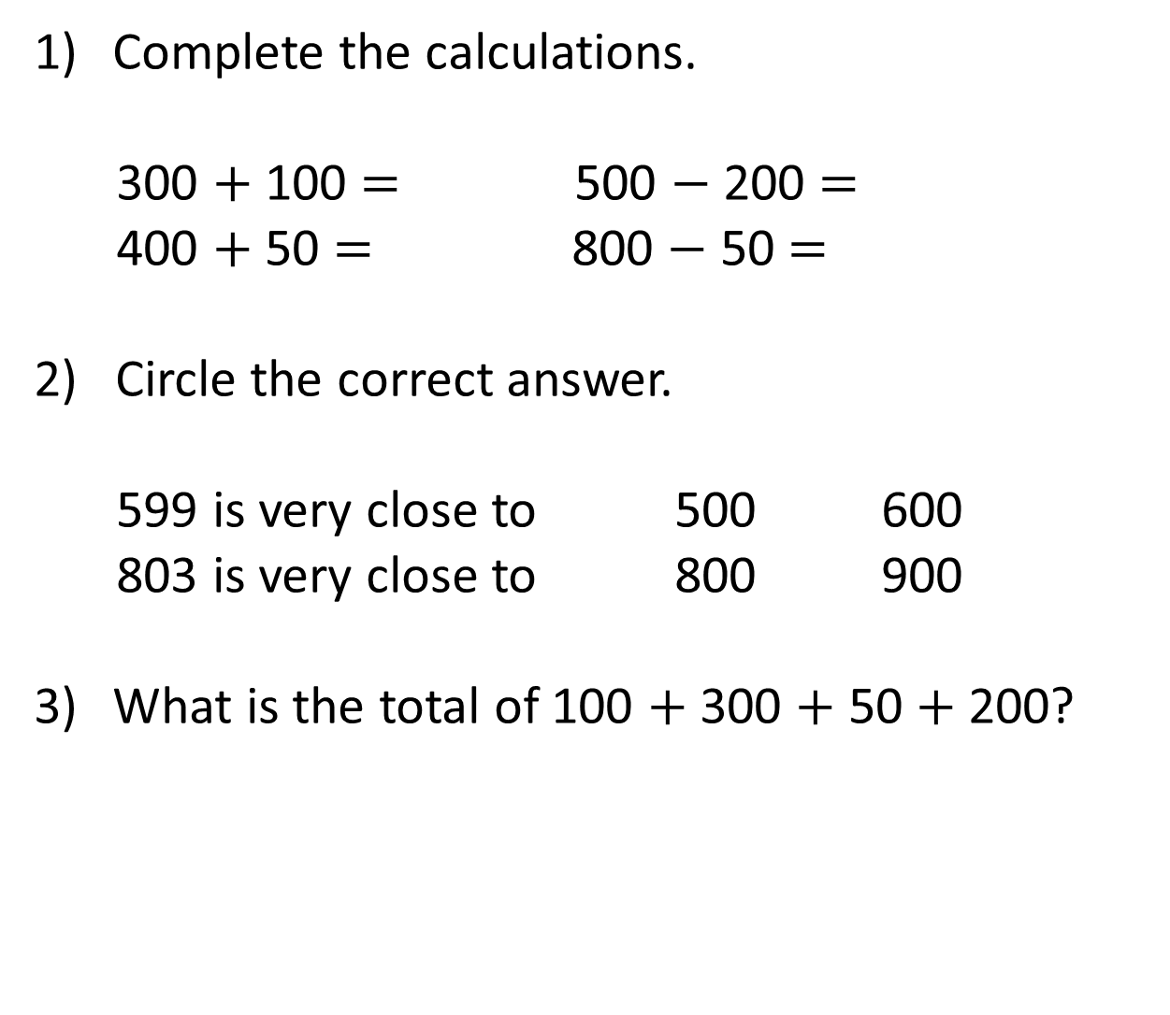
Complete the calculations.
300 $+$ 100 $=$ 500 $−$ 200 $=$
400 $+$ 50 $=$ 800 $−$ 50 $=$
2) Circle the correct answer.
599 is very close to 500 600
803 is very close to 800 900
What is the total of 100 $+$ 300 $+$ 50 $+$ 200?

Slide 4
Complete the calculations.
300 $+$ 100 $=$ 500 $−$ 200 $=$
400 $+$ 50 $=$ 800 $−$ 50 $=$
2) Circle the correct answer.
599 is very close to 500 600
803 is very close to 800 900
What is the total of 100 $+$ 300 $+$ 50 $+$ 200?
400
300
450
750
650

Slide 6
Estimate
To give an approximate answer
Check what an answer should be close to
To see approximately how many we have or need

Slide 7

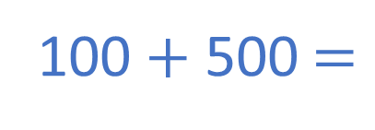
High Street School has 119 pupils.
Main Road School has 486 pupils.
Estimate how many pupils there are in total.
100
119 is close to ____
100
119
100 $+$ 500 $=$
600 pupils
200
500
486 is close to ____
400
486
500

Slide 8

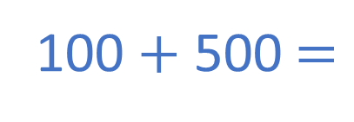
High Street School has 119 pupils.
Main Road School has 486 pupils.
Estimate how many pupils there are in total.
100 $+$ 500 $=$
600 pupils
H | T | O
1 | 1 | 9
4 | 8 | 6
There are approximately
600 pupils
$$+$$
6
0
5
1
1

Slide 9
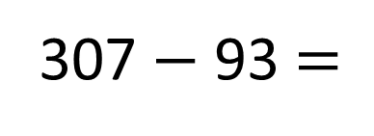
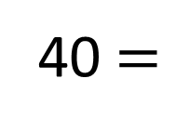
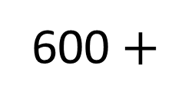
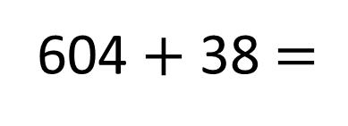
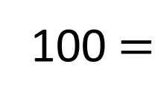
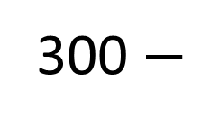
604 $+$ 38 $=$
307 $−$ 93 $=$
600 $+$
40 $=$
640
300 $−$
100 $=$
200

Slide 10

Have a think
Mr Brown saves some money each week.
Week 1 | Week 2 | Week 3 | Week 4
£181 | £291 | £254 | £93
£200
£300
£250
£100
Mr Brown needs to pay £700 for his holiday.
Has he saved enough?
£850
Yes, he has saved enough.

Slide 11

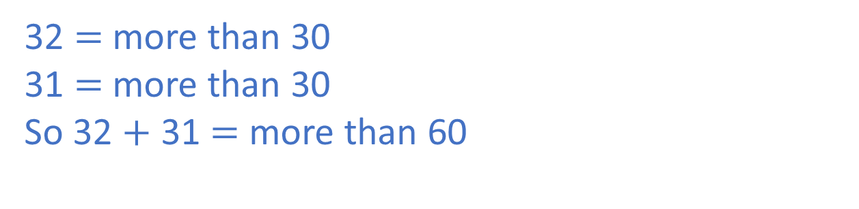
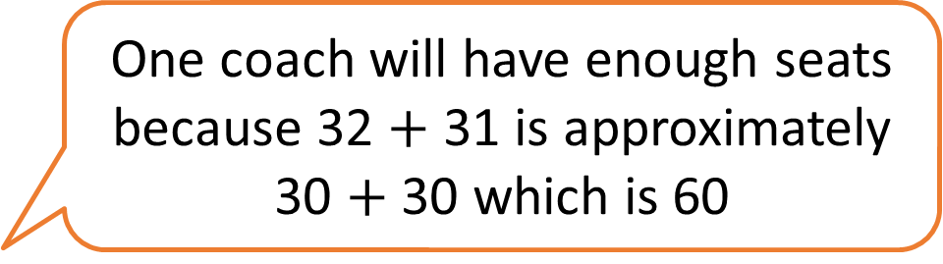
Two classes are going on a school trip.
In Class 2 there are 32 pupils.
In Class 3 there are 31 pupils.
One coach holds 60 pupils.
One coach will have enough seats because 32 $+$ 31 is approximately 30 $+$ 30 which is 60
Jack says,
Is Jack correct? Explain why.
Have a think
32 $=$ more than 30
31 $=$ more than 30
So 32 $+$ 31 $=$ more than 60

Slide 12



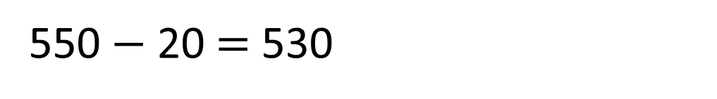
H | T | O
5 | 4 | 7
2 | 2
3 | 2 | 7
H | T | O
5 | 4 | 7
 | 2 | 2
5 | 2 | 5
Have a think
$$−$$
$$−$$
550 $−$ 20 $=$ 530
That can’t be right. The answer should be more than 500

Slide 13
Have a go at the questions on the worksheet

