Slide 1

Stone Age
Was Stone Age man just a simple hunter and gatherer?

Slide 2
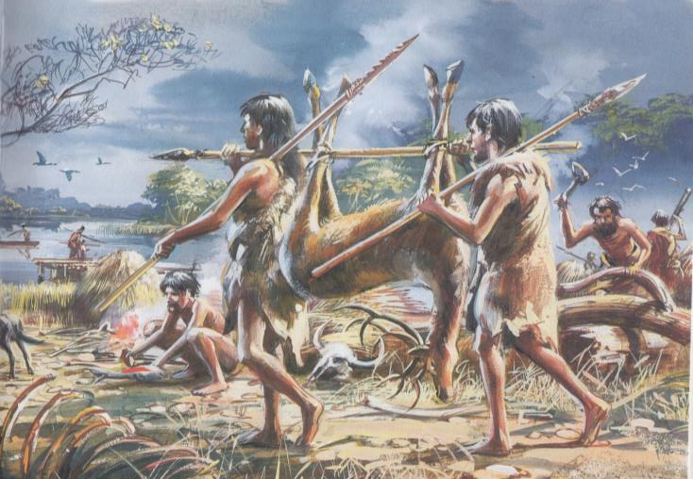
What can we work out about life in the Stone Age from this picture?

Slide 3
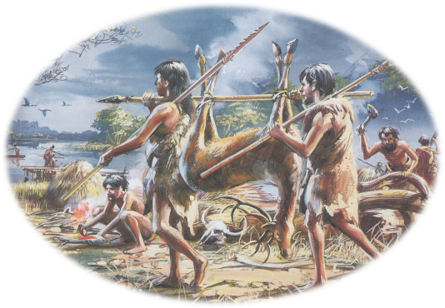
❷
❶
❸
❼
❹
❻
❺

Slide 4
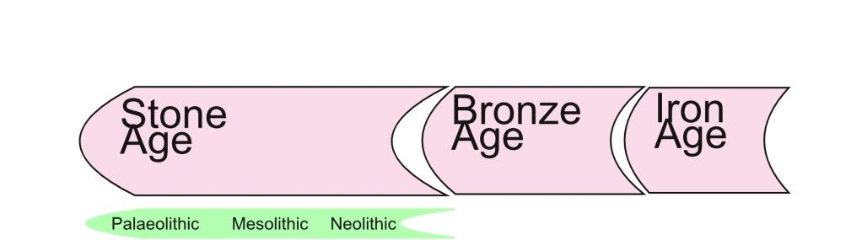
FF
15,000 years ago
5,000 years ago
2,000 years ago
Hunter gatherers
F A R M E R S

Slide 5
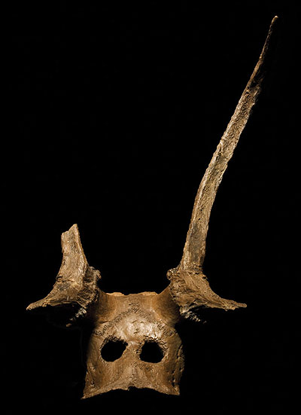
http://maa.cam.ac.uk/assemblingbodies/exhibition/body/285/

Slide 6
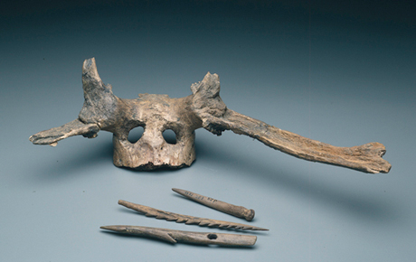
http://maa.cam.ac.uk/maa/wp-content/uploads/2013/02/reddeerfrontlet_460x290.jpg

Slide 7
These worked antlers are thought to be head-dresses. The holes would have been used to tie them to the head with a leather thong. They may have been worn by hunters as a disguise, but it is more likely that they were part of a costume worn on special occasions, perhaps during religious ceremonies.

Slide 8
They also found other objects which showed how artistic Stone Age people were.
What do you think this is?

Slide 9
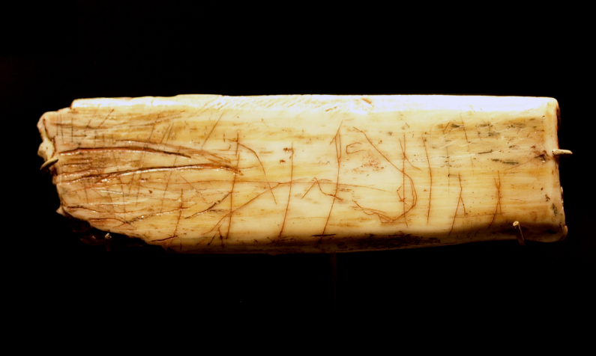

Slide 10

Decorated animal rib was estimated to be between 12,500 and 13,000 years old. Can you see the animal carved on it?
http://en.wikipedia.org/wiki/Robin_Hood_Cave_Horse

Slide 11
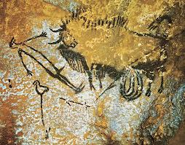
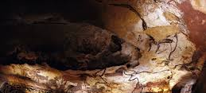
What do these images from the Stone Age tell us?

Slide 12
Was Stone Age man just a simple hunter and gatherer?
Yes | No

Slide 13
Credits
Illustration by Mike Codd for The History of Britain and Ireland by Mike Corbishley, John Gillingham, Rosemary Kelly, Ian Dawson and James Mason (Revised edition, OUP, 2005), reproduced by permission of Oxford University Press.

