Slide 1

KQ2 The coming of farming
How much did life change for Stone Age man when he learned to farm?

Slide 2
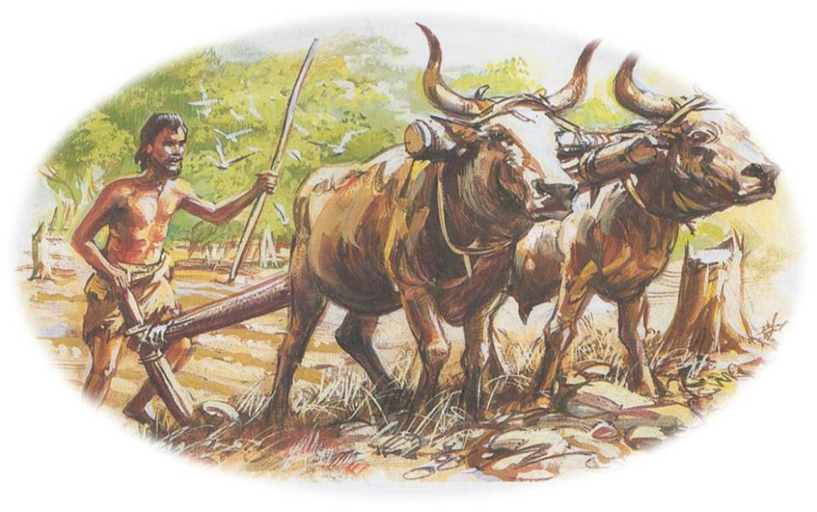

Slide 3
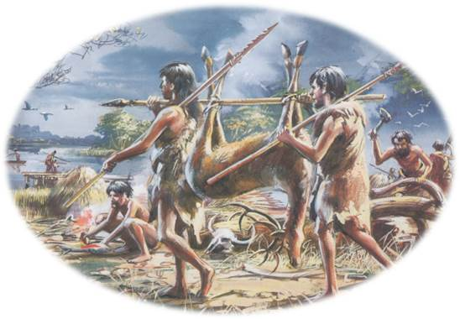
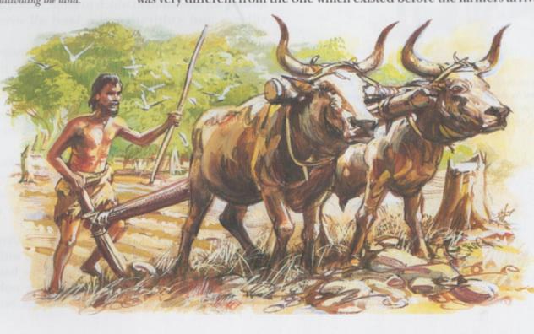
9,000 years ago
5,000 years ago

Slide 4
Spectrum
Look at the 8-10 cards which tell you about life at the end of the Stone Age when people started to farm. This was about 3,500 BC in what people call the New Stone Age or Neolithic times.
Your job is to work out which cards show:
BIG really important changes
little changes
that some things carried on as before, alongside farming.

Slide 5
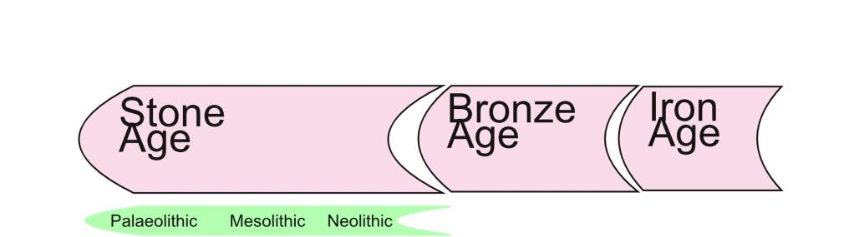
FF
15,000 years ago
5,000 years ago
2,000 years ago
Hunter gatherers
F A R M E R S

Slide 6
Credits
Images on slide 2 and 3 from illustrations by Mike Codd for The History of Britain and Ireland by Mike Corbishley, John Gillingham, Rosemary Kelly, Ian Dawson and James Mason (Revised edition, OUP, 2005), reproduced by permission of Oxford University Press.

