Slide 1



On the first day of Christmas, #
cheapside gave to me,
one marvellous Head teacher.

Slide 2
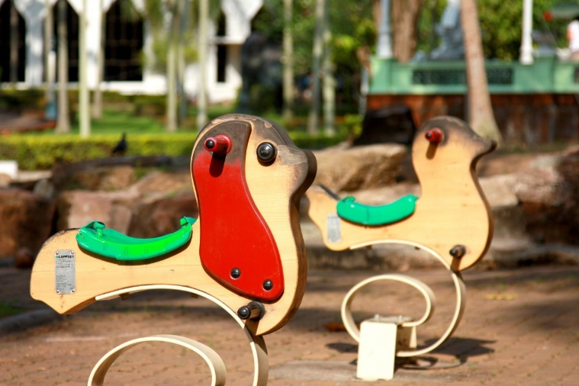
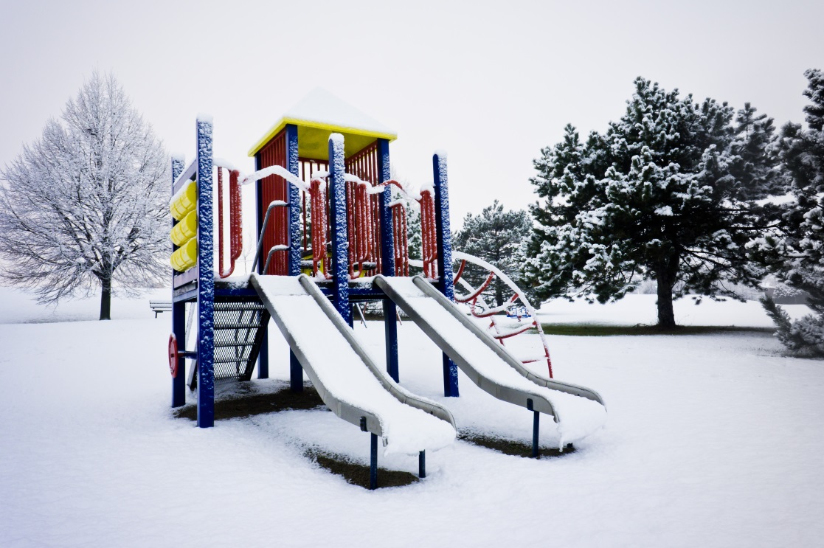

On the second day of Christmas,
Cheapside gave to me,
Two brilliant break times…

Slide 3
And
one marvellous Head teacher.

Slide 4
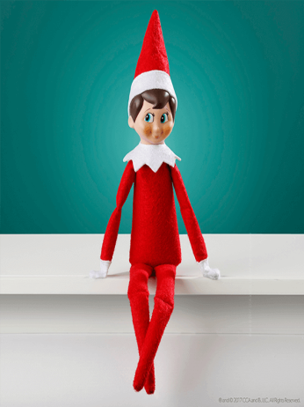
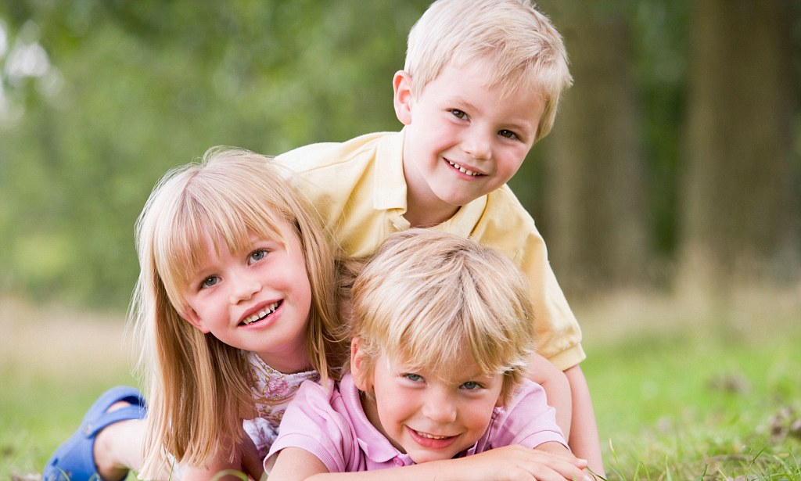


On the 3rd day of Christmas,
Cheapside gave to me,
Three cheeky children…

Slide 5
Two brilliant break times…

Slide 6
And
one marvellous Head teacher.

Slide 7
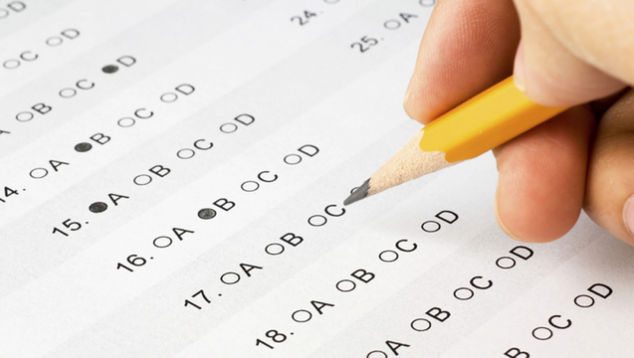
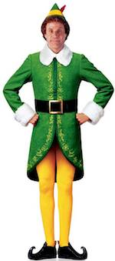
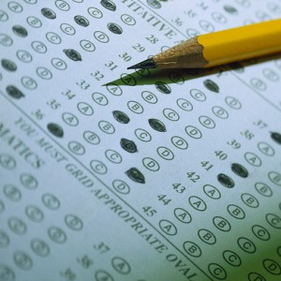
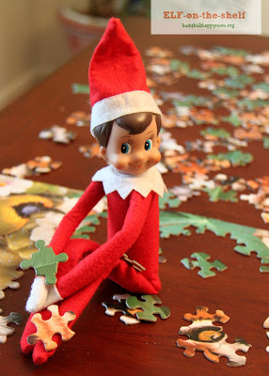
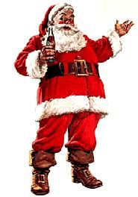
On the fourth day of Christmas,
Cheapside gave to me ,
FOUR super spelling days...

Slide 8
Three cheeky children…

Slide 9
Two brilliant break times…

Slide 10
And
one marvellous Head teacher.

Slide 11
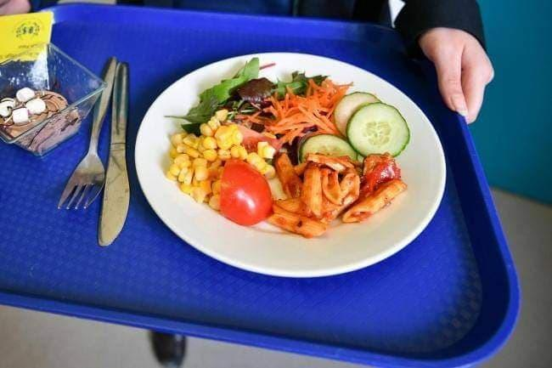
On the fifth day of Christmas Cheapside gave to me,
5 lovely lunches…

Slide 12
FOUR super spelling days...

Slide 13
Three cheeky children…

Slide 14
Two brilliant break times…

Slide 15
And
one marvellous Head teacher.

Slide 16
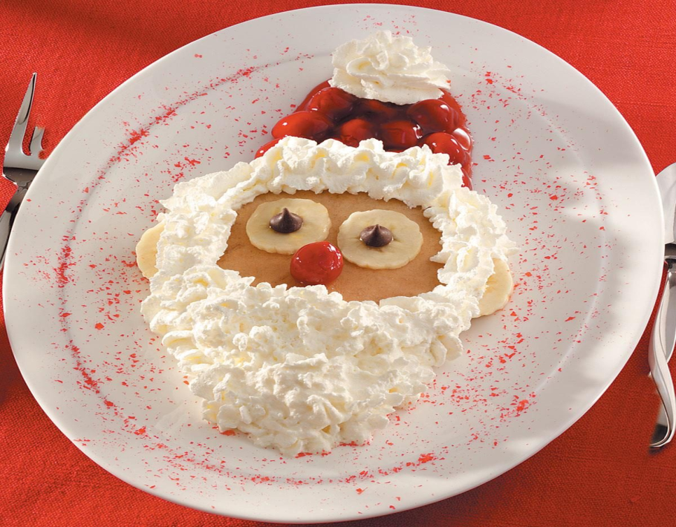
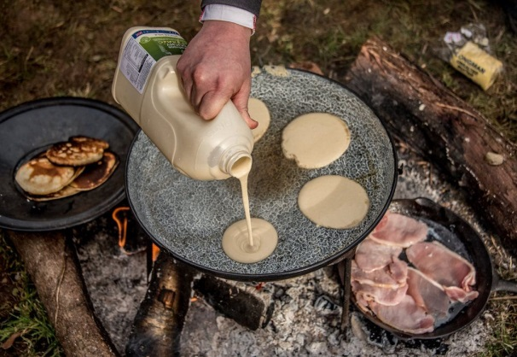
On the sixth day of Christmas Cheapside gave to me,
6 forest school pancakes…
.

Slide 17
5 lovely lunches!

Slide 18
FOUR super spelling days...

Slide 19
Three cheeky children…

Slide 20
Two brilliant break times…

Slide 21
And
one marvellous Head teacher.

Slide 22

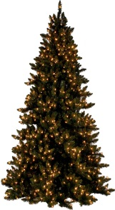





on the seventh day of Christmas Cheapside gave to me,
7 headteacher awards…

Slide 23
6 forest school pancakes…
.

Slide 24
5 lovely lunches!

Slide 25
FOUR super spelling days...

Slide 26
Three cheeky children…

Slide 27
Two brilliant break times…

Slide 28
And
one marvellous Head teacher.

Slide 29
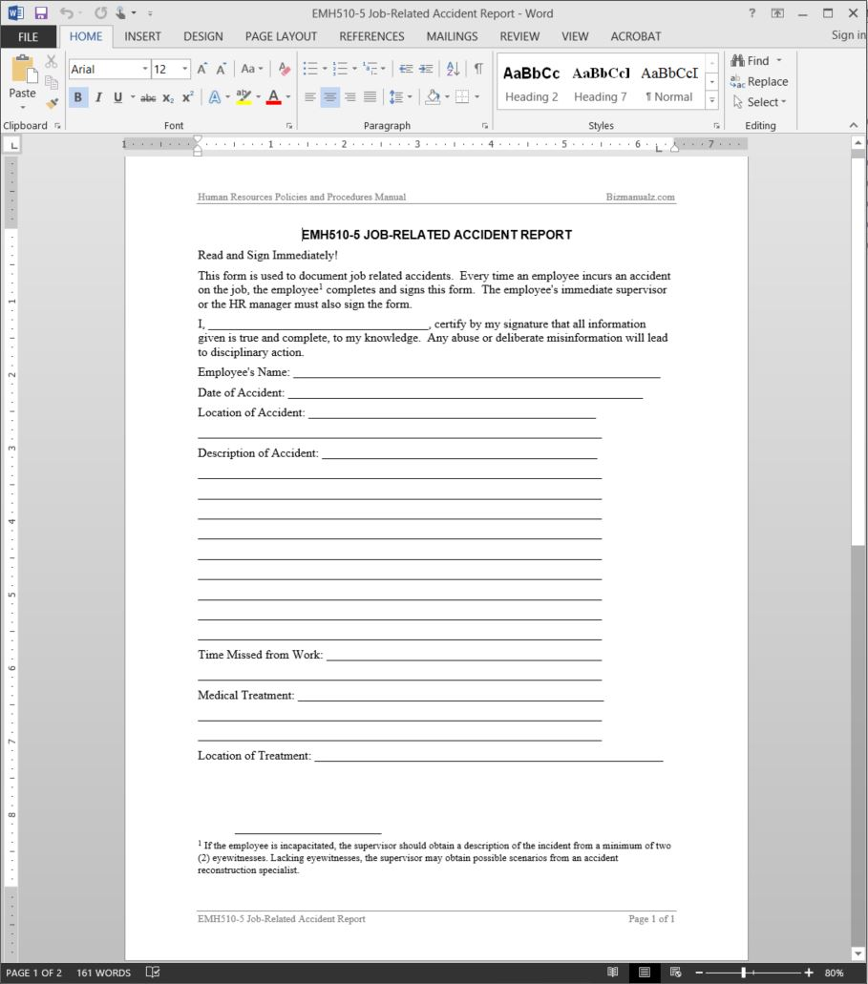

On the 8th day of Christmas Cheapside gave to me,
8 accident forms…

Slide 30
7 headteacher awards…

Slide 31
6 forest school pancakes…
.

Slide 32
5 lovely lunches!

Slide 33
FOUR super spelling days...

Slide 34
Three cheeky children…

Slide 35
Two brilliant break times…

Slide 36
And
one marvellous Head teacher.

Slide 37
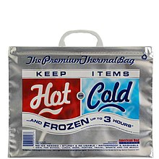
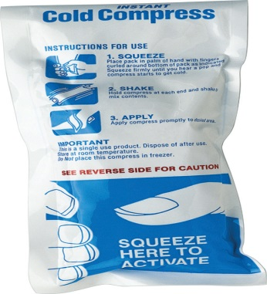

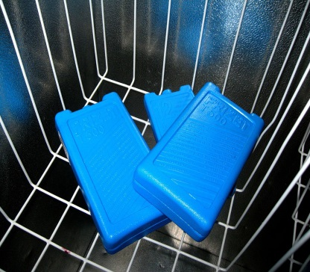
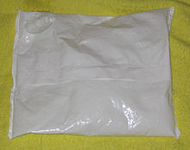

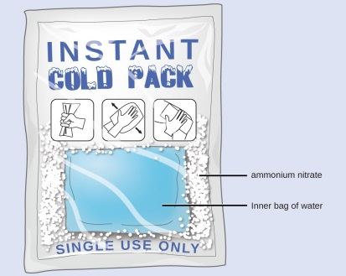
On the ninth day of Christmas
Cheapside gave to me, 9 Melting ice packs…
.

Slide 38
8 accident forms…

Slide 39
7 headteacher awards…

Slide 40
6 forest school pancakes…
.

Slide 41
5 lovely lunches!

Slide 42
FOUR super spelling days...

Slide 43
Three cheeky children…

Slide 44
Two brilliant break times…

Slide 45
And
one marvellous Head teacher.

Slide 46

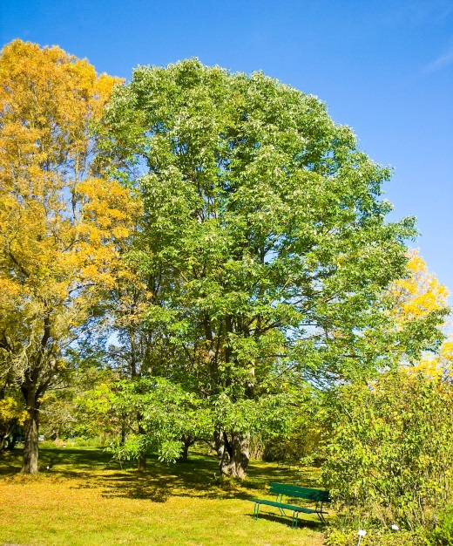
On the tenth day of Christmas
Cheapside gave to me,
10 team ticks…

Slide 47
9 Melting ice packs…
.

Slide 48
8 accident forms…

Slide 49
7 headteacher awards…

Slide 50
6 forest school pancakes…
.

Slide 51
5 lovely lunches!

Slide 52
FOUR super spelling days...

Slide 53
Three cheeky children…

Slide 54
Two brilliant break times…

Slide 55
And
one marvellous Head teacher.

Slide 56
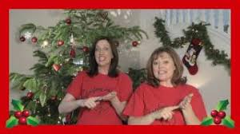
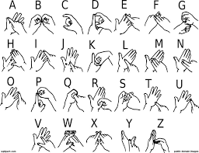
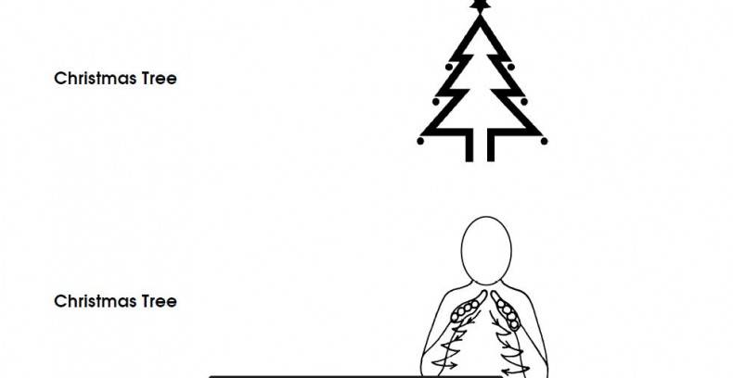
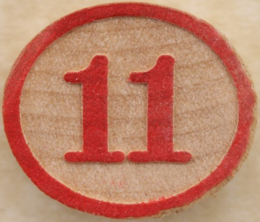
On the eleventh day of Christmas
Cheapside gave to me,
11 minutes of Makaton…

Slide 57
10 team ticks…

Slide 58
9 Melting ice packs…
.

Slide 59
8 accident forms…

Slide 60
7 headteacher awards…

Slide 61
6 forest school pancakes…
.

Slide 62
5 lovely lunches…

Slide 63
FOUR super spelling days...

Slide 64
Three cheeky children…

Slide 65
Two brilliant break times…

Slide 66
And
one marvellous Head teacher.

Slide 67


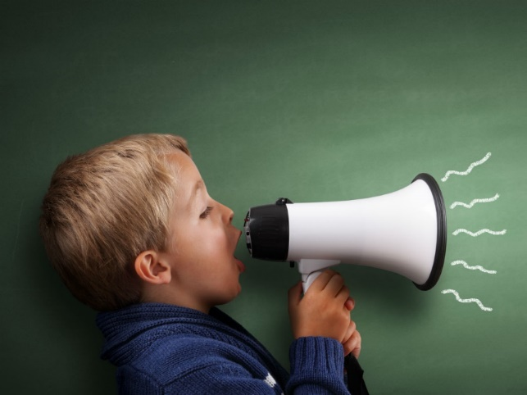
On the twelfth day of Christmas
Cheapside gave to me,
12 chatty children.……..

Slide 68
11 minutes of Makaton…

Slide 69
10 team ticks…

Slide 70
9 Melting ice packs…
.

Slide 71
8 accident forms…

Slide 72
7 headteacher awards…

Slide 73
6 forest school pancakes…
.

Slide 74
5 lovely lunches!

Slide 75
FOUR super spelling days...

Slide 76
Three cheeky children…

Slide 77
Two brilliant break times…

Slide 78
And
one marvellous Head teacher.

