Slide 1
Turrets and Tiaras
Not forgetting the dragons
Year 1 Topic web Summer Term 1 and 2

Slide 2


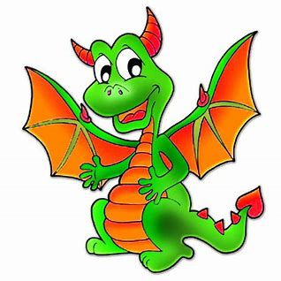

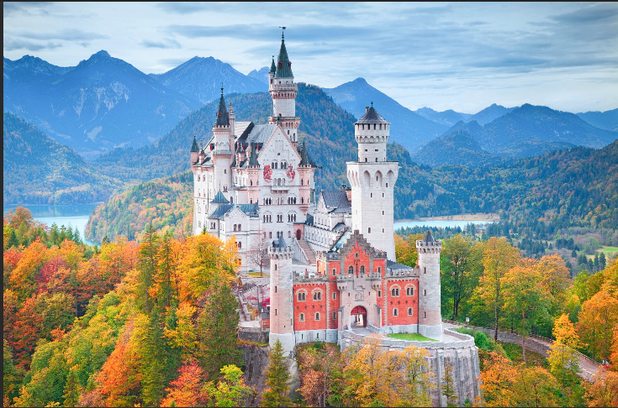

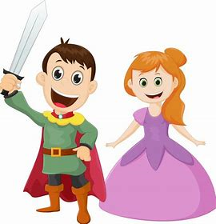
Year 1
Geography: locate castles near us and mark on a map, name and locate places in the UK including their capital cities, all about British Castles.
Maths:
Counting ships and soldiers, repeating pattern towers, castle word problems, archery doubles, measure castles, capacity of oil buckets, weight of catapult missiles.
Turrets and Tiaras
PSHE: Knights code of Chivalry linked to class rules. Continue non-topic Jigsaw scheme of work.
DT: design and build a Motte and Bailey castle and design and make a crown.
Science – non- topic link plants, trees and seasons.
History: Features of a castle, types of castles, life in a castle, why were castles built, timeline of kings and queens, castle defence and attack, William the Conquerer
Music: Sound effects – castle sensory story, Grand old Duke of York –Rhythm, horses, medieval dancing.
Literacy: Non-fiction fact book about Castles, labelling castles, Medieval recipe, Story of Harold and William, apply for a castle job, job application to be knight. Various Dragon stories to take inspiration on for writing. Finally, all about Fairy Tales!
Art: Portraits of Kings and Queens, Paul Klee ‘Castles and Sun’, Coat of Arms, shield for a knight – size, shape, colour – include coat of arms design. Non-topic work on Van Gogh linked to sunflower's growing unit of work.

