Slide 1
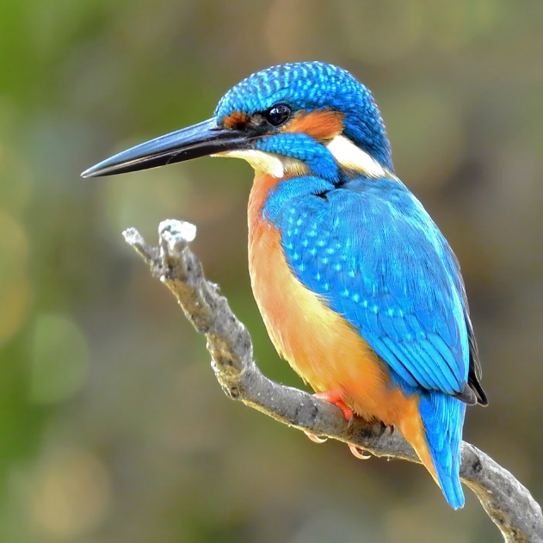
Welcome to Kingfisher Class
Wednesday 11th September 2024
Miss Dineen

Slide 2
General Information
At 8:50am we start lessons. The register closes at 9:00am; to avoid being marked as late it is essential that children are in school and ready for the school day at 8:50am.
Key stage 2 now have the same pick up time of 3:20p.
Notes:
I would say 9:00 and I’d also say that the register closes at 9:05

Slide 3
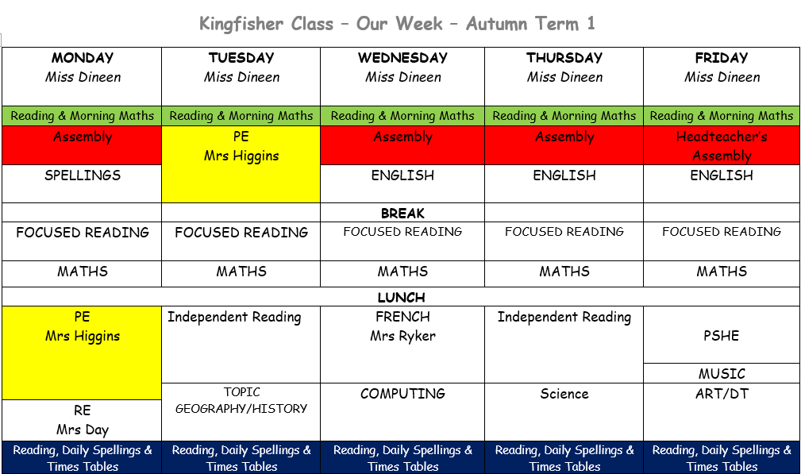
Weekly Timetable – Autumn 1
Notes:
I think perhaps don’t use quite so many colours – it’s not quite clear why the colours are different from each other and it’s a bit confusing. Also, focused has just one s. Thursday is Singing or Makaton Assembly – I would also add that Wednesday is vicar’s assembly.

Slide 4
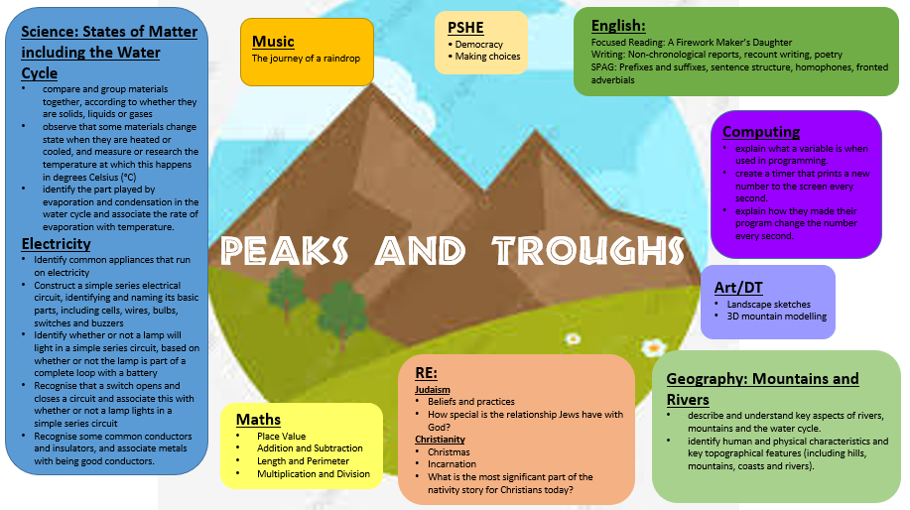
Year 4 Autumn Term Topic Map

Slide 5
Reading
When the children come in each morning they have the opportunity to change their reading book and take part in some independent reading.
Every morning, we have a ‘focused’ reading slot: during this time children will usually work on a class book. We aim to build up their comprehension skills and their skills as readers for enjoyment.
They will be allocated a book from school according to their reading level. The children are also allowed to have a second book from the book case which they can bring home to read for pleasure. They can change these at school and we will keep track of these. Your child will also be read with at school, we keep a log of this in class.
Reading is a great way of understanding the world and reading to your child is as important as listening to your child read.
Notes:
Add that there is a second book they can bring home which is their reading for pleasure choice.

Slide 6
Writing
Key skills being covered:
  Spelling, grammar and punctuation
  Story writing and descriptive writing
  Poetry
  Non-fiction writing
    Non-chronological reports
    Recount texts
    Information texts
    Instruction texts

Slide 7
Maths
Building on all skills through White Rose Maths, with a focus on:
  Arithmetic and number fluency (including times tables)
  Problem solving
  Space, shape and measure (including telling the time)
Any practical reinforcement you can do at home is greatly appreciated e.g. finding opportunities to tell the time or work out how long until tea time; reciting times tables or counting in multiples of a given number when in the car.

Slide 8
Homework
Ongoing – Reading, KIRFS and Year 3&4 Spellings.
Daily Spellings – children will be set given 10-12 spellings on a Wednesday and will be tested on a Monday. Some of the spellings are based on misspellings in their work and the rest are from the spellings for Year 3&4 curriculum.
Times tables will be given out on a Wednesday and children will be tested on the following Tuesday.
Notes:
You might want to explain what KIRFs are. They are given about 10-12 spellings not 4 or 5.

Slide 9
What’s needed in school each day:
Water bottles
Reading book – please make sure this comes back into school every day
Pencil case – please keep this small and try to avoid children bringing in anything too precious.
Pupils should have a pencil, ruler, rubber, sharpener and glue stick.
Notes:
I would add details of what exactly should be in the pencil case

Slide 10
Expectations in Key Stage 2 (Years 3-6)
Role models to the younger children
Uniform – neat and correct
Homework on time where possible
Sensible, helpful and polite around the school
Hard work but lots of fun too
Achieving our best – in thought, in word, in deed

Slide 11
Can you help?
Is there is anything that you can help me or the PTA with?
Do you have any skills that you would like to share?
Do you have any spare time that you would like to give? I am always keen to have volunteers to listen to readers.
If so, please let me know as I would love to have parents actively involved in Kingfisher Class.

Slide 12
Any questions?
I am always here for a quick chat at the end of each day (it’s always tricky to talk at the beginning of the day – if you have something urgent to tell me please let the office know).
If you want to see either of me for a longer chat please ask and we’ll set up a meeting. Staff meetings tend to happen on a Wednesday after school but any other day is available.
I use the Class Page on the website so please do look there. All the information from today’s meeting will go onto the Class Page and homework and resources will be uploaded regularly too.
Do you have any questions?

