Slide 1
Comprehension
This involves:
Understanding the vocabulary
Understanding the text
- what happens in the beginning, middle and end of a story?
- what new information have you learnt?
- can you follow the instructions/recipe?
Discussion of the text
- relating the text to their own experiences
- predicting what might happen next before reading the end of the story
- adding extra information about the text based on what they have read
(making inferences)
Notes:
Lorna

Slide 2
How do we teach reading in books?
Reading practice sessions are:
timetabled each week
taught by a trained teacher/teaching assistant
taught in small groups.
* Additional 1-1 reading with each child when possible with a teacher, TA, volunteer or older child.
Notes:
LORNA
The children read the same book three times in a week. The first time we work on decoding (sounding out) the words, the second time we work on prosody which is reading with expression – making the book sound more interesting with our story-teller voice or our David Attenborough voice – and the third time we look at comprehension. We read the books three times at school because we want to develop the fluency. The more they see words the more they begin to read them automatically without having to sound them out.

Slide 3
Reading Practice Sessions
There are three elements to the group Reading Practise Sessions:
1) Decoding
2) Prosody – expression and intonation
3) Comprehension
In order to cover all the above the reading practice book will be read up to three time.
Children will need to be able to decode the words confidently before they can add expression and fully discuss the text.
We practise reading some of the words before looking at the book.
By re-reading a book the children grow in confidence in their own capabilities, and they begin to add new words to their long-term memory.
Notes:
Lorna

Slide 4
Reading Stamina
As your child learns to read so the reading books will become longer to match their capabilities.
The books are often repetitive in vocabulary, particularly to start with. This is so your child can practice reading the same word and then eventually be able to blend it in their head or read it automatically.
If your child finds reading difficult then they may only manage half the book in one session. Encourage them to persevere as they are more likely to gain confidence the more they read.
Notes:
Lorna

Slide 5
Extra Support
We all have different strengths
Literacy
Numeracy
Creative
Social
Supporting reading
Regular practice – just 10 minutes per day
Appropriate and convenient time for child and parent
Recap sounds and words
Positive mindset
Build confidence and enjoyment
Notes:
Lorna

Slide 6
Teaching of reading in class
Shared Text work
One text read by the teacher to the class. Used for oral comprehension and the language and structure of both fiction and non-fiction writing. Usually as part of Literacy lessons and reading for pleasure, at the end of the school day
Notes:
LORNA
6

Slide 7

We use assessment to match your child the right level of book
Notes:
Lorna
We assess your child every six weeks to check progress. Any child who needs extra support has daily keep-up sessions planned for them.

Slide 8

Reading a book at the right level
This means that your child should:
Know all the sounds and tricky words in their phonics book well
Read many of the words by silent blending (in their head) – their reading will be automatic
Only need to stop and sound out about 5% of the words but they should be able to do this on their own.
Before exchanging their book for a new one.
Notes:
Lorna

Slide 9

Notes:
Lorna

Slide 10

The most important thing you can do is read with your child
Reading a book and chatting had a positive impact a year later on children’s ability to…
understand words and sentences
use a wide range of vocabulary
develop listening comprehension skills.
The amount of books children were exposed to by age 6 was a positive predictor of their reading ability two years later.
Parental involvement in the development of children’s reading skills: A five-year longitudinal study (2002) Senechal, M. and Lefvre, J
Notes:
Lorna
Celebrate child’s success at school, make time for reading at home!

Slide 11

Books going home
Notes:
Lorna
As well as the ‘learning to read’ book that your child will bring home they will also bring home a book for sharing with you. This book is SO important. This is how we are going to give them the WILL to read. Please read with your child as often as you can – at least once a day if possible. The children will be able to choose a sharing book from our school library which has recently been stocked with brand new books funded by the PTA.

Slide 12
Listening to your child read their phonics book
Your child should be able to read their book without your help.
If they can’t read a word read it to them.
Talk about the book and celebrate their success.
Notes:
Lorna

Slide 13

Read to your child
The shared book is for YOU to read:
Make the story sound as exciting as you can by changing your voice.
Talk with your child as much as you can:
  Introduce new and exciting language
  Encourage your child to use new vocabulary
  Make up sentences together
  Find different words to use
  Describe things you see.
Notes:
Lorna

Slide 14
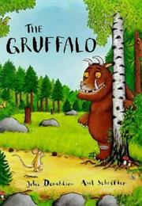
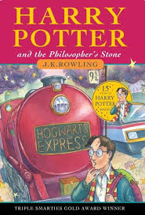

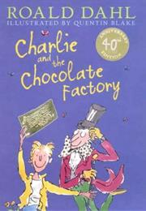

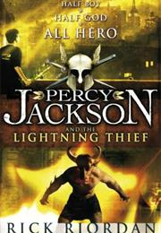
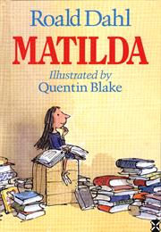
Teachers’ recommendations of the top books all children should read before they leave primary school. (Source – Times Educational Supplement)
The obvious choices:
Notes:
Clare R

Slide 15



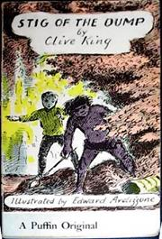





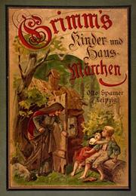

Children’s Classics! Great to be read aloud to children at bedtime – or use an audio book.
Notes:
Clare R

Slide 16






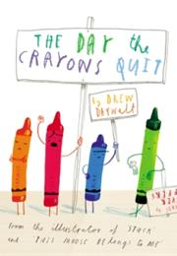

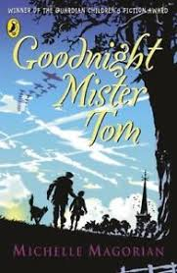


Examples of books from the list that we teach in school:
Notes:
Clare R

Slide 17
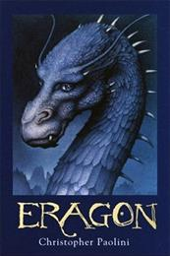
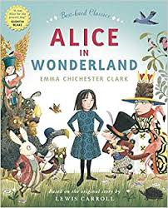
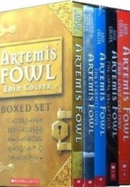
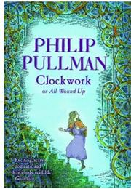
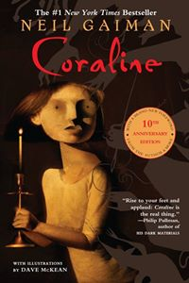






Which leaves the books on the list that we hope the children will discover for themselves:
Notes:
Clare R

Slide 18
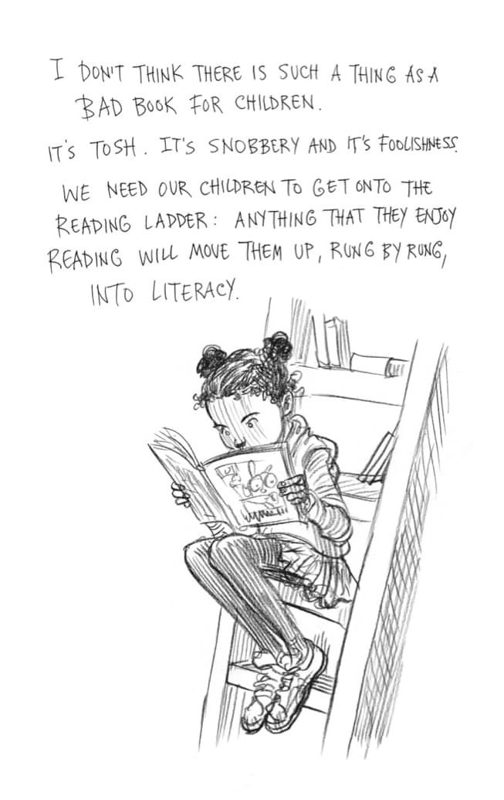
Chris Riddell – former Children’s Laureate and author of Ottoline books
Notes:
Clare R

Slide 19
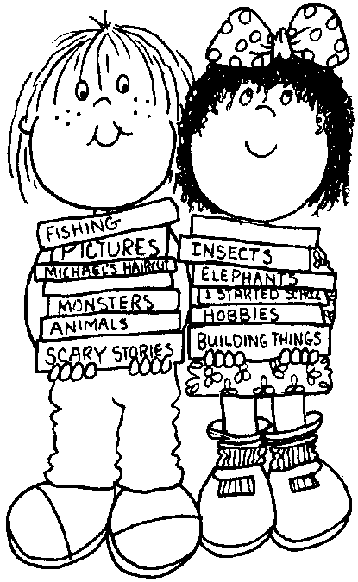
What can they read at home?
Reading should be for enjoyment and interest.
A school reading book is only ONE part of a child’s reading repertoire:
Books - picture books, short stories, chapter books
Magazines – comics, annuals, football programmes
Information books – brochures, catalogues, flyers, newspapers, guide-books
eBooks – kindle, websites
Take-away menus, instructions
Visit the library, bookshops and charity shops
Notes:
Clare R
19

Slide 20
Using the public library
https://www.pressreader.com/
http://rbwm.lib.overdrive.com/A47F18A4-6F68-430D-B0A5-0D5E0B4F3287/10/498/en/Default.htm
http://library.eb.co.uk/storelibrarycard?id=rbowm&target=/levels/junior
http://www.whonextguide.com/
Notes:
Clare R – PLEASE CHECK THE LINKS (3 & 4) AS THEY AREN’T WORKING. THANKS or add other recommended websites?

Slide 21
Ways to help your child become a better reader
Research has shown that children who read regularly at home believe they are ‘Good at Reading’, and are therefore keen to move their reading forward for their own enjoyment
Encourage them to read every day ( 10 minutes a day), make this a REGULAR ROUTINE! Alternatively, share a book with your child; you can read to them or you can share the reading. Make it an enjoyable experience
Remind them to‘ read on’ or ‘back’ to check word meanings
Talk about words they do not understand, try to work them out by reading the whole sentence or paragraph, or look them up
Support them by writing a comment in their home school reading record, noting what they have enjoyed, or any new words they may have encountered
Model reading by letting them see you read
Read to them beyond when they can ‘read for themselves’ aiming for books of a higher reading age if possible
Notes:
Clare R

Slide 22
How you can help…
Read, read, read!
Complete children’s Reading Record Book to say when and how
many times your child has read a book so that we can change it.
  Volunteer to read with children at school
  Hopefully, this evening has given you an insight into reading at school!
  Thank you for listening.
Notes:
Clare R

