Slide 1
Reading at Cheapside School
Notes:
Clare R

Slide 2
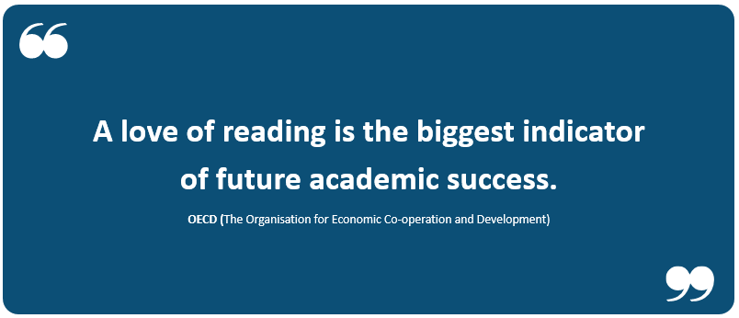
Notes:
Clare R

Slide 3
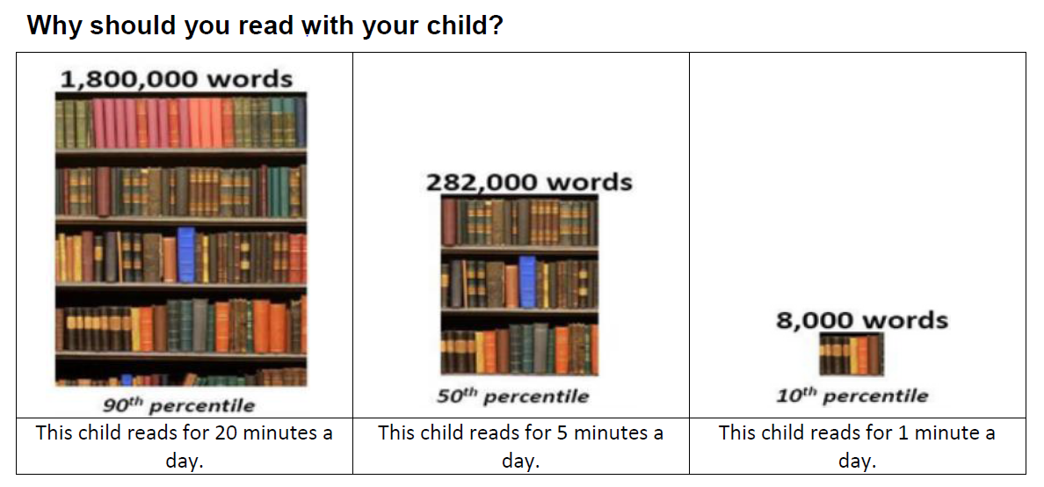
Chris Riddell – former Children’s Laureate and author of Ottoline books
Notes:
Clare R
Children will be exposed to the above number of words EACH school year.
Children will more likely to score in the 90th percentile in standardized tests or 90% better than their peers who read less than 20 mins per day.

Slide 4

How many times have you already read today?
It really is a vital skill.
Notes:
Clare R

Slide 5
Starting with you…
What do you enjoy reading now?
What did you enjoy reading as a child?
Did anyone read to you as a child? Or can you remember being read to as a child?
Do you consider reading as a pleasurable activity now?
When do you read?
Notes:
Clare R

Slide 6
Reading at Cheapside
What we do, how we do it and how you can help.
Notes:
Clare R

Slide 7
Alan Gibbons – children’s author, winner of the Blue Peter book award in 2000 and former teacher…
A reading child is a successful child. So says the Organisation for Economic Cooperation and Development. This body has concluded that reading for pleasure is even more important than a child’s home background in determining academic and social success.
That shouldn’t come as a surprise. Children who read regularly and for fun open up new worlds. They embark on journeys. They step into other people’s shoes and walk around in them, as one truly great writer put it. They empathise with people from different backgrounds, different countries. They find it easier to understand, even change the world around them. Maybe most importantly, they embark on the most epic voyage of all, the one that takes them deep into their own identity and imagination.
Notes:
Clare R

Slide 8
The National Curriculum asks that children:
Read easily, fluently and with good understanding
Develop a habit of reading widely and often, for both pleasure and information
Acquire a wide vocabulary, an understanding of grammar and knowledge of linguistic conventions for reading, writing and spoken language
Appreciate our rich and varied literary heritage
Notes:
Clare R

Slide 9
Reading comprises (taken from National Curriculum in England):
Word reading
  Skilled word reading involves both the speedy working out of the pronunciation of unfamiliar printed words (decoding) and the speedy recognition of familiar printed words. Underpinning both is the understanding that the letters on the page represent the sounds in spoken words. This is why phonics should be emphasised in the early teaching of reading to beginners (i.e. unskilled readers) when they start school.
Comprehension (both listening and reading)
  Good comprehension draws from linguistic knowledge (in particular of vocabulary and grammar) and on knowledge of the world. Comprehension skills develop through pupils’ experience of high-quality discussion with the teacher, as well as from reading and discussing a range of stories, poems and non-fiction. All pupils must be encouraged to read widely across both fiction and non-fiction to develop their knowledge of themselves and the world in which they live, to establish an appreciation and love of reading, and to gain knowledge across the curriculum. Reading widely and often increases pupils’ vocabulary because they encounter words they would rarely hear or use in everyday speech. Reading also feeds pupils’ imagination and opens up a treasure-house of wonder and joy for curious young minds.
It is essential that, by the end of their primary education, all pupils are able to read fluently, and with confidence, in any subject in their forthcoming secondary education.
Notes:
Clare R

Slide 10

Phonics
Everything you need to know to decode the funny noises your child comes home making after a day with us! ☺
Notes:
Deanna

Slide 11
What is Phonics?
Phonics (apart from being lots of fun) is the way we teach children how to read and write in an orderly way – it may sound complicated but children pick it up really quickly with lots of practise at school and at home.
Through phonics, children are developing their phonemic awareness. This means their ability to hear, identify and manipulate the sounds within words to read and write them.
Notes:
Deanna

Slide 12

Little Wandle Letters and Sounds Revised
Our school has chosen
Little Wandle Letters and Sounds Revised as our systematic, synthetic phonics (SSP) programme to teach early reading and spelling.
Notes:
Deanna
44 sounds
Explain 2nd year of using the scheme, based on Govt programme Letters & Sounds. Transitioning to this scheme. Govt. advised that all schools should follow a recognised scheme.

Slide 13
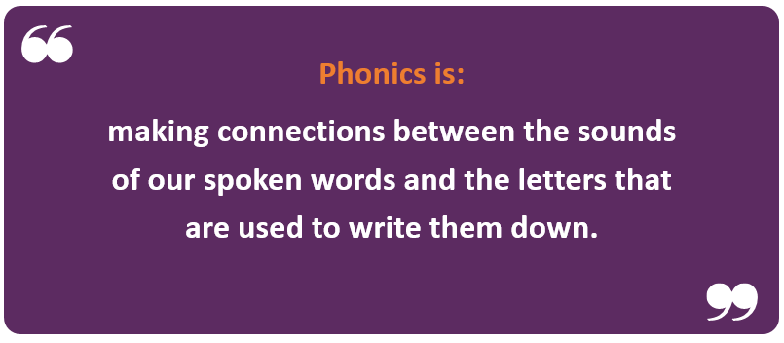
Notes:
Deanna

Slide 14
Phonics Overview
It is split into 6 phases with the different phases being covered in different years in Foundation Stage and Key Stage 1.
Phase 1– Nursery / Reception
Phase 2– Reception
Phase 3– Reception
Phase 4– Reception / Year 1
Phase 5– Year 1/Year 2
Phase 6– Year 2
Notes:
Deanna

Slide 15

Developing word recognition skills
Phoneme (letter sound) awareness and phonics teaching
Repetition and teaching of ‘tricky’ words
Recognising patterns in words to enable fluent reading
c-a-t
Notes:
15
Deanna

Slide 16

Blending to read words
Notes:
Deanna
Some children learn to blend really quickly, and others take a little longer. If your child is finding it difficult, ask your child’s teacher for ways to help at home – playing blending games at home is so helpful!
Show parents this video from the website: https://www.littlewandlelettersandsounds.org.uk/resources/for-parents/

Slide 17
Terminology
Phoneme
Split vowel digraph
Grapheme
Blend
Digraph
Segment
Trigraph
Notes:
Deanna
Explain what each word means – use our glossary to help: https://www.littlewandlelettersandsounds.org.uk/resources/my-letters-and-sounds/getting-started/
Cake ice rose

Slide 18
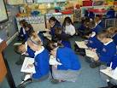
Structure of a Phonics Session
c-a-t
  Review/Revisit
  Teach & Practise
  Practise & Apply
  Children are taught phonics for 30 minutes a day which gradually increases to include handwriting, spelling and reading sessions. Children will be given opportunities to apply this knowledge across all areas of their learning through out the school day.
Notes:
18
Deanna

Slide 19


Teaching order
Notes:
Deanna
We usually teach four new sounds a week and have a review lesson on a Friday. You can find a list of the sounds that we are learning on the class page of the school website. The parent’s section on the Little Wandle website will help you with formation and pronunciation.

Slide 20


Gradually your child learns the entire alphabetic code:
Notes:
Deanna
We will work our way through the whole Little Wandle Programme until your child can read fluently.

Slide 21






How we make learning stick
Notes:
Deanna – use cards to demonstrate how children learn each sound, hide in flashcards, tricky word shuffle time, etc
There are specific resources for the Little Wandle Programme which the children will be very familiar with. Each sound that we teach to begin with has either a mnemonic (like the astronaut that you can see here) or a phrase like boing-boing for ‘oi’. This helps the children recognise and remember the graphemes. Every time we teach a new sound, we also read words during the phonics lesson that contain that new sound so that the children practise what they have learned. We then go on to reading a sentence containing some of those words. We have displays in the classroom and on the tables to support the children throughout the day.

Slide 22
Reading and spelling
Notes:
Deanna will explain briefly how graphemes, digraphs, trigraphs sometimes have different sounds and this learning begins in Y1 and Y2
This is an example of what the children learn in Year 1.
Children learn that there are graphemes that can have different sounds and sounds that can be made with different letters.

Slide 23
And all the different ways to write the phoneme sh:
shell
chef
special
caption
mansion
passion
Notes:
Deanna – and some sounds are represented by different graphemes, trigraphs, etc.

Slide 24
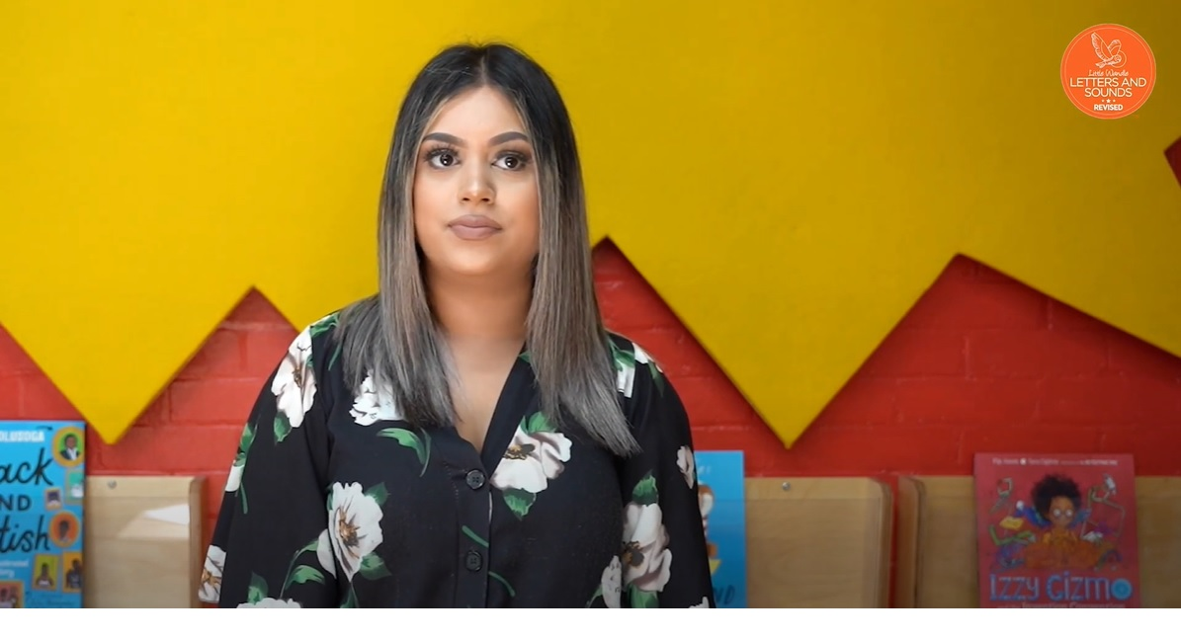
Tricky words
Notes:
Deanna
Have a look at this video on the website: https://www.littlewandlelettersandsounds.org.uk/resources/for-parents/

Slide 25

Spelling
Say the word.
Segment the sounds.
Count the sounds.
Write them down.
Notes:
Deanna
Model the process on a flipchart for the parents to see.

Slide 26

Supporting your child with phonics
Notes:
It is really important that you pronounce the sounds correctly at home if you are supporting your child. These videos are on the website for you to refer to and if you are unsure, please ask your child’s teacher.
Show the parents where to access the videos on the website and play them!
https://www.littlewandlelettersandsounds.org.uk/resources/for-parents/

Slide 27
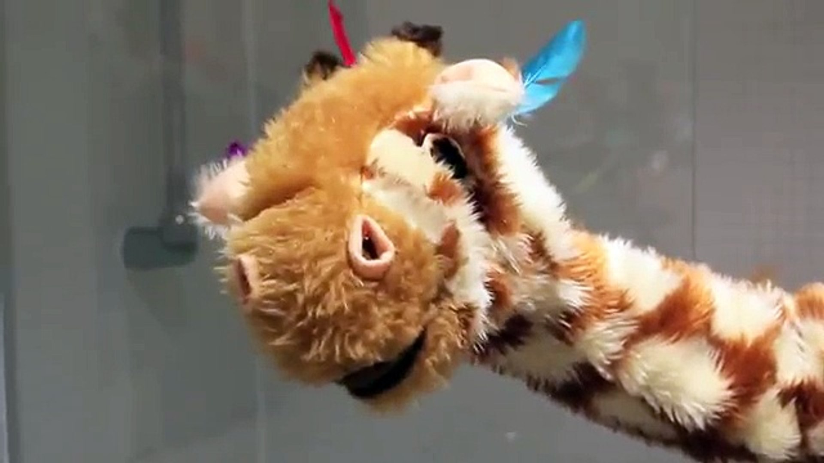
Watch Geraldine Giraffe – Mr Thorne Does Phonics
( You Tube)
The children love her!
Notes:
Deanna

