Slide 1
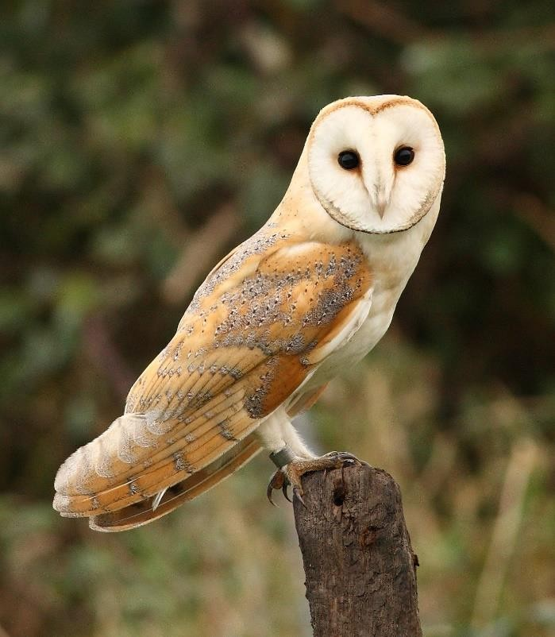

Meet the Teacher
Friday 13th September 2024
Owl Class, Year 6, 2024-2025

Slide 2

General Information
School is open from 8:30am and everyone is expected in class, ready to learn by 8:55am when the register is completed.
To avoid being marked late it is essential that children are in school and ready for the school day by 8:55am.
Pick-up is from the playground at 3:20pm. If you wish your child to walk home by themselves, this needs to be put into writing and sent to the school office.
Children should not bring mobile phones into school, however, if there is a specific reason for your child to have a mobile phone in school then it needs to be handed into the school office at the beginning of the day and picked up from the office at the end of the day – it will be kept in the school safe.

Slide 3
P.E.
Mondays (Mrs Higgins and Mr. Wickenden) & Tuesdays (Mrs Higgins)
Autumn sports are: rugby, football, indoor athletics & swimming (Autumn 2)
Children should come into school in full P.E. kit on these days.
Long hair should be tied back and earrings should be removed (plastic retainers could be used to ensure that newly pierced ears maintain their holes).

Slide 4
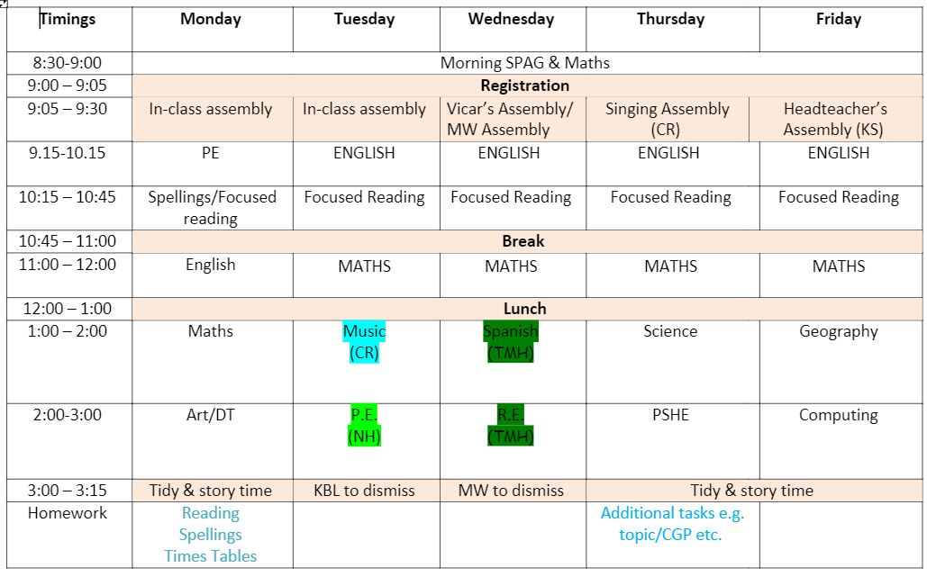
Daily Timetable – Autumn

Slide 5
Maths – White Rose Maths
As in previous years, the curriculum focuses on key areas:
  Reasoning & problem solving
  Arithmetic & number fluency
  Space, shape & measure (including time)
Any practical reinforcement you can do at home in addition to homework is very useful especially finding opportunities to tell the time etc. KIRFs will continue – please use these to support learning and understanding.
Times tables – these will be part of homework this term. Having these learnt fluently is invaluable as the maths curriculum becomes more demanding.

Slide 6
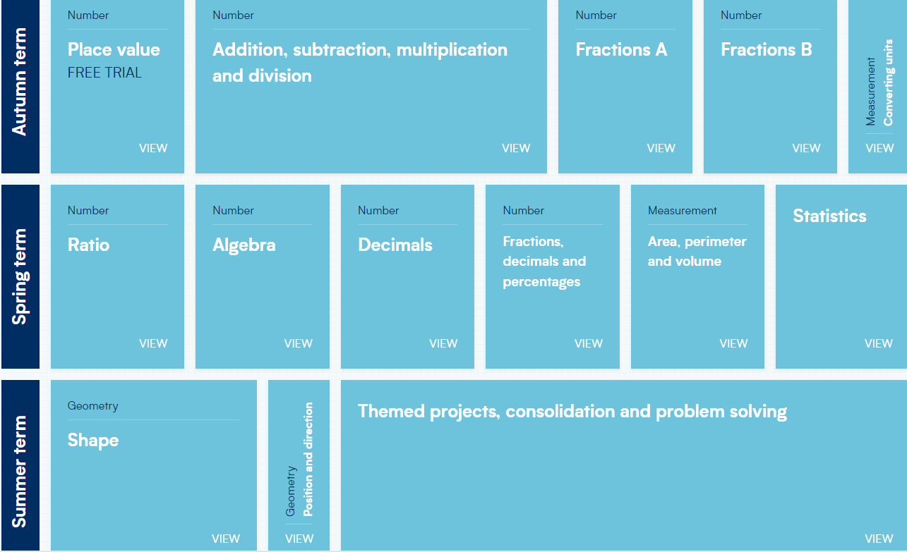

Slide 7
Reading
Focused reading – regular slots which will look at fluency, comprehension, choral reading, peer reading and whole class reading. Within this, we will also look at poetry and non-fiction texts as well as novels and short stories.
Reading books –it is important that we foster a love of books and reading for pleasure. They need to be reading every day and this is a homework expectation but this could include reading to younger siblings or being read to. Their reading books should be in school every day and can be selected from school or from home.
Reading scrapbook.

Slide 8
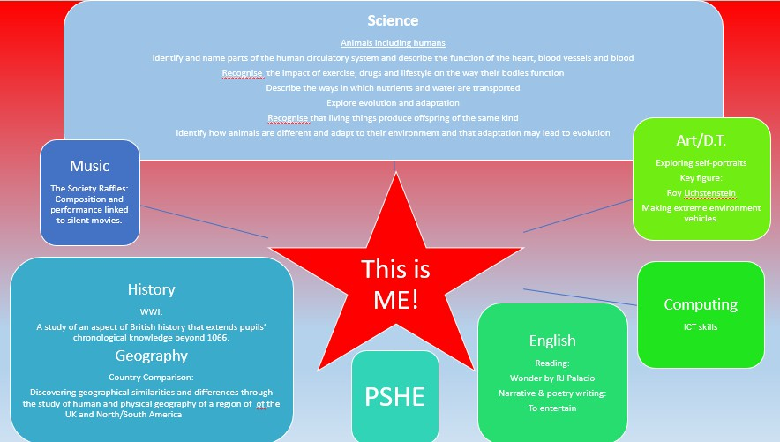

Slide 9
Writing
Focus is on writing for a purpose and audience considering which techniques need to be used and what tone
Skills from SPAG need to be incorporated
Independence is key
Areas covered:
  Writing to entertain – narratives (stories), poetry, descriptions, settings
  Writing to inform – instructions, reports, newspapers, blogs, biographies,
recounts
  Writing to persuade – letters, emails, debates/speeches, adverts
  Writing to discuss – balanced arguments, newspapers, reviews

Slide 10
Key items
What should be in my pencil case?
blue or black ink handwriting pens
a good quality rubber
HB (yellow and black) pencils
a plastic ruler
a glue stick
a small sharpener
Additional extras:
a selection of fine-liner pens
highlighter pens
A selection of colouring pencils
a selection of felt-tip pens
What do I need?
Please can you bring the following items into school:
a non-spill water bottle
homework diary
pencil case
reading book
wellies/outdoor shoes
raincoat

Slide 11
Homework
Daily reading – expectation to read every evening
Spellings & times tables – set every Monday for a test the following Monday
Maths and/or English homework set every Thursday to be brought in for marking in class on a Monday
KIRFs (Key Instant Recall Facts) – the secret to success is practising little and often. Children should be encouraged to practise these KIRFs whenever possible (in the car, walking to school etc.)
The children will be provided with a list of either common exception words, topic related words or vocabulary based on building and extending spelling knowledge and understanding that pupils should be familiar with by the end of Year 6.

Slide 12
Expectations in Year 6
Role model to younger children – buddies to Reception
Leading play and clubs for younger children
Uniform – neat and correct
Homework – punctual (if there’s a problem or your child is unable to complete on time, please write a message in their homework diary)
Responsibilities and jobs around the school as well as ambassadors for visitors
Achieving their best – in thought, in word, in deed

Slide 13
Team Ticks
These will be awarded to children for working hard, being helpful, demonstrating good behaviour etc.
These are displayed on a chart in class. The team ticks earned by the children will solely go towards raising money for the charities that the children have selected.
The charities which the money is raised for are chosen by the children in Year 6 each year.

Slide 14
End of KS2 – SATs
The Key Stage 2 tests are timetabled from
There will be an English Reading test; English Spelling and Grammar test; Maths Arithmetic paper; Maths Reasoning Paper 1 and Maths Reasoning Paper 2.
Writing scores are taken from a selection of pieces, from across the year, that are teacher assessed and may be externally moderated.

Slide 15
School Residential
Mill on the Brue, Somerset
Monday 16th June – Thursday 19th June
https://www.millonthebrue.co.uk/
Further information will be sent out during the year regarding payment, activities etc.

Slide 16
Can we help?
We are usually available for a quick chat at the end of each day on the playground. If you have something urgent then please do let the office know.
If you need a longer chat, then please arrange a meeting via the office.
Staff meetings are on Tuesdays .
There will be lots of information going up on the Class Page, so please do look there for resources and information:
https://www.cheapsideschool.org.uk/owls-year-6-4/

Slide 17
Can you help?
If you would like to come into school and volunteer to listen to readers or help with school trips etc. then you are very welcome. Speak to the front office as your first port of call.
If you have an area of expertise that you’d like to share with pupils or if you have a connection with any of the topic areas we’re covering this year we’d love your input.

