Slide 1

Cancer research UK
By oak team
ThePhoto by PhotoAuthor is licensed under CCYYSA.
ThePhoto by PhotoAuthor is licensed under CCYYSA.

Slide 2
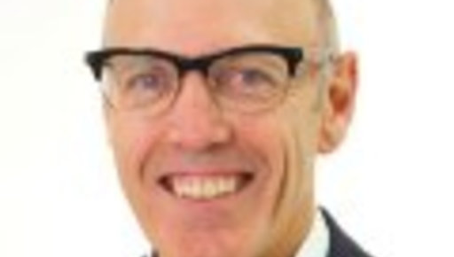

When cancer research starred
Cancer research was founded on the 4th of February 2002 by nick James who went Birmingham university.
Hopefully cancer research will carry on for much longer.

Slide 3
What do they do?
-Race for life. You can run a certain distance to raise money for charity.
-Charity shops. People donate items to charity shops and people volunteer to work there.
-Fundraising and fun ideas to raise money.

Slide 4


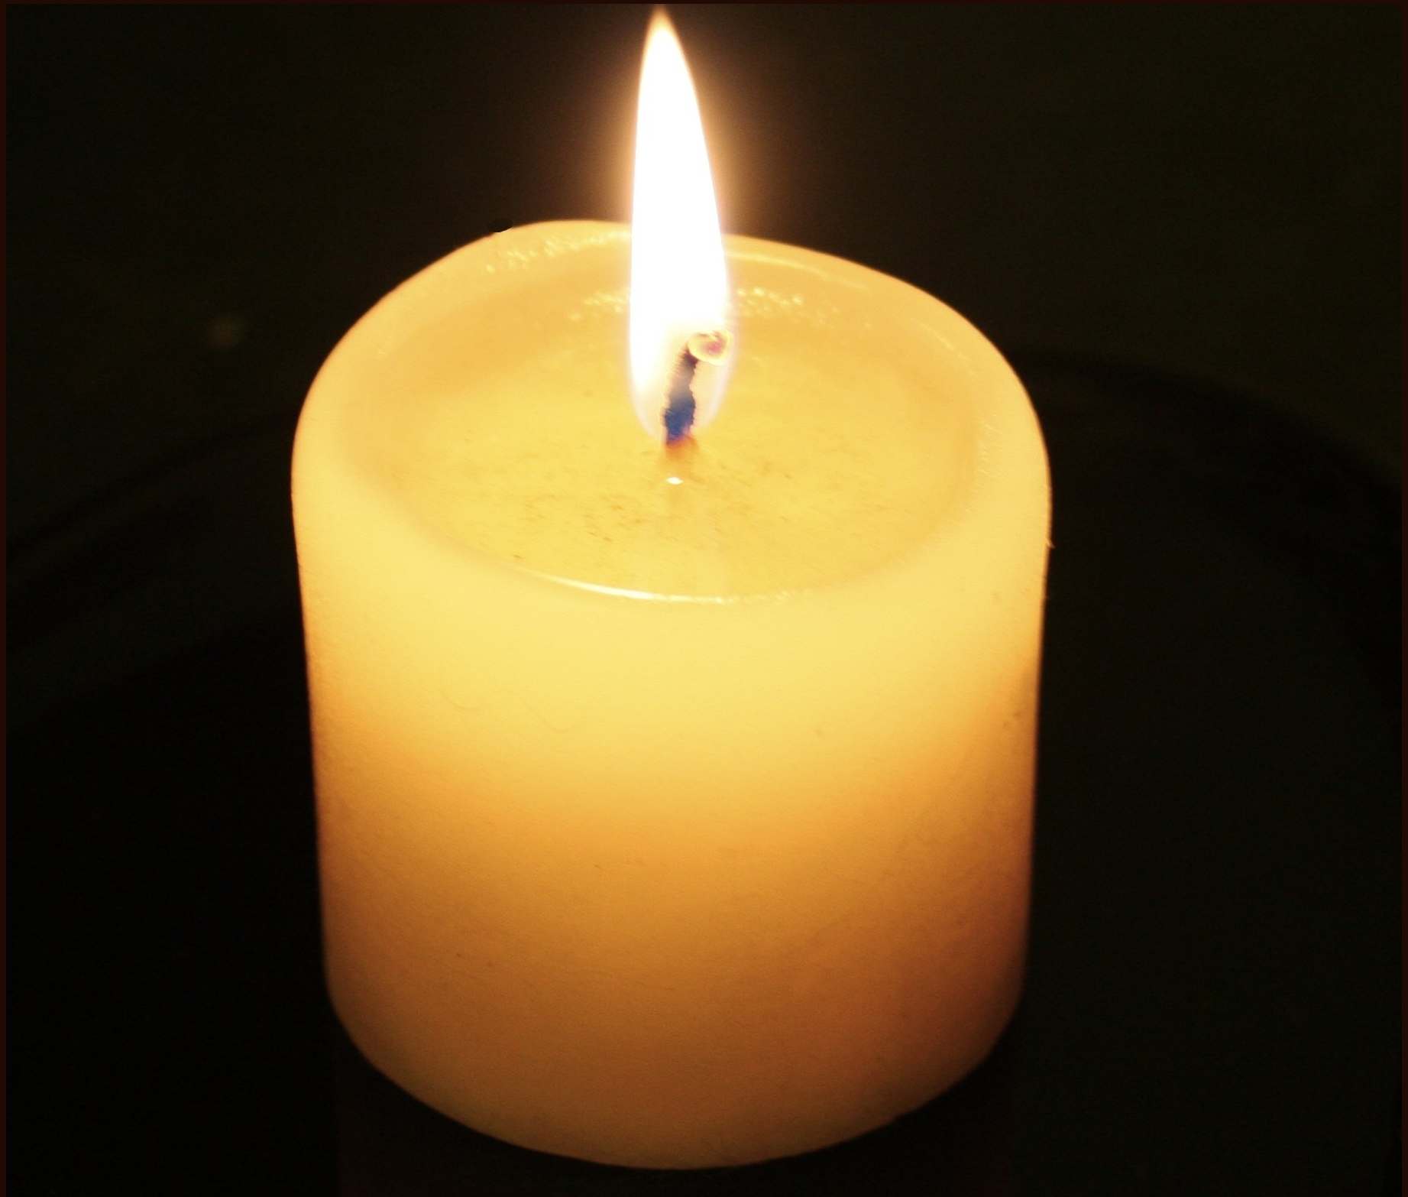

Oak's Prayer!
Dear God,
We pray that everyone enjoys there time at school with all our kind and lovely teachers.
We pray that this school year will be alright for all of us and a time to remember.
Oak will work very hard get team ticks which will raise money for cancer research UK.
We hope we have changed your mind about cancer research and how important it is to all of us.
Lord in your mercy, hear our prayer.

Slide 5
Cancer
Oak is going to try to get as many team ticks as we can to try to rase money to cancer research
Thanks for watching!!!

