Slide 1
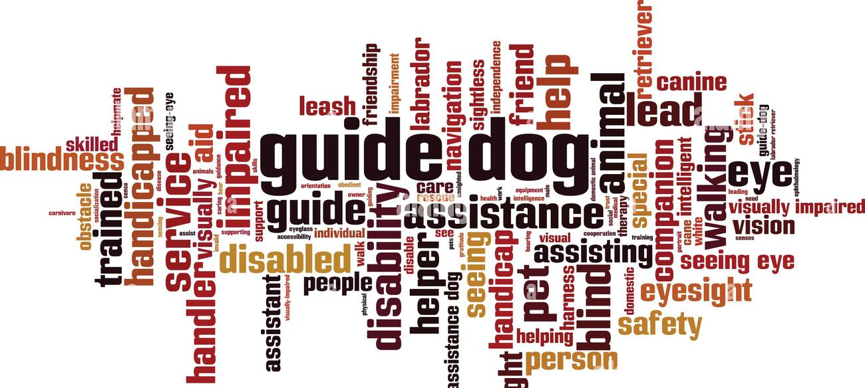
Guide dogs!
By Willow House!

Slide 2

What Guide dogs do?
Guide dogs help people with loss of sight or other disabilities to change lives of others. The dogs are trained by professional trainers . Then that is where the Guide Dog charity comes in.

Slide 3
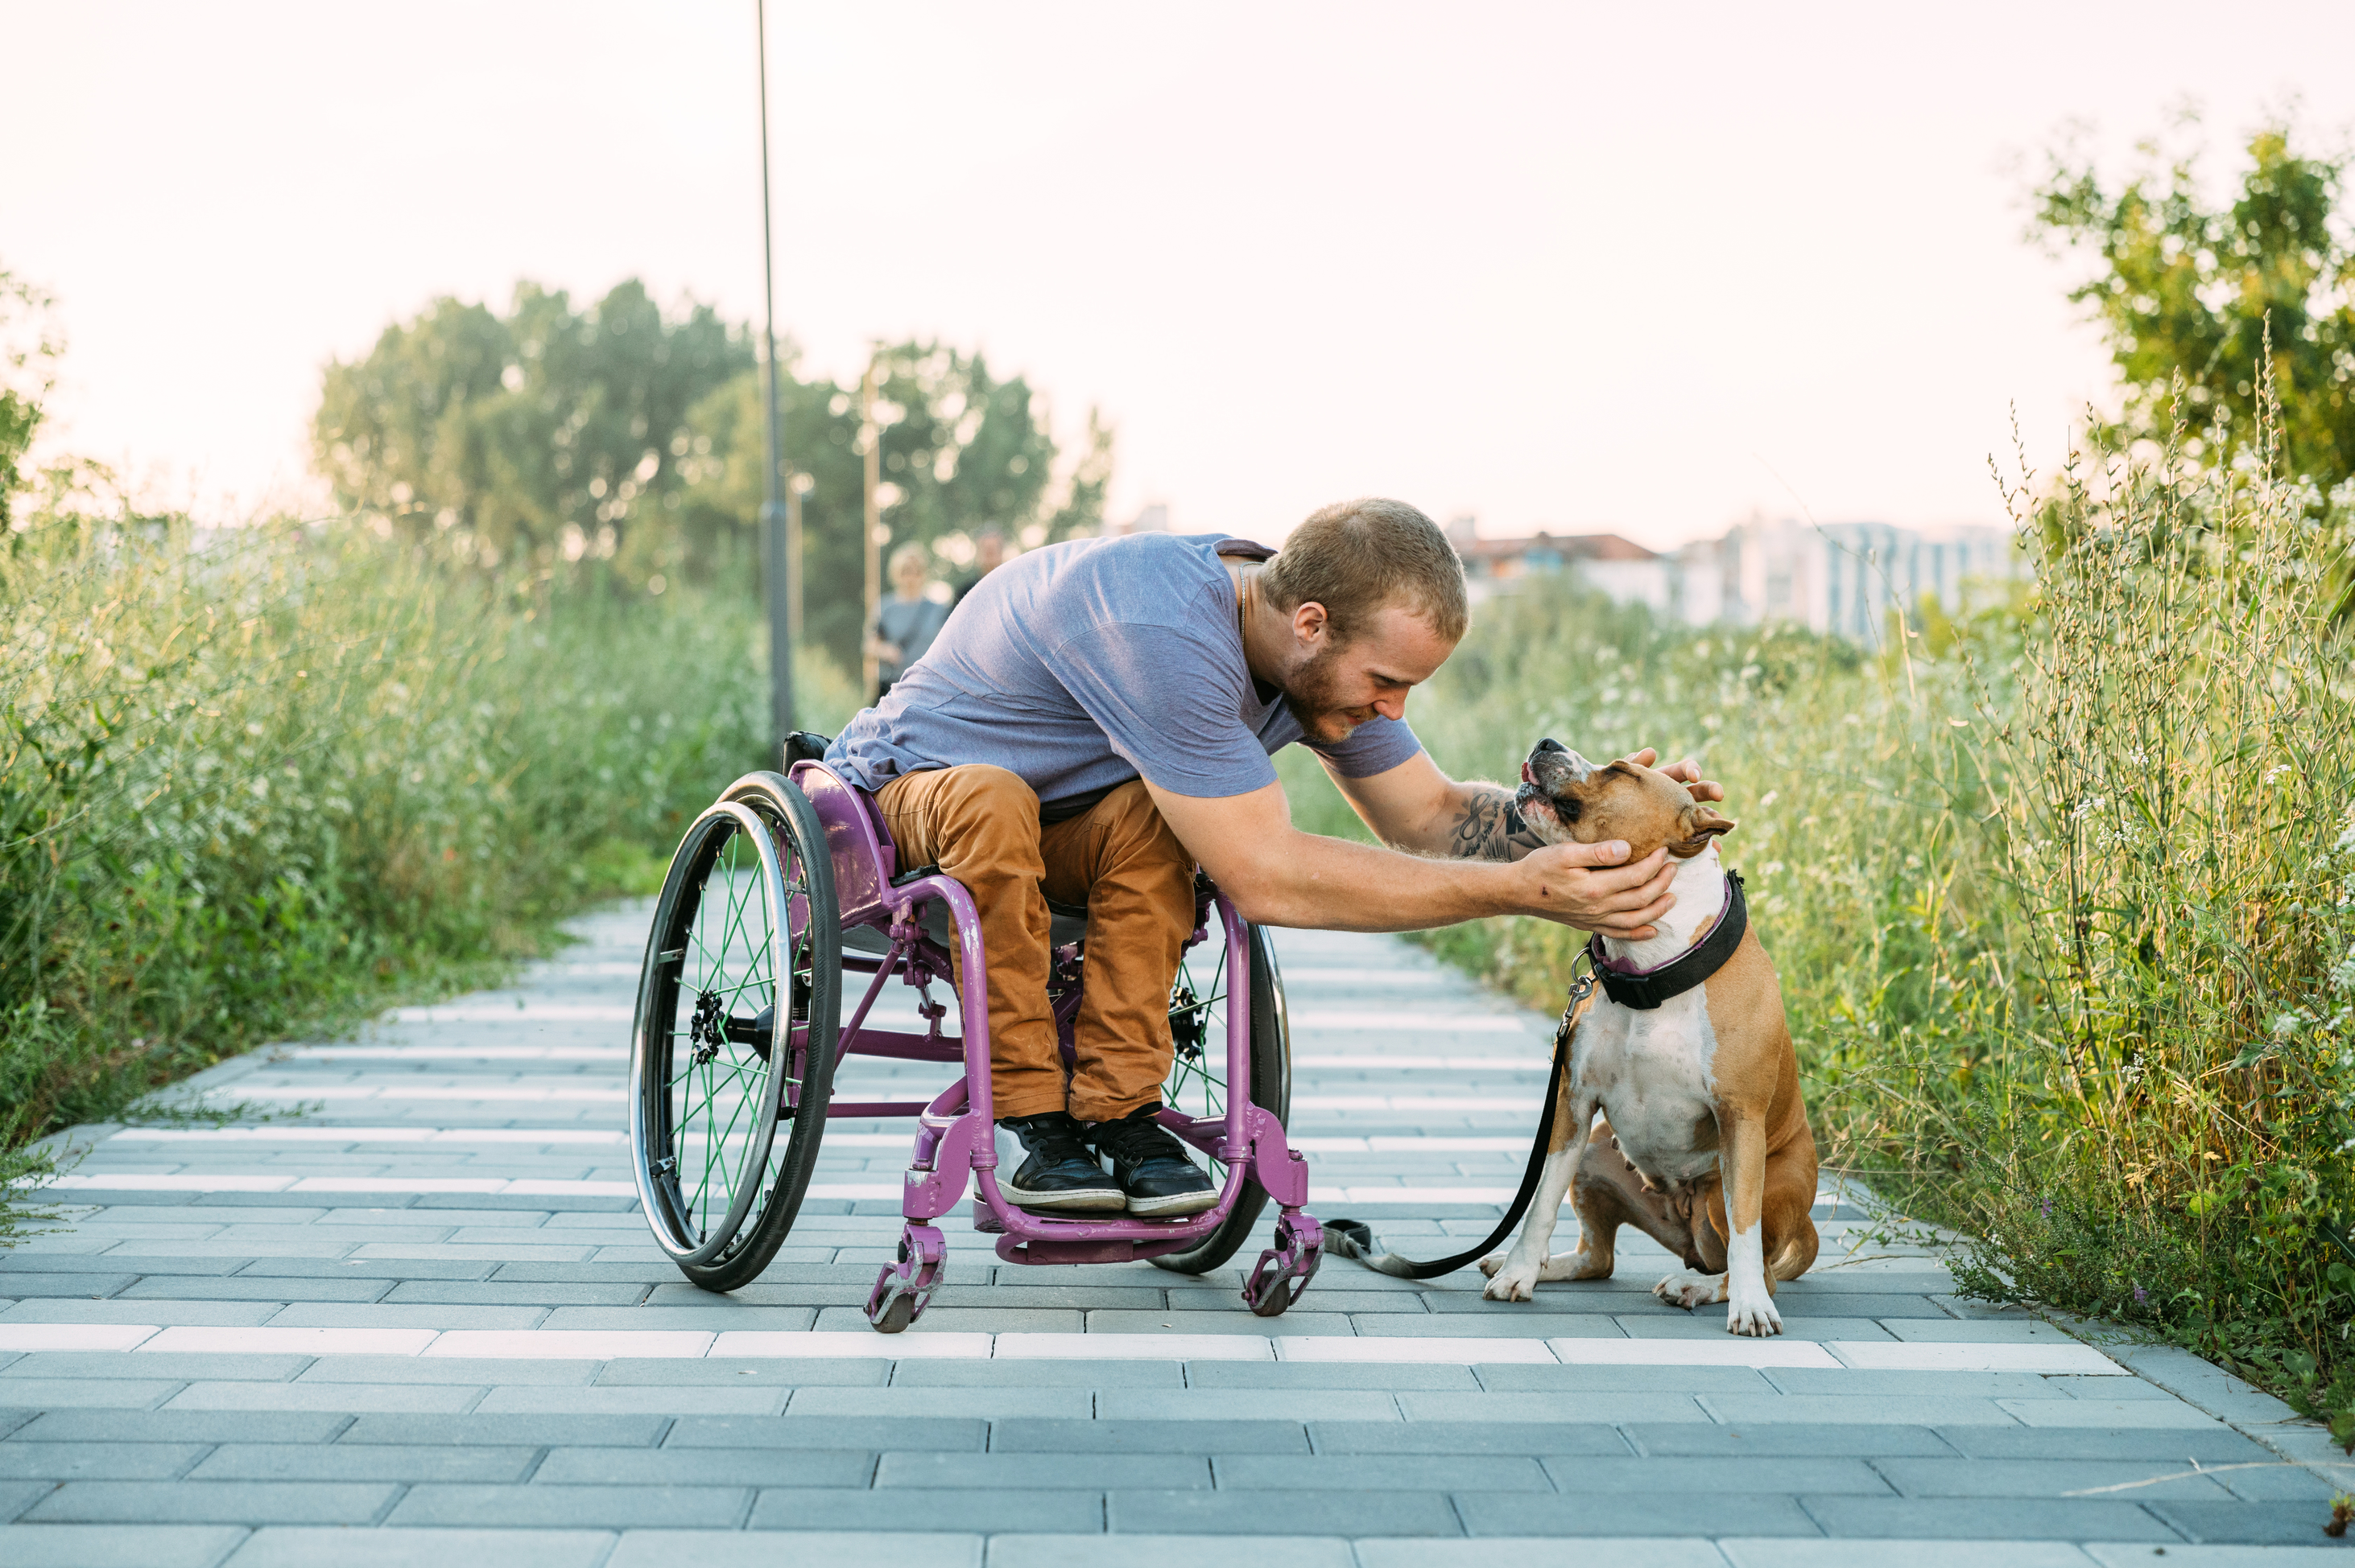
A life for a guide dog
Have you ever wondered what a guide dog does?
Our dedicated team travelled the UK to capture the commitment, love and time that goes into creating a guide dog, how we match guide dogs to guide dog owners and what happens when a guide dog’s working career comes to an end.
Watch the series to learn how guide dogs give people with sight loss the confidence to get out and about safely and provide life-changing support every single day.
View the series playlist

Slide 4
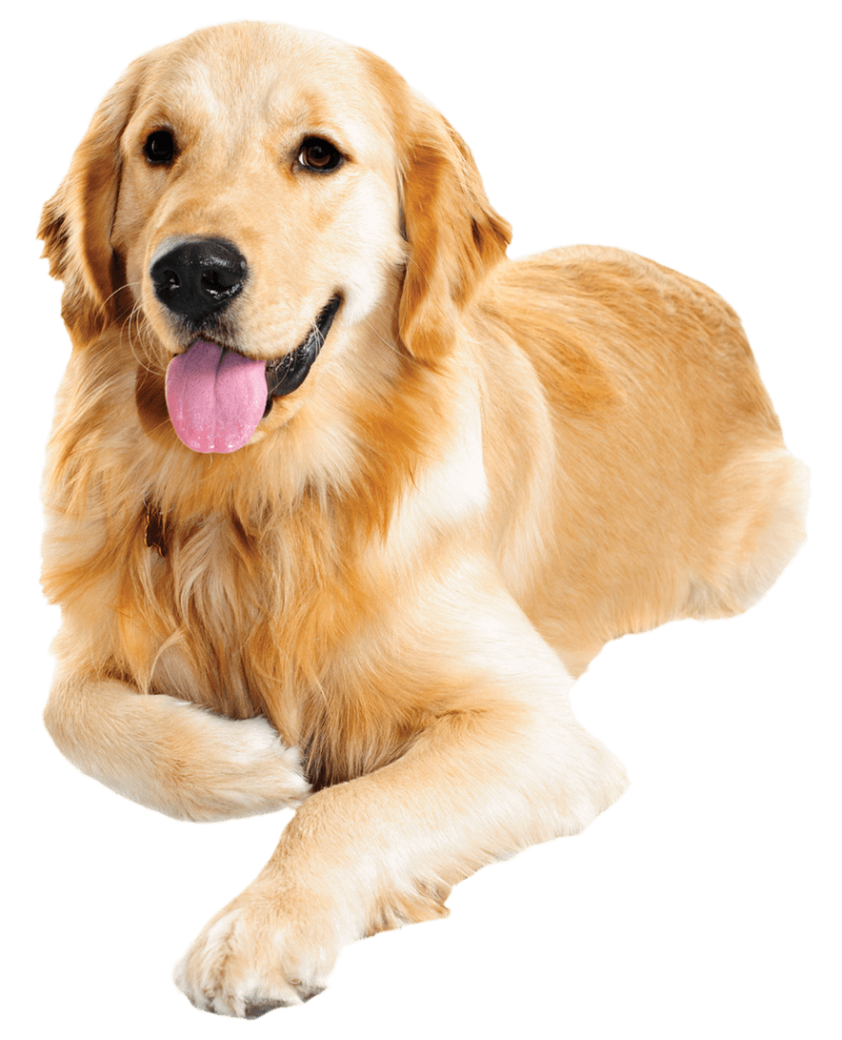
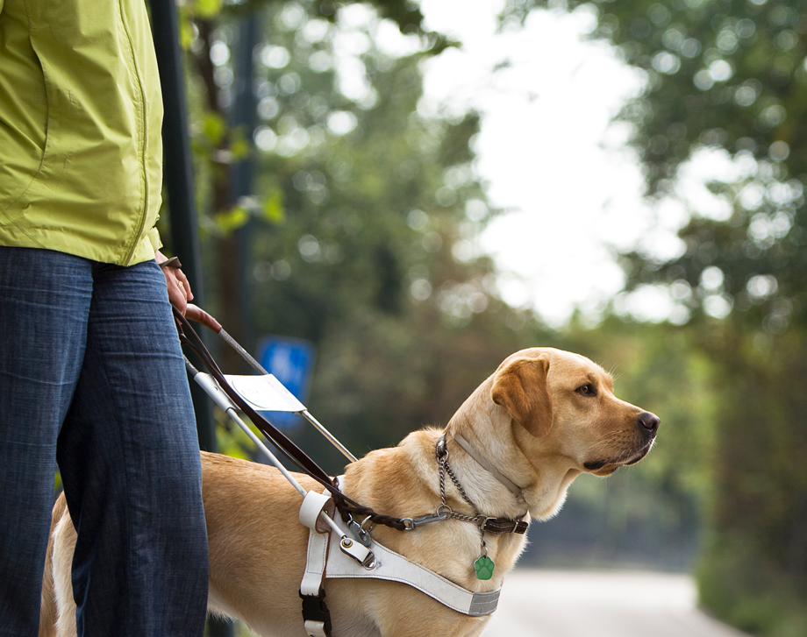

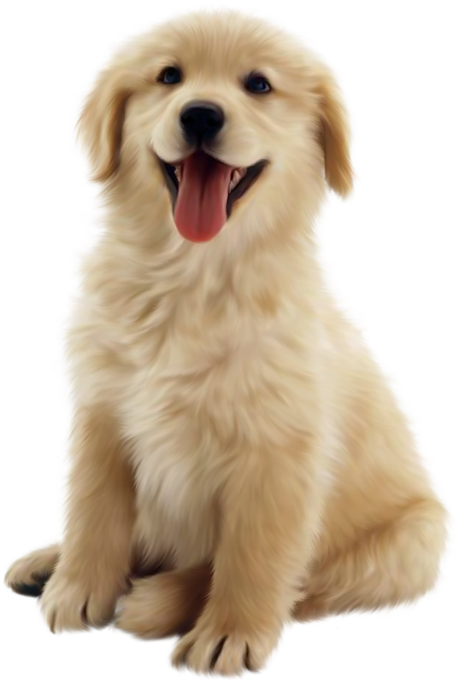
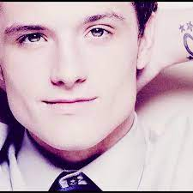
Why Should We support Them??
We should support the Guide Dogs charity as they raise money and pair partially blind or fully blind people with guide dogs, which may not seem like much, but it helps blind people a huuuge lot!! Also we like dogs :3
ThePhoto by PhotoAuthor is licensed under CCYYSA.
ThePhoto by PhotoAuthor is licensed under CCYYSA.

Slide 5
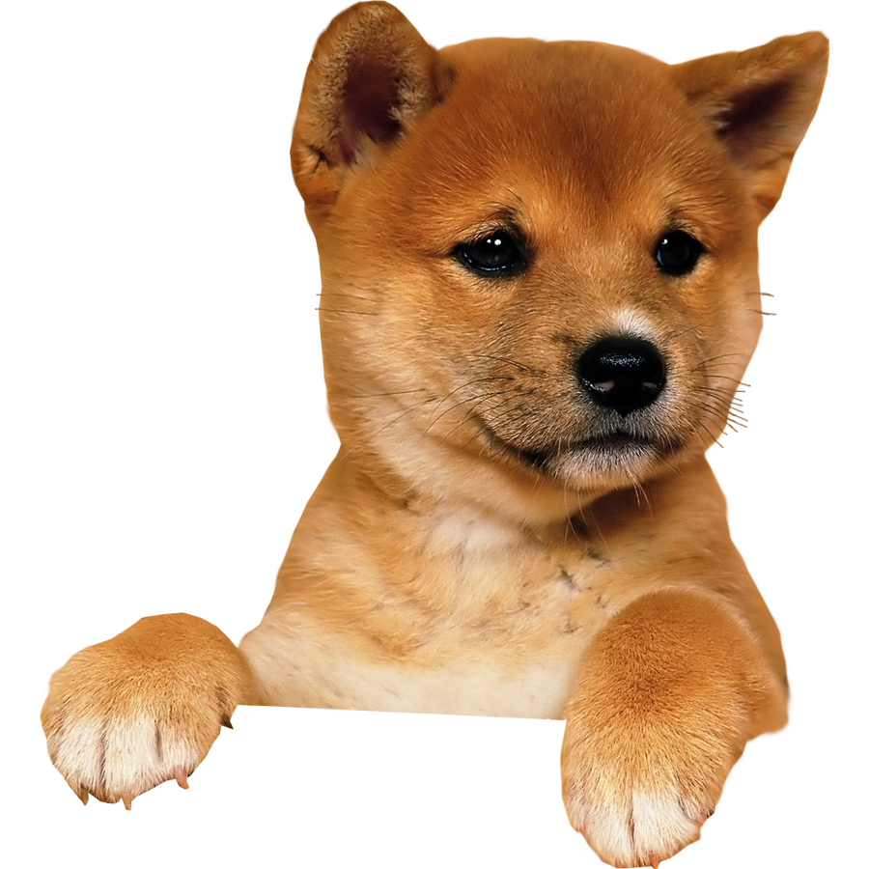
When they started :)
The Guide Dogs story started in 1931 with two amazing British pioneers, Muriel Crooke and Rosamund Bond. These remarkable women organised the training of the first four British guide dogs from a humble lock up garage in Wallasey, Merseyside. We've come a very long way since those early days.

Slide 6
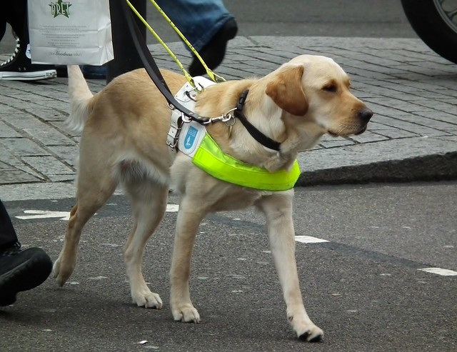
Let us pray...
Dear Lord
As you proceed to help blind people in need, we thank you for the guide dogs that do their job to help our population.
We are sorry for all the cruelty and harm that may have occurred in a dogs life.
Please continue to treat dogs with love and care as we would like to be treated.
Thank you for the things Guide dogs have done to blind and disabled people.
Lord in your mercy
Hear our prayer.

