Slide 1

The Birch charity

Slide 2
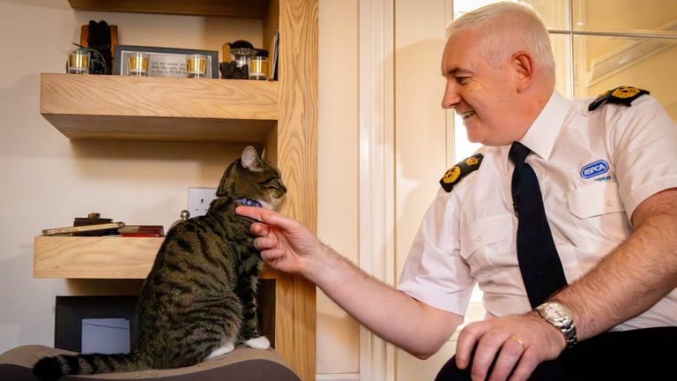
Introduction
RSPCA is an animal charity, designed to help animals in need.
It was founded in 1824, and is celebrating its 200 years anniversary.

Slide 3
What is it?
They are the Royal Society for the Prevention of Cruelty to Animals (the RSPCA) and they exist to inspire everyone to create a better world for every animal. Every day, they change lives, laws, industries and minds so all animals can live a better life.
They ensure animals have a good life by rescuing and caring for those in need, by advocating on behalf of all animals and by inspiring everyone to treat them with compassion and respect.
We've already achieved so much under our five strategic priorities: rescue and care • advocacy • prevention • support • organisational effectiveness.

Slide 4
How did they become the RSPCA?
In 1824, a small group of people met in a London coffee shop, determined to change animals' lives. They created the society that became the RSPCA, making a difference that spread around the world.

Slide 5
Why should we support?
RSPCA helps animals from animal testing.
This is our planet. We need to take care of all of the living things
We need to protect all of the living things on it

Slide 6
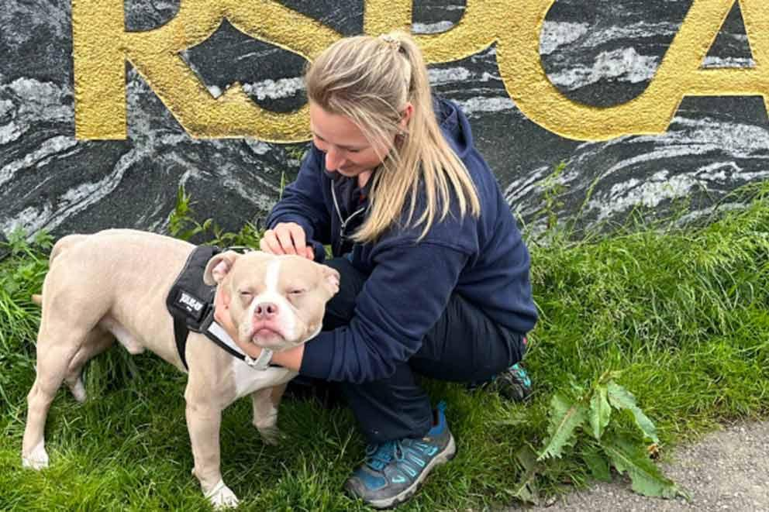

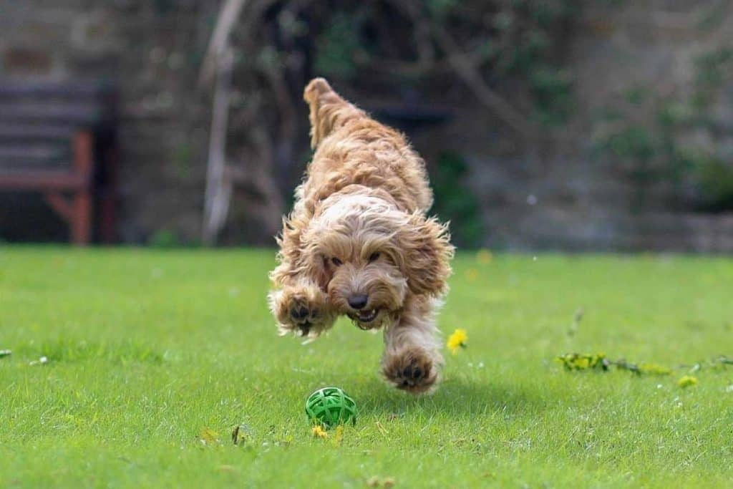
Overcoming
Nervousness

Slide 7
Let us pray
Dear Lord,
Thank you for all the amazing charities and all of the money that we have raised, as we hope that animal cruelty will soon be stopped.
Please continue to allow scientists to care for animals. Lord in your mercy,
Hear our prayer

