Slide 1


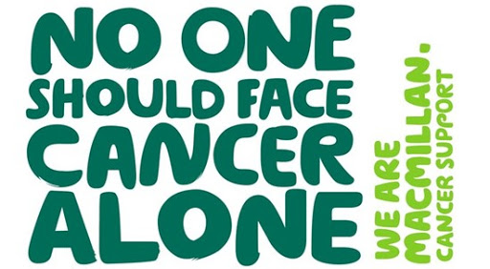
By Ash

Slide 2

When and where it started
In the 1980's, in partnership with the league of friends of the royal Victoria Hospital, they built the first Macmillan cancer care unit at Christchurch Hospital in Dorset.

Slide 3

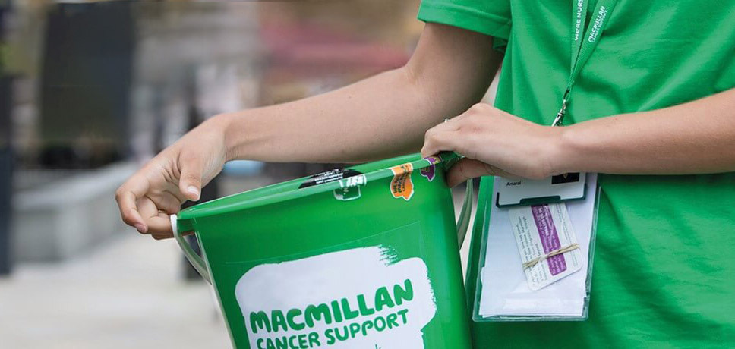
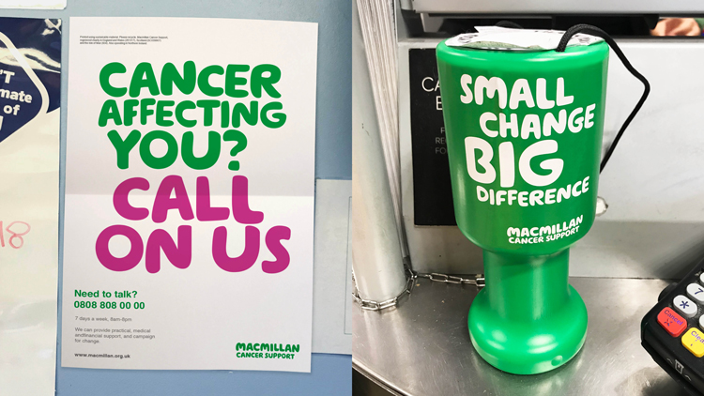

What do they do?
Macmillan Cancer Support provides services for people living with cancer at every stage of their cancer experience. They are there to provide emotional, practical, physical, and financial support.
They raise money to provide vital cancer services, research and campaign to achieve better cancer care, and support the cancer workforce.
We provide healthcare professionals with up-to-date resources, tools, information, and training courses to help them to support people living with cancer.

Slide 4


Events they have
They have many events including runs, cycles, hikes, swims.
But they also have coffee mornings, Brighton marathons, skydive weekends and even a London to Brighton cycle! But there is still a lot more amazing things they do!!!
There is also a event called "brave the shave" where people get together and shave there head and also you can donate hair to make wigs out of!

Slide 5

QUIZ
Is Macmillan funded by NHS?

Slide 6
How did Macmillan cancer support start?
A] Too many people were dying of cancer so a group of people started this charity
B] In 1911 a young man called Douglas Macmillan watched his father die of cancer so he started a group to stop it
C] Its name was changed
What age was Douglas Macmillan when he died?
A] 1998
B]1969
C]1946
How did Douglas Macmillan die?
A] Old age
B] Cancer

Slide 7


Let us pray
Dear God,
Please help others who are undergoing treatment for cancer and the others who are about to,
Thank you for the workers who help others in need ,
Thank you for the volunteers which sign up every year to help out and support others,
Please help the people who have cancer that are needing support,
Lord in your mercy,
Here our prayer.

Slide 8


Thank you for listening!
Enjoy the rest of your day!

