Slide 1

SATS
MEETING
Wednesday 23rd April 2025

Slide 2

Week beginning Monday 12th May 2025
Date
Subject
Length of time
Monday 12th May (am)
Grammar, punctuation
and spelling (SPAG) –
Paper 1
45 minutes
Spelling – Paper 2
Not timed – approx. 20
minutes
Tuesday 13th May (am)
English reading
One hour
Wednesday 14th May (am) Arithmetic – Paper 1
30 minutes
Maths Reasoning – Paper 2 40 minutes
Thursday 15th May (am)
Maths Reasoning – Paper 3 40 minutes

Slide 3

Spelling, Punctuation and Grammar Test
The SPAG test includes questions that assess the following elements of the
English curriculum:
◆ Sentence grammar through both identifying and writing sentences that are
grammatically correct
◆ Punctuation through identifying and writing sentences that are correctly
punctuated
◆ Vocabulary through identifying and writing sentences in which a word is used
correctly
◆ Spellings from both the Year 3, 4, 5 and 6 spelling patterns and rules
Questions:
◆ Requires multiple choice or short sentence answers e.g. capitalising the
correct words in a sentence; explaining why; putting the correct punctuation
into a given sentence; writing sentences that illustrate two different
meanings of the same word (such as ‘present’); identifying grammatical
features within a sentence; using plurals correctly.

Slide 4
Spelling Test
◆ Paper 2 is a spelling test, where children will have to spell words dictated by
the teacher (presented within sentences). For example:
- The word is ‘television’
- Tania turned on the television to watch her favourite cartoon.
- The word is television

Slide 5
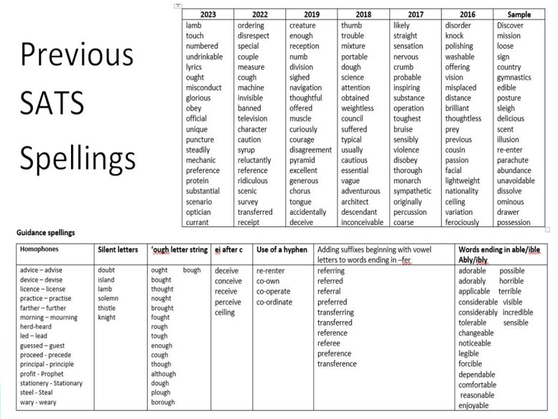

Slide 6

Spelling, Punctuation and Grammar
Paper One and Two
Paper One = 50 marks
Paper Two (Spelling Test) = 20 marks
Total Mark out of 70
https://assets.publishing.service.gov.uk/government/uploads/system/uploads
/attachment_data/file/723470/2018_KS2_scaled_score_conversion_tables.pdf
Year
Age Related Expectations (ARE)
Greater Depth
PASS
2016
2017
2018
2019
2022
2023
43/70 SS 100
36/70 SS 100
38/70 SS 100
36/70 SS 100
35/70 SS 100
36/70 SS 100
61/70 SS 110
56/70 SS 110
56/70 SS 110
55/70 SS 110
55/70 SS 110
55/70 SS 110
2024 | 35/70 SS 100 | 53/70 SS 110

Slide 7
How to help your child…
◆ Write down some unpunctuated sentences for your child to punctuate
correctly.
◆ Call out a word and ask your child to tell you a synonym (a word that
means the same) or an antonym (a word that means the opposite).
◆ When writing letters or emails, encourage your child to add an
adjective or adverb to a sentence (e.g. ‘Thank you for
my wonderful birthday present’)
◆ If your child asks you a question, ask how he would rephrase it as a
command (e.g. ‘Can you make me a drink?’ becomes, ‘Make me a
drink!’)
◆ Make spelling part of everyday life!
◆ Encourage your child to read a variety of texts – fiction, information
books, comics, newspapers, magazines, etc. – to broaden
their vocabulary.

Slide 8
Spelling top tips
Make sure letters are clear - don’t join if it’s
making it messy!
Do not join words written in the contracted form
e.g. don’t
Encourage children to look up words
Can they spot trends?
Play spelling games
Ensure correct spellings lots of the words on the
test they will see everyday!

Slide 9
Reading Paper
◆ The test consists of a reading answer
booklet and a separate reading booklet.
◆ Children have a total of one hour to read
all three texts in the reading booklet and
complete the questions at their own pace.
◆ They can approach the test as they
choose, e.g. working through one text and
answering the questions before moving
onto the next, or reading all three texts
first

Slide 10

Types of Questions
◆ Retrieval of information
Finding the information within the text
◆ Inference
Example question: How does Matthew feel about eating cottage pie and peas? How do you
know?
Answer: He loves cottage pie and peas. We know this because he grins from ear to ear when
his mum tells him that is what she is making for dinner.
◆ Deduction
Example question: What do you think Matthew might do next? Explain why you think this.
Answer: There could be several answers to this, but the person marking the text would be
looking for the child to have thought about what Matthew might do, based on what they
have read. For example: I think Matthew will go and watch TV instead of doing his spellings
because he doesn’t want to do his spellings.
◆ Opinion
Example question: Do you think Matthew’s mum is a kind person? Use evidence from the text
to support your answer.
Answer: Yes, I think Matthew’s mum is a kind person because she is cooking his favourite
meal. We also know she wants him to do well at school, which is why she asks him to
practise his spellings.
◆ Commenting on effectiveness of language
Example question: ‘Matthew thought practising spellings was a bit like watching paint dry.’
Why is this a good way to show how Matthew feels about his spellings?
Answer: The author is comparing spelling practice to watching paint dry to show how boring
Matthew finds it

Slide 11

Reading Paper
Paper One = 50 marks
Total Mark out of 50
Year
Age Related
Expectations
(ARE)
Greater Depth
Number of words
in the papers
PASS
2016
2017
2018
2019
2022
2023
21/50 SS 100 34/50 SS 110
26/50 SS 100 39/50 SS 110
28/50 SS 100 40/50 SS 110
28/50 SS 100 41/50 SS 110
29/50 SS 100 41/50 SS 110
24/50 SS 100 38/50 SS 110
Total: 1788 words
Total: 1915 words
Total: 1484 words
Total: 2194 words
Total: 1564 words
Total: 2106 words
2024 | 27/50 SS 100 | 40/50 SS 110

Slide 12
Maths Paper
◆ Paper 1 will consist of fixed response questions, where
children have to give the correct answer to
calculations, including long multiplication and division.
Papers 2 and 3 will involve a number of question types,
including:
◆ Multiple choice
◆ True or false
◆ Constrained questions, e.g. giving the answer to a
calculation, drawing a shape or completing a table or
chart
◆ Less constrained questions, where children will have to
explain their approach for solving a problem

Slide 13

Maths Paper
Arithmetic (Paper One) = 40 marks
Reasoning (Paper Two) = 35 marks
Reasoning (Paper Three) = 35 marks
Total marks = 110
Year
Age Related Expectations (ARE)
Greater Depth
PASS
2016
2017
2018
2019
2022
2023
60/110 SS 100
57/110 SS 100
61/110 SS 100
58/110 SS 100
58/110 SS 100
56/110 SS 100
98/110 SS 110
95/110 SS 110
96/110 SS 110
95/110 SS 110
96/100 SS 110
94/100 SS 110
2024 | 54/110 SS 100 | 93/110 SS 110

Slide 14
Writing
◆ Teacher assessed
◆ Children complete a portfolio of writing evidence
over the year in their English books
◆ Schools are moderated to ensure consistency
◆ Results are presented with SATS results
◆ PKS, WTS, EXS, GDS
◆ https://assets.publishing.service.gov.uk/media/637
ba0b0e90e072854bcab87/2018-
19_teacher_assessment_frameworks_at_the_end_of
_key_stage_2.pdf

Slide 15
Arrangements
◆ Children cannot be given an advantage
◆ Strict timetable and timings
◆ Classroom displays must be covered
◆ Children need to sit at separate desks, adequately spaced out
◆ Silence
◆ Questions can be asked but hands will need to be raised
◆ Access arrangements may be in place for some children
The local authority does check that access arrangements are
fair including checking the delivery of the SATS as well as
where the papers are stored before and after the tests.

Slide 16
Access Arrangements
◆ Extra time entitlement
◆ Larger texts
◆ Movement breaks/stop the clock
◆ Readers (for some papers – not the reading one)
◆ Scribes
This has to be a part of normal classroom practice –
teachers will discuss this with families on an
individual basis beforehand

Slide 17
How will the SATS be marked?
◆ You will be given your child’s scaled score and whether
they have reached the expected standard set by the
Department for Education (‘NS’ means that the expected
standard was not achieved and ‘AS’ means the expected
standard was achieved).
◆ The range of scaled scores available for each KS2 test is:
◆ 80 (the lowest scaled score that can be awarded)
◆ 120 (the highest scaled score)
◆ The expected standard for each test is a scaled score of
100 or more. If a child is awarded a scaled score of 99 or
less they won't have achieved the expected standard in the
test.
◆ The Department for Education expects at least 65 per cent
of children to reach the expected standard (the figure was
initially 85 per cent but has been revised).

Slide 18
Top tips before the SATS
◆ Prepare well
◆ Give them a break!
◆ Sleep well
◆ Have a good breakfast
These are good exam strategies for all exams and
will prepare them well for the future!

Slide 19
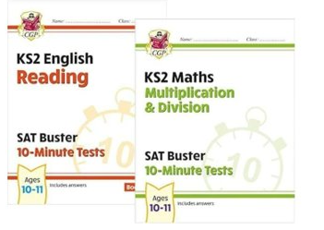

Slide 20
Breakfast Club
All children are invited to come to
breakfast club every morning of SATS
week from 8am
Free of charge
Run by staff
Great way to settle any nerves and ask
any last-minute questions

Slide 21
And remember…
◆ It is essential that the children don’t feel under pressure.
We always say in class that we (the school) are being tested, not them! Whilst we want them to do their best, it should not be at the cost of their wellbeing.
◆ S ATs are representative of a moment in time, and they do not necessarily sum up what each child has achieved here over the course of their time with us. They are so much more than a test result!

