Slide 1
Year 6 Residential Trip
June 16th – 19th 2025

Slide 2
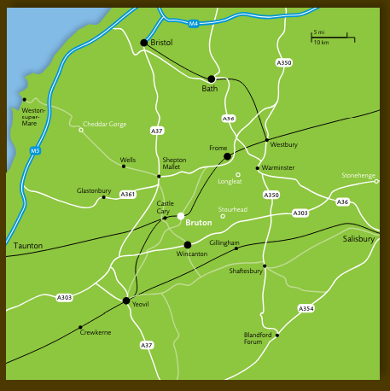


Slide 3
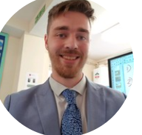
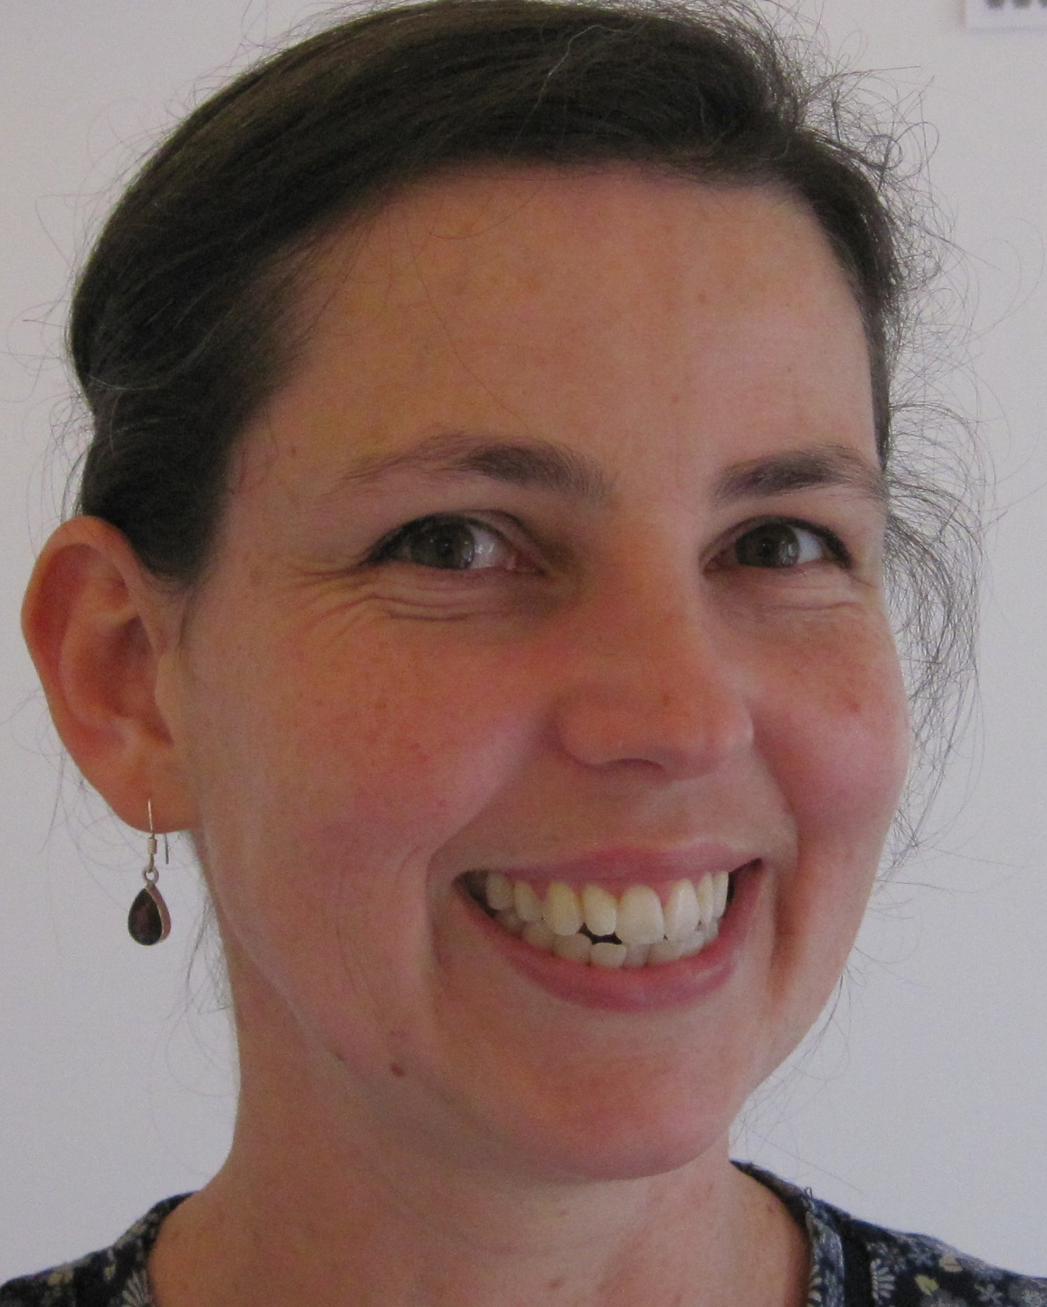
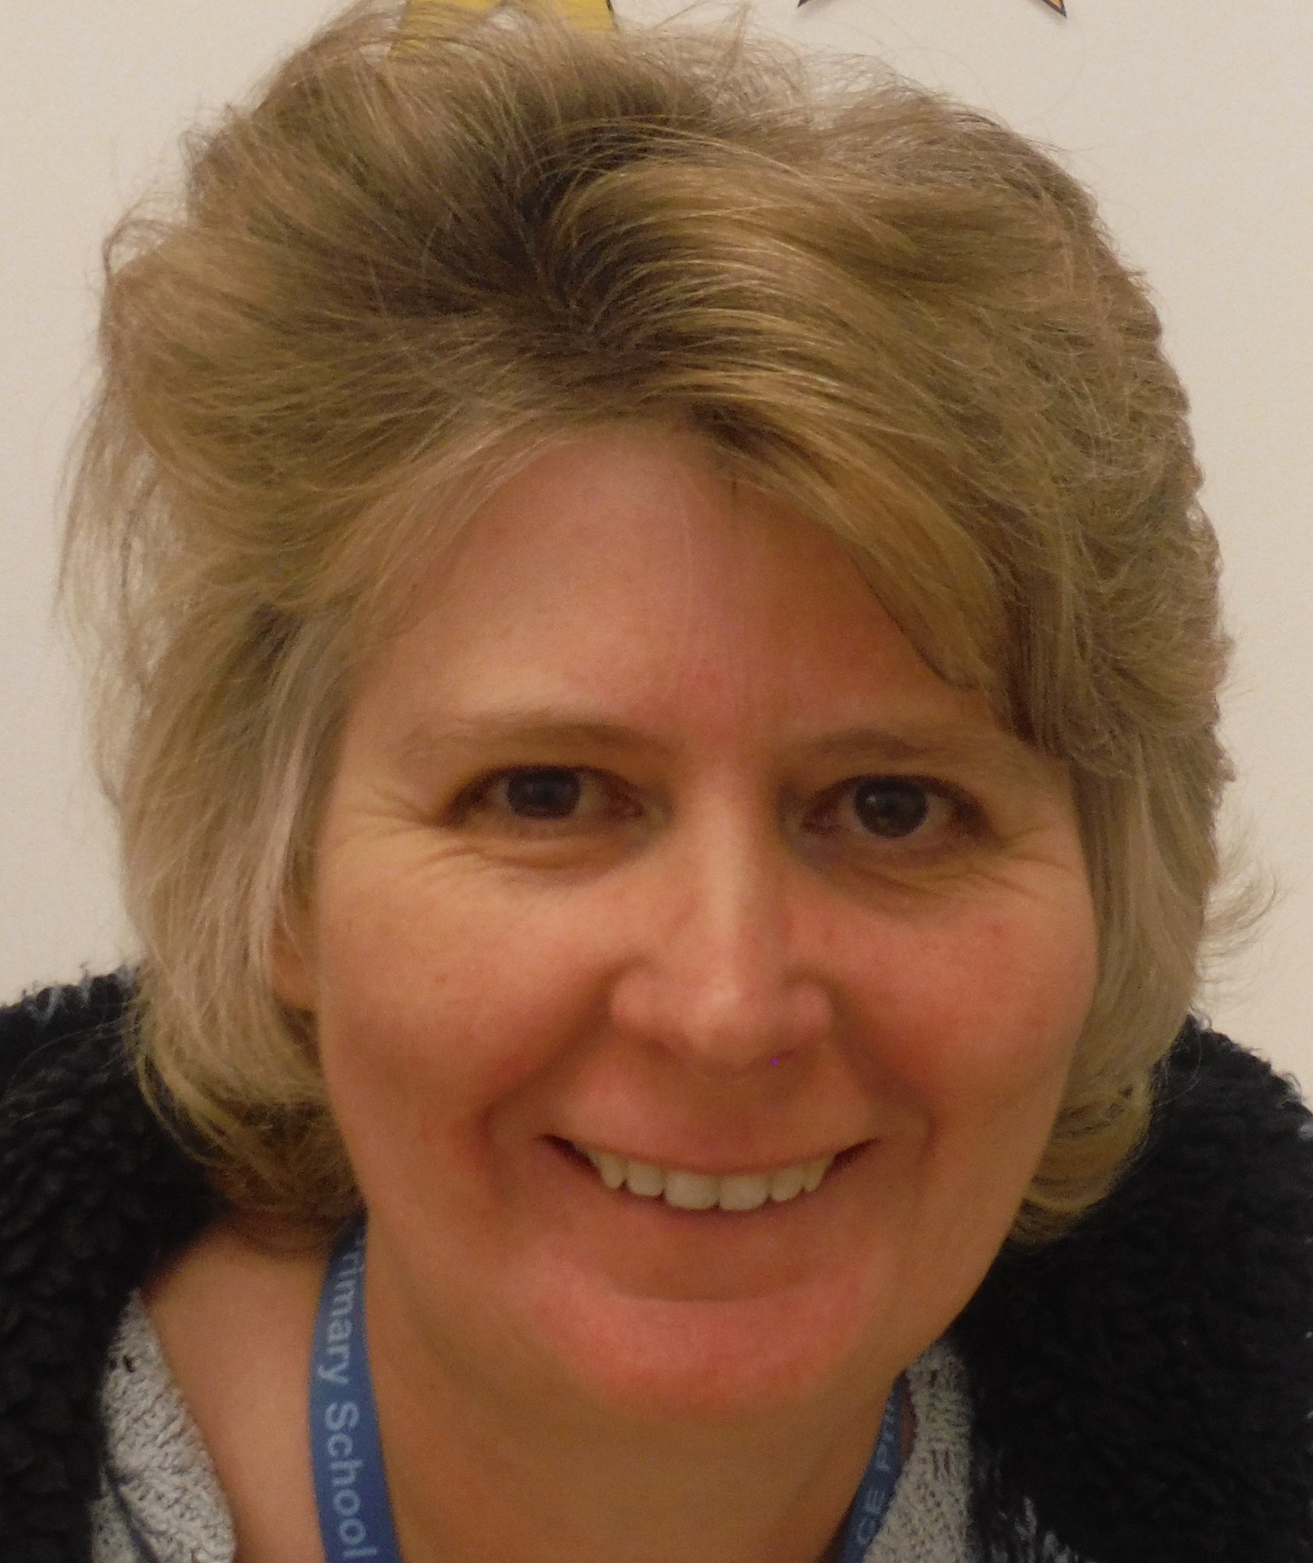
Staffing
Mr. Wickenden Mrs Roberts Mrs Howarth

Slide 4


Staff will provide regular updates via the school.
In case of emergency contact Ms Southby 07936 621 110

Slide 5
Food
On the journey: drink (not fizzy), sweets for the journey (a packet) and no chocolate or chewing gum please.
Mill on the Brue have requested no additional drinks or snacks to be taken.
Food at Mill on the Brue: https://www.millonthebrue.co.uk/outdoor-activity-centres/food/

Slide 6

Packing: (labelled – inc. bags)
Please use the Mill on the Brue packing list.
Children will need a sleeping bag.
Long sleeved tops and longer shorts, leggings or trousers are essential for certain activities.
Wellington or walking boots and old trainers that can get wet, in addition to other trainers.
If your child has waterproofs, please pack them.
Hats and sunscreen should also be brought.

Slide 7

Medicines:
All medicines, including asthma pumps, should be placed in a plastic bag and clearly labelled with your child’s name and any instructions.
These should be given to Mr. Wickenden.
This incudes any travel sickness medication for the return journey.
These medications should be detailed on the OA4 form.

Slide 8
Dentistry:
This is an activity holiday and, as dentistry is often not provided by the NHS, you may wish to take out private dental insurance which covers accidental damage to teeth.
RBWM’s policy covers the costs for treatment due to injury from an accident damaging teeth up to £1000.

Slide 9
Timings:
Children must be in school by 8:15 am on Monday morning (16th June) as we aim to depart between 8:45 and 9:00 am. You may stay and wave them goodbye.
The children will be returning back on Thursday 19th June at 9.30 p.m
Should there be any changes to these times, you will be informed accordingly.

Slide 10
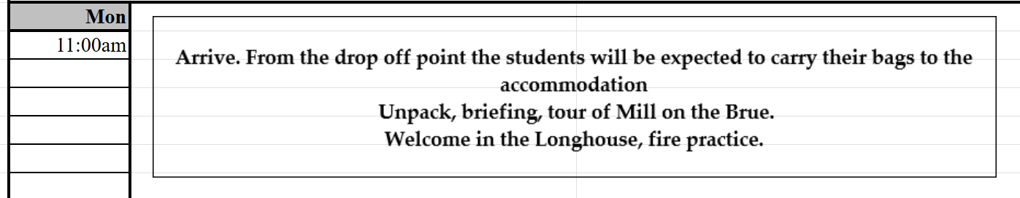
Activity Timetable:

Slide 11
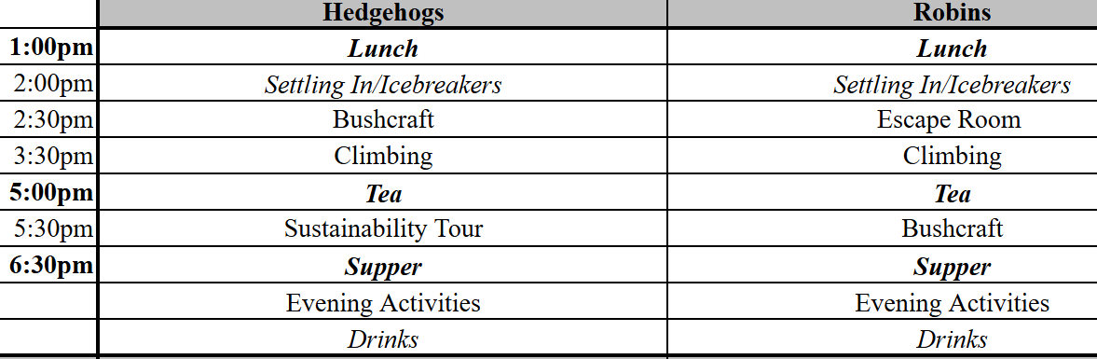
Activity Timetable:

Slide 12
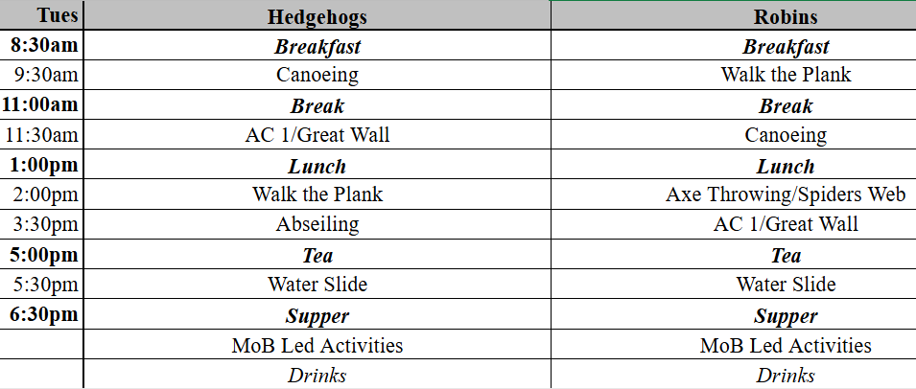
Activity Timetable:

Slide 13
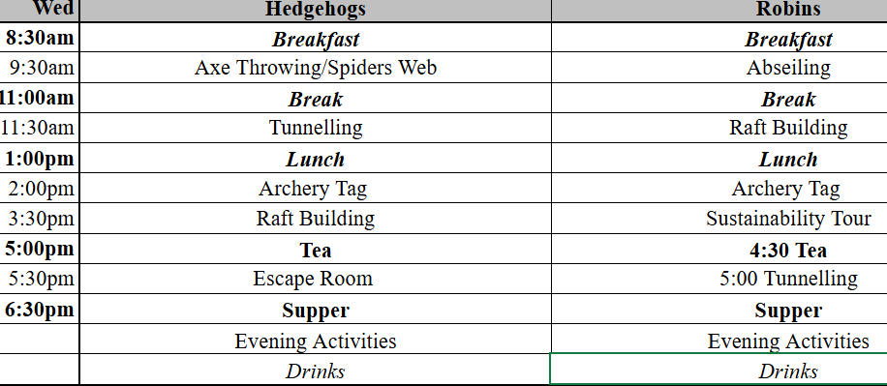
Activity Timetable:

Slide 14
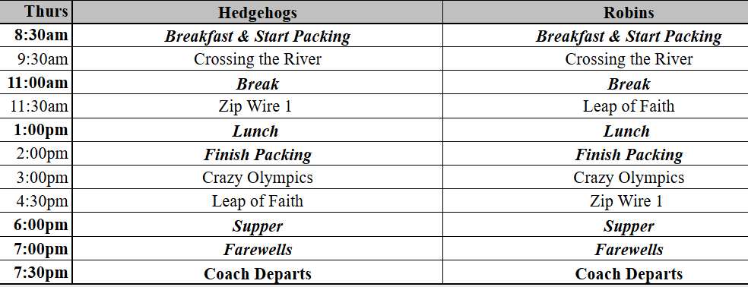
Activity Timetable:

Slide 15
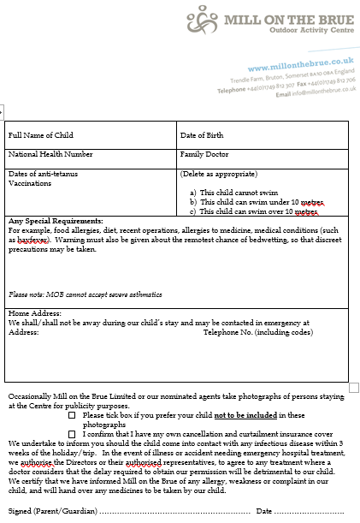
Paperwork
Please make sure the following are completed and returned to school by Friday 13th June.
OA4 consent form
Medication permission slip
Mill on the Brue medical and special requirements form

