Slide 1
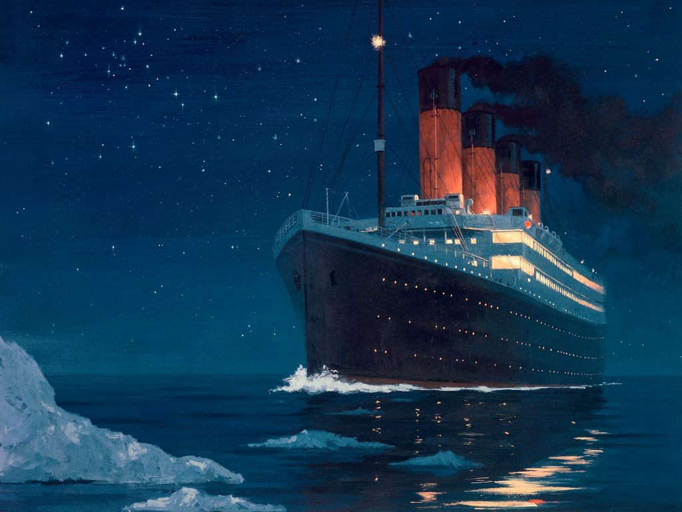
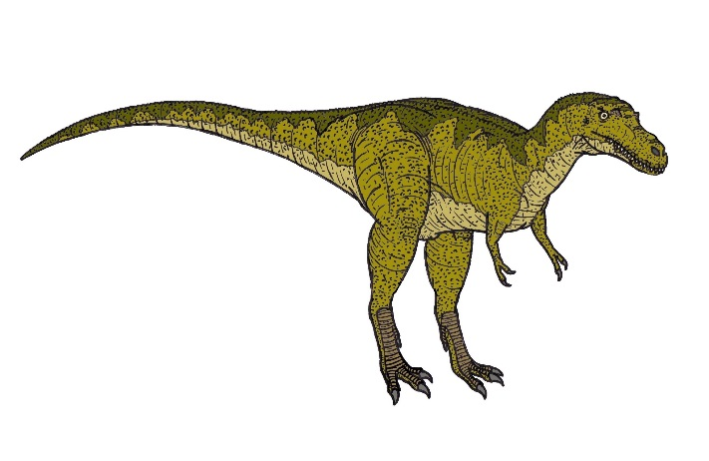
Autumn Term: Sept-Dec 2021
English
Texts:
How to grow a Dinosaur.
Harry and the bucketful of Dinosaurs.
Harry and the dinosaurs at the museum.
Art/DT
Chalk drawings
Dioramas of animal habitats
Making dinosaurs using paper plates
Creating Dinosaur scene.
Titanic dioramas.
WATCH OUT!!
Maths:
Place Value
Addition
Shape – 2D and 3D
Computing:
Purple Mash- decoding
History:
to build on what children already know from stories, general knowledge, film, etc • to release prior learning and stimulate new specialist vocabulary through discussion to develop the ability to recall key events and sequence them appropriately, developing suitable connectives
Geography:
Name and locate the world’s 7 continents and 5 oceans
PHSE- Jigsaw
Being me in my world
Science:
Animals and their habitats
Uses of everyday materials

