Slide 1

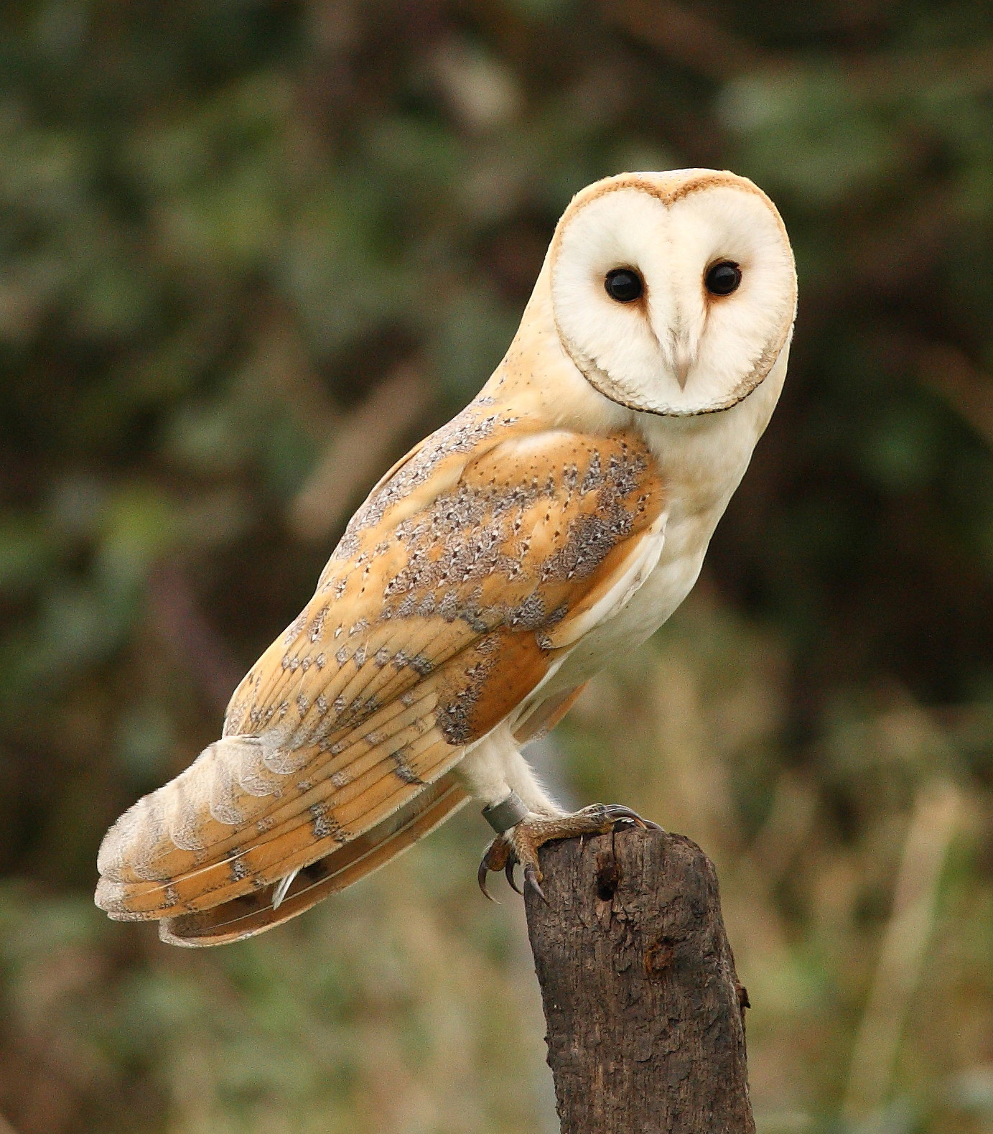

Owls
Teacher: Mrs M Rees

Slide 2
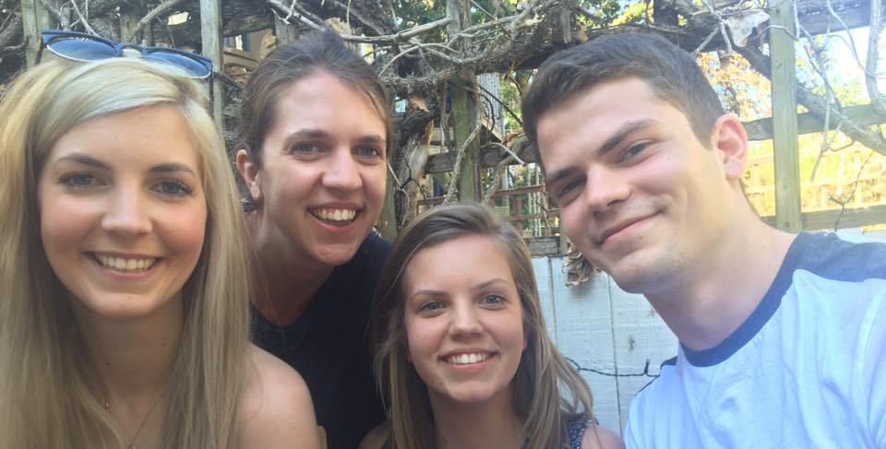

Slide 3
General Information
• At 8:45, the children begin to arrive and complete EMW. This could be maths related or learning required for lessons that day. At 9:00am we start lessons. The register closes at 8:55am.
To avoid being marked late, it is essential that children are in school and ready for the school day by then.
• School ends at 3:20pm and children are dismissed from the playground.
• If you know you will be arriving late, please notify the office staff.

Slide 4
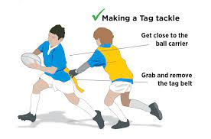
P.E
For the first half term, the children will be taking part in Tag Rugby activities and Hockey.
• After half term, our sports will be Football and Dance.
• P.E. is on Mondays and Tuesdays.
• Children should come to school in PE kit on these days.
• Long hair must be tied back and earrings should be removed (plastic retainers could be used to ensure newly pierced ears maintain their holes).

Slide 5
Year 6 Weekly Timetable
 | MONDAY | TUESDAY | WEDNESDAY | THURSDAY | FRIDAY
08:40-08:55 | Maths Fluency | Maths Fluency | Maths Fluency | Maths Fluency | Maths Fluency
09;05-09:25 | School Assembly | Values Assembly | School Assembly | Singing Assembly | Achievement Assembly
09:30-10:45 | PE with Mrs Higgins | English | English | English Homework handed in | English Spelling Test Homework given out
10:45-11:00 | BREAK
11:00-12:00 | English | Maths | Maths | Maths | Maths
12:00-13:00 | LUNCH
13:00-13:15 | Registration Quiet Reading/PSHE small group work | Registration Quiet Reading/PSHE small group work | Registration Quiet Reading/PSHE small group work | Registration Quiet Reading/PSHE small group work | Registration Quiet Reading/PSHE small group work
13:15-14:00 | Maths | Music/French Mrs Roberts PE with Mrs Higgins | RE | Science | Geography
14:00-14:15 | Brain Break |  | Brain Break | Brain Break | Art/DT
14:15-15:00 | Topic |  | Topic | Science
15:00-15:20 | Reading | Reading | Reading | Reading | Reading
Year 6 weekly

Slide 6
Maths - White Rose Mathematics
The maths curriculum focuses on the following areas:
• reasoning
• problem solving
• arithmetic and number fluency
• space, shape and measure
• Any practical reinforcement you can do at home is greatly appreciated e.g. finding opportunities to tell the time or work out how long until tea time etc. (KIRFs)
times tables

Slide 7
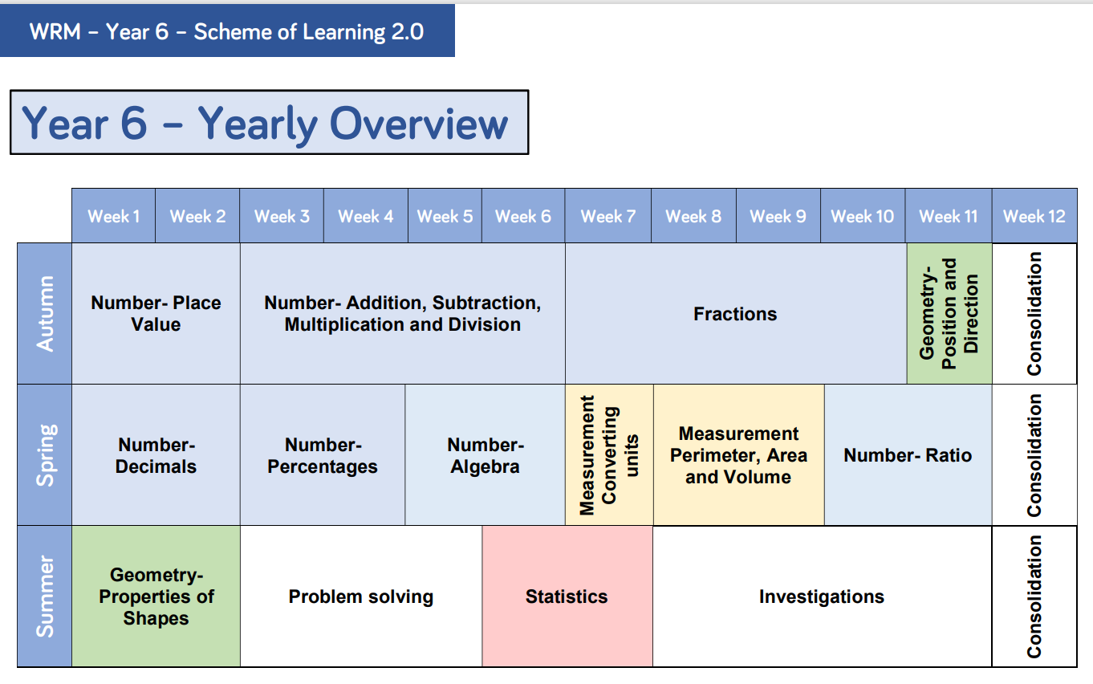

Slide 8

Children who read well, write well!
Reading
This year, we will have regular ‘focused reading’ slots. During this time, children will usually work on a book that we are reading as a class. I aim to increase their comprehension skills and promote reading for pleasure!
The children require a reading a book, of their choice, that can be brought into school every day/taken from the bookshelf and read at home each night. It would be wonderful if you could listen to your child read and discuss what they have read.
Reading competition!
Reading is a great way of understanding the world and reading to your child is equally as important as listening to your child read.

Slide 10

Writing!
Key areas covered:
• spelling, grammar and punctuation
• story writing
• non- chronological reports
• recount texts
• non- fiction writing
• instruction texts
• biographies
• poetry
In Year 6, there is a heavy focus on children editing their own work in order to encourage independence and improvement within their writing.

Slide 11
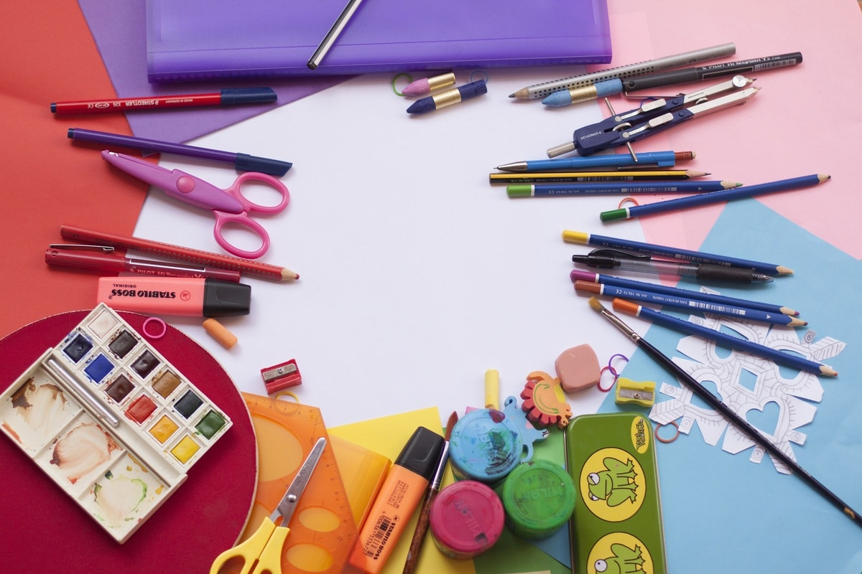
What must be in my pencil case?
blue ink handwriting pens
a good quality rubber
4 HB (yellow and black) pencils
a selection of fine-liner pens
a highlighter – preferably yellow or orange
A selection of colouring pencils
30cm plastic ruler
a selection of felt-tip pens
glue stick
a small sharpener
What do I need?
Please can you bring the following items into school:
• a non-spill water bottle
• homework diary
• pencil case
• reading book
• wellies/outdoor shoes
Please name everything!

Slide 12
Homework
• The children are expected to read every night.
• English/topic/spellings and maths homework will be set on a Friday and will be due in the following Thursday, ready to be marked in class. Spellings will be tested on Fridays.
• KIRFs (Key Instant Recall Facts) The secret to success is practising little and often. Can you practise these KIRFs while walking to school or during a car journey?
• The children will be provided with a list of either common exception words, topic related words or vocabulary based on building and extending spelling knowledge and understanding that pupils should be familiar with by the end of Year 6.

Slide 13

Expectations in Year 6
• Role models to the younger children, as they are the senior members of the school.
• Uniform – neat and correct.
• Homework on time, where possible.
• Sensible, helpful and polite around the school.
• Hard work but lots of fun too!
• Achieving our best – in thought, in word, in deed.
• The children will also be given different ‘jobs’ this year in order to promote responsibility and pride in their school.

Slide 14

Team Ticks
These will be awarded to children for working hard, being helpful, demonstrating good behaviour etc.
These are displayed on a chart in class. The team ticks earned by the children will solely go towards raising money for the charities that the children have selected.

Slide 15
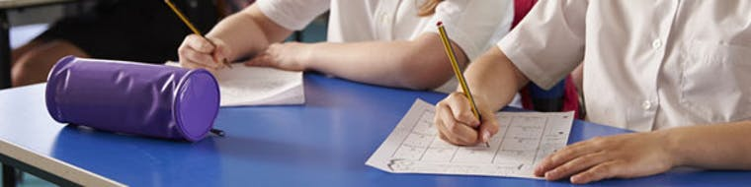
Year 6 SATs
The key stage 2 tests are timetabled from Monday 8 May to Thursday 11 May 2023.
There will be an English Reading test; English Spelling and Grammar test; Maths Arithmetic paper; Maths Reasoning paper 1 and Maths Reasoning paper 2.
Writing scores are taken from a selection of pieces, from across the year, that are assessed internally and moderated.

Slide 16

Can I help?
I am always here for a quick chat at the end of each day – if you have something urgent to tell me, please email the office.
If you want to see me for a longer chat, please ask and I will arrange a meeting. Staff meetings tend to happen on a Wednesday after school, but I am available the rest of the week.
I will be using our ‘Class Page’, on the website, so please do look there.

Slide 17


