Slide 1

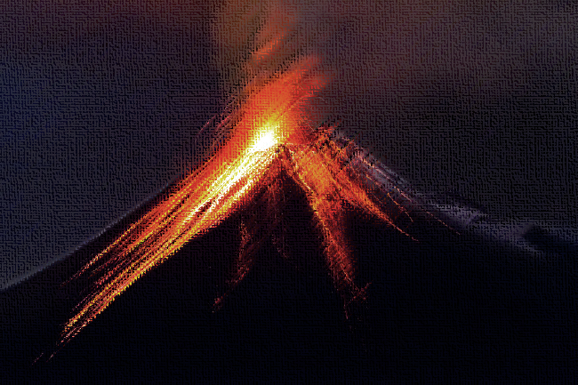
English: Reading and writing linking to Rocks in Geography & Science including information texts, descriptive writing, writing a letter and Poetry
Geography: Exploring aspects of extreme geographical phenomena, including earthquakes, volcanoes, tornadoes and tsunamis
Science: Rocks! Classifications and groupings. Where do rocks come from and how are they formed?
Music: Pentatonic Scales
Computing: Spreadsheets and Typing.
Art: Drawing Skills and exploring Primary Colours
History: A fascinating study of Henry VIII, his wives and life in Tudor times.
PE: Ball skills and Games skills, including Netball and Hockey.
French: Les Fruits (Fruits)
and
Je peux... (I can...)
Science: Forces & Magnets. What is a force and what types of forces are there? What makes something magnetic?
DT: Creating a volcano, linked to our topic
RE : Could Jesus heal people? Were these miracles or is there some other explanation? What is ‘good’ about Good Friday?
PSHE: Dreams & Goals and Healthy Me
Extreme Earth
Extreme Earth

