Slide 1

Lesson 5:
Computing Scheme of Work
Unit 5.3 - Spreadsheets
Event Planning with a Spreadsheet
Notes:
Resources
Unless otherwise stated, all resources can be found on the main unit 5.3 page. From here, click on the icon to set a resource as a 2Do for your class. Use the links below to preview the resources; right-click on the link and ‘open in new tab’ so you do not lose this page.
2Calculate – found in the Maths tools section of Purple Mash.
Example recipe for cupcakes – You could add variety by using additional recipes for children to work in small groups to plan e.g. some children could work with an egg or milk free recipe to cater for those with allergies, some could plan chocolate cupcakes or different decorations such as fruit. They could even design their cupcakes beforehand and research their own recipes to make the lesson more relevant to real life and combine with design and technology learning objectives.
Lesson 5, example 1 uses example prices but you might want to show children how to look up real prices for their local supermarket.

Slide 2


Aim
Slide 2
To use a spreadsheet to help plan a school cake sale.
Need more support? Contact us:
Tel: +44(0)208 203 1781 | Email: support@2simple.com | Twitter: @2simplesoftware
Notes:
Display slide 2 and outline the lesson aim.

Slide 3
Success Criteria
Slide 3
Children can use a spreadsheet to model a real-life situation and come up with solutions that can be practically applied.
Need more support? Contact us:
Tel: +44(0)208 203 1781 | Email: support@2simple.com | Twitter: @2simplesoftware
Notes:
Display slide 3 and outline the success criteria.

Slide 4


Introduction: Using a Spreadsheet to Plan a Cake Sale
Slide 4
Today’s tasks are:
Using a cupcake recipe to plan what ingredients to buy so there are enough cakes for everyone.
Using the spreadsheet to plan how much we should sell the cakes for to maximise profit.
Points to consider:
We want everyone in the school to be able to buy a cupcake and some parents and some staff.
We do not want too many cupcakes because they will go stale and get wasted.
Not all children will buy a cupcake and not all parents or staff.
*Recipe for cupcakes.
Let’s take a look at the recipe for cupcakes.
What amount of cupcakes should we make? We need a sensible figure.
Need more support? Contact us:
Tel: +44(0)208 203 1781 | Email: support@2simple.com | Twitter: @2simplesoftware
Notes:
Display slide 4. Explain to the children we will be using a spreadsheet to help us plan a cupcake sale. Open the recipe for cupcakes, children should open on their devices too. Go through the points to consider and decide upon the amount of cupcakes we should make for the sale.

Slide 5
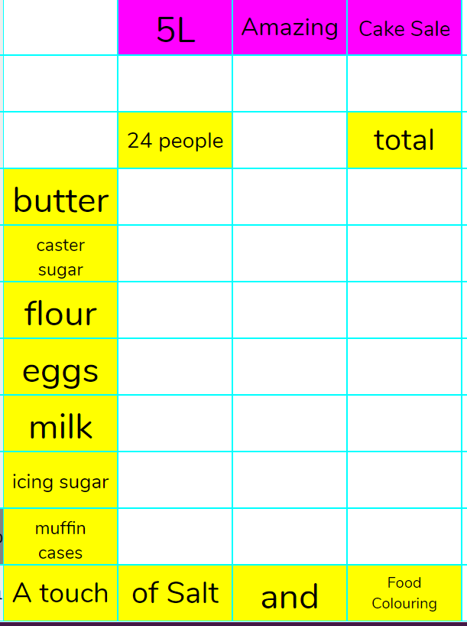
Activity 1: Creating a Spreadsheet of Things to Buy
Slide 5
Let’s open an ‘Advanced Mode’ 2Calculate file on our devices and start creating a list of things we need to buy based on the recipe for cupcakes.
Your spreadsheet should start looking a little like this.
We need to put 24 people up here as the recipe is based on 24 people. We can use calculations a little later to help us work out the ingredients needed for the number of people we decided upon for our school.
The muffin cases will need to be calculated individually as they come in packs with a certain amount in.
We can assume that salt and food colouring will only need one packet as a small amount will be needed.
Need more support? Contact us:
Tel: +44(0)208 203 1781 | Email: support@2simple.com | Twitter: @2simplesoftware
Notes:
Display slide 5. Tell children to open an ‘Advanced Mode’ 2Calculate file and start creating a list of items we need to buy. Reveal example image wen appropriate. Note* you may decide a different layout and also you may decide to calculate salt and food colouring.

Slide 6
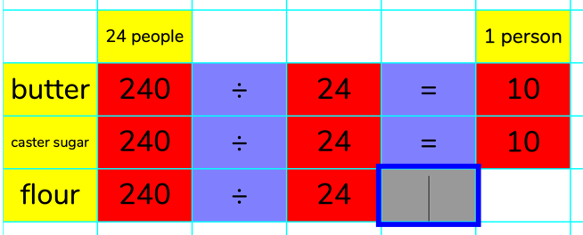
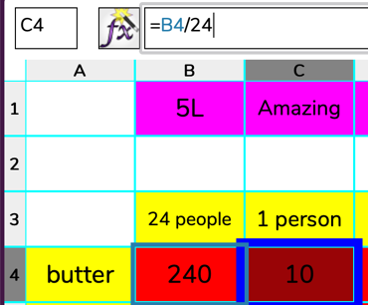
Activity 2: Calculating the Amount of Ingredients Needed
Slide 6
The next thing we need to do is calculate the amount of ingredients needed for 1 person. This will help us to work out amount needed for any number of people a little later.
Step 1: Enter the amount of each ingredient for 24 people.
*Ignore units of measure.
Step 2: Create a formula to work out for 1 person so we can use this to easily multiply by the number of cupcakes we decided upon.
Formula should be the amount for 24 people divided by 24.
Need more support? Contact us:
Tel: +44(0)208 203 1781 | Email: support@2simple.com | Twitter: @2simplesoftware
Notes:
Display slide 6. Explain that we know what the amount of ingredients is for 24 people as it shows this on the recipe but we need to find out what this is for 1 person. When we know for 1 person, we can calculate it for any number of people. Children to enter amounts for 24 people then create formula for calculating for 1 person.

Slide 7
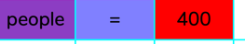
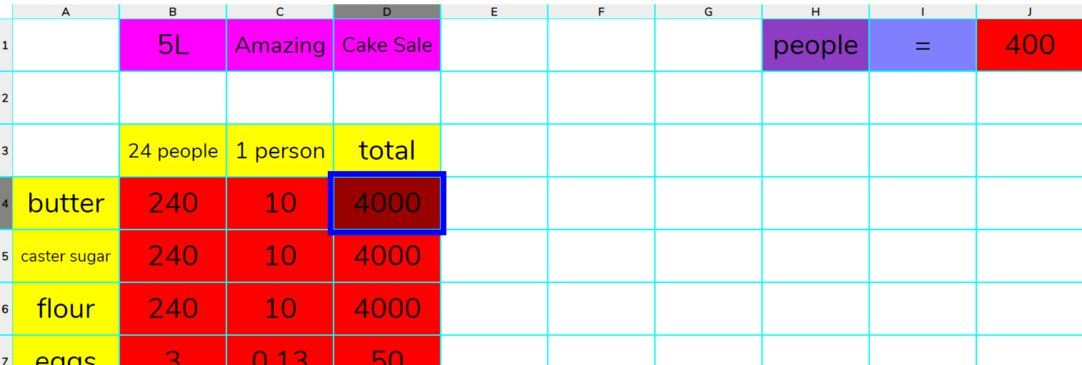

Activity 3: Calculating Amount of Ingredients for Desired Number of People
Slide 7
We now need to work out amount of ingredients for the desired number of people (cupcakes) we decided upon.
Step 1: Set a variable called ‘people’ equal to the desired amount. For example:
Using a variable means that we can update the people cell and the recipe will automatically update.
Step 2: Enter formula in the column for total that will work out ingredients needed for the number of people.
The formula is the number for 1 person multiplied by the variable of people.
Need more support? Contact us:
Tel: +44(0)208 203 1781 | Email: support@2simple.com | Twitter: @2simplesoftware
Notes:
Display slide 7. Explain that we need to create a variable called ‘people’ and set this to the amount we decided. Children to create variable then show children how to create a formula which calculates the amount of each item needed for the number set in the variable.

Slide 8
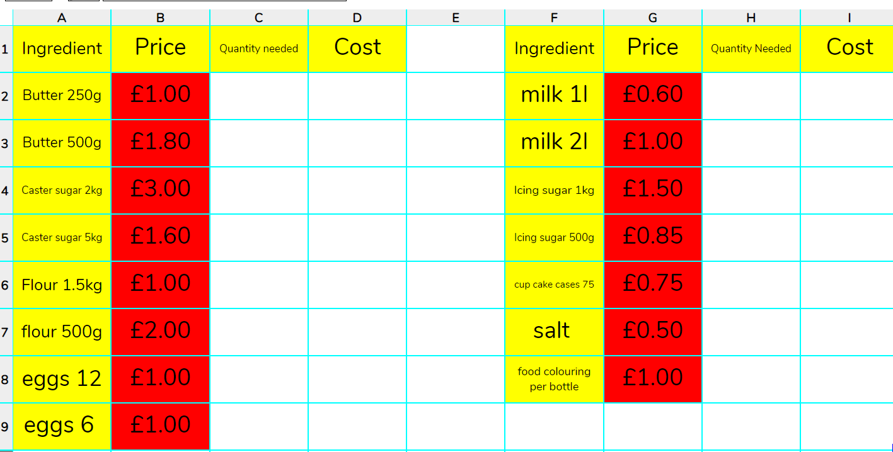
Activity 4: Finding Prices of Ingredients
Slide 8
We now need to find the prices of ingredients. It may be best to save your spreadsheet and open another spreadsheet in a separate tab so you can refer to each one as needed.
Step 1: Research prices of ingredients or use the price list on the example file.
Step 2: Enter the data (prices) and place the following headings on your spreadsheet.
Need more support? Contact us:
Tel: +44(0)208 203 1781 | Email: support@2simple.com | Twitter: @2simplesoftware
Notes:
Display slide 8. Children to save their spreadsheet and open a new ‘Advanced Mode’ spreadsheet in a new tab. Children to enter prices of ingredients as modelled on slide. Either allow children to research the prices of ingredients or provide them with the example spreadsheet to use.

Slide 9
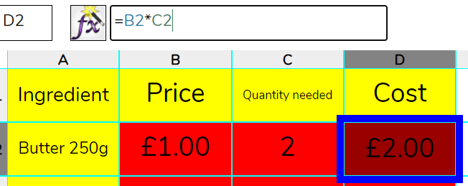
Activity 5: Calculating Costs
Slide 9
We can now start calculating the cost of all the ingredients for the number of people (cupcakes) we decided upon.
Step 1: Work out the quantities needed for each ingredients. You will need to look back at your previous spreadsheet. Then enter the quantities.
Step 2: Add formulas to calculate quantity multiplied by price. *Remember you can copy and paste.
Need more support? Contact us:
Tel: +44(0)208 203 1781 | Email: support@2simple.com | Twitter: @2simplesoftware
Notes:
Use slide 9 to explain that the children need to start calculating the cost of the ingredients needed. Children to refer to their previous spreadsheet to help them work out the quantity of each ingredient needed. Children to then add formulas into a ‘Cost’ column that multiplies the ingredient price by the quantity needed.

Slide 10
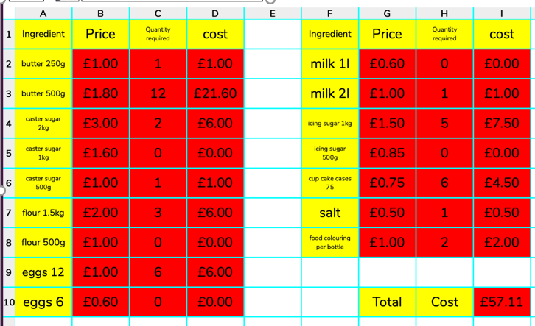
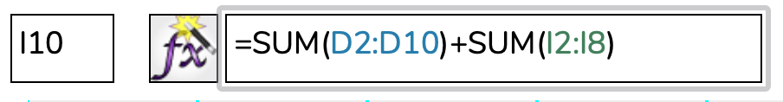
Activity 5: Calculating Costs
Slide 10
Step 3: Use a formula to work out the total cost of making the cakes. To do this you will need to add all the cost columns up.
In cell I10 (the total cost) is calculated like this because the totals for each ingredient are in more than one column.
Need more support? Contact us:
Tel: +44(0)208 203 1781 | Email: support@2simple.com | Twitter: @2simplesoftware
Notes:
Use slide 10 to explain to the children how to calculate the total cost of making the cakes. Note that if the cost of ingredients is in more than one column, the formula used must add both sums of each column together as shown on the slide.

Slide 11
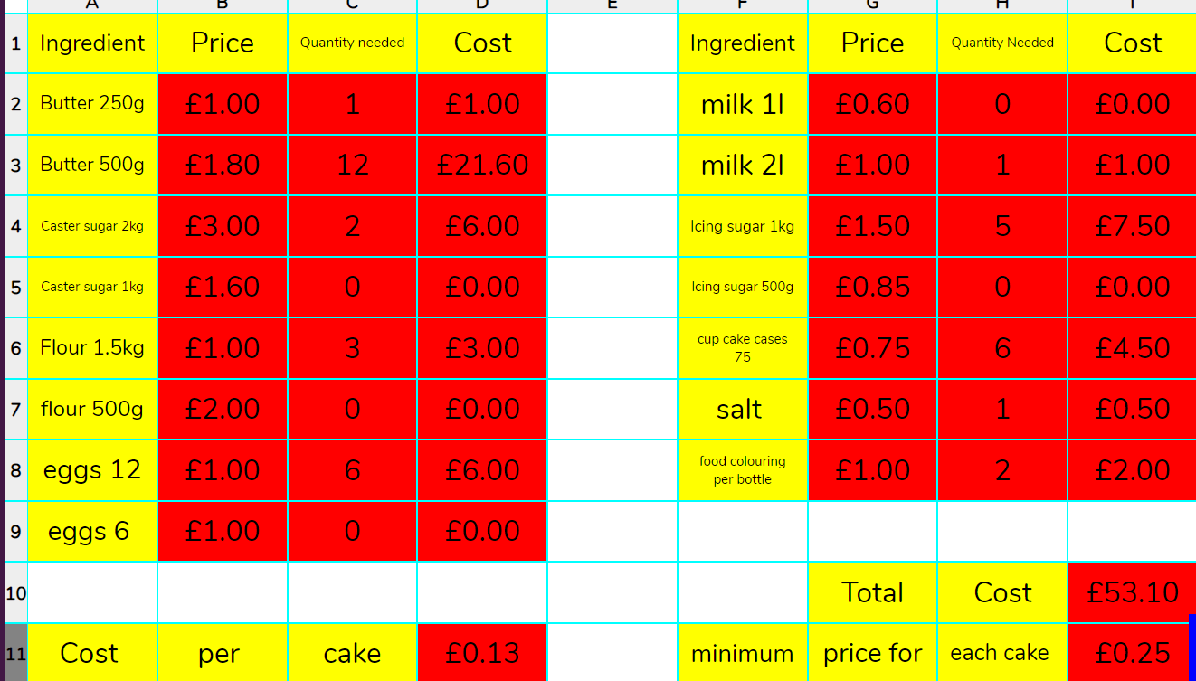


Activity 6: Finding Operating Cost and Profit
Slide 11
We need to find the cost of making one cupcake and decide on the profit we wish to make.
Step 1: Calculate cost per a cake. To do this you will need to divide the total cost by the number of people (cupcakes).
Step 2: Now decide on the profit you wish to make for each cake. For example, if you wanted 12p profit per a cake, you would create a formula that added 12p to the cost per a cake.
Need more support? Contact us:
Tel: +44(0)208 203 1781 | Email: support@2simple.com | Twitter: @2simplesoftware
Notes:
Display slide 11. Explain that we need to work out the profit we want to make on each cupcake. To do this we need to calculate the cost of making one cupcake. Support children in working out that we divide the total cost by the number of people (cupcakes) needed. Children add appropriate formula as shown on slide. Then decide on the profit for each cake and create a formula e.g. 12pence profit + cost of making cake as shown on slide.

Slide 12
Review Success Criteria
Slide 12
I can use a spreadsheet to model a real-life situation and come up with solutions that can be practically applied.
Need more support? Contact us:
Tel: +44(0)208 203 1781 | Email: support@2simple.com | Twitter: @2simplesoftware
Notes:
Display slide 12. Review the success criteria from slide 3. Children could rate how well they achieved this using a show of hands.

