Slide 1

Lesson 3:
Computing Scheme of Work
Unit 5.3 - Spreadsheets
Formulae Including the Advanced Mode
Notes:
Resources
Unless otherwise stated, all resources can be found on the main unit 5.3 page. From here, click on the icon to set a resource as a 2Do for your class. Use the links below to preview the resources; right-click on the link and ‘open in new tab’ so you do not lose this page.
2Calculate – found in the Maths tools section of Purple Mash.
Cuboids Example - Extension

Slide 2


Aims
Slide 2
To use a spreadsheet to model a real-life problem.
To use formulae to calculate area and perimeter of shapes.
Need more support? Contact us:
Tel: +44(0)208 203 1781 | Email: support@2simple.com | Twitter: @2simplesoftware
Notes:
Display slide 2 and outline the lesson aims.

Slide 3
Success Criteria
Slide 3
Children can use a spreadsheet to work out the area and perimeter of rectangles.
Children can use these calculations to solve a real-life problem.
Need more support? Contact us:
Tel: +44(0)208 203 1781 | Email: support@2simple.com | Twitter: @2simplesoftware
Notes:
Display slide 3 and outline the success criteria.

Slide 4
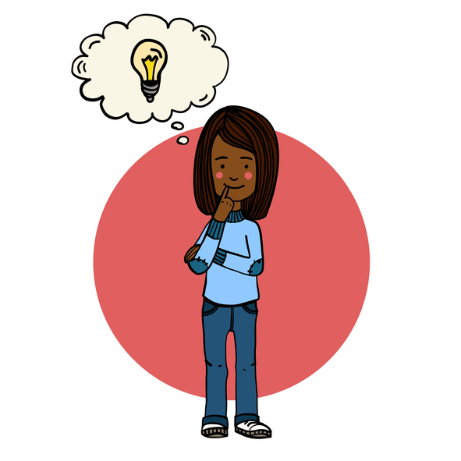

Introduction: Modelling
Slide 4
Today we are going to be using ‘Computer Modelling’ to help solve a problem.
What is Modelling?
Key Tools & Vocabulary
Modelling in Computing means creating or using a model or simulation of a real-life situation, on a computer.
Formula: A formula can be used to perform calculations on cells such as working out area.
A formula can be copied to save time.
For example, we could start by creating a page in 2Calculate which added up how much money we made by selling 3 pizzas for 25p and 2 apples for 10p. We could then use 2Calculate to explore what would happen if we changed parts of the model—by putting up the prices.
Changing certain values within the page and seeing what happens is what is meant by modelling.
Area: This is the term used to describe the amount of space taken up by a flat shape or surface. For example the size of a field. Simple shapes like rectangles can have area calculated by multiplying length x width.
Perimeter: Is the term used to describe all the sides lengths added up. For example, to work out perimeter of a rectangle we can add up all its sides lengths.
Need more support? Contact us:
Tel: +44(0)208 203 1781 | Email: support@2simple.com | Twitter: @2simplesoftware
Notes:
Display slide 4. Explain that we will be using computer modelling to solve a problem. Ask the children what is meant by computer modelling and if they can give an example, before revealing. Share the key vocabulary and tools needed for the lesson.

Slide 5
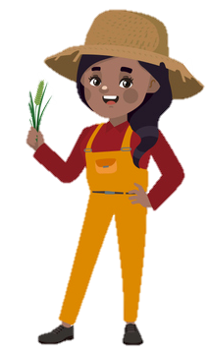
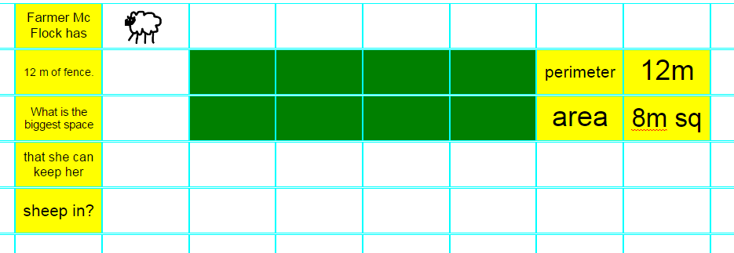
Activity 1: Helping Farmer McFlock
Slide 5
Let’s help solve a problem for farmer McFlock.
Farmer McFlock keeps sheep and each sheep needs at least 1m² of space in the field. She wants to know the maximum number of sheep that can be kept with 12m of fence.
Step 1: Open a new ‘Advanced Mode’ 2Calculate sheet and recreate what is shown here. Remember to colour 8 cells.
We can see that the maximum number of sheep that can fit with this configuration is 8.
NB this is not to scale; each cell height or width represents 1m.
Need more support? Contact us:
Tel: +44(0)208 203 1781 | Email: support@2simple.com | Twitter: @2simplesoftware
Notes:
Display slide 5. Explain the farmer’s problem and discuss with the children. Ask the children to open a new ‘Advanced Mode’ sheet and recreate what is shown on the slide. Elicit that the maximum number of sheep with the current configuration that can be kept is 8.

Slide 6

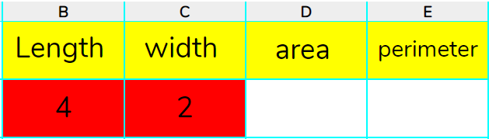


Activity 1: Helping Farmer McFlock
Slide 6
We could use formula to help us work out the configuration of the fence that will give the maximum number of sheep for 12m of fencing.
Step 2: Find a space on your sheet and enter the following heading.
We can enter formula to solve area and also perimeter.
Step 3: Enter the length and width.
Area = length x width
Perimeter =(2xlength)+(2xWidth)
Need more support? Contact us:
Tel: +44(0)208 203 1781 | Email: support@2simple.com | Twitter: @2simplesoftware
Notes:
Display slide 6. Explain we can use formula to help work out the maximum number of sheep for 12m of fencing. Remind children about how to calculate area and perimeter. Children to create headings shown on their sheet and attempt entering formula that calculates area and perimeter. Example formula shown on slide. See if the children can find the best configuration.

Slide 7
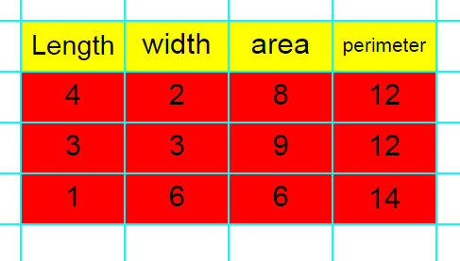
Activity 2: Changes to Fence Length
Slide 7
Can you experiment with different size fences and find the best configuration to achieve the maximum amount of sheep for the fence length?
Step 1: Add to your table and use formula for area and perimeter. You could try copying and pasting it.
Step 2: Try the following fence lengths:
Fence lengths – 14m, 18m, 20m, 24m.
Need more support? Contact us:
Tel: +44(0)208 203 1781 | Email: support@2simple.com | Twitter: @2simplesoftware
Notes:
Display slide 7. Remind children to save their file before continuing. Explain you want the children to add to their table as shown on the slide. Children to copy and paste formula for area and perimeter in the respective columns and find the best length and width configurations for the new fence lengths given on the slide.

Slide 8
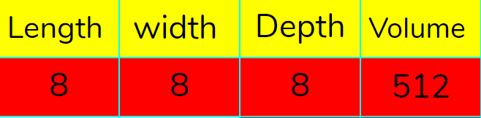

Activity 3 : Extension
Slide 8
Can you calculate volumes of cuboids using a spreadsheet?
Step 1: Launch the example file of cuboids.
Step 2: Create the following headings on a new 2Calculate ‘Advanced Mode’ file.
Step 3: Enter the first shape’s (Cube) dimensions.
Step 4: Enter the correct formula into the volume column cells.
Hint
Have you noticed any mathematical patterns?
Need more support? Contact us:
Tel: +44(0)208 203 1781 | Email: support@2simple.com | Twitter: @2simplesoftware
Notes:
Display slide 8 to introduce an extension activity where children calculate volume of cuboids shown on example file.

Slide 9
Review Success Criteria
Slide 9
I can use a spreadsheet to work out the area and perimeter of rectangles.
I can use these calculations to solve a real-life problem.
Need more support? Contact us:
Tel: +44(0)208 203 1781 | Email: support@2simple.com | Twitter: @2simplesoftware
Notes:
Display slide 9. Review the success criteria from slide 3. Children could rate how well they achieved this using a show of hands.

