Slide 1
MULTIPLY 2-DIGITS (AREA MODEL)

Slide 3
7 × 6 =
70 × 6 =
60 × 7 =
70 × 60 =

Slide 4
7 × 6 =
70 × 6 =
60 × 7 =
70 × 60 =
42
10 times the size
10 times the size
420
420
4,200
10 times the size
10 times the size
100 times the size
7 × 6 = 42

Slide 6

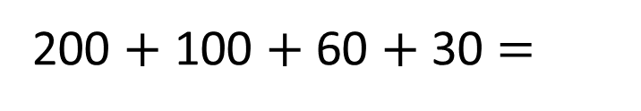
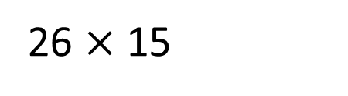
26 $×$ 15
20
6
$$×$$
200
10
60
100
5
30
200 $+$ 100 $+$ 60 $+$ 30 $=$
390

Slide 7




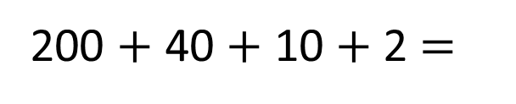

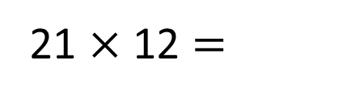
21 $×$ 12 $=$
252
$$×$$
$$×$$
20
1
10
200
10
2
40
2
200 $+$ 40 $+$ 10 $+$ 2 $=$
252

Slide 8

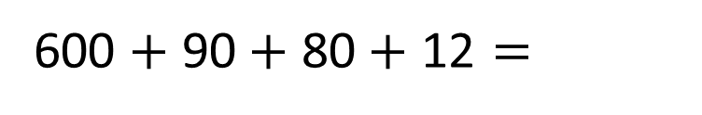
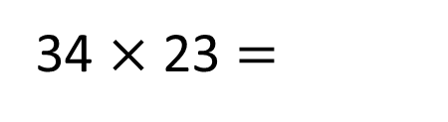
34 $×$ 23 $=$
782
$$×$$
30
4
20
600
80
3
90
12
600 $+$ 90$+$ 80$+ \text{12}=$
782

Slide 9

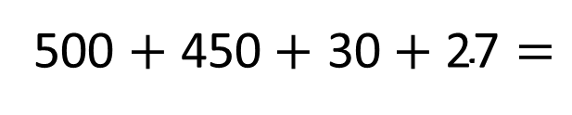
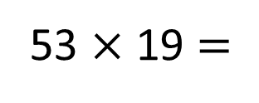
Have a think
53 $×$ 19 $=$
1,007
$$×$$
50
3
10
500
30
9
450
27
500 $+$ 450$+$ 30$+ \text{27}=$
1,007

Slide 10
Have a go at questions
5 - 7 on the worksheet

Slide 11
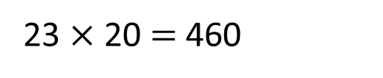
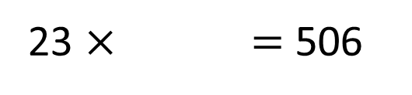
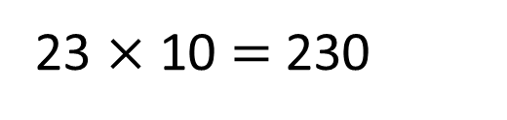
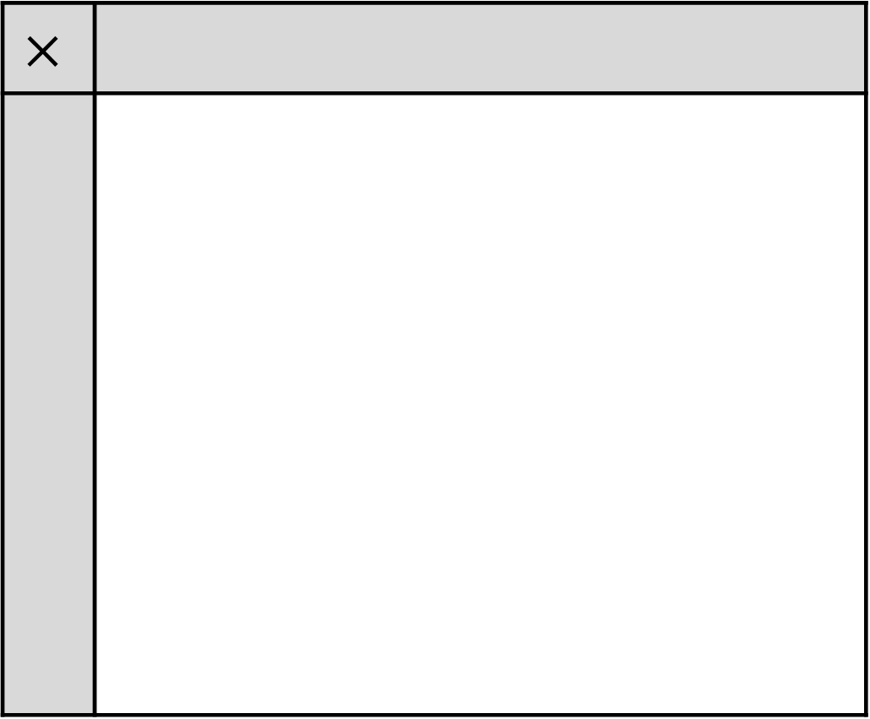
23 $×$ $=$ 506
Have a think
$$×$$
23 $×$ 10 $=$ 230
23 $×$ 20 $=$ 460

Slide 12
22
23 $×$ $=$ 506
$$×$$
500
6

Slide 13
Have a go at questions
8 - 9 on the worksheet

