Slide 1
MULTIPLY 2-DIGITS (AREA MODEL)

Slide 3




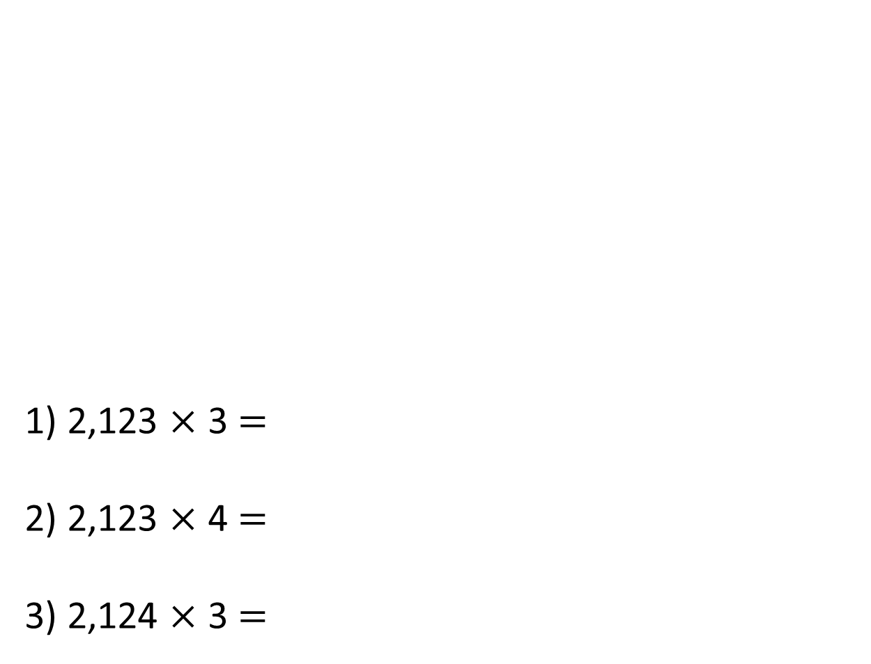
Thousands | Hundreds | Tens | Ones
1) 2,123 $×$ 3 $=$
2) 2,123 $×$ 4 $=$
3) 2,124 $×$ 3 $=$

Slide 4
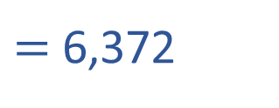
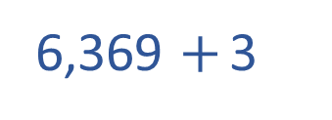
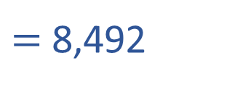
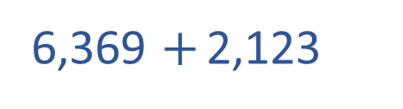
Thousands | Hundreds | Tens | Ones
1) 2,123 $×$ 3 $=$
2) 2,123 $×$ 4 $=$
3) 2,124 $×$ 3 $=$
6,369
6,369 $+$ 2,123
$=$ 8,492
6,369 $+$ 3
$=$ 6,372

Slide 6
12 cm
10 cm
2 cm
5 cm
10 × 5 =
50
2 × 5 =
10
12 × 5 =
2
60 cm
50 + 10 =
60

Slide 7
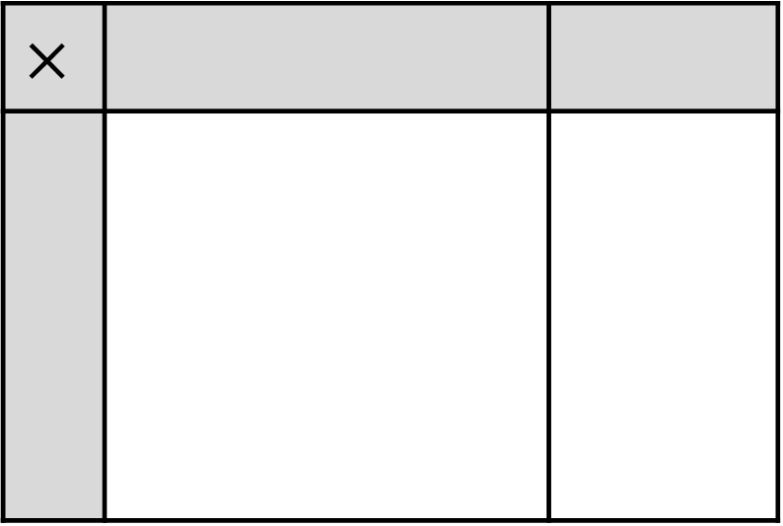
12
10
2
$$×$$
5
There are 10 ones altogether.
There are 5 tens altogether.
There are 6 tens altogether.
60

Slide 8
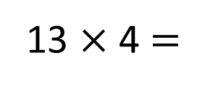

13 $×$ 4 $=$
52
10
3
$$×$$
4
There are 12 ones altogether.
There are 2 ones altogether.
There are 4 tens altogether.
There are 5 tens altogether.

Slide 9
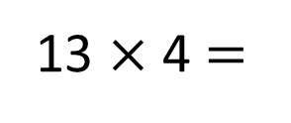
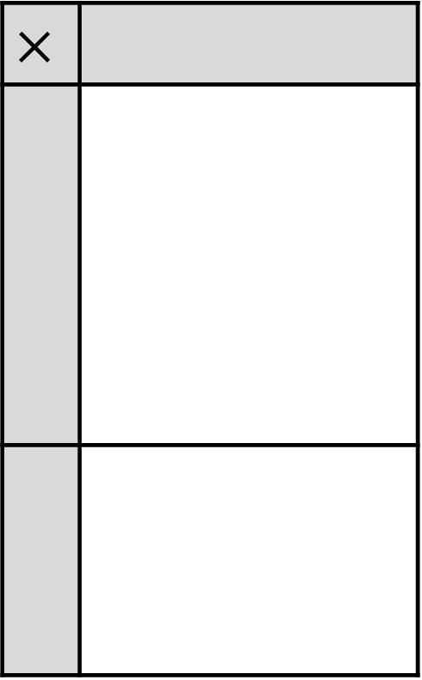
13 $×$ 4 $=$
52
4
$$×$$
10
3

Slide 10

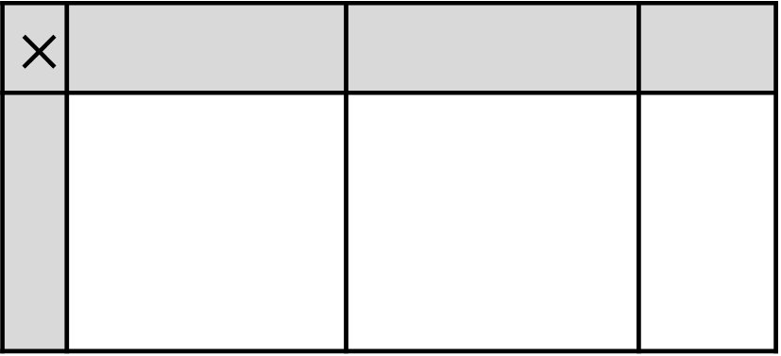
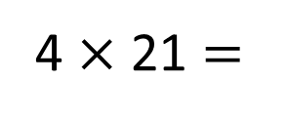
Have a think
4 $×$ 21 $=$
84
20
1
$$×$$
4

Slide 11
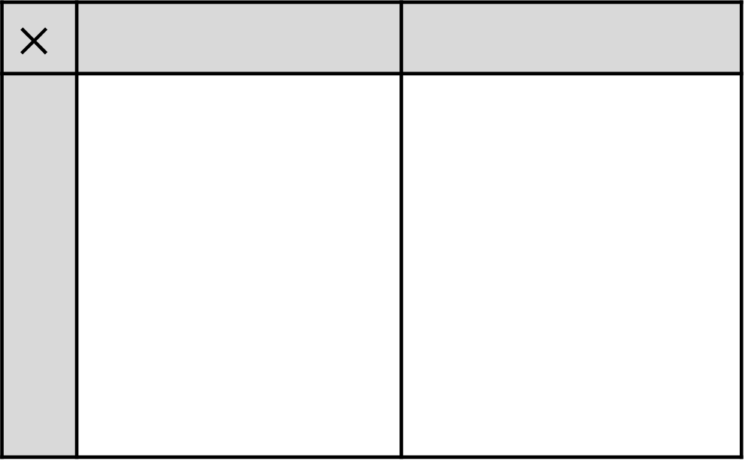
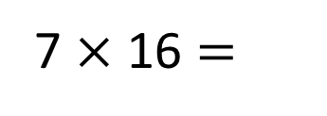
112
10
6
7 $×$ 16 $=$
$$×$$
7
There are 2 ones altogether.
There is 1 ten altogether.
There is 1 hundred altogether.

Slide 12
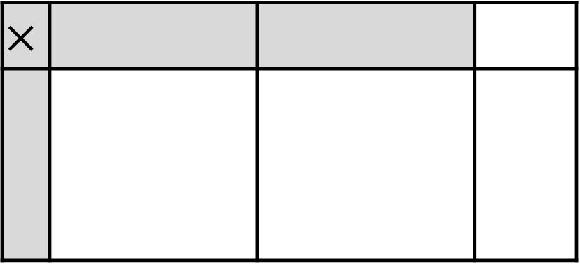
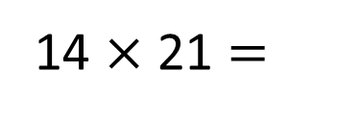

14 $×$ 21 $=$
2
9
4
20
20
1
1
$$×$$
$$×$$
4
10
4

Slide 13
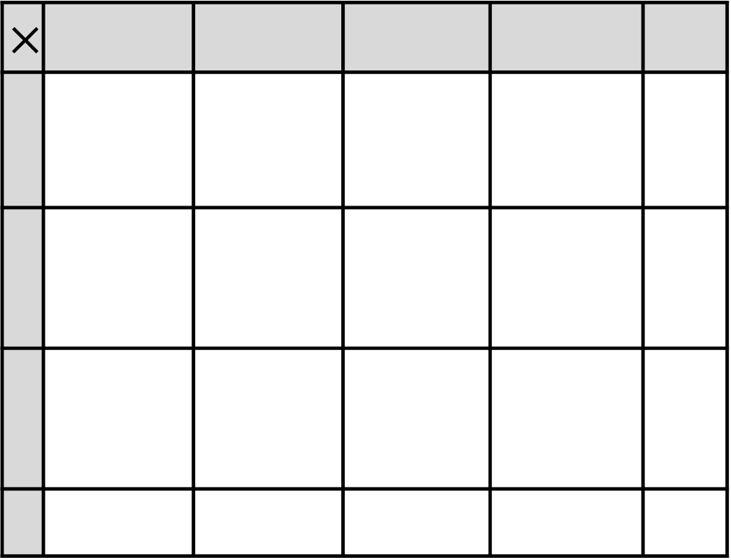
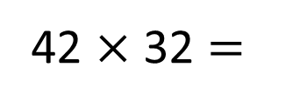
42 $×$ 32 $=$
Have a think
1,
3
4
4
40
2
$$×$$
30
2

Slide 14
Have a go at questions
1 - 4 on the worksheet

