Slide 1
Victorian Inventions
What were the major inventions of the Victorian Period?

Slide 2
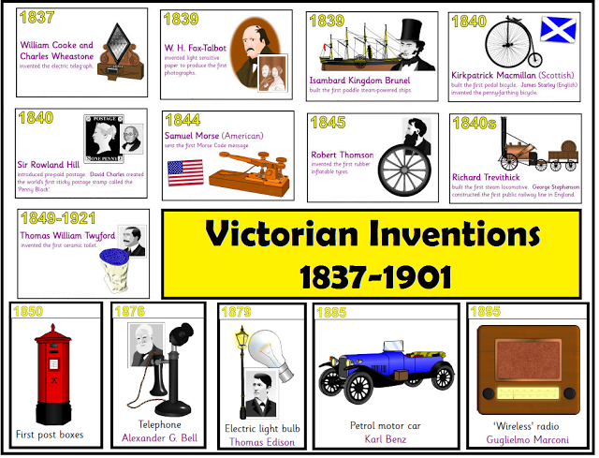
Which invention do you think was the most important and why?

Slide 3

Which invention would have been best to have been support by Dragon’s Den? Why

Slide 4
Make a ‘Dragon’s Den’ ‘bid’
Choose one of the Victorian Inventions.
What would you say to the ‘Dragon’s Den’ panel to make them invest in your invention?

Slide 5
Plenary:
What have you learnt?
When might you use what you’ve learnt again?

