Slide 1

What was life like for climbing boys?
And how do we know?

Slide 2
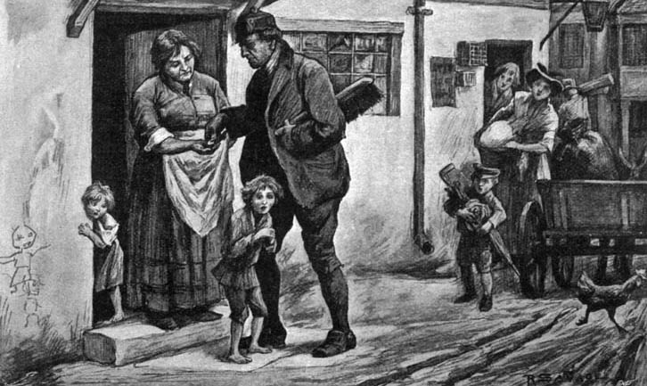
Mystery picture. Can you work out what is being shown?
http://www.bbc.co.uk/schools/primaryhistory/victorian_britain/victorian_children_at_work/

Slide 3
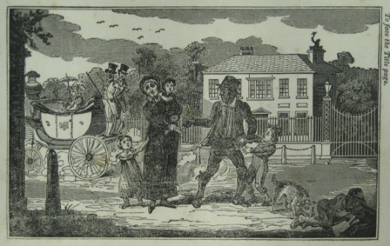
A poor mother is selling her son as an apprentice to a master-sweep, from 'The Chimney Sweep’s Friend and Climbing Boys Album‘.
Does the boy look happy to be going?
Does the title of the book suggest that this picture wants us to feel sorry for him?
Why do you think this picture was produced?

Slide 4
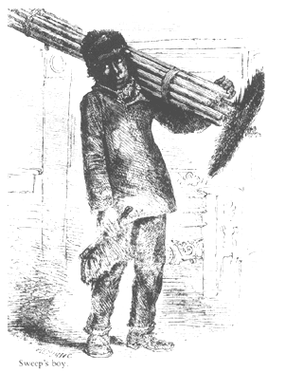

Slide 5
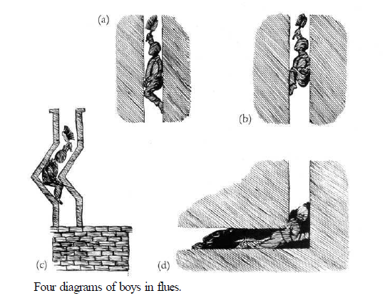

Slide 6
The master sweep had duties: to teach the craft and its mysteries, to provide the apprentice with a second suit of clothes, to have him cleaned once a week, allow him to attend church, and not send him up chimneys that were on fire. An apprentice agreed to obey his master.
Once his seven year long apprenticeship was completed he would become a journeyman sweep, and would continue to work for a master sweep of his choice. Other apprentices were sold on to the sweep, or sold by their parents.

Slide 7
A popular website called Wikipedia
In the United Kingdom, the master sweeps took apprentices, who were boys from the workhouse or bought them from their parents and trained them to climb chimneys. Boys as young as four climbed hot flues that could be as narrow as 9 inches square. Work was dangerous and they could get jammed in the flue, suffocate or burn to death.

Slide 8
Witness William Cooper, 1819
What did you feel upon the first attempt to climb a Chimney? - The first Chimney I went up, they told me there was some plum-pudding and money up at the Top of it, and that is the Way they enticed me up; and when I got up, I would not let the other Boy get from under me to get at it, I thought he would get it; I could not get up, and shoved the Pot and Half the Chimney down into the Yard.

Slide 9
William Cooper’s evidence- 2
What sort of place do you sleep in? - Very bad indeed, some have no more than One Blanket, some a Bit of Straw, and some a few Sacks to lie on.
Where do they generally sleep? - In the Cellar, and up in the Loft.
When they sleep in the Cellar, is the soot put into the same Place? - Yes, always.
What Sort of Clothing are they generally allowed? - According to the Masters; some Masters look after the boys pretty well as to giving them Clothes: other Masters altogether keep them months and months before they are washed to the skin.

Slide 10
1834 - Chimney Sweeps Act
The law now says that you had to be at least 10 years old to an apprenticeship chimney sweep

Slide 11
Another law to stop boys going up chimneys
A law of 1840 made it an offence, punishable by a fine, to send anyone under the age of 21 up a chimney to sweep it and the minimum age for sweeps’ apprentices was raised to 16.

Slide 12
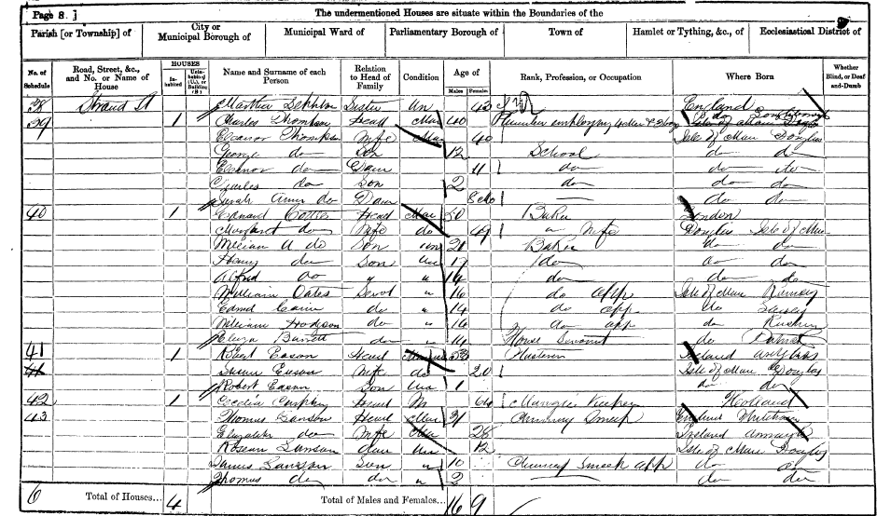


Slide 13
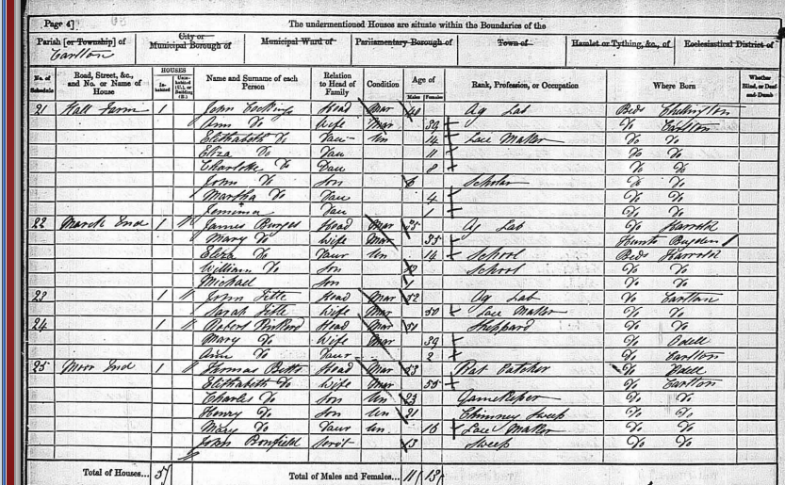
1861 census

Slide 14
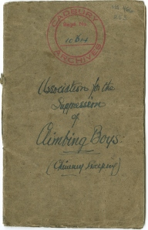
Inside this pamphlet (Association for the Suppression of climbing boys) Richard writes:
The sufferings I endured then and subsequently I would not again repeat for any amount of wealth. I was forced up chimneys in a state of complete nudity, sometimes two or three times a day, and my bed for those ten years consisted of straw and soot-bags.
http://birminghamchildrenslives.wordpress.com/tag/chimney-sweeps/

Slide 15

In 1863 the publication of 'The Water-Babies', a novel by Charles Kingsley, did much to raise public awareness about the gross mistreatment of children in this kind of employment through its central character, Tom, a child chimney sweep.

Slide 16
Finally
In 1875 the police were given powers to make sure no young boys went up chimneys again.
Instead work was carried out by special machines as you can see on the next slide.

Slide 17
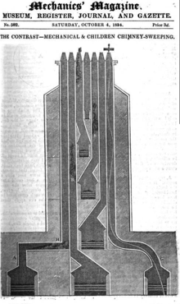
Then they started to use machines rather than boys.

Slide 18
The Chimney Boy's Story
Inside the chimney, high I climb.
It's dark inside the sooty stack.
I lose all sense of passing time.
Inside the chimney,
high I climb.
Inside the chimney, high I climb.
Far, far above .... a patch of blue
where one white cloud drifts into view.
I stop to rest, but that's a crime.
Inside the chimney,
high I climb.
Inside the chimney, high I climb.
My bare feet slip on crumbling bricks.
I clear rooks' nests - dead leaves and sticks.
The master yells, 'Get working, brat!'
I'm starved. Sometimes I eat a stewed rat.
Soots's in my hair. I'm tasting grime.
Inside the chimney,
high I climb.
Wes Magee

