Slide 1

What was life like for climbing boys?
And how do we know?

Slide 2
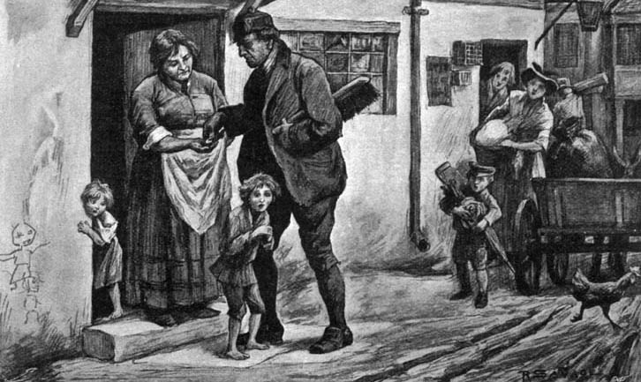
Mystery picture. Can you work out what is being shown?
http://www.bbc.co.uk/schools/primaryhistory/victorian_britain/victorian_children_at_work/

Slide 3
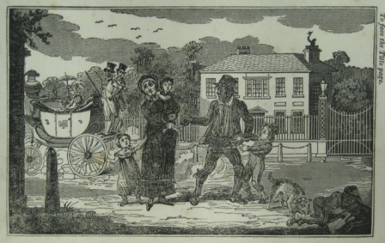
A poor mother is selling her son as an apprentice to a master-sweep, from 'The Chimney Sweep’s Friend and Climbing Boys Album‘.
Does the boy look happy to be going?
Does the title of the book suggest that this picture wants us to feel sorry for him?
Why do you think this picture was produced?

Slide 4
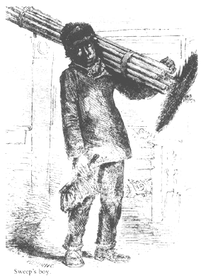
The Chimney Boy's Story
Inside the chimney, high I climb.
It's dark inside the sooty stack.
I lose all sense of passing time.
Inside the chimney,
high I climb.
Inside the chimney, high I climb.
Far, far above .... a patch of blue
where one white cloud drifts into view.
I stop to rest, but that's a crime.
Inside the chimney,
high I climb.
Inside the chimney, high I climb.
My bare feet slip on crumbling bricks.
I clear rooks' nests - dead leaves and sticks.
The master yells, 'Get working, brat!'
I'm starved. Sometimes I eat a stewed rat.
Soots's in my hair. I'm tasting grime.
Inside the chimney,
high I climb.
Wes Magee

