Slide 1


Slide 3
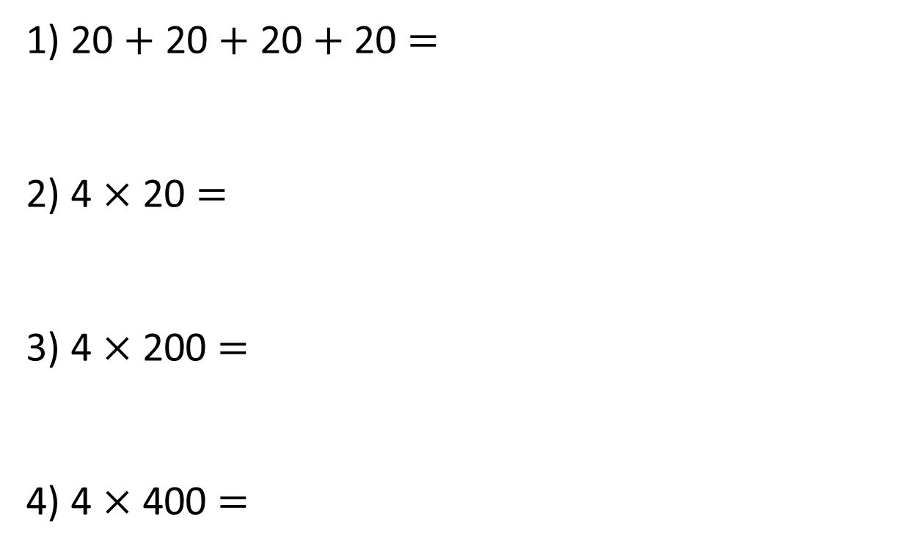
1) 20 $+$ 20 $+$ 20 $+$ 20 $=$
2) 4 $×$ 20 $=$
3) 4 $×$ 200 $=$
4) 4 $×$ 400 $=$

Slide 4

1) 20 $+$ 20 $+$ 20 $+$ 20 $=$
2) 4 $×$ 20 $=$
3) 4 $×$ 200 $=$
4) 4 $×$ 400 $=$
80
80
800
1,600
4 $×$ 200 $×$ 2

Slide 6





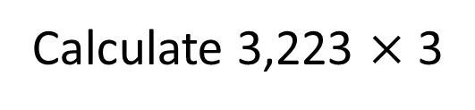
Calculate 3,223 $×$ 3
Thousands | Hundreds | Tens | Ones
Th | H | T | O
3 | 2 | 2 | 3
 |  |  | 3
$$×$$
9
6
6
9
9,669

Slide 7


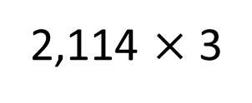

There are 2,114 seats in a theatre. The theatre is fully
booked for 3 shows. How many people attend overall?
2,114 $×$ 3
Thousands | Hundreds | Tens | Ones
Th | H | T | O
2 | 1 | 1 | 4
 |  |  | 3
$$×$$
6
3
4
2
1
Have a think
6,342 people attend

Slide 8


2,420 $×$ 4 $=$ 968
Thousands | Hundreds | Tens | Ones
Have a think

Slide 9

2,420 $×$ 4 $=$ 968
Thousands | Hundreds | Tens | Ones
Th | H | T | O
 | 2 | 4 | 2
 |  |  | 4
$$×$$
9
6
8
1

Slide 10

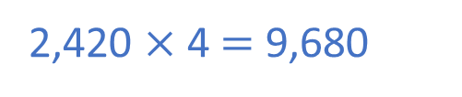
2,420 $×$ 4 $=$ 968
Thousands | Hundreds | Tens | Ones
Th | H | T | O
2 | 4 | 2 | 0
 |  |  | 4
$$×$$
9
6
8
0
1
2,420 $×$ 4 $=$ 9,680

Slide 11
Have a go at questions
1 - 4 on the worksheet

Slide 12
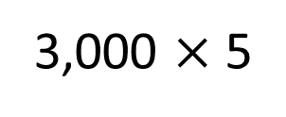
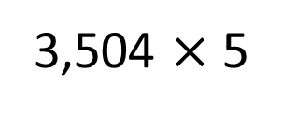
TTh | Th | H | T | O
3,504 $×$ 5
3,000 $×$ 5
TTh | Th | H | T | O
 | 3 | 5 | 0 | 4
 |  |  |  | 5

Slide 13

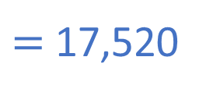
TTh | Th | H | T | O
3,504 $×$ 5
$=$ 17,520
TTh | Th | H | T | O
 | 3 | 5 | 0 | 4
 |  |  |  | 5
1
7
5
2
0
1
2
2

Slide 14
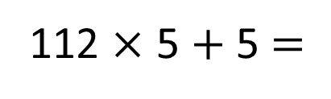
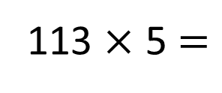
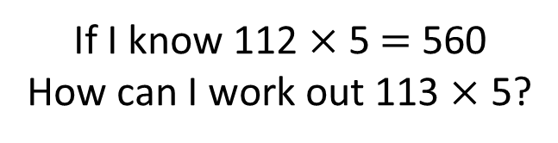
If I know 112 $×$ 5 $=$ 560
How can I work out 113 $×$ 5?
113
112
5
560
5
113 $×$ 5 $=$
112 $×$ 5 $+$ 5 $=$
565

Slide 15
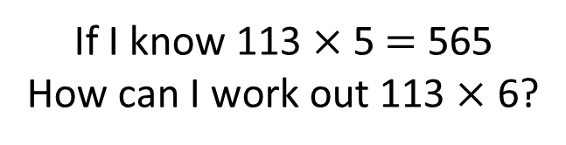
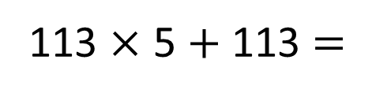
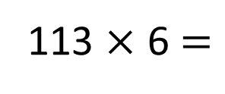
If I know 112 $×$ 5 $=$ 560
How can I work out 113 $×$ 5?
If I know 113 $×$ 5 $=$ 565
How can I work out 113 $×$ 6?
113
112
5
565
6
560
5
113
113 $×$ 5 $=$
112 $×$ 5 $+$ 5 $=$
565
113 $×$ 6 $=$
113 $×$ 5 $+$ 113 $=$
678

Slide 16
Have a go at questions at the rest of the worksheet

