Slide 1

Lesson 2:
Computing Scheme of Work
Unit 5.3 - Spreadsheets
The Count Tool
Notes:
Resources
Unless otherwise stated, all resources can be found on the main unit 5.3 page. From here, click on the icon to set a resource as a 2Do for your class. Use the links below to preview the resources; right-click on the link and ‘open in new tab’ so you do not lose this page.
2Calculate – found in the Maths tools section of Purple Mash.
Example Vowel Counter (import text to enable it to function).
Example Vowel and Consonant Counter (import text to enable it to function).

Slide 2


Aim
Slide 2
To use the count tool to answer hypotheses about common letters in use.
Need more support? Contact us:
Tel: +44(0)208 203 1781 | Email: support@2simple.com | Twitter: @2simplesoftware
Notes:
Display slide 2 and outline the lesson aims.

Slide 3
Success Criteria
Slide 3
Children can use a spreadsheet to work out which letters appear most often.
Children can use the ‘how many’ tool.
Need more support? Contact us:
Tel: +44(0)208 203 1781 | Email: support@2simple.com | Twitter: @2simplesoftware
Notes:
Display slide 3 and outline the success criteria.

Slide 4


Introduction: Investigations
Slide 4
We are going to see how spreadsheets can also be used for literacy and carrying out investigations.
Before we continue, let’s look at today’s key vocabulary and tools.
In this lesson, we will be testing out a hypothesis about which letters are most commonly used in the English language.
Key Tools & Vocabulary
Advance Mode: A mode in 2Calculate that displays cell references and formulae.
‘How Many?’ Tool:
This tool counts how many of a variable there are in a spreadsheet.
Variable: In today’s lesson, the ‘How Many?’ tool will count different letters, these letters are all variables.
We will start off by asking: Is ‘e’ is the most common vowel?
Need more support? Contact us:
Tel: +44(0)208 203 1781 | Email: support@2simple.com | Twitter: @2simplesoftware
Notes:
Display slide 4. Explain that spreadsheets can be used for carrying out investigations. Reveal the lesson’s key tools and vocabulary. Then share the hypothesis you want the children to test: Is ‘e’ the most popular vowel in English?

Slide 5
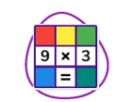
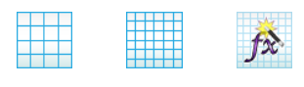

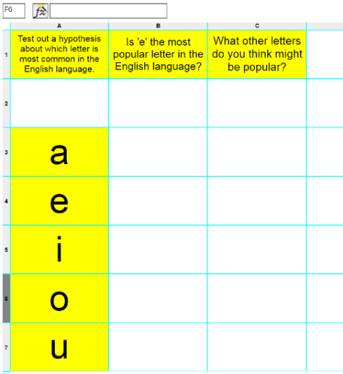
Activity 1: Creating a Vowel Counter
Slide 5
Let’s make a vowel counter spreadsheet that will enable us to test if ‘e’ really is the most popular vowel.
Vowel Counter Example
Open a new 2Calculate file in ‘Advance Mode’ on your devices.
Can you remember how to make your spreadsheet bigger? Try adding a few more cells.
Create a spreadsheet like the following picture.
Any yellow coloured cell that has letters ‘a’ ‘e’ ‘i’ ‘o’ ‘u’ in will be counted.
Need more support? Contact us:
Tel: +44(0)208 203 1781 | Email: support@2simple.com | Twitter: @2simplesoftware
Notes:
Show slide 5. Ask the children to open a new ‘Advance Mode’ 2Calculate file on their devices. Then they need to copy the example displayed or you could launch the example spreadsheet.

Slide 6
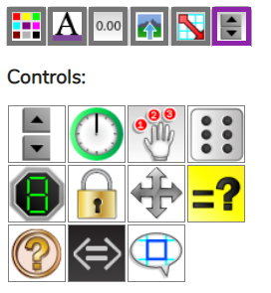

Activity 1: Creating a Vowel Counter
Slide 6
The vowels are the variables and we want the spreadsheet to count them.
If we click on the cell next to the letter (a) and add a ‘How Many Tool’, the tool will count the number of times the letter (a) appears on the spreadsheet except for the one next to it.
Have a go at doing this for the rest of the vowels and then type some words in the empty cells above.
Is ‘e’ the most common vowel so far?
Need more support? Contact us:
Tel: +44(0)208 203 1781 | Email: support@2simple.com | Twitter: @2simplesoftware
Notes:
Show slide 6. Explain that the vowels are the variable we want the spreadsheet to count. Reveal the slide to demonstrate adding a count tool next to the letter (a) vowel. Then ask children to do the same for all vowels on their sheet. Children then test typing words or sentences on the empty cells above the counters to see if ‘e’ is the most common vowel. Children to save their file.

Slide 7
Activity 2: Adding Consonant Counters
Slide 7
We are going to now add consonants to our counting spreadsheet. Let’s look at the example spreadsheet together.
Vowel & Consonant Counter Example
Have a go at adding consonant counters on your spreadsheet.
Add some sentences for the tools to count. You could type these in or copy and paste from a suitable website such as an online encyclopedia.
What are the most popular letters?
What are the least popular letters?
Would different genres affect the count?
Need more support? Contact us:
Tel: +44(0)208 203 1781 | Email: support@2simple.com | Twitter: @2simplesoftware
Notes:
Show slide 7. Open the example spreadsheet ‘Vowel & Consonant Counter Example’. Explore it together and then ask the children to add consonant counters to their spreadsheets. Children experiment typing/pasting text and answering questions on the slide. Remind children to save their file.

Slide 8
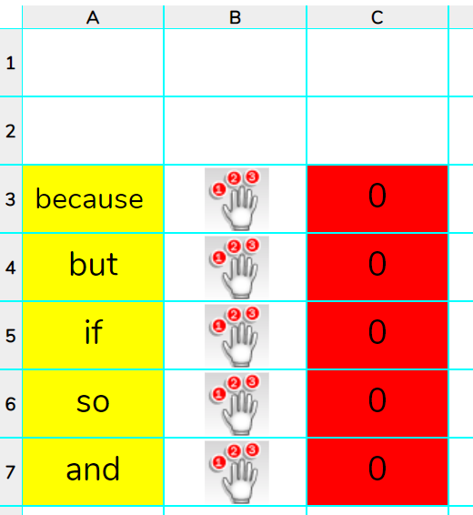
Activity 3 : Extension
Slide 8
Can you create a spreadsheet that counts words?
Conjunctions?
Pronouns?
Verbs?
Your spellings this week?
You could type or paste in the first paragraph of your reading book and see the most popular conjunction are used or how many instances your weekly spellings appear.
Need more support? Contact us:
Tel: +44(0)208 203 1781 | Email: support@2simple.com | Twitter: @2simplesoftware
Notes:
Display slide 8. Explain that 2Calculate could count words. Children explore creating various word class counters such as conjunctions.

Slide 9
Review Success Criteria
Slide 9
I can use a spreadsheet to work out which letters appear most often.
I can use the ‘how many’ tool.
Need more support? Contact us:
Tel: +44(0)208 203 1781 | Email: support@2simple.com | Twitter: @2simplesoftware
Notes:
Display slide 9. Review the success criteria from slide 3. Children could rate how well they achieved this using a show of hands.

