Slide 1

Lesson 1:
Computing Scheme of Work
Unit 5.3 - Spreadsheets
Conversion of Measurements
Notes:
Resources
Unless otherwise stated, all resources can be found on the main unit 5.3 page. From here, click on the icon to set a resource as a 2Do for your class. Use the links below to preview the resources; right-click on the link and ‘open in new tab’ so you do not lose this page.
2Calculate – found in the Maths tools section of Purple Mash.
Example Vowel Counter (import text to enable it to function).
Example Vowel and Consonant Counter (import text to enable it to function).

Slide 2


Aim
Slide 2
To use formulae within a spreadsheet to convert measurements of length and distance.
Need more support? Contact us:
Tel: +44(0)208 203 1781 | Email: support@2simple.com | Twitter: @2simplesoftware
Notes:
Display slide 2 and outline the lesson aims.

Slide 3
Success Criteria
Slide 3
Children can create a formula in a spreadsheet to convert m to cm.
Children can apply this to creating a spreadsheet that converts miles to km and vice versa.
Need more support? Contact us:
Tel: +44(0)208 203 1781 | Email: support@2simple.com | Twitter: @2simplesoftware
Notes:
Display slide 3 and outline the success criteria.

Slide 4

Introduction: Converting Measures
Slide 4
We are going to be using a spreadsheet to convert measures of lengths and distance.
Key Tools & Vocabulary
Why would we need to convert measures of length and distance?
Advance Mode: A mode in 2Calcualte in which the cells have references and can include formulae.
Imperial or Metric = We use two main unit systems. We might understand one system better over the other so will want to convert to the preferred system.
Copy and Paste: A way to copy information from the screen into the computer’s memory and paste it elsewhere
Ease = The length of a carpet might be 2756cm. A carpet fitter might find working with metres easier and a more sensible unit to deal with.
Formula Wizard:
The wizard guides you in creating a variety of formulae for a cell such as calculations, totals, averages, minimum and maximum for the selected cells.
Accuracy = If an appropriate unit of measurement is used there are less likely to be mistakes. E.g. using centimetres for material needed for a table cloth instead of metres.
Need more support? Contact us:
Tel: +44(0)208 203 1781 | Email: support@2simple.com | Twitter: @2simplesoftware
Notes:
Display slide 4. Explain that we will be using a spreadsheet to convert measures of lengths and distance. Discuss why we would need to convert in real-life and reveal possible ideas. Reveal key vocab and tools for today.

Slide 5
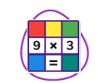
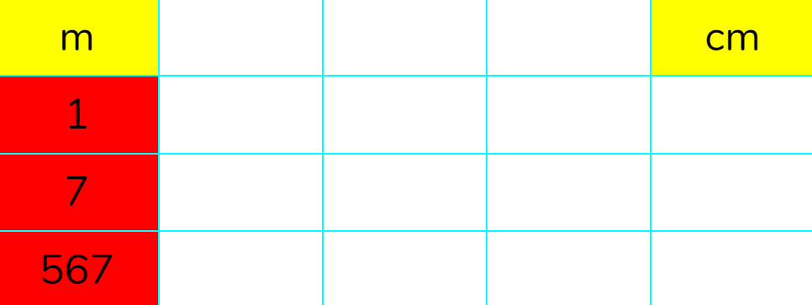
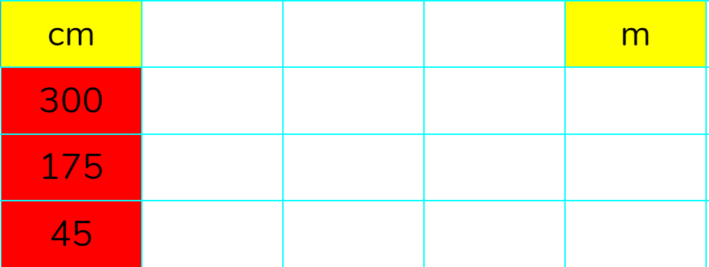

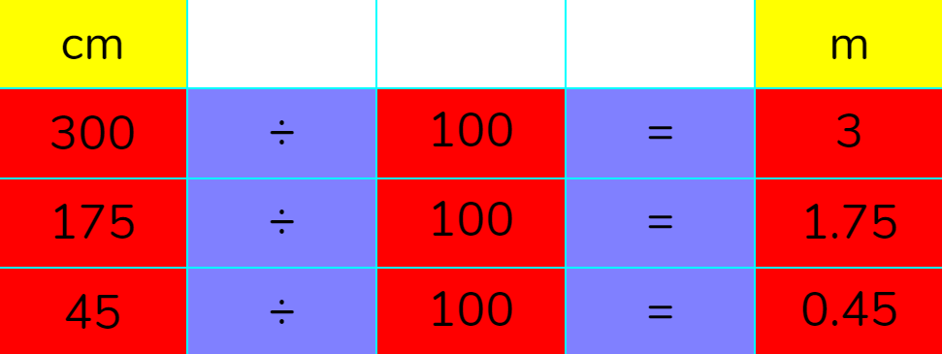
Example Spreadsheet
Slide 5
Let’s take a look at the conversion example spreadsheet and open it on our devices.
Conversion Example
What do you need to do to a measurement in metres, to convert to centimetres?
Can you do the same on your sheets to convert CM to M? (use the / key for divide)
Reveal
Reveal
Once you enter your calculation and include = followed by enter, 2Calculate will calculate the answer.
Need more support? Contact us:
Tel: +44(0)208 203 1781 | Email: support@2simple.com | Twitter: @2simplesoftware
Notes:
Show slide 5. Open the example spreadsheet to show the class and ask them to open on their devices too. Discuss calculation needed to convert between cm and m and click reveal to show the answers. Children then practise on their devices. *When entering = in a cell, children must press enter key.

Slide 6
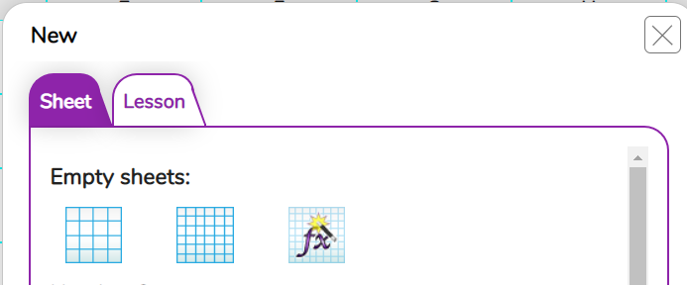
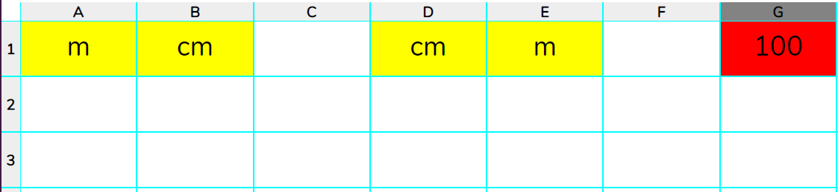

Advanced Mode and Headings
Slide 6
Let’s open a new blank spreadsheet on all our devices in Advanced Mode. We want to use formulas instead of manually entering calculations to convert between units of measure.
Let’s remind ourselves from last year.
Put the following column headings on your spreadsheet:
2Calculate
Click on sheet tab and then on the formula wizard in ‘Empty sheets’.
You can switch between advance and simple mode when in a sheet by clicking this icon.
Need more support? Contact us:
Tel: +44(0)208 203 1781 | Email: support@2simple.com | Twitter: @2simplesoftware
Notes:
Display slide 6. Explain that we want to use formulas to calculate conversions and will need to use advanced mode to do so. Children open 2Calculate advanced mode on their devices and create headings shown on the slide.

Slide 7


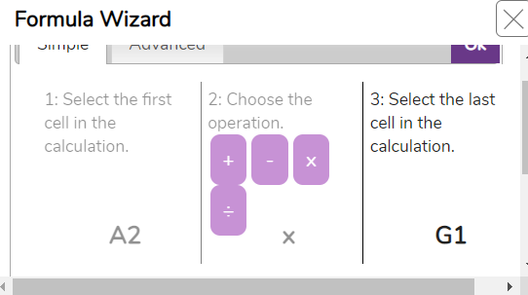
Activity 1: Formula for Converting CM to M
Slide 7
Now we have our headings on a sheet in ‘Advanced mode’, we can start putting some formulas on the sheet, instead of writing out long calculations to convert between units.
Step 1. Click on cell B2. We want the number in this cell to equal the number in cell A2 x 100.
Why do we need to multiply A2 by 100?
Step 2. Click on the formula wizard button.
This will open the wizard in simple mode.
Step 3. Click on cell A2 then choose x as the operator then click on cell G1 (this contains the number 100). Click ‘ok’.
Try entering a number in cell A2. The calculation of the conversion to cm should occur automatically in B2. ’
Need more support? Contact us:
Tel: +44(0)208 203 1781 | Email: support@2simple.com | Twitter: @2simplesoftware
Notes:
Display slide 7. Explain to children that we can start putting some formulas into our sheet. Show children how to put a formula into a cell that calculates a CM conversion from M. Let the children try it out on their sheets, entering different numbers into cell A2 (Metres).

Slide 8
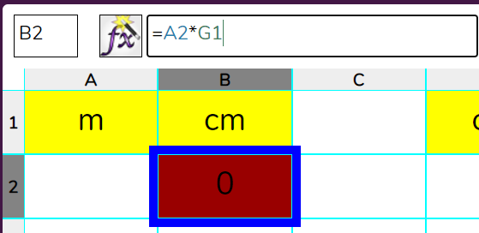



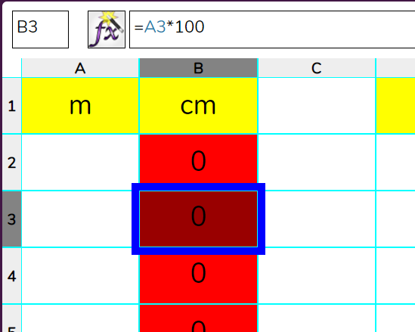
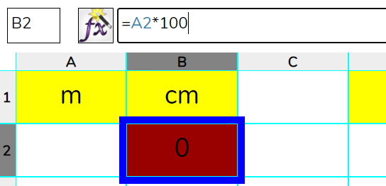
Activity 2: Copying and Pasting Formula
Slide 8
Now it’s your turn to create formula for the rest of column B that would convert M into CM. Copying and pasting formula makes things a lot quicker than manually entering formula for each cell.
The formula in B2 is:
Step 2. Copy cell B2: Click on cell B2 then press + .
Step 3. Now select the rest of column B and then paste
+ .
Your sheet should look something like this. Test it out by putting numbers in Column A.
Step 1. Click on the formula bar and change the text ‘G1’ to the number 100.
Now we have changed it to 100, it means we can copy and paste the formula.
Next see slide 10
Need more support? Contact us:
Tel: +44(0)208 203 1781 | Email: support@2simple.com | Twitter: @2simplesoftware
Notes:
Display slide 8. Explain to the children that copying and pasting formula is a lot more efficient. Demonstrate the process of doing this as shown on the slide. Children to try to copy and paste on their own sheets and to enter numbers into column A.
*Tablet instructions for copying and pasting on slide 9.

Slide 9

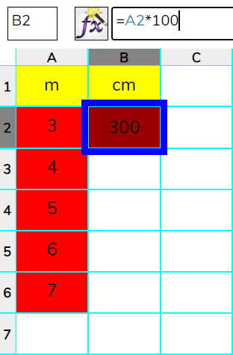
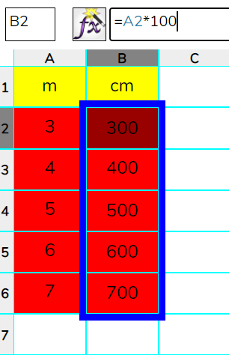
Activity 2: Copying and Pasting Formula
Slide 9
Tablet instructions
On a tablet, tap the first cell (B2) so that a blue border appears around the cell. Press and hold along the bottom blue border and then drag down the column to add the formula to all cells.
Need more support? Contact us:
Tel: +44(0)208 203 1781 | Email: support@2simple.com | Twitter: @2simplesoftware
Notes:
*Tablet instructions for copying and pasting on slide 9.

Slide 10
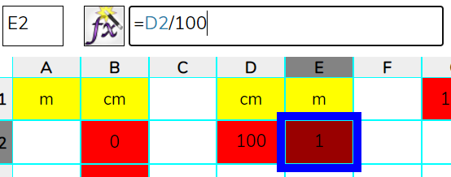
Activity 3: Formula for Converting to M
Slide 10
It’s your turn to see if you can create a formula to convert Centimetres to Metres.
Step 1. Click on E2 and enter the formula into the formula bar.
Click for hint
Step 2. Copy the formula in cell E2 and paste it into the rest of the cells in column E.
Step 3. Test your spreadsheet. Does it work? Will it convert CM to M and M to CM?
Need more support? Contact us:
Tel: +44(0)208 203 1781 | Email: support@2simple.com | Twitter: @2simplesoftware
Notes:
Display slide 10. Children to enter formula and copy and paste it in order to convert between Centimetres and Metres. Children to then test whether their sheet works. Click to reveal hint on the slide if needed.

Slide 11
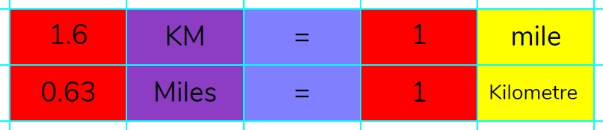
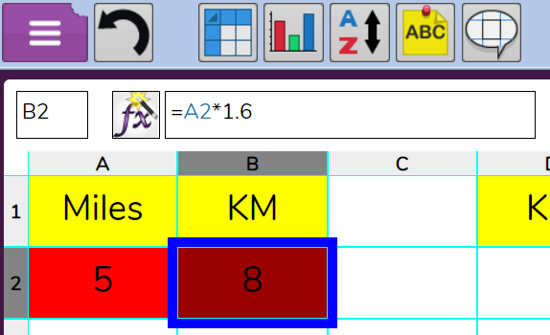
Activity 4: Converting Between KM and Miles
Slide 11
Can you create a spreadsheet which converts between Kilometres and Miles?
This is the relationship between KM and Miles.
Click for hint
Need more support? Contact us:
Tel: +44(0)208 203 1781 | Email: support@2simple.com | Twitter: @2simplesoftware
Notes:
Use slide 11 to show children the relationship between miles and kilometres. Children to attempt to create a spreadsheet that converts between these units. Click to reveal hint if required.

Slide 12
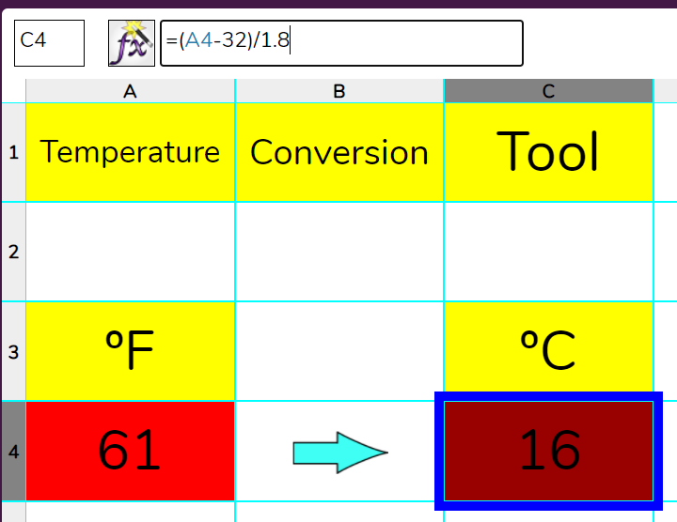
Activity 5: Extension
Slide 12
Can you create a spreadsheet that converts between ºF and ºC ?
Monthly Maximum Temperature ºF
Jan 34 ºF
Feb 30 ºF
Mar 35 ºF
Apr 50 ºF
May 60 ºF
June 70 ºF
July 75 ºF
Aug 74 ºF
Sept 65 ºF
Oct 54 ºF
Nov 46 ºF
Dec 35 ºF
Conversion Example
Step 1. Create a table similar to Conversion Example.
Step 2. Enter the data shown in the table.
Step 3. Use this conversion to help you
ºC = (ºF - 32) ÷ 1.8
Step 4. Try presenting this data as a graph.
Need more support? Contact us:
Tel: +44(0)208 203 1781 | Email: support@2simple.com | Twitter: @2simplesoftware
Notes:
Display the extension activity on slide 12. Children to follow steps to create a spreadsheet that converts from ºF to ºC.

Slide 13
Review Success Criteria
Slide 13
I can create a formula in a spreadsheet to convert m to cm.
I can apply this to creating a spreadsheet that converts miles to km and vice versa.
Need more support? Contact us:
Tel: +44(0)208 203 1781 | Email: support@2simple.com | Twitter: @2simplesoftware
Notes:
Use slide 13 to evaluate success of meeting success criteria.

