Slide 1


Slide 3
1) One side of a square is 11 km.
What is the square’s perimeter?
2 a) 2 × 9 =
b) 42 – 18 =
c) Subtract 2 × 9 from 42
3) 6,000 m = ___ km
4) 9 + 3 + 3 + 9 = ___ × 2 + 9 × ___

Slide 4
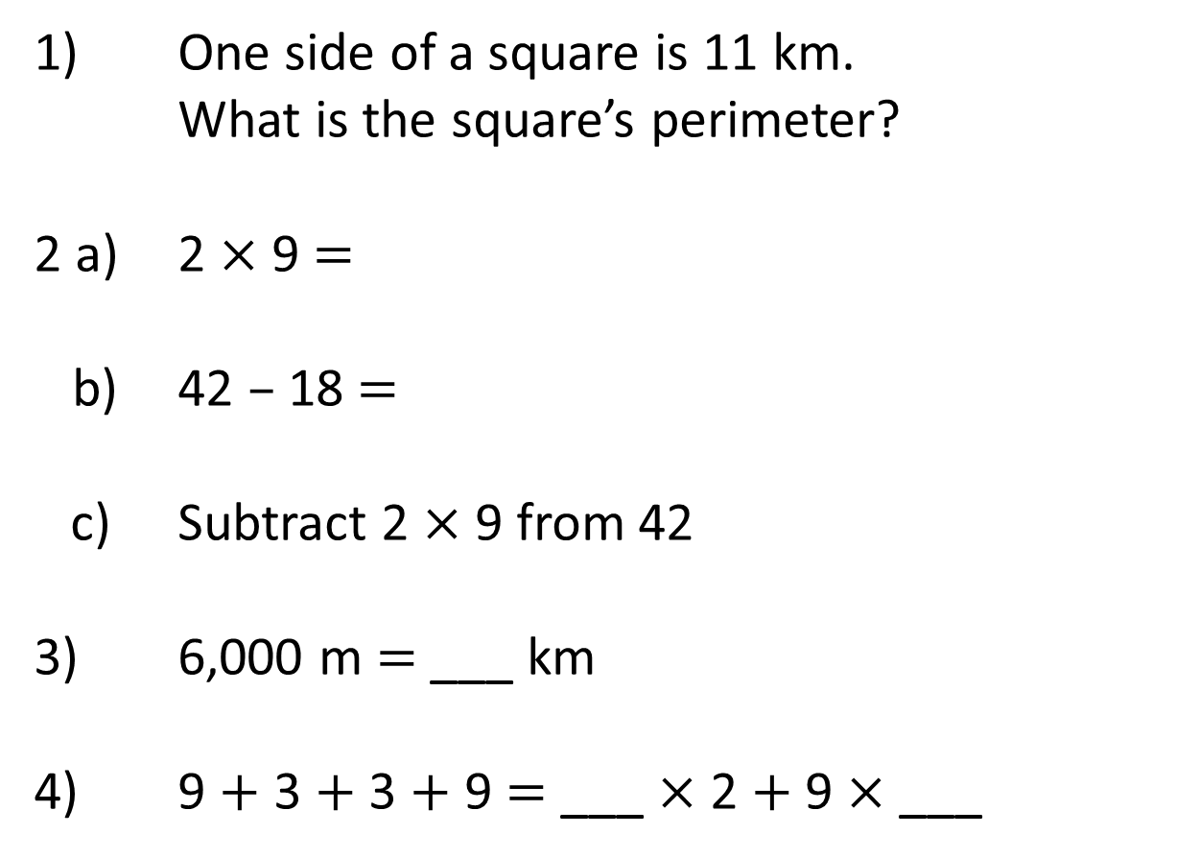
1) One side of a square is 11 km.
What is the square’s perimeter?
2 a) 2 × 9 =
b) 42 – 18 =
c) Subtract 2 $×$ 9 from 42
3) 6,000 m = ___ km
4) 9 + 3 + 3 + 9 = ___ × 2 + 9 × ___
44 km
18
24
24
6
3
2

Slide 6

Perimeter $=$ the length around a closed 2D shape
1 cm
1 cm
5 cm
4 cm
4 cm
5 cm
5 cm
+ 4 cm
+ 5 cm
+ 4 cm
= 18 cm

Slide 7

Have a think
Note down the features of a rectangle.
2 cm
2 cm
2D shape
4 sides
All sides are straight
6 cm
6 cm
2 pairs of equal sides
Perimeter =
16 cm
8 cm ?
6 cm
+ 2 cm
+ 6 cm
+ 2 cm
= 16 cm

Slide 8
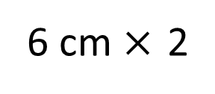
2 cm
6 cm
6 cm
+ 2 cm
+ 6 cm
+ 2 cm
= 16 cm
6 cm $×$ 2
+
2 cm × 2
= 16 cm
= 16 cm
8 cm
× 2

Slide 9
2)
1)
Have a think
6 cm
14 cm
9 cm
22 cm
2 cm
40 cm
7 cm
3)
4)
18 cm
Square
3 cm
6 cm
28 cm

Slide 10
Have a go at questions
1 - 3 on the worksheet

Slide 11
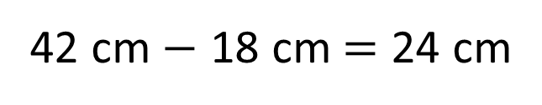
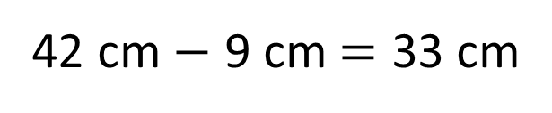
Perimeter of the rectangle = 42 cm
9 cm
12 cm
33 cm
33
12
24
cm
9 cm
9 cm
42 cm $−$ 9 cm = 33 cm
42 cm $−$ 18 cm = 24 cm
24 cm ÷ 2 = 12 cm
33 + 9 + 33 + 9 = 84 cm

Slide 12
Have a go at questions
4 - 5 on the worksheet

