Slide 1


Slide 3
1) 1 cm = _____ mm
2) 75 mm = _____ cm
3) How many sides does a quadrilateral have?
4) How many pairs of equal sides does a rectangle have?

Slide 4
10
1) 1 cm = _____ mm
2) 75 mm = _____ cm
3) How many sides does a quadrilateral have?
4) How many pairs of equal sides does a rectangle have?
7.5
4
2 pairs

Slide 6

32 mm
or 3.2 cm
3 cm
2 mm
30 mm
1 cm = 10 mm

Slide 7

Have a think
Is this line 6 cm long?
How long is the line? Give your answer in millimetres.
45 mm

Slide 8
Have a think
6 cm or 60 mm
Is the line equal to, greater than or less than 30 mm?
Greater than

Slide 9
Have a go at questions
1 - 3 on the worksheet

Slide 10
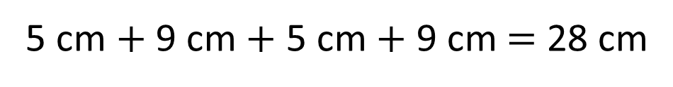

Perimeter $=$ the length around a closed 2D shape
5 cm
9 cm
9 cm
5 cm
5 cm $+$ 9 cm $+$ 5 cm $+$ 9 cm $=$ 28 cm
9 cm + 5 cm =
14 cm
14 cm × 2 =
28 cm

Slide 11
Perimeter $=$ the length around a closed 2D shape
Have a think
Do we need to measure all the sides to find the perimeter?

Slide 12
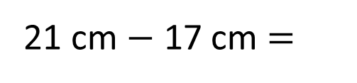
Perimeter $=$ the length around a closed 2D shape
4.5 cm
5 cm
Complete the shape so its perimeter is 21 cm
3 cm
3.9 cm
0.6 cm
Have a think
What would you do first to complete the task?
5 cm + 4.5 cm + 3.9 cm + 3 cm + 0.6 cm =
5 cm + 4.5 cm + 3.9 cm + 0.6 cm + 3 cm =
17 cm
21 cm $−$ 17 cm =
4 cm
4.5 cm

Slide 13
Have a go at questions
4 - 8 on the worksheet

