Slide 1


Slide 3
1) ___ cm = 90 mm
2) 30 = 6 × ___
3) 5 =
4) 100 = ____
2
2

Slide 4
1) ___ cm = 90 mm
2) 30 = 6 × ___
3) 5 =
4) 100 = ____
9
5
2
25
2
10

Slide 6
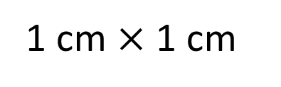
1 cm
1 cm
1 cm $×$ 1 cm
1 cm squared
2
1 cm

Slide 7
1 cm
6 squares
1 cm
2 rows
There are 2 rows.
There are 6 squares in each row.
There are 12 squares altogether.
2 × 6 =
12
The area of the rectangle is 12 cm squared.
12 cm
2

Slide 8

1 square
1 cm
1 cm
3 rows
Have a think
3
There are ___ rows.
1
There is ___ square in each row.
There are ___ squares altogether.
3
3
1
___ × ___ =
3
___
3
The area of the rectangle is ___ cm squared.
3
2
___ cm

Slide 9
Have a go at questions
1 - 3 on the worksheet

Slide 10
Have a think
3 cm
4 cm
2 cm
20 mm
7 cm
4 × 2 =
8 cm
2
3 × 7 =
21 cm
2

Slide 11

9 mm
2 m
2 m
Square
9 mm
9 × 9 =
2
The area of this rectangle is 4 m
81 mm
2
2
2
9 =
81 mm
Have a think
Explain why Tiny is incorrect.

Slide 12
Area = 72 m
2
?
12
12 m
6 m
6 × ___ = 72
?
Have a think
17 cm
2
Area = 17 cm
1 cm
17
1 × ___ = 17

Slide 13
Have a go at questions
4 - 8 on the worksheet

