Slide 1


Slide 3
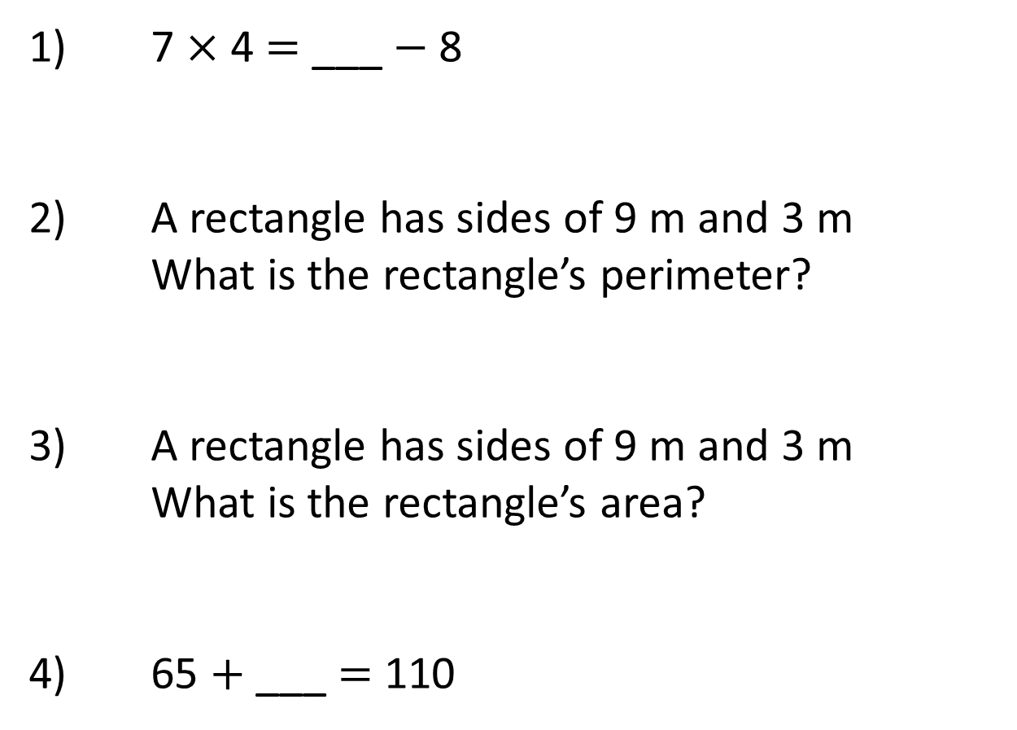
1) 7 × 4 = ___ $−$ 8
2) A rectangle has sides of 9 m and 3 m
What is the rectangle’s perimeter?
3) A rectangle has sides of 9 m and 3 m
What is the rectangle’s area?
4) 65 + ___ = 110

Slide 4
36
1) 7 × 4 = ___ $−$ 8
2) A rectangle has sides of 9 m and 3 m
What is the rectangle’s perimeter?
3) A rectangle has sides of 9 m and 3 m
What is the rectangle’s area?
4) 65 + ___ = 110
24 m
27 m²
45

Slide 6
What is a compound shape?
A shape made up of 2 or more shapes

Slide 7

Have a think
1 cm
1 cm
1
2
3
4
5
6
7
8
9
10
11
12
2
Area = 12 cm

Slide 8
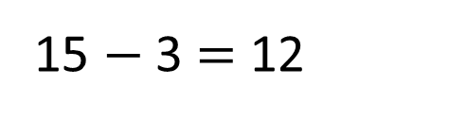
2
Area = 12 cm
1 cm
5
1 cm
2
3
6
4
10
2
10 + 2 = 12
4 + 6 + 2 = 12
5 × 3 = 15
15 $−$ 3 = 12

Slide 9
B
2 cm
6 cm
A
8 cm
5 cm
A
6 × 5 =
2
30 cm
B
2 × 8 =
2
16 cm
2
2
2
30 cm + 16 cm =
46 cm

Slide 10
10 cm
6 cm
A
8 cm
B
A
6 × 10 =
2
7 cm
60 cm
B
8 × 7 =
Have a think
2
56 cm
2
2
2
60 cm + 56 cm =
116 cm

Slide 11
Have a go at questions
1 - 3 on the worksheet

Slide 12
5 cm
4 cm
A
6 cm
1 cm
3 cm
B
12 cm
A
4 × 5 =
2
20 cm
B
3 × 12 =
2
36 cm
2
2
2
20 cm + 36 cm =
56 cm

Slide 13
5 cm
4 cm
6 cm
1 cm
B
3 cm
3 cm
A
C
3 cm
A
3 × 6 =
12 cm
2
Have a think
18 cm
B
5 × 7 =
2
35 cm
2
2
2
2
C
3 × 1 =
18 cm + 35 cm + 3 cm =
56 cm
2
3 cm

Slide 14
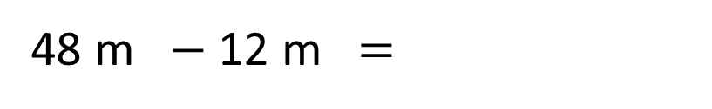
3 m
6 m
4 m
8 m
Have a think
2
2
8 × 6 =
48 m
3 × 4 =
12 m
2
2
2
48 m $−$ 12 m =
36 m

Slide 15
3 cm
Have a think
5 cm
5 cm
4 cm
15 cm
5 cm
A
B
C
5 cm
5 cm
B 3 × 15 =
2
12 cm
45 cm
A 5 × 5 =
2
25 cm
2
2
2
2
45 cm + 25 cm + 20 cm =
90 cm
C 4 × 5 =
2
20 cm

Slide 16
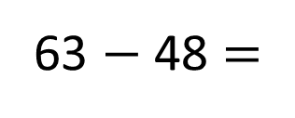
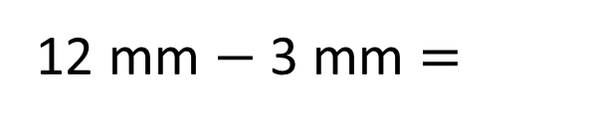
12 mm
48 mm
2
4 mm
9 mm
9 mm
The area of the shape is 63 mm
What is the perimeter of the shape?
15 mm
2
5 mm
2
3 mm
12 + 9 + 9 + 5 + 4 + 3 =
12 + 4 + 9 + 5 + 3 + 9 =
9 mm
12 mm $−$ 3 mm =
12 + 9 + 9 + 9 + 3 =
2
5
63 $−$ 48 =
15 mm
3 × ___ = 15
12 + 27 + 3 =
12 + 30 =
42 mm

Slide 17
Have a go at questions
3 - 6 on the worksheet

