Slide 1


Slide 3








1) 4 × =
2) Which is correct?
3) = = 11 ×
4) × 3 =
$$\frac{\text{1}}{\text{9}}$$
$$\frac{\text{1}}{\text{5}}$$
$$\frac{\text{4}}{\text{20}}$$
$$\frac{\text{1}}{\text{5}}$$
$$\frac{\text{4}}{\text{5}}$$
×
4
=
×
4
=
$$\frac{\text{1}}{\text{5}}$$
$$\frac{}{\text{13}}$$
$$\frac{\text{3}}{\text{13}}$$

Slide 4





1) 4 × =
2) Which is correct?
3) = = 11 ×
4) × 3 =
$$\frac{\text{1}}{\text{9}}$$
$$\frac{\text{4}}{\text{9}}$$
$$\frac{\text{1}}{\text{5}}$$
$$\frac{\text{4}}{\text{20}}$$
$$\frac{\text{1}}{\text{5}}$$
$$\frac{\text{4}}{\text{5}}$$
×
4
=
×
4
=
$$\frac{\text{1}}{\text{5}}$$
$$\frac{\text{1}}{\text{5}}$$
$$\text{2}$$
$$\text{1}$$
$$\frac{}{\text{13}}$$
$$\frac{\text{3}}{\text{13}}$$

Slide 6














Ron drinks l of orange juice each day for 3 days.
$$\frac{\text{2}}{\text{9}}$$
How much orange juice does Ron drink
during the 3 days altogether?
Have a think
$$\frac{\text{2}}{\text{9}}$$
$$\frac{\text{2}}{\text{9}}$$
$$\frac{\text{2}}{\text{9}}$$
$$\frac{\text{2}}{\text{9}}$$
$$\frac{\text{2}}{\text{9}}$$
$$\frac{\text{2}}{\text{9}}$$
$$\frac{\text{6}}{\text{9}}$$
$$\frac{\text{2}}{\text{9}}$$
$$\frac{\text{6}}{\text{9}}$$
$$\frac{\text{2}}{\text{3}}$$
+
+
=
l
×
3
=
=
l

Slide 7
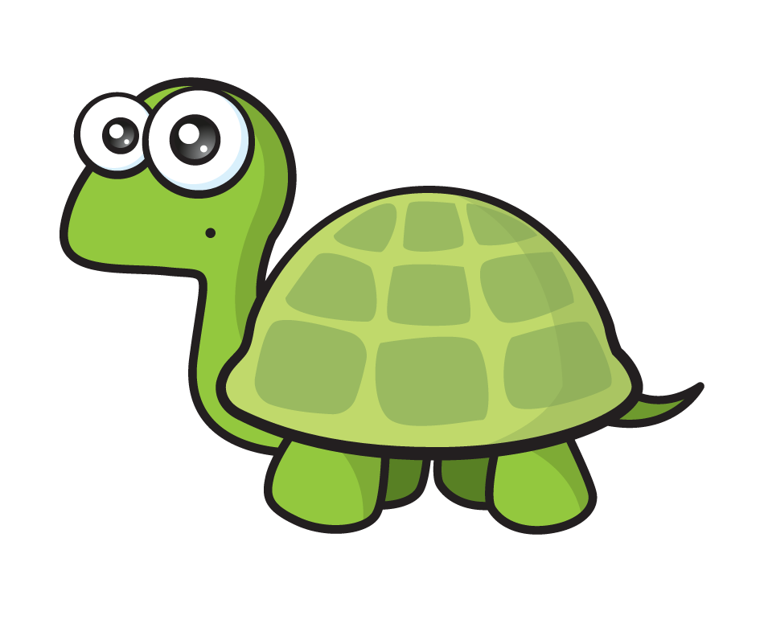
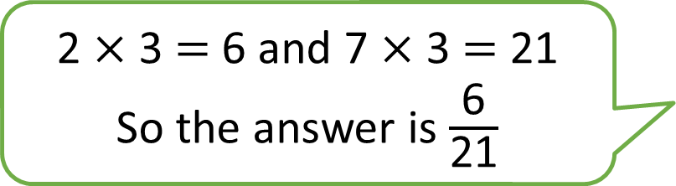





$$\frac{\text{2}}{\text{7}}$$
$$\frac{\text{6}}{\text{7}}$$
×
3
=
Have a think
2 $×$ 3 $=$ 6 and 7 $×$ 3 $=$ 21
So the answer is $\frac{\text{6}}{\text{21}}$
$$\frac{\text{2}}{\text{7}}$$
$$\frac{\text{2}}{\text{7}}$$
$$\frac{\text{2}}{\text{7}}$$
+
+

Slide 8









$$\frac{\text{2}}{\text{11}}$$
$$\frac{\text{2}}{\text{11}}$$
$$\frac{\text{2}}{\text{11}}$$
$$\frac{\text{4}}{\text{11}}$$
+
=
2
×
=
Have a think
$$\frac{\text{3}}{\text{10}}$$
$$\frac{\text{3}}{\text{10}}$$
$$\frac{\text{3}}{\text{10}}$$
$$\frac{\text{3}}{\text{10}}$$
$$\frac{\text{9}}{\text{10}}$$
×
3
=
+
+
=

Slide 9
Have a go at questions
1 - 4 on the worksheet

Slide 10

















$$\frac{\text{2}}{\text{7}}$$
$$\frac{\text{8}}{\text{7}}$$
$$\frac{\text{1}}{\text{7}}$$
4 ×
=
=
1
Have a think
0
1
2
$$\frac{\text{1}}{\text{7}}$$
$$\frac{\text{2}}{\text{7}}$$
$$\frac{\text{3}}{\text{7}}$$
$$\frac{\text{4}}{\text{7}}$$
$$\frac{\text{5}}{\text{7}}$$
$$\frac{\text{6}}{\text{7}}$$
$$\frac{\text{7}}{\text{7}}$$
$$\frac{\text{8}}{\text{7}}$$
$$\frac{\text{9}}{\text{7}}$$
$$\frac{\text{10}}{\text{7}}$$
$$\frac{\text{11}}{\text{7}}$$
$$\frac{\text{12}}{\text{7}}$$
$$\frac{\text{13}}{\text{7}}$$
$$\frac{\text{14}}{\text{7}}$$

Slide 11







$$\frac{\text{3}}{\text{8}}$$
$$\frac{\text{39}}{\text{8}}$$
$$\frac{\text{7}}{\text{8}}$$
Have a think
13 ×
=
=
4
$$\frac{\text{5}}{\text{6}}$$
$$\frac{\text{30}}{\text{6}}$$
× 6
=
=
5
$$\frac{\text{3}}{\text{11}}$$
$$\frac{\text{33}}{\text{11}}$$
×
11
=
3
=

Slide 12


1
2
$$\frac{}{\text{9}}$$
$$\frac{\text{36}}{\text{9}}$$
18
36
×
=
4
=
Factors of 36
36
×
1
=
36
Have a think
The fraction is a non-unit fraction.
18
×
2
=
36

Slide 13
Have a go at questions
5 - 7 on the worksheet

