Slide 1


Slide 3


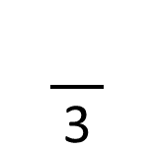
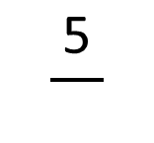
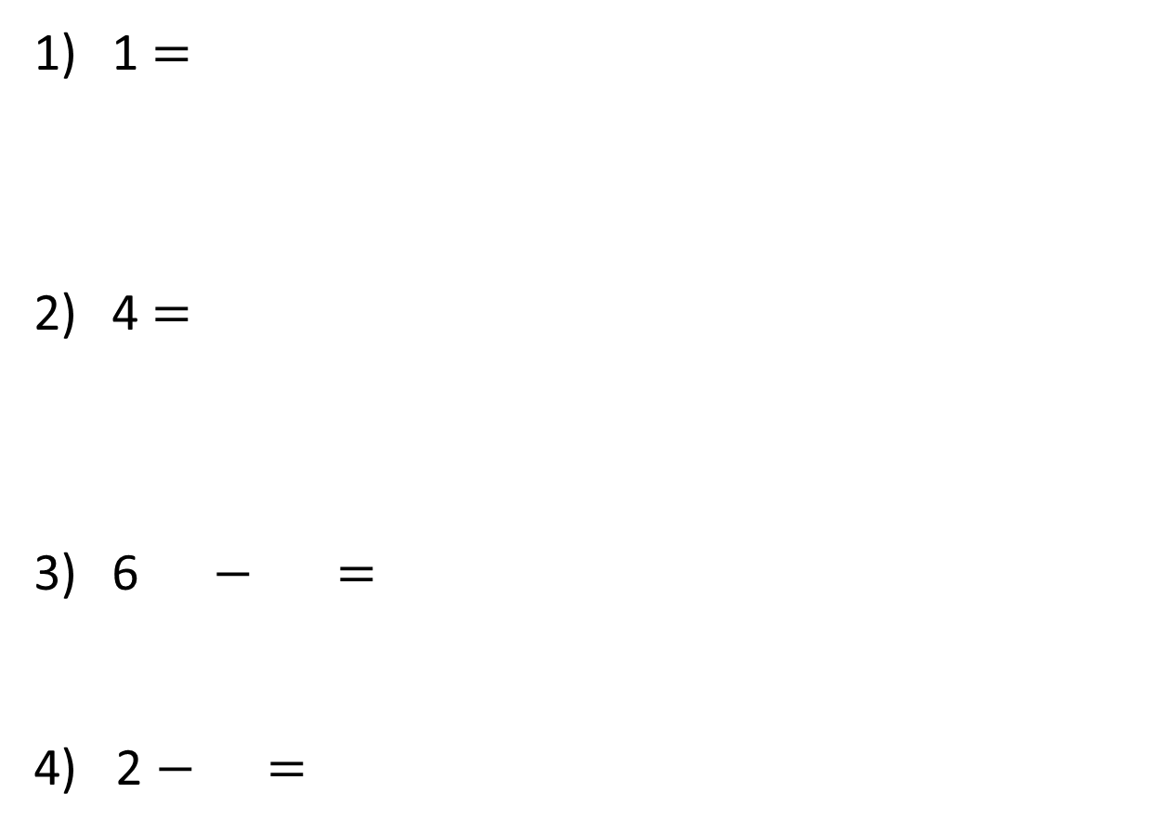

$$\frac{\text{5}}{}$$
1 =
4 =
6 $−$ =
4) 2 $−$ =
$$\frac{}{\text{3}}$$
$$\frac{\text{1}}{\text{2}}$$
$$\frac{\text{5}}{\text{12}}$$
$$\frac{\text{1}}{\text{3}}$$

Slide 4




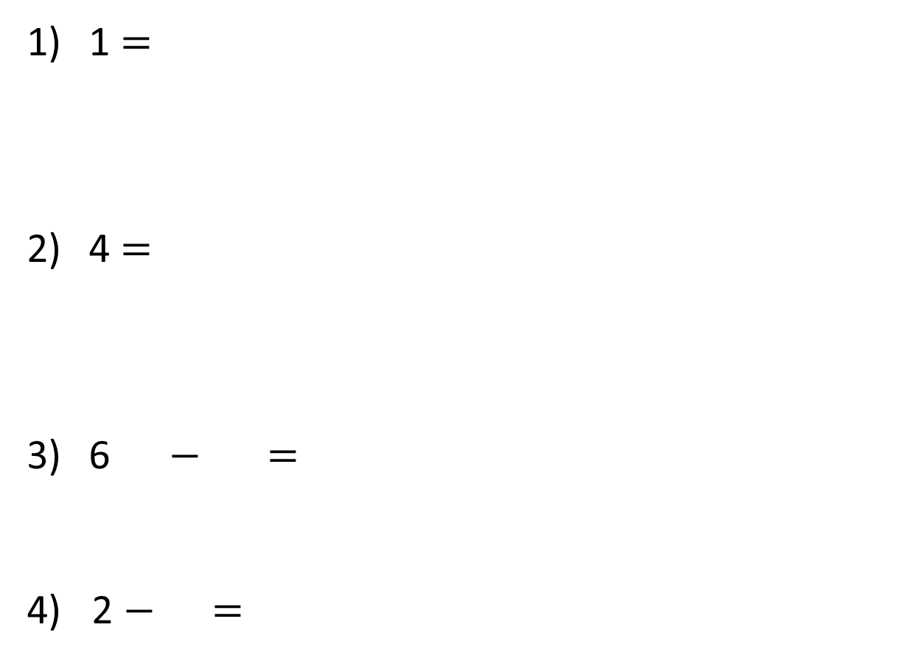





$$\frac{\text{5}}{}$$
$$\frac{\text{5}}{}$$
1 =
4 =
6 $−$ =
4) 2 $−$ =
$$\text{5}$$
$$\frac{}{\text{3}}$$
$$\frac{}{\text{3}}$$
$$\text{12}$$
$$\frac{\text{1}}{\text{2}}$$
$$\frac{\text{5}}{\text{12}}$$
$$\frac{\text{6}}{\text{12}}$$
$$\frac{\text{5}}{\text{12}}$$
$$\frac{\text{1}}{\text{12}}$$
$$\frac{\text{1}}{\text{2}}$$
$$\text{6 }\text{−} \text{=}$$
$$\text{6}$$
$$\frac{\text{1}}{\text{3}}$$
$$\frac{\text{2}}{\text{3}}$$
$$\text{1}$$

Slide 6


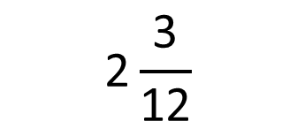
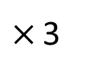
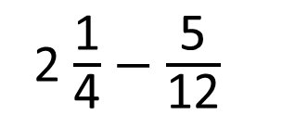
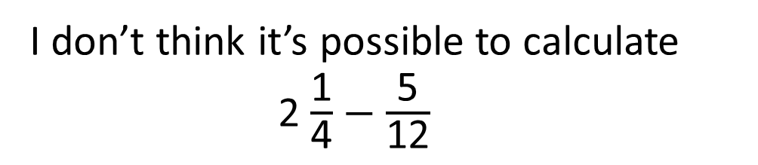
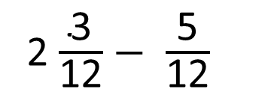
I don’t think it’s possible to calculate 2 $\frac{\text{1}}{\text{4}}$ $−$ $\frac{\text{5}}{\text{12}}$
2 $\frac{\text{1}}{\text{4}}$ $−$ $\frac{\text{5}}{\text{12}}$
$×$ 3
$$\text{2}\frac{\text{3}}{\text{12}}$$
2 $\frac{\text{3}}{\text{12}}$ $−$ $\frac{\text{5}}{\text{12}}$
Have a think

Slide 7
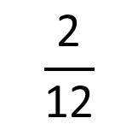
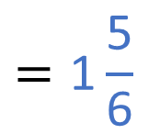
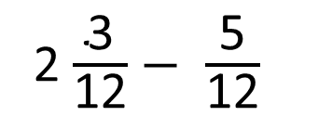
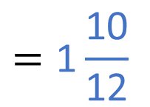
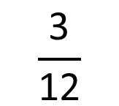
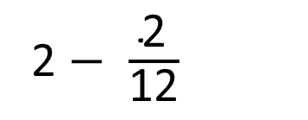
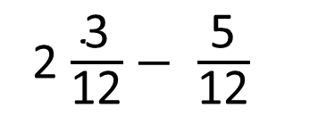
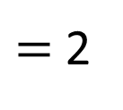
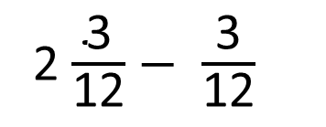
2 $\frac{\text{3}}{\text{12}}$ $−$ $\frac{\text{5}}{\text{12}}$
2 $\frac{\text{3}}{\text{12}}$ $−$ $\frac{\text{5}}{\text{12}}$
2 $\frac{\text{3}}{\text{12}}$ $−$ $\frac{\text{3}}{\text{12}}$
$=$ 2
$$=\text{1}\frac{\text{10}}{\text{1}\text{2}}$$
$$=\text{1}\frac{\text{5}}{\text{6}}$$
2 $−$ $\frac{\text{2}}{\text{12}}$
$$\frac{\text{3}}{\text{12}}$$
$$\frac{\text{2}}{\text{12}}$$

Slide 8
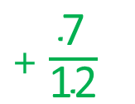

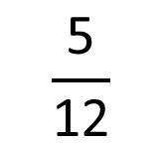
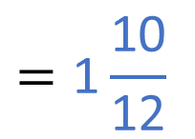
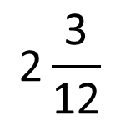
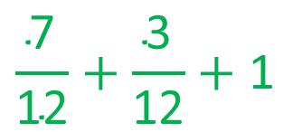
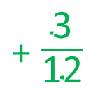
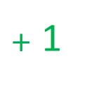
2 $\frac{\text{3}}{\text{12}}$ $−$ $\frac{\text{5}}{\text{12}}$
$+$ $\frac{\text{7}}{\text{12}}$
$+$ $\frac{\text{3}}{\text{12}}$
$+$ 1
0
1
2
3
$$\frac{\text{5}}{\text{12}}$$
$$\text{2}\frac{\text{3}}{\text{12}}$$
$$\frac{\text{7}}{\text{12}}+\frac{\text{3}}{\text{12}}+\text{1}$$
$$=\text{1}\frac{\text{10}}{\text{1}\text{2}}$$
$$=\text{1}\frac{\text{5}}{\text{6}}$$

Slide 9
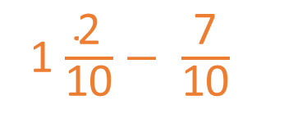
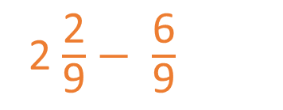
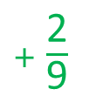
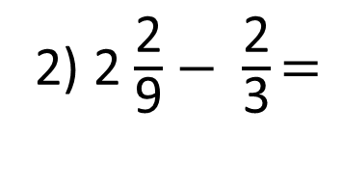
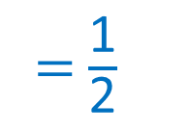

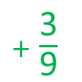
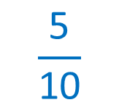
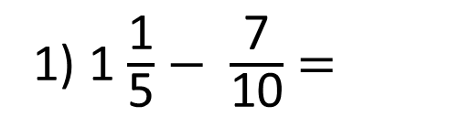

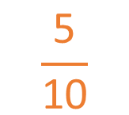
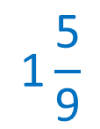
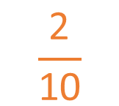
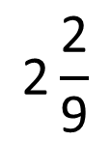
$$\frac{\text{5}}{\text{10}}$$
1) 1 $\frac{\text{1}}{\text{5}}$ $−$ $\frac{\text{7}}{\text{10}}$ =
= $\frac{\text{1}}{\text{2}}$
Have a think
1 $\frac{\text{2}}{\text{10}}$ $−$ $\frac{\text{7}}{\text{10}}$
$$\frac{\text{2}}{\text{10}}$$
$$\frac{\text{5}}{\text{10}}$$
$$\frac{\text{6}}{\text{9}}$$
$$\text{2}\frac{\text{2}}{\text{9}}$$
2) 2 $\frac{\text{2}}{\text{9}}$ $−$ $\frac{\text{2}}{\text{3}}\text{=}$
$$\text{1}\frac{\text{5}}{\text{9}}$$
$+$ $\frac{\text{3}}{\text{9}}$
$$+ \text{1}$$
$+$ $\frac{\text{2}}{\text{9}}$
2 $\frac{\text{2}}{\text{9}}$ $−$ $\frac{\text{6}}{\text{9}}$
0
1
2
3

Slide 10
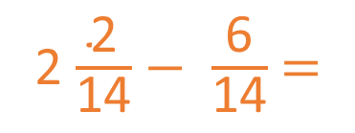
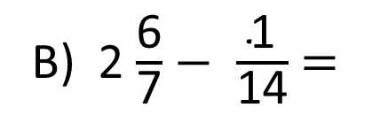
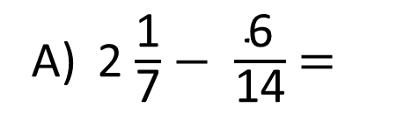
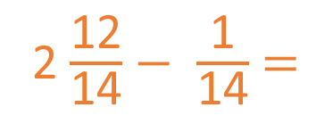
A) 2 $\frac{\text{1}}{\text{7}}$ $−$ $\frac{\text{6}}{\text{14}}$ =
B) 2 $\frac{\text{6}}{\text{7}}$ $−$ $\frac{\text{1}}{\text{14}}$ =
2 $\frac{\text{2}}{\text{14}}$ $−$ $\frac{\text{6}}{\text{14}}$ =
2 $\frac{\text{12}}{\text{14}}$ $−$ $\frac{\text{1}}{\text{14}}$ =
Which calculation will break the whole?
A
How do you know?
Have a think

Slide 11
Have a go at questions
1 - 3 on the worksheet

Slide 12


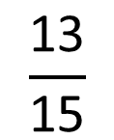
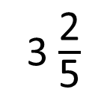
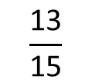
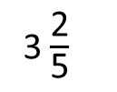
3 $\frac{\text{2}}{\text{5}}$
Dexter watches television for hours during a weekend.
$$\frac{\text{13}}{\text{15}}$$
Dora watches fewer hours than Dexter.
Dora watches 1 hour of television on Saturday.
For how long does Dora watch television on Sunday?
3 $\frac{\text{2}}{\text{5}}$
Have a think
Dexter
$$\frac{\text{13}}{\text{15}}$$
Dora

Slide 13
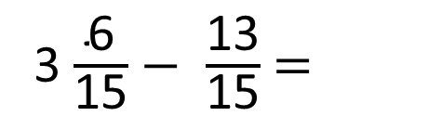
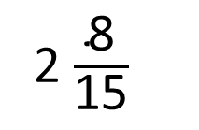
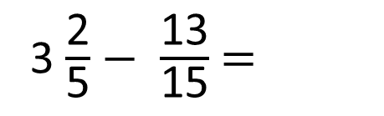
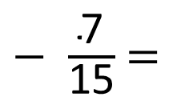
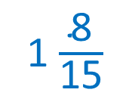







3 $\frac{\text{2}}{\text{5}}$
Dexter
$$\frac{\text{13}}{\text{15}}$$
Dora
2 $\frac{\text{8}}{\text{15}}$
3 $\frac{\text{2}}{\text{5}}$ $−$ $\frac{\text{13}}{\text{15}}$ =
Dora watches 1 hour of television on Saturday.
For how long does Dora watch television on Sunday?
3 $\frac{\text{6}}{\text{15}}$ $−$ $\frac{\text{13}}{\text{15}}$ =
2 $\frac{\text{8}}{\text{15}}$ $−$ $\text{1}$ =
1 $\frac{\text{8}}{\text{15}}$
hours
$$\frac{\text{6}}{\text{15}}$$
$$\frac{\text{7}}{\text{15}}$$
3 $\frac{\text{6}}{\text{15}}$ $−$ $\frac{\text{6}}{\text{15}}$ =
3
3
$−$ $\frac{\text{7}}{\text{15}}$ =
2 $\frac{\text{8}}{\text{15}}$

Slide 14






The difference between a fraction and a mixed number is
$\frac{\text{3}}{\text{4}}$
The fraction has a denominator of 12
What could the fraction and mixed number be?
$\frac{}{} −$ $\frac{\text{3}}{\text{4}}$ =
$$\text{12}$$
5
8
$\frac{}{} −$ $\frac{\text{9}}{\text{12}}$ =
1
$$\text{12}$$
$$\text{12}$$

Slide 15
Have a go at questions
4 - 6 on the worksheet

