Slide 1
Week 1: Lesson 4
Alive in 5!

Slide 2
Lesson 4:
Comparing Numbers to 5

Slide 3


Activity 1
Dots
I am going to show you some dots.
Some of the dots will be red and some of them will be black.
I would like you to tell me how many dots there are altogether.
Can show me how many there are using your fingers?
3

Slide 4
Activity 1
Dots
Here’s the first one.
How many dots are there altogether?
4

Slide 5
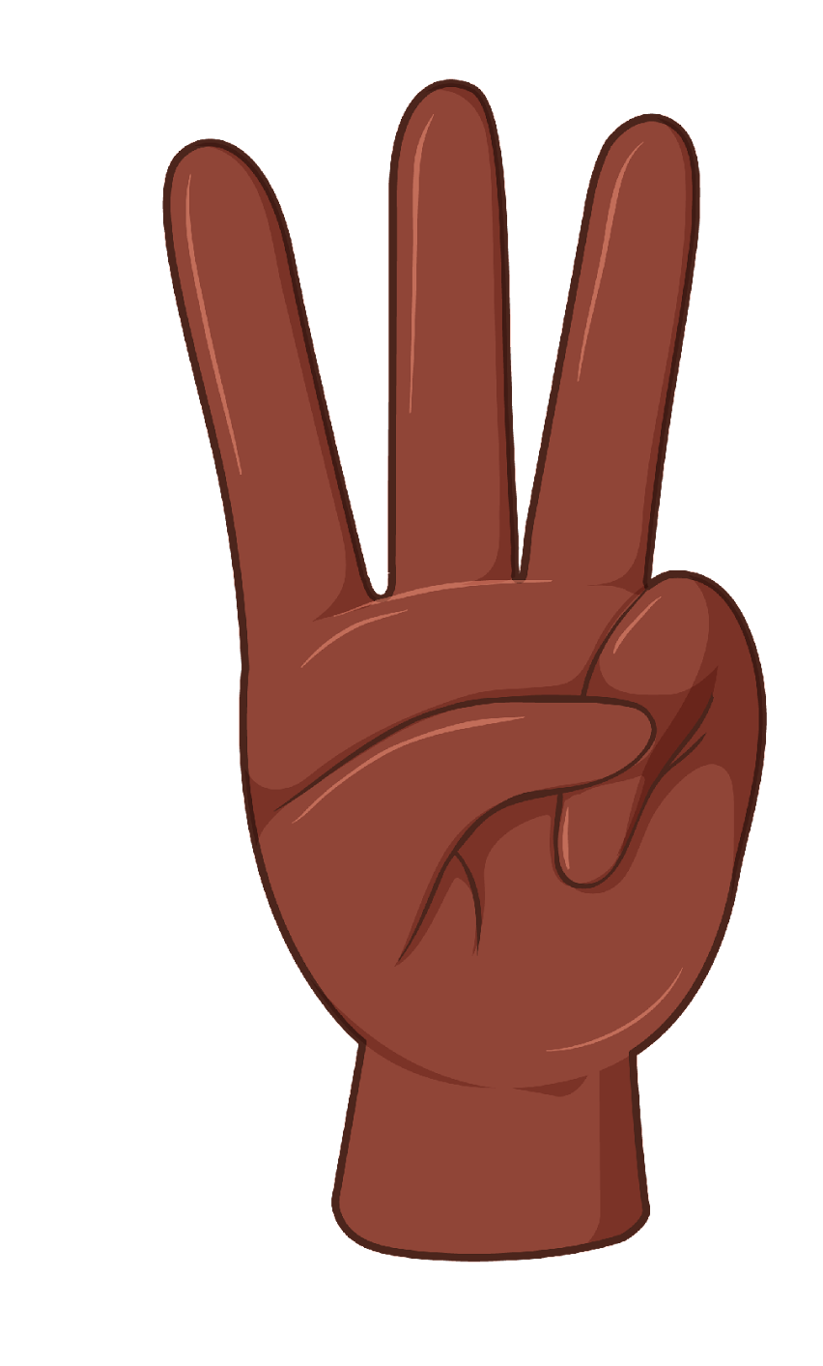
Activity 1
Dots
Yes, there are 3 dots altogether.
There are 2 red dots and 1 black dot.
So, altogether there are 3 dots.
3
5

Slide 6
Activity 1
Dots
How many dots do we have now?
6

Slide 7
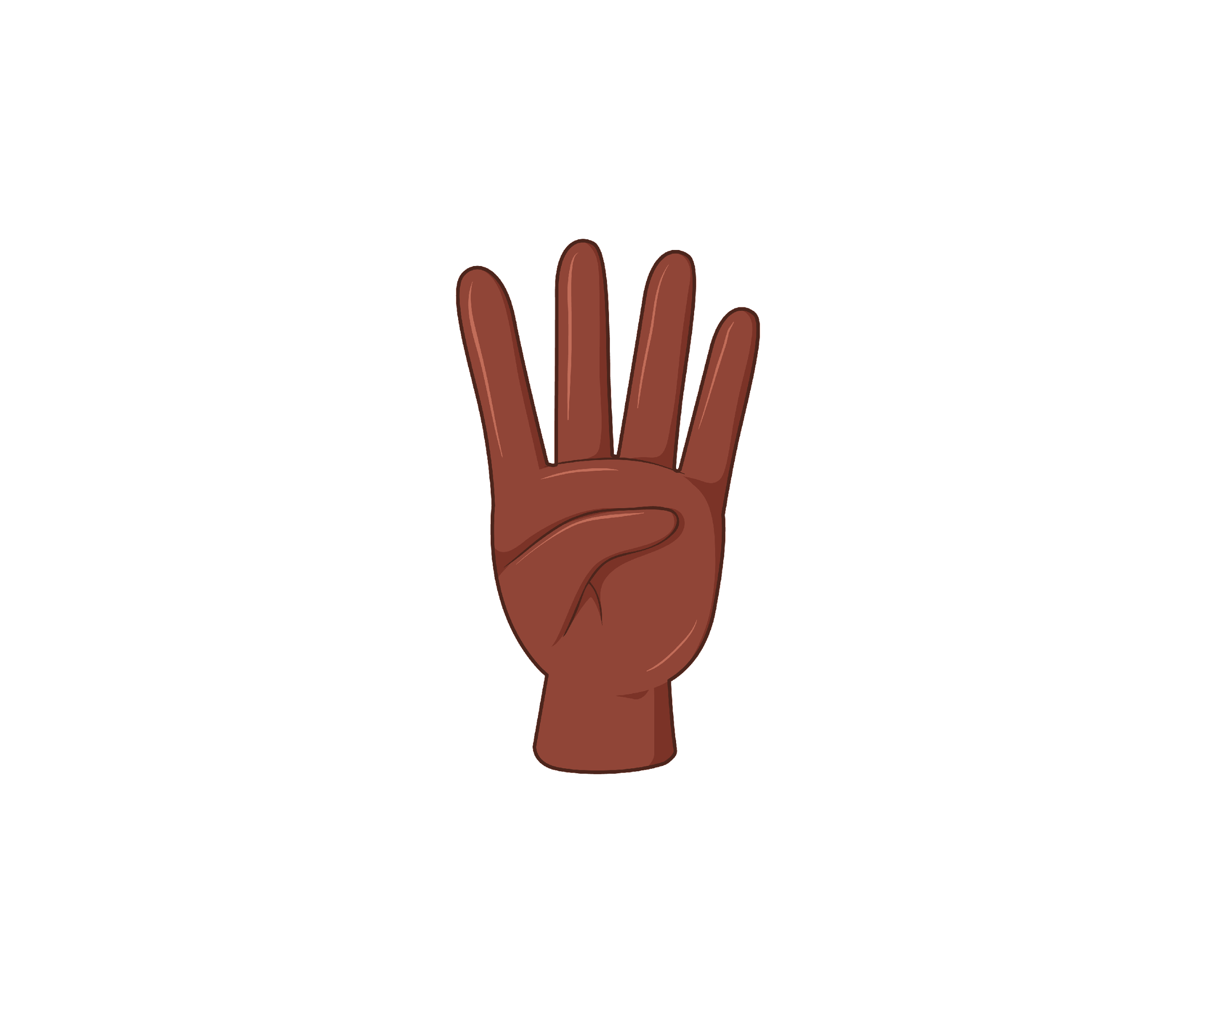
Activity 1
Dots
Yes, there are 4 dots.
There are 3 red dots and 1 black dot.
So, altogether there are 4.
4
7

Slide 8
Activity 1
Dots
How many dots are there this time?
8

Slide 9

Activity 1
Dots
Yes, we have got 2 dots
They are both black..
We have got 2 dots altogether.
2
9

Slide 10
Activity 1
Dots
How many dots are there now?
10

Slide 11

Activity 1
Dots
That’s right, there are 5 dots.
There are 3 red dots and 2 black dots.
There are 5 dots altogether.
5
11

Slide 12
Activity 1
Dots
How many dots are there this time?
12

Slide 13

Activity 1
Dots
Yes, there are 1 dot .
There is 1 red dot and 0 black dots.
So, there is 1 dot altogether.
1
13

Slide 14
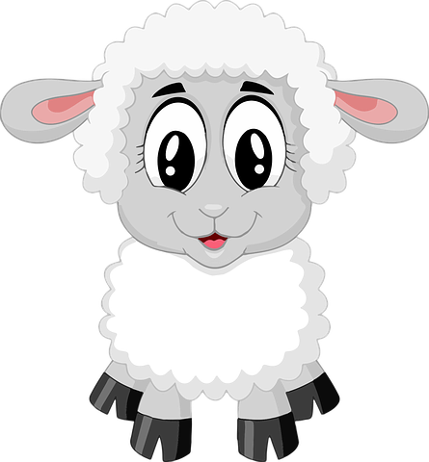
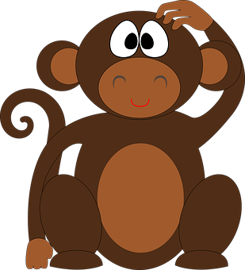
Activity 2
Comparing Numbers to 5
Today the sheep and the monkey are going to play a card game.
They are both going to turn over their cards at the same time.
Can you help me work out which animal has more?
14

Slide 15

Activity 2
Comparing Numbers to 5
Here is the first set of cards.
What do you notice?
15

Slide 16
Activity 2
Comparing Numbers to 5
Here we can see that the sheep has 4 pencils and the monkey has 2.
Who has more?
4
2
16

Slide 17
Activity 2
Comparing Numbers to 5
4 is more than 2 so the sheep wins the cards.
4
2
17

Slide 18
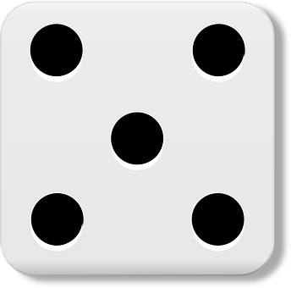

Activity 2
Comparing Numbers to 5
Here are two different cards.
What do you notice?
18

Slide 19
Activity 2
Comparing Numbers to 5
The sheep’s card has 5 spots.
The monkey’s card has 1 spot.
Who has more?
5
1
19

Slide 20
Activity 2
Comparing Numbers to 5
Yes, the sheep has more.
5 spots is more than 1 spot.
So, the sheep wins these two cards as well.
5
1
20

Slide 21



Activity 2
Comparing Numbers to 5
Here are two different cards.
What do you notice?
21

Slide 22
Activity 2
Comparing Numbers to 5
The sheep has 1 bear on his card.
The monkey has 3 bears on his card.
Who has more?
1
3
22

Slide 23
Activity 2
Comparing Numbers to 5
Yes, 3 bears is more than 1 bear so the monkey gets to keep these cards.
1
3
23

Slide 24

Activity 2
Comparing Numbers to 5
Here are two different cards.
How many spots does each ladybird have?
24

Slide 25
Activity 2
Comparing Numbers to 5
The sheep has a ladybird with 4 spots.
The monkey has a ladybird with 3 spots.
Which ladybird has more spots?
4
3
25

Slide 26
Activity 2
Comparing Numbers to 5
Yes, 4 spots is more than 3 spots so the sheep wins this round.
4
3
26

Slide 27
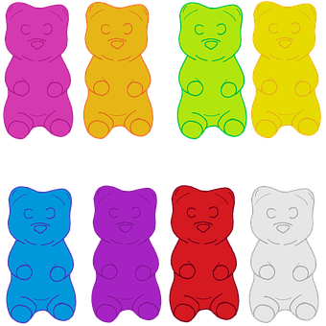
Activity 2
Comparing Numbers to 5
Here’s our final set of cards.
What do you notice?
27

Slide 28
Activity 2
Comparing Numbers to 5
Yes, the sheep has 2 sweets.
The monkey has 5 sweets.
Who has more sweets?
2
5
28

Slide 29
Activity 2
Comparing Numbers to 5
Yes, 5 sweets is more than 2 sweets so the monkey wins these cards.
2
5
29

Slide 30
Activity 2
Comparing Numbers to 5
Now, let’s see who is the winner of the game. How many cards have they collected?
30

Slide 31
Activity 2
Comparing Numbers to 5
The sheep has collected 6 cards.
The monkey has collected 4 cards.
Who has more cards?
31

Slide 32
Activity 2
Comparing Numbers to 5
The sheep has more cards than the monkey.
The monkey has fewer cards than the sheep.
So the sheep wins the game!
32

Slide 33
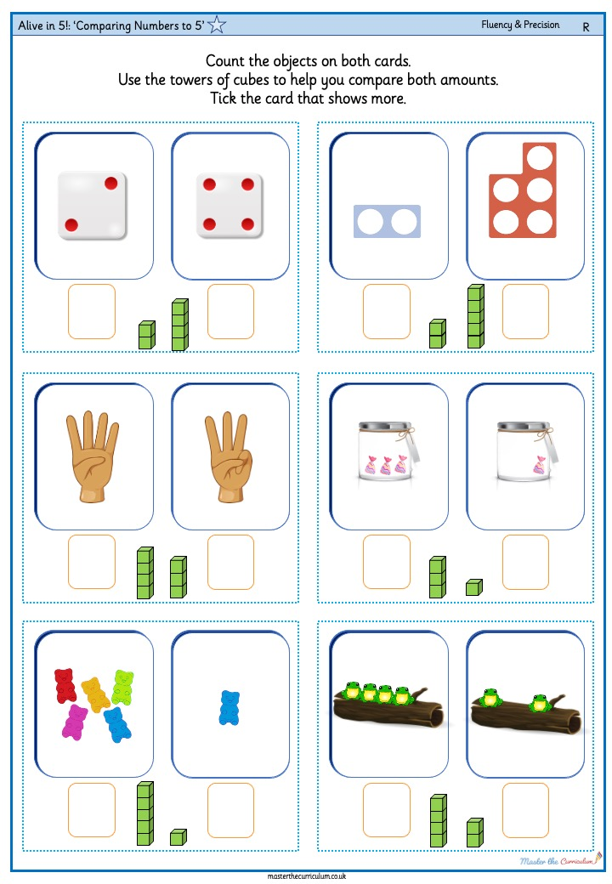
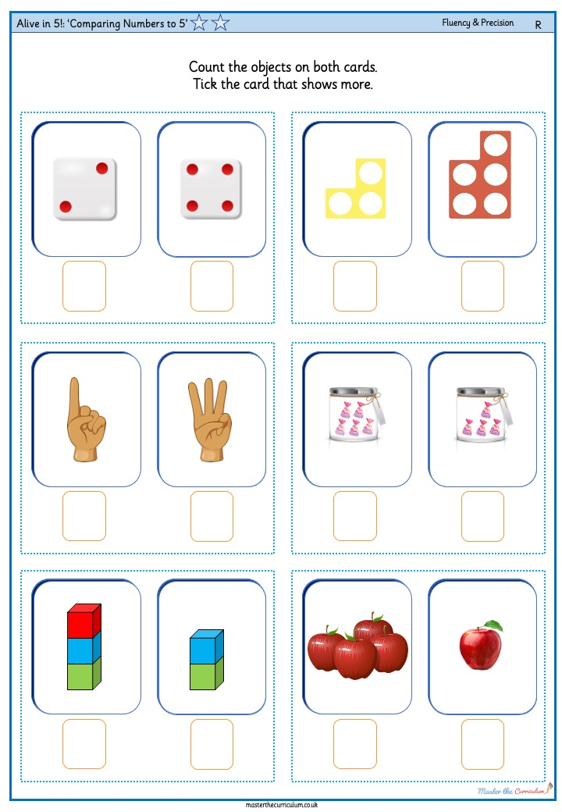
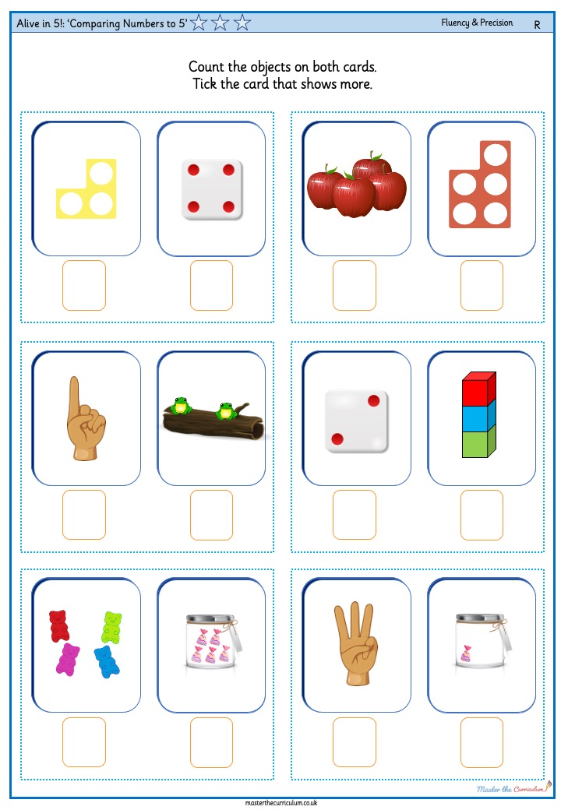
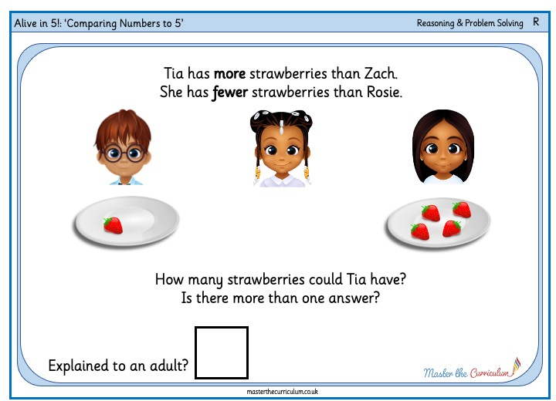
Your turn!
Comparing Numbers to 5
These are the activities that you can do.
Look at the pictures on your sheet and compare the numbers.
33

