Slide 1
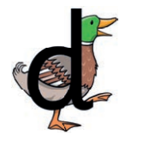
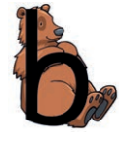
Round the duck’s body, up to its head and
down to its feet.
Down bear’s back, up and round his
big tummy.

Slide 2

The letter d looks like this…
d
Click on the pencil to see the letter formation.
Can you draw it with your finger?

Slide 3
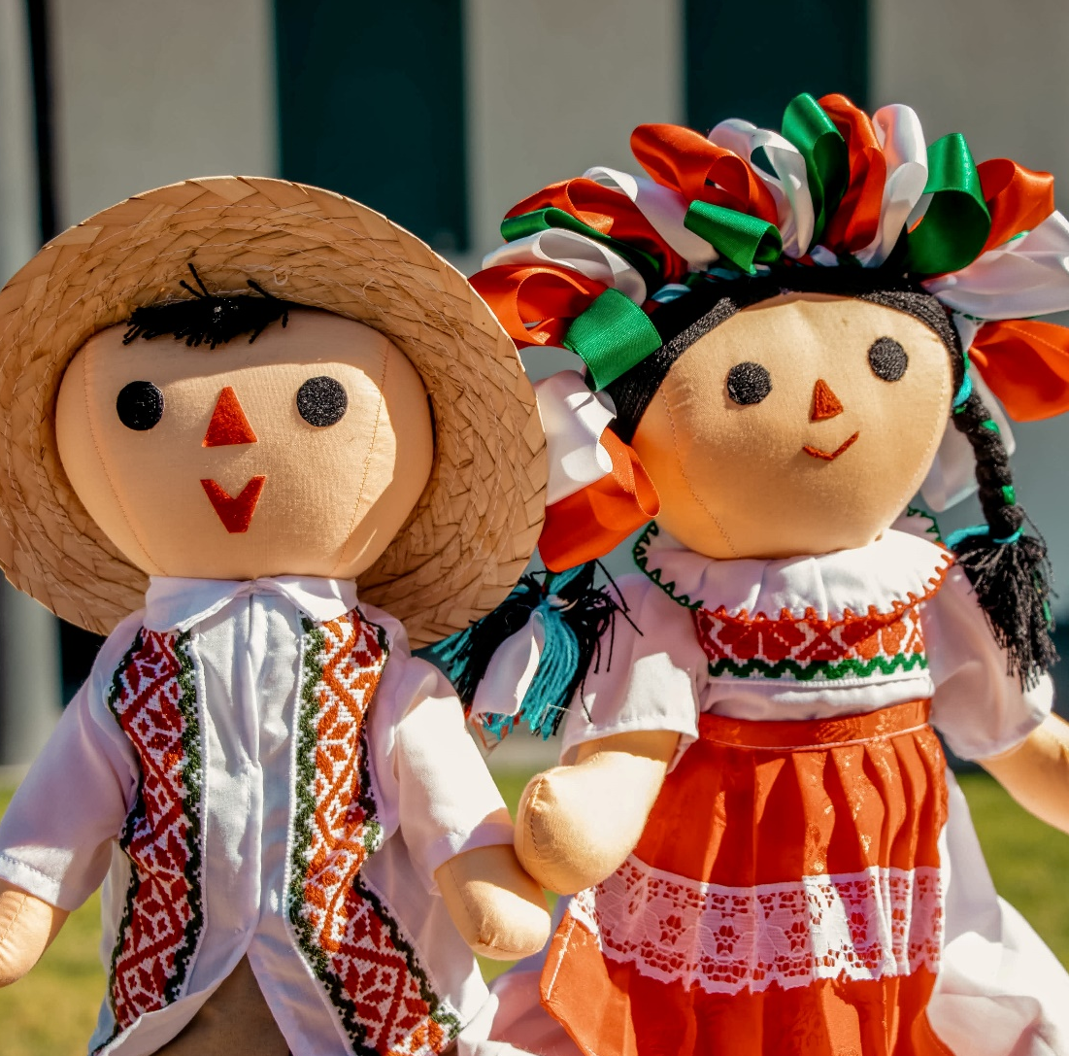
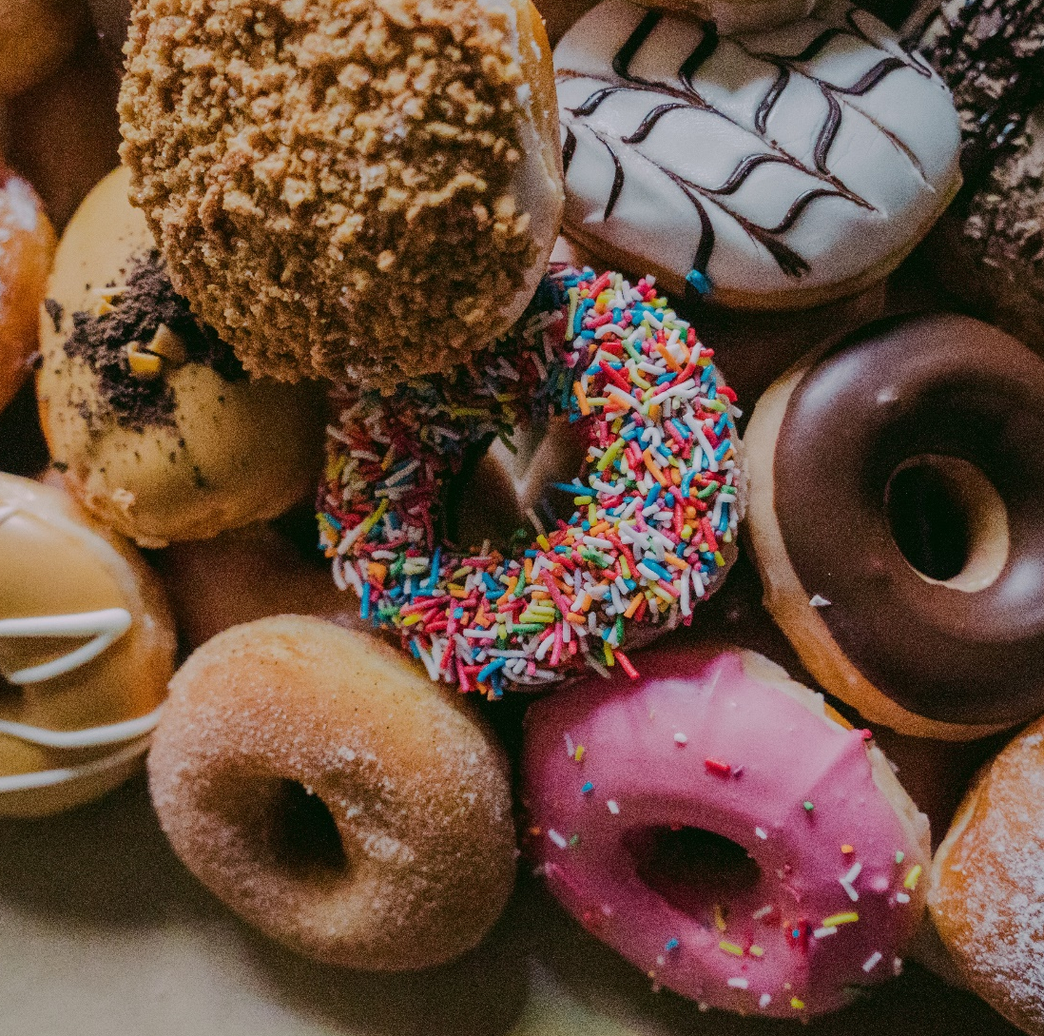
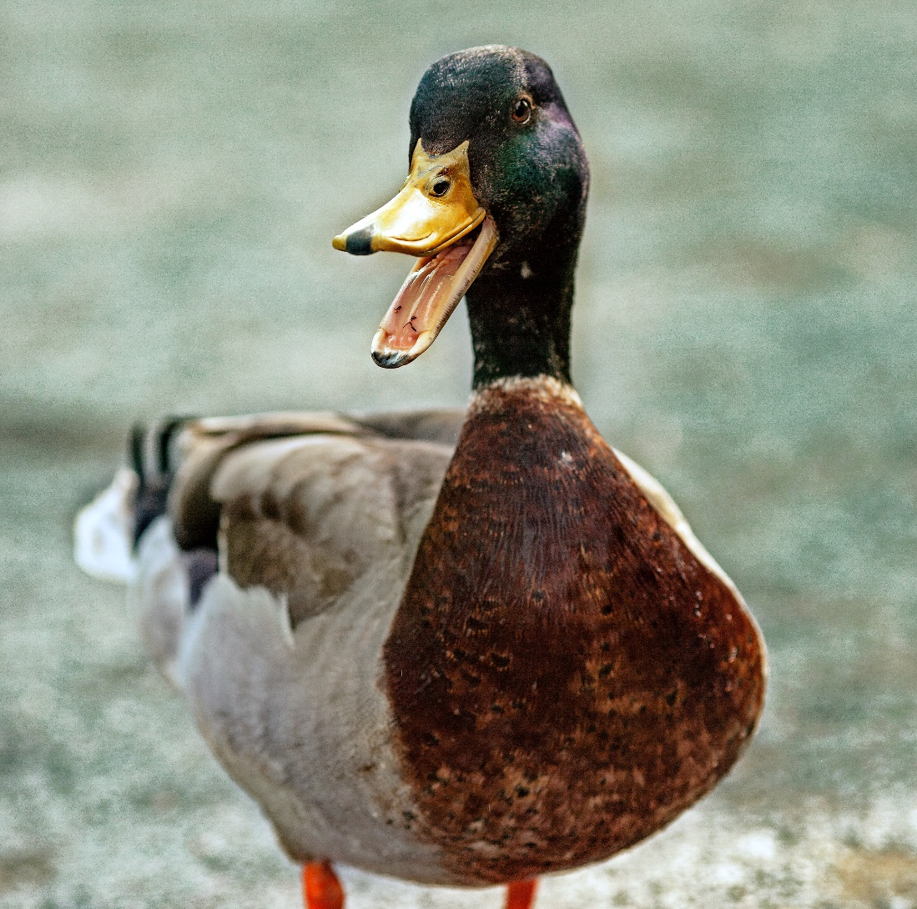
Some things that start with d are…

Slide 4
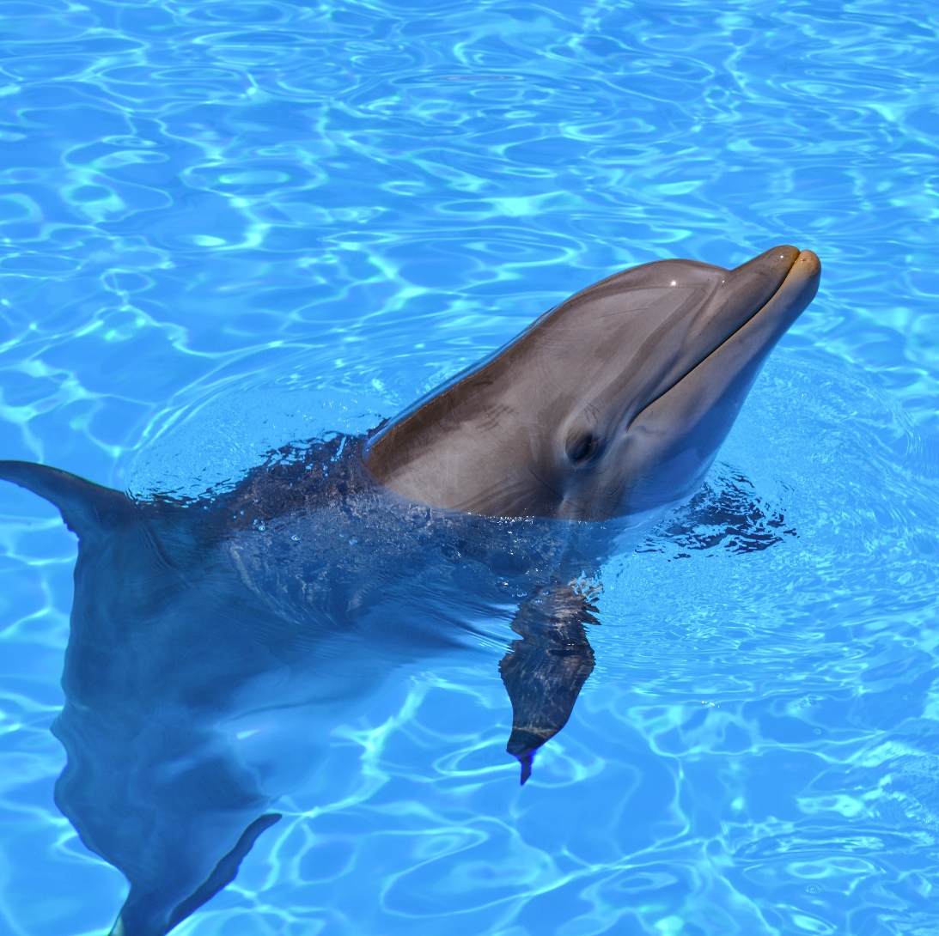

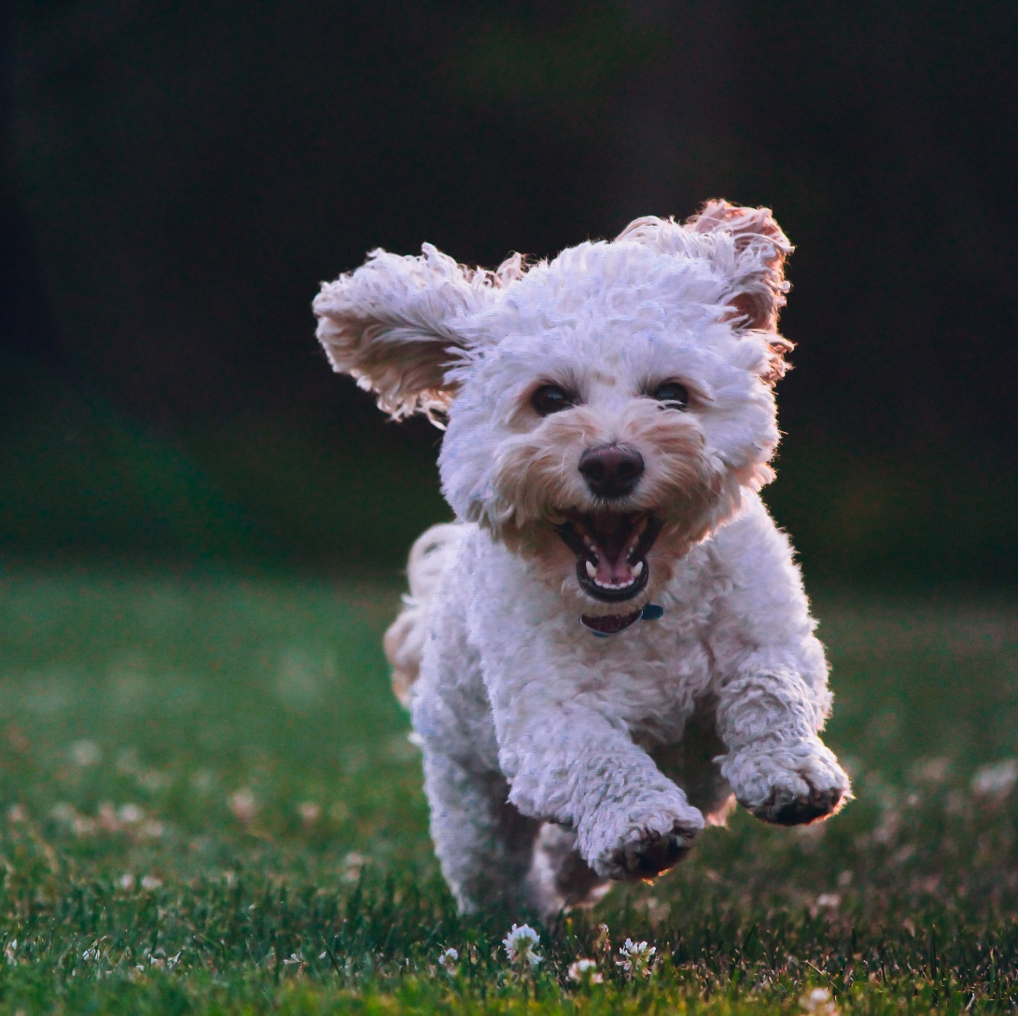
Some things that start with d are…

Slide 5

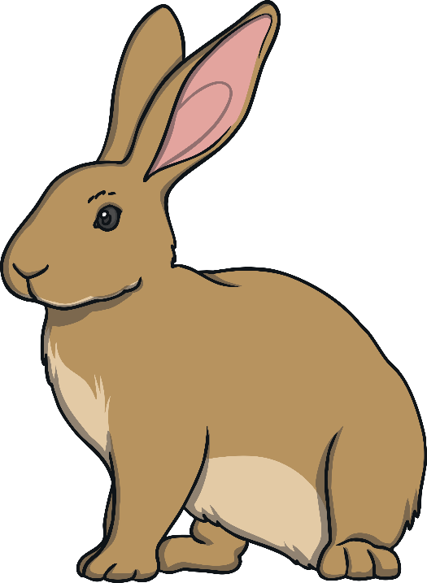
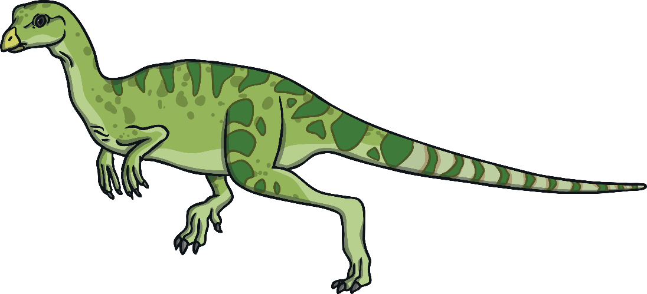
Which of These Start with D?
TRY AGAIN!
YES!
Notes:
Teaching note: Pause briefly after the initial sound of each word to assist students to identify the sounds

Slide 6
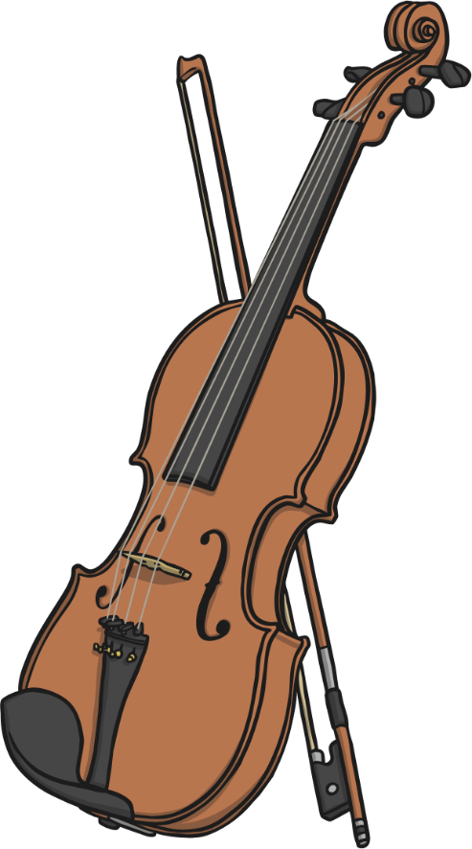
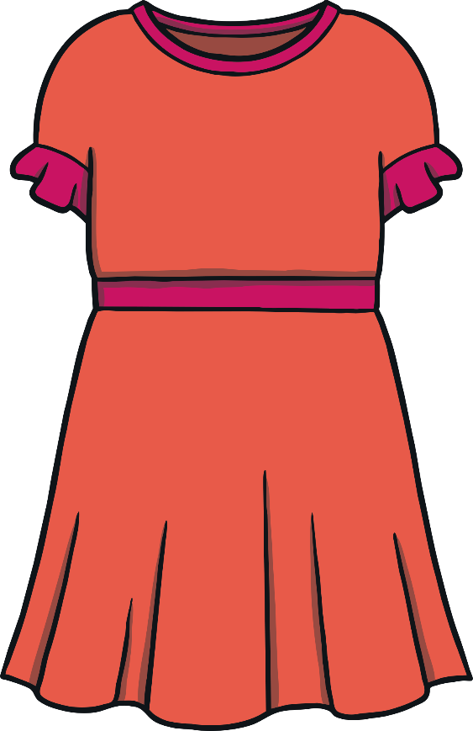
Which of These Start with D?
TRY AGAIN!
YES!
Notes:
Teaching note: Pause briefly after the initial sound of each word to assist students to identify the sounds

Slide 7
Which of These Start with D?
TRY AGAIN!
YES!
Notes:
Teaching note: Pause briefly after the initial sound of each word to assist students to identify the sounds

Slide 8
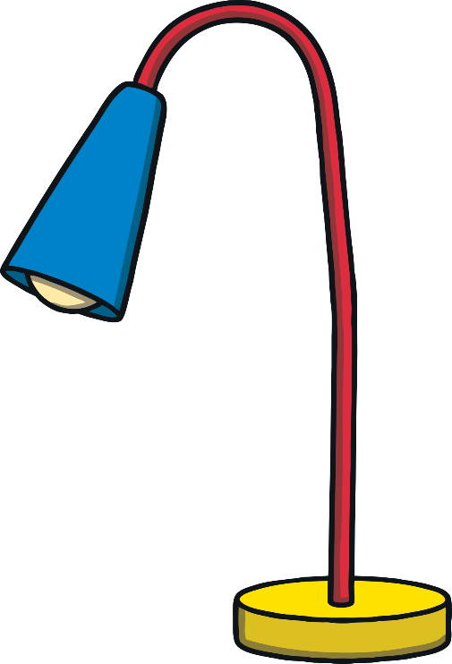
Which of These Start with D?
TRY AGAIN!
YES!
Notes:
Teaching note: Pause briefly after the initial sound of each word to assist students to identify the sounds

Slide 9

The Letter B Looks like This…
B
b
Click on the pencil to see the letter formation.
Can you draw it with your finger?

Slide 10

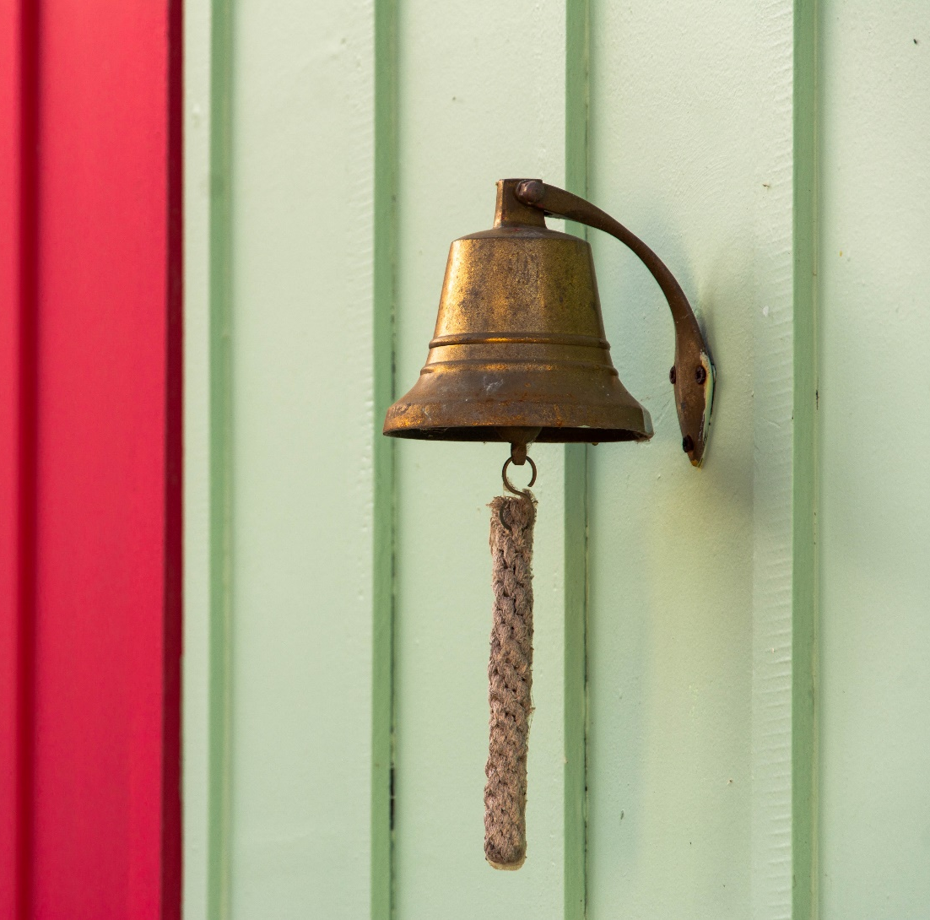
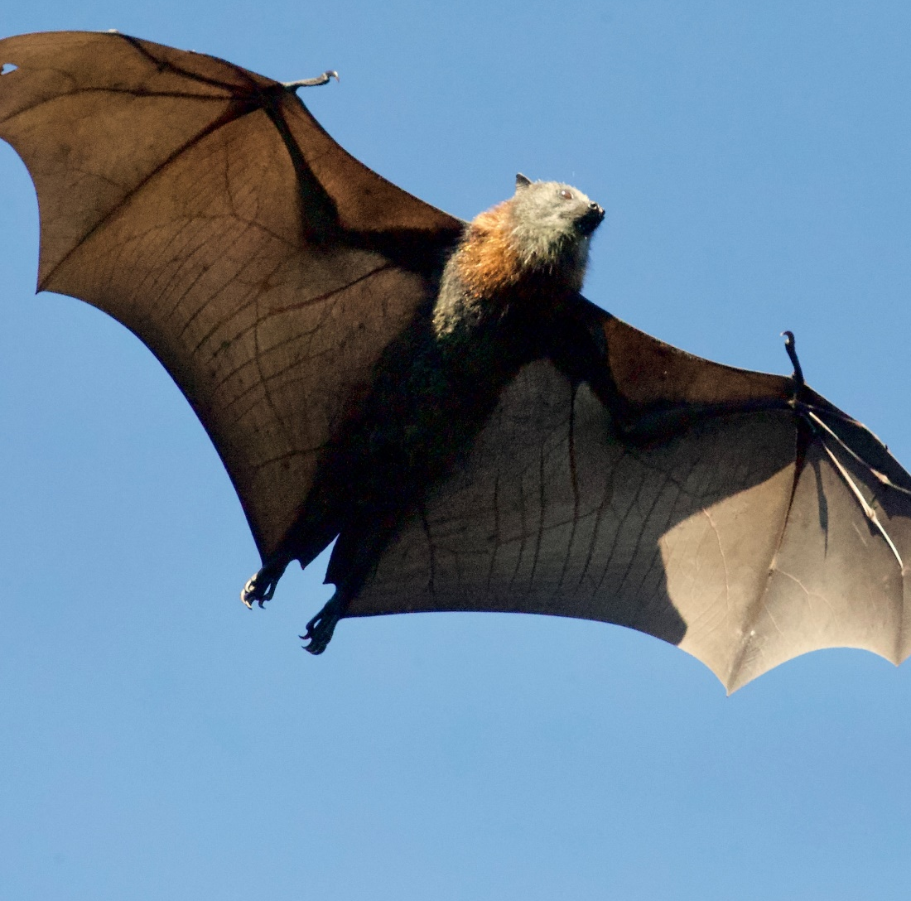
Some Things That Start with B Are…

Slide 11
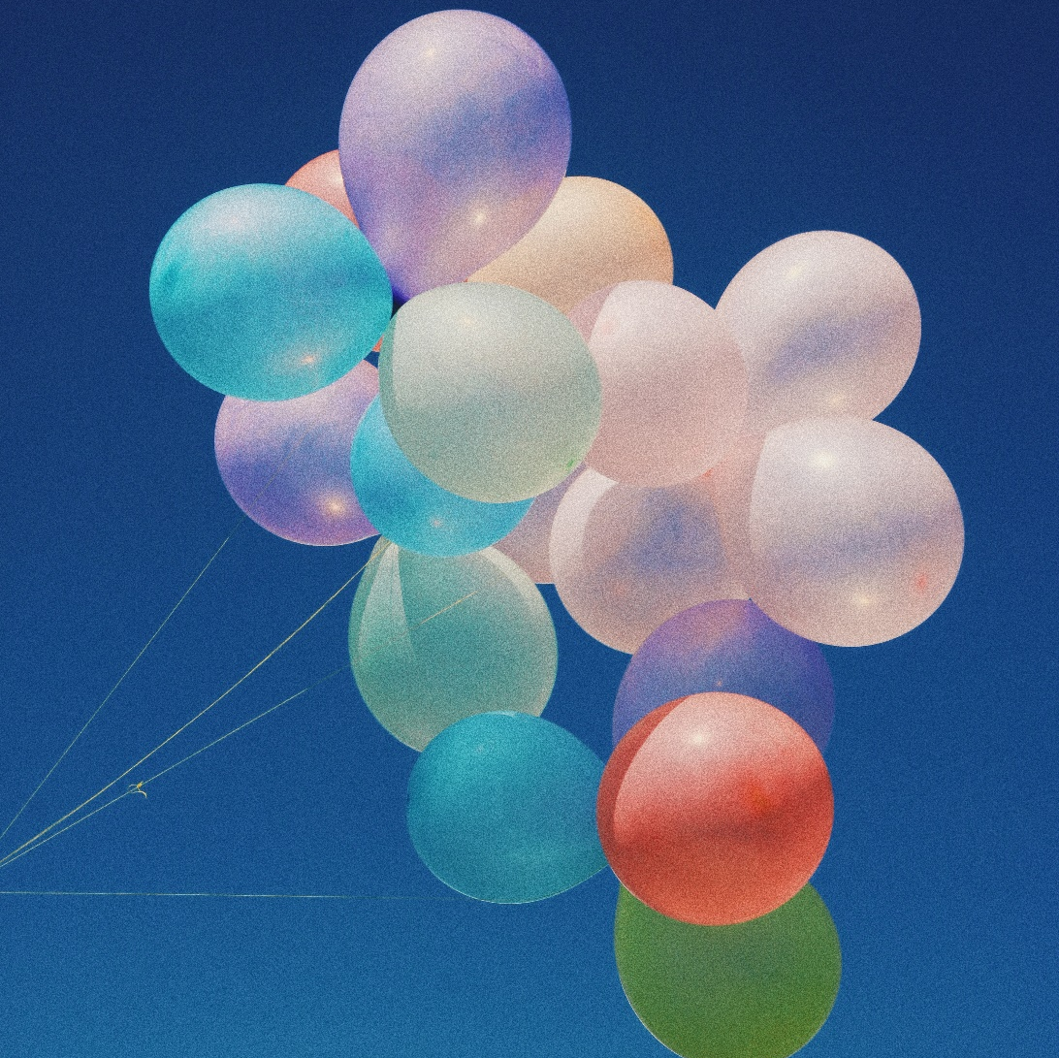
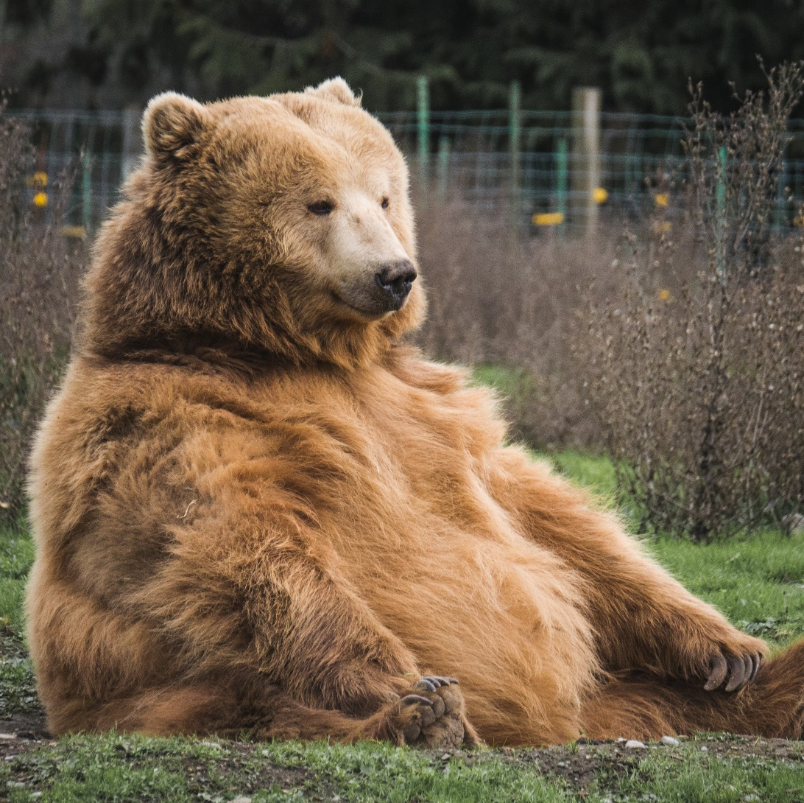
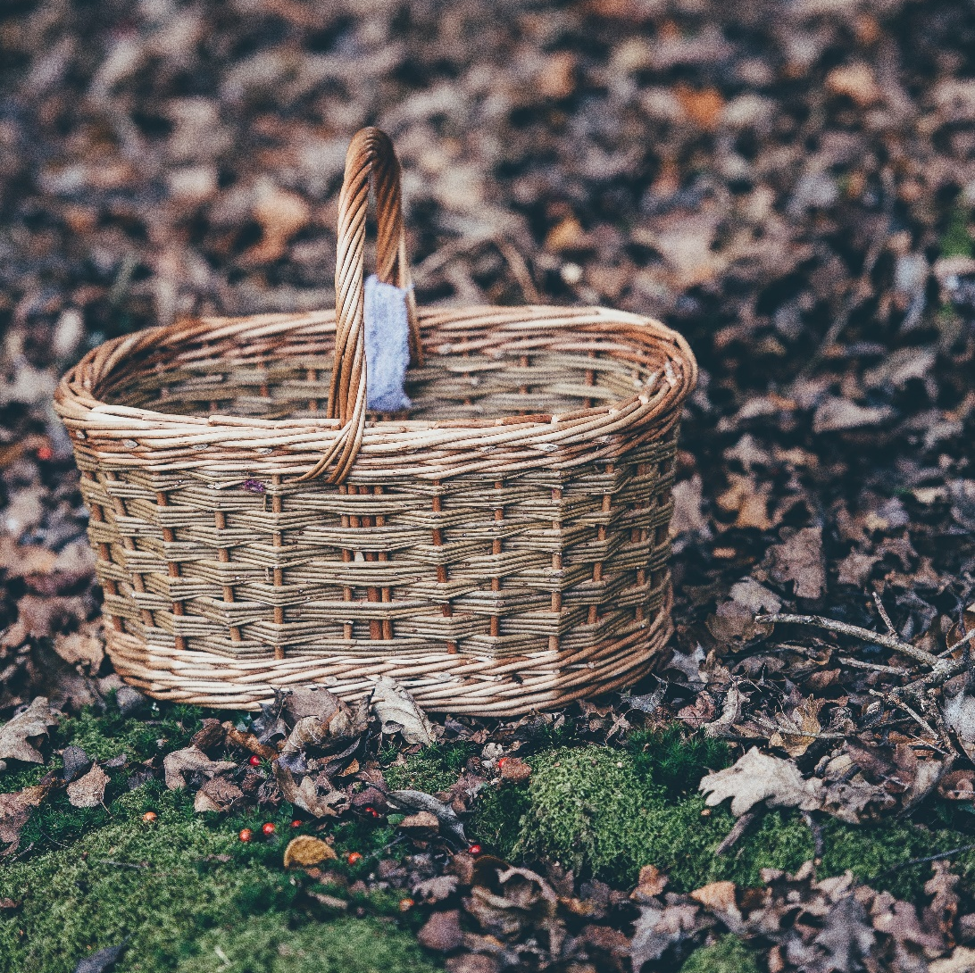
Some Things That Start with B Are…

Slide 12
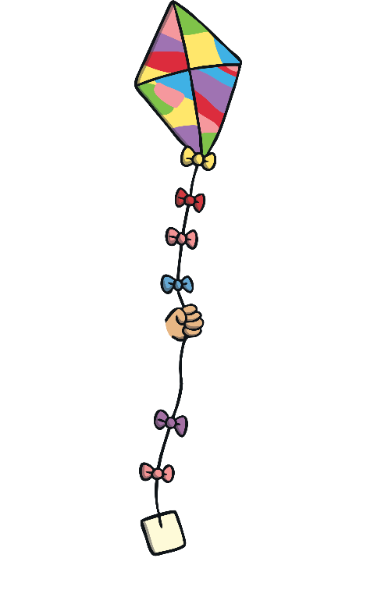
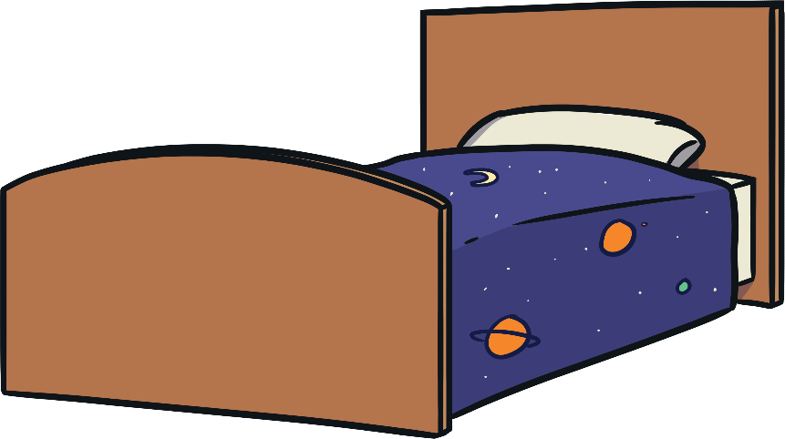
Which of These Start with B?
TRY AGAIN!
YES!
Teaching note: Pause briefly after the initial sound of each word to assist students to identify the sounds.

Slide 13
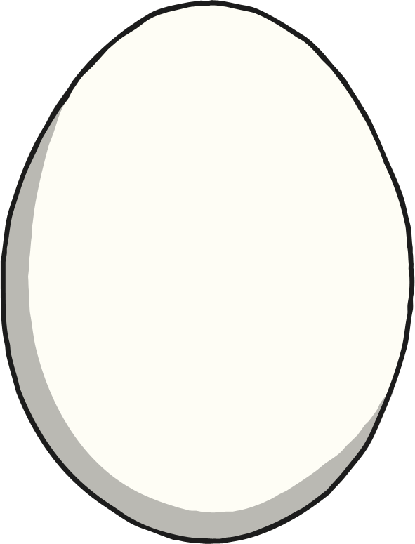

Which of These Start with B?
TRY AGAIN!
YES!
Teaching note: Pause briefly after the initial sound of each word to assist students to identify the sounds.

Slide 14

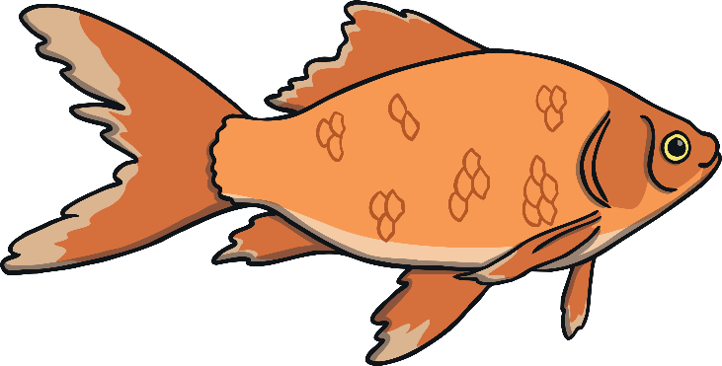
Which of These Start with B?
TRY AGAIN!
YES!
Teaching note: Pause briefly after the initial sound of each word to assist students to identify the sounds.

Slide 15
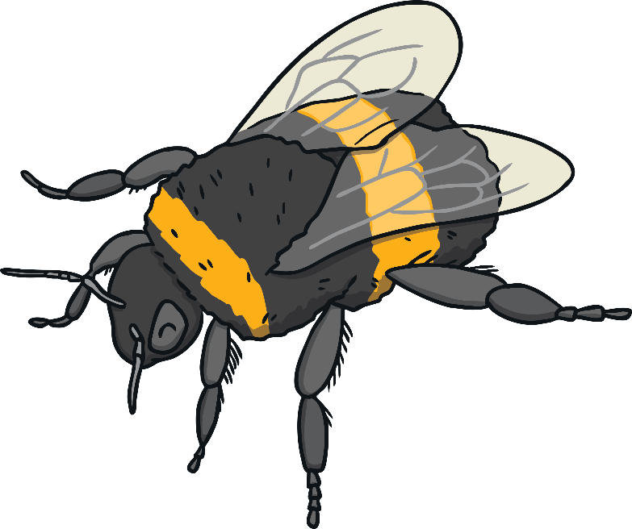
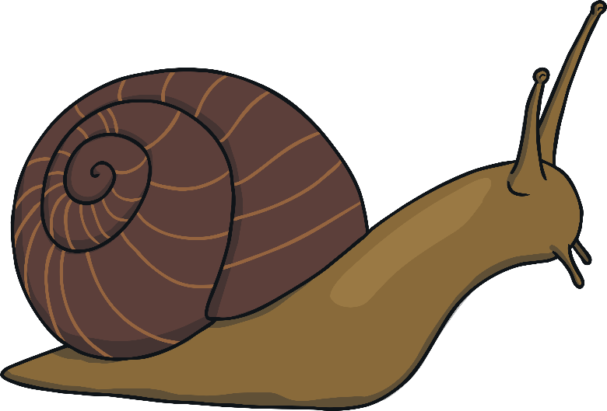
Which of These Start with B?
TRY AGAIN!
YES!
Teaching note: Pause briefly after the initial sound of each word to assist students to identify the sounds.

Slide 16
Have a go at the worksheets
and games. Can you challenge
yourself to write a sentence or your own story by looking at the pictures from the extra challenge story? Write some words containing the sounds ‘d’ and ‘b’.

