Slide 1
Week 1: Lesson 3
Alive in 5!

Slide 2
Lesson 3:
Composition of Numbers to 5

Slide 3
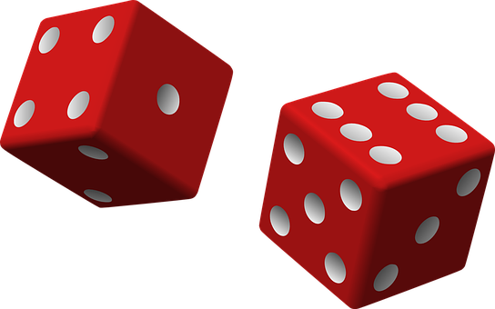
Activity 1
Dots
I am going to show you some dots on the screen.
Some of the dots will be red and some of them will be black.
I would like you to tell me how many dots there are altogether.
Be as quick as you can and see if you can show me how many there are using your fingers.
3

Slide 4
Activity 1
Dots
Here’s the first one.
How many dots are there altogether?
4

Slide 5
Activity 1
Dots
Yes, there are 4 dots altogether.
There are 2 red dots and 2 black dots.
So, altogether there are 4 dots.
4
5

Slide 6
Activity 1
Dots
Here’s the next one.
How many dots are there altogether?
6

Slide 7
Activity 1
Dots
Yes, there are 5 dots.
There are 3 red dots and 2 black dots.
So, altogether there are 5.
5
7

Slide 8
Activity 1
Dots
How many dots are there this time?
8

Slide 9
Activity 1
Dots
Yes, there is 1 black dot here.
We have got 1 altogether.
1
9

Slide 10
Activity 1
Dots
How many dots are there now?
10

Slide 11
Activity 1
Dots
That’s right we haven’t got any dots.
There are 0 dots.
0
11

Slide 12
Activity 1
Dots
How many dots are there this time?
12

Slide 13
Activity 1
Dots
Yes, there are 3 dots .
There are 3 red dots and 0 black dots.
So, there are 3 dots altogether.
3
13

Slide 14

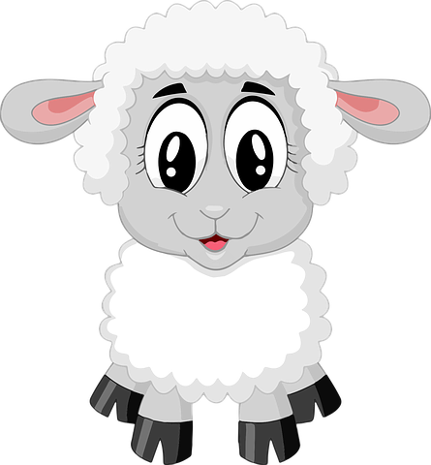

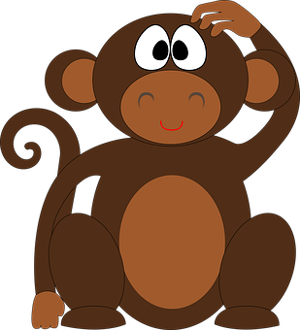

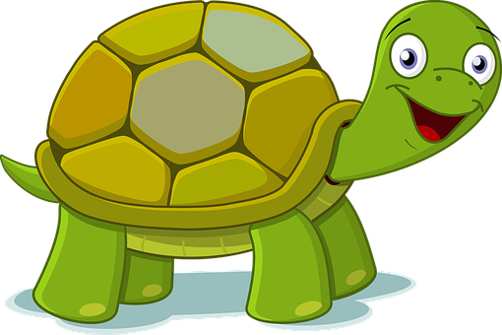
Activity 2
Composition of Numbers to 5
These animals are going to play a game together today.
14

Slide 15

Activity 2
Composition of Numbers to 5
There is a hoop and 5 balls.
Each of the animals is going to try and throw the balls into the hoop.
15

Slide 16
Activity 2
Composition of Numbers to 5
We are going to see how many balls land inside the hoop and how many land outside the hoop.
They will get a point for every ball that lands inside the hoop.
16

Slide 17
Activity 2
Composition of Numbers to 5
The hippo goes first.
How many balls have landed inside the hoop?
17

Slide 18
Activity 2
Composition of Numbers to 5
Yes, 3 balls have landed inside the hoop.
How many have landed outside the hoop?
18

Slide 19
Activity 2
Composition of Numbers to 5
Yes, 2 balls have landed outside the hoop.
19

Slide 20
Activity 2
Composition of Numbers to 5
The hippo got 3 balls in the hoop so he scores 3 points.
20

Slide 21
Activity 2
Composition of Numbers to 5
Here is the numeral 3.
3
21

Slide 22
Activity 2
Composition of Numbers to 5
Now it is the sheep's turn.
How many balls have landed inside the hoop?
22

Slide 23
Activity 2
Composition of Numbers to 5
Yes, 4 balls have landed inside the hoop.
How many balls have landed outside the hoop?
23

Slide 24
Activity 2
Composition of Numbers to 5
Yes, 1 ball has landed outside the hoop.
24

Slide 25
Activity 2
Composition of Numbers to 5
The sheep got 4 balls inside the hoop so she has scored 4 points.
25

Slide 26
Activity 2
Composition of Numbers to 5
Here is the numeral 4.
4
26

Slide 27
Activity 2
Composition of Numbers to 5
Here are the hippo and the sheep again.
Here are their scores.
Who scored the most?
3
4

Slide 28
Activity 2
Composition of Numbers to 5
The sheep scored the most because she got 4 balls in the hoop. The hippo got fewer than 4 balls in the hoop because the hippo only got 3 balls inside the hoop.
3
4

Slide 29
Activity 2
Composition of Numbers to 5
Now the penguin is going to have a turn.
How many balls have landed inside the hoop?
29

Slide 30
Activity 2
Composition of Numbers to 5
Yes, that’s right, the penguin got all 5 balls inside the hoop. There are 0 balls outside the hoop.
30

Slide 31
Activity 2
Composition of Numbers to 5
The penguin scored 5 points.
31

Slide 32
Activity 2
Composition of Numbers to 5
Here is the numeral.
5
32

Slide 33
Activity 2
Composition of Numbers to 5
Now it’s the tortoises' turn.
How many balls have landed inside the hoop?
33

Slide 34
Activity 2
Composition of Numbers to 5
Well spotted. There aren’t any balls in the hoop.
The tortoise has got 0 balls in the hoop.
How many balls are outside the hoop?
34

Slide 35
Activity 2
Composition of Numbers to 5
There are 5 balls outside the hoop.
35

Slide 36
Activity 2
Composition of Numbers to 5
The tortoise scores 0.
We don’t need to make any marks on our chalkboard because there aren’t any balls in the hoop.
36

Slide 37
Activity 2
Composition of Numbers to 5
Here is the numeral.
0
37

Slide 38
Activity 2
Composition of Numbers to 5
Here is the penguin and the tortoise again.
Here are their scores.
Who scored the most this time?
5
0

Slide 39
Activity 2
Composition of Numbers to 5
Yes, the penguin scored the most because he got
5 balls inside the hoop.
The tortoise scored fewer because he got 0 balls in the hoop.
5
0

Slide 40
Activity 2
Composition of Numbers to 5
Here’s the monkey.
How many balls have landed inside the hoop?
40

Slide 41
Activity 2
Composition of Numbers to 5
Yes, there is 1 ball in the hoop.
How many have landed outside the hoop?
41

Slide 42
Activity 2
Composition of Numbers to 5
Yes, there are 4 balls outside the hoop.
42

Slide 43
Activity 2
Composition of Numbers to 5
The monkey scores 1 point.
43

Slide 44
Activity 2
Composition of Numbers to 5
Here is the numeral.
1
44

Slide 45
Activity 2
Composition of Numbers to 5
Finally, it is the frog’s turn.
How many balls have landed inside the hoop?
45

Slide 46
Activity 2
Composition of Numbers to 5
Yes, there are 2 balls in the hoop.
How many balls have landed outside the hoop?
46

Slide 47
Activity 2
Composition of Numbers to 5
Yes, there are 3 balls outside the hoop.
47

Slide 48
Activity 2
Composition of Numbers to 5
The frog scores 2 points for the 2 balls in the hoop.
48

Slide 49
Activity 2
Composition of Numbers to 5
Here is the numeral.
2
49

Slide 50
Activity 2
Composition of Numbers to 5
Here is the monkey and the frog again.
Here are their scores.
Who scored the most this time?
1
2

Slide 51
Activity 2
Composition of Numbers to 5
The frog scored the most because he got 2 balls inside the hoop. The monkey got fewer than 2 balls in the hoop
because he only got 1.
1
2

Slide 52
Activity 3
Ordering Numbers
Now, we’re going to put the animals and their scores in order starting with the animal that scored the most.
3
4
5
0
1
2
52

Slide 53
Activity 3
Ordering Numbers
First, we have the penguin who scored 5 points.
5
53

Slide 54
Activity 3
Ordering Numbers
Then, we have the sheep who scored 4 points.
5
4
54

Slide 55
Activity 3
Ordering Numbers
Next, we have the hippo who scored 3 points.
5
4
3
55

Slide 56
Activity 3
Ordering Numbers
Then, we have the frog who scored 2 points.
5
4
3
2
56

Slide 57
Activity 3
Ordering Numbers
Then, we have the monkey who scored 1 point.
5
4
3
2
1
57

Slide 58
Activity 3
Ordering Numbers
Finally, we have the tortoise who scored 0 points.
5
4
3
2
1
0
58

Slide 59
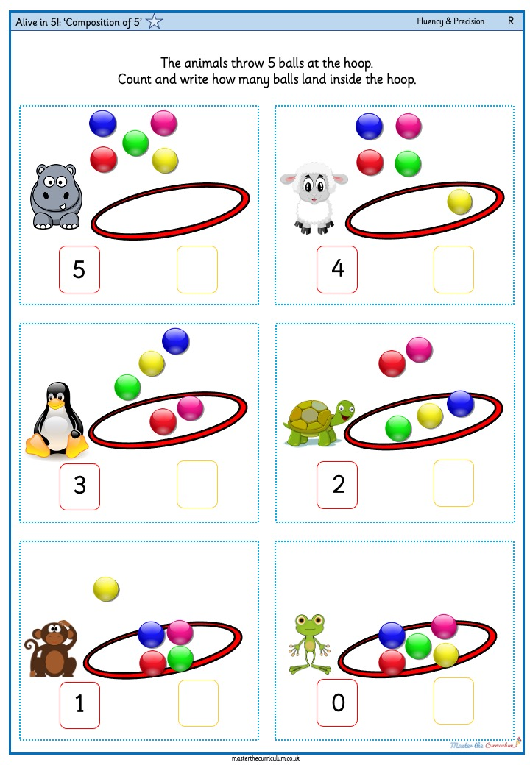
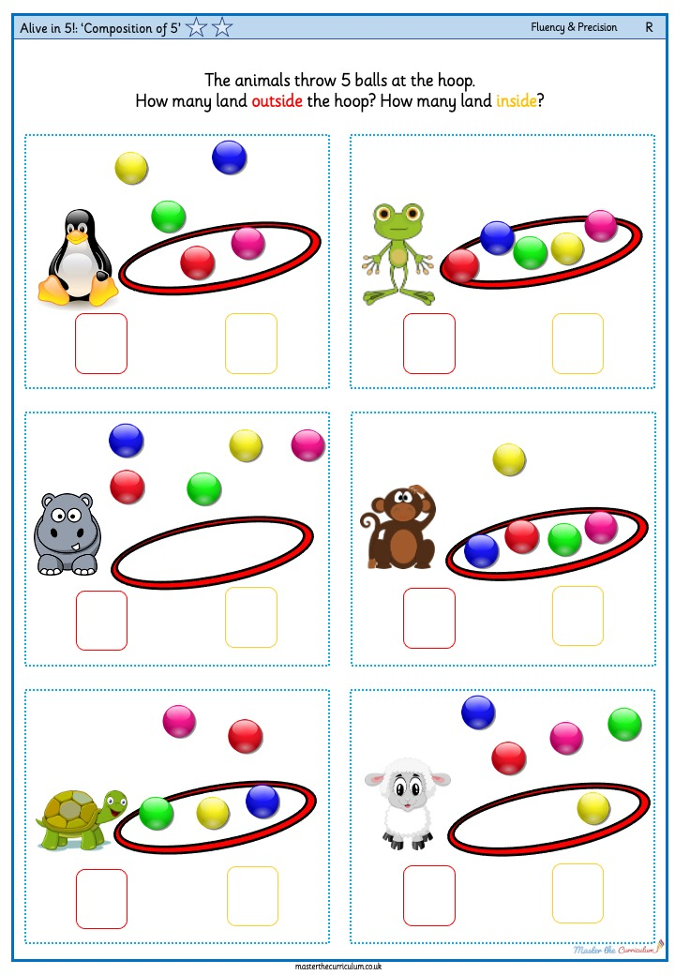
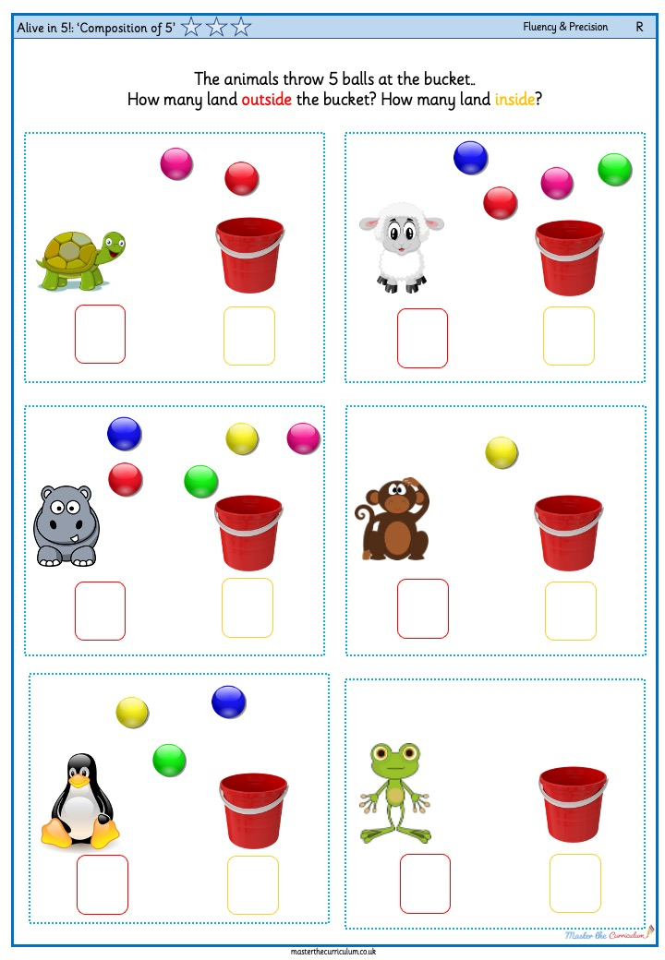
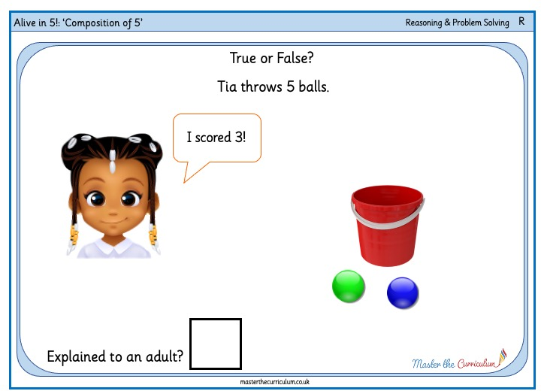
Your turn!
Ordering Numbers
These are the activities that you can do.
Hoopla: You need a bucket/hoop and 5 beanbags/balls. Can you throw all five balls and count how many landed inside the hoop and how many landed outside?
Record your score on a whiteboard or chalkboard using tallies or numerals.
Use 5 double sided counters in a cup. Shake the cup and tip out the counters. How many counters are red and how many are yellow? You can put the counters on a 5 frame or draw a picture to show how they landed.
Use two different coloured cubes to build towers of 5. How many are there of each colour?
How many different towers can you build?
Look at the pictures on your sheet find the 2 numbers that make the number 5.
59

