Slide 1

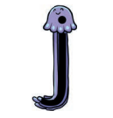
Today we are going to practise the sounds ‘i’ and ‘j’.
They look very alike, don’t they? Can you see how they are different from each other? Yes the ‘flick’ at the bottom of each letter is the opposite to each other!

Slide 2


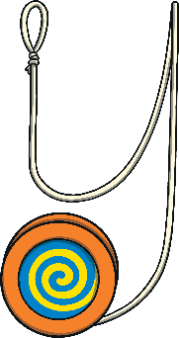
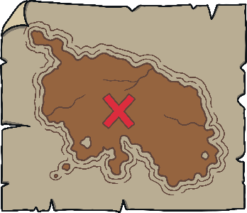
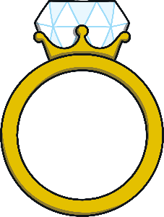
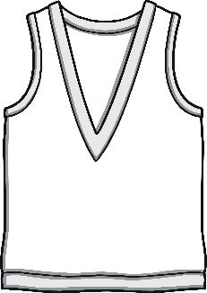



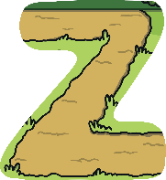
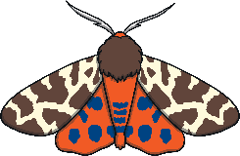
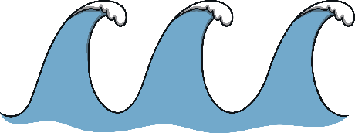

Revisit and Review
Let’s practise Sam’s Sounds and Tricky Words!
v
j
y
x
qu
ch
ng
w
zz
z
th
th
sh
she
me
we
he
be

Slide 3
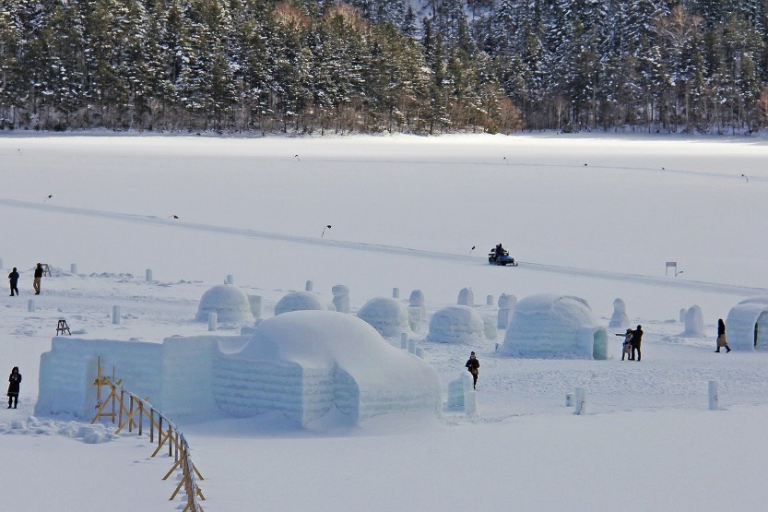
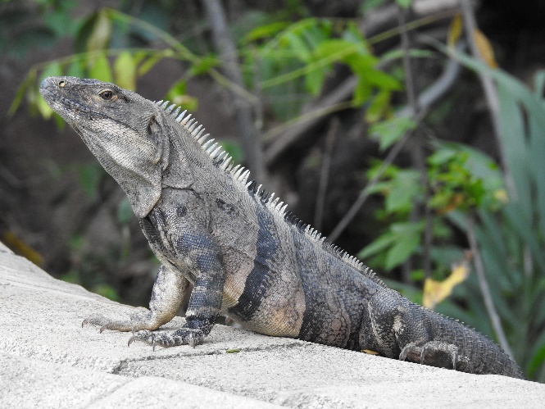
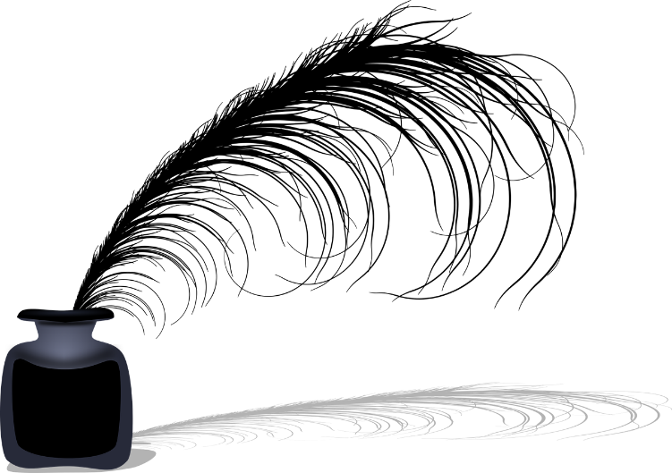
Some things that start with ‘i’ are…

Slide 4
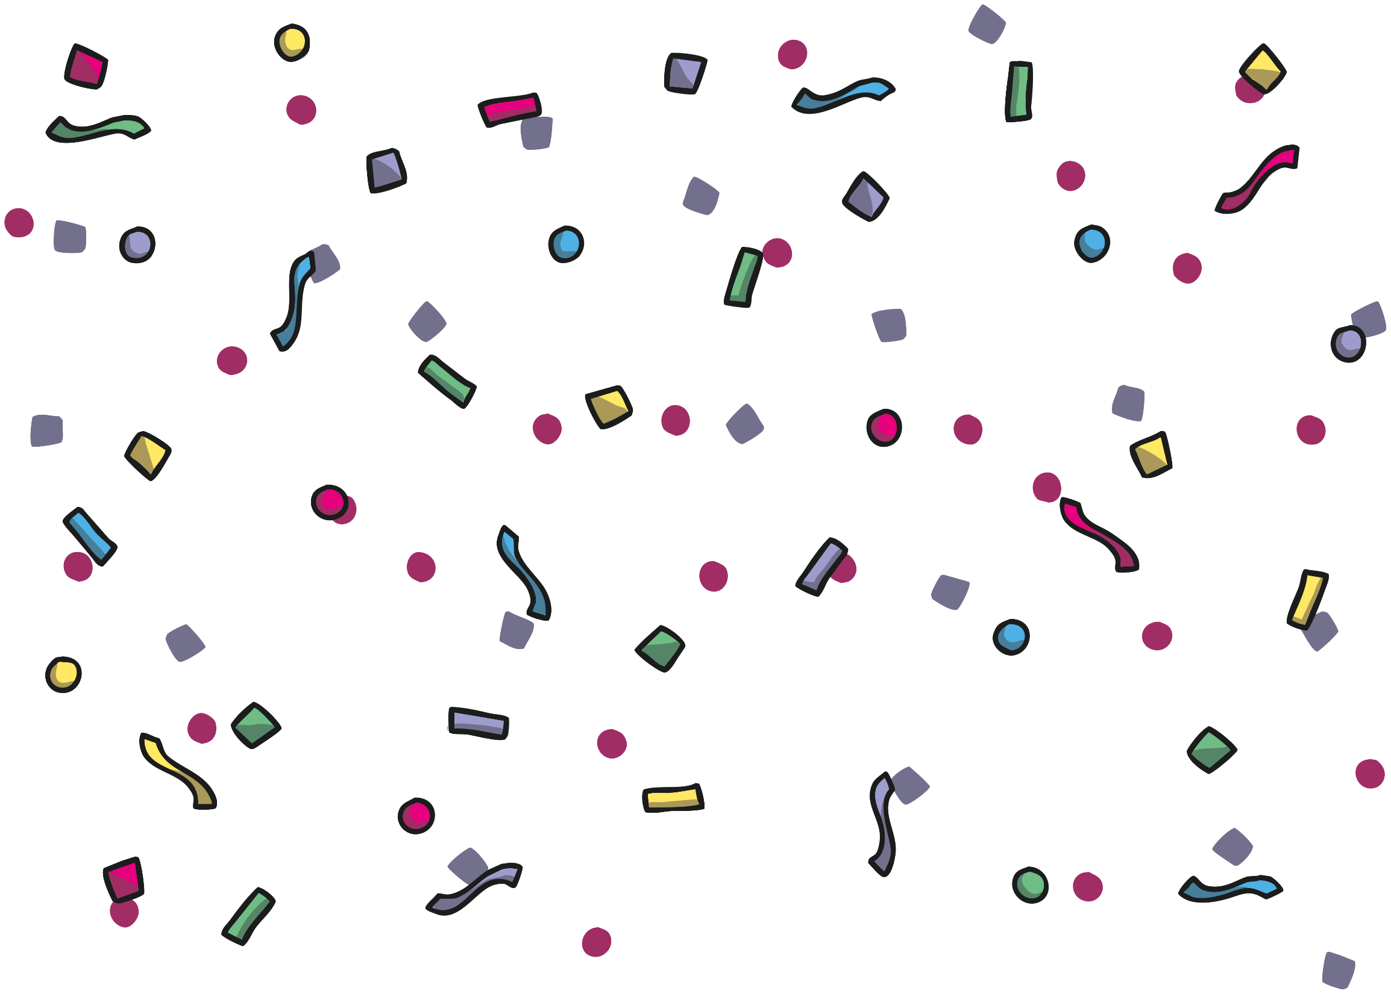
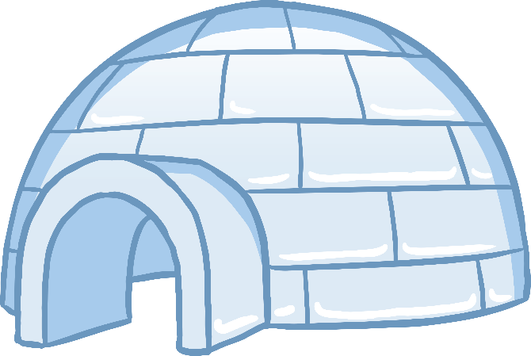
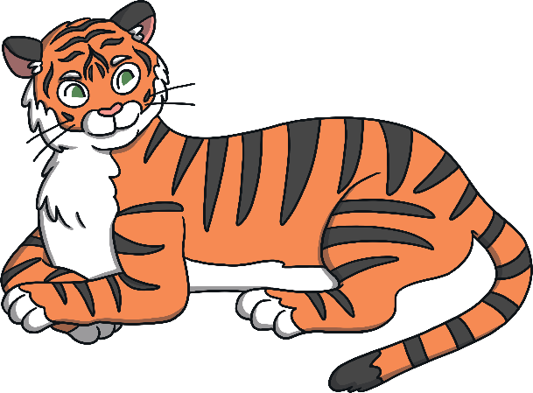
Which of These Start with I?
TRY AGAIN!
YES!
Notes:
Pause briefly after the initial sound of each word to assist students to identify the sounds.

Slide 5
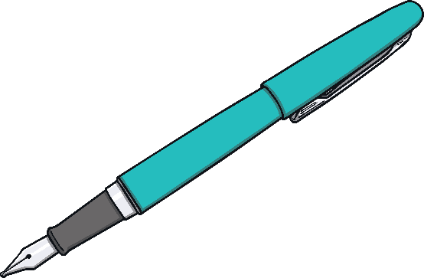
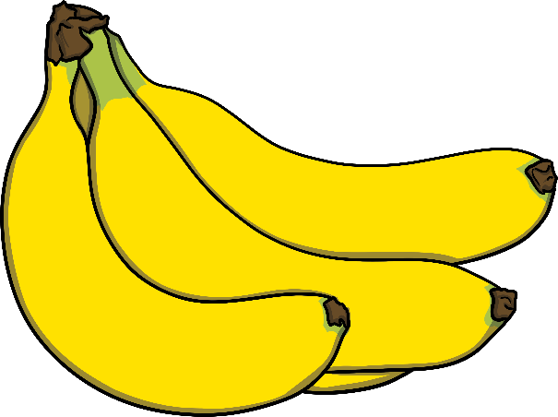
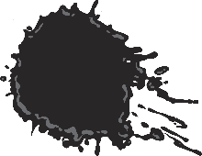
Which of These Start with I?
TRY AGAIN!
YES!

Slide 6
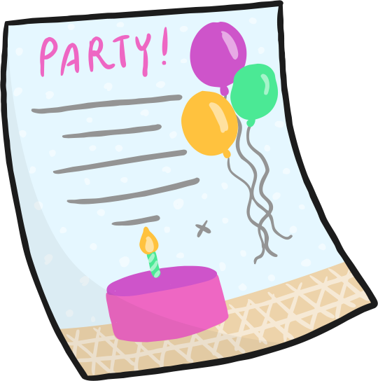
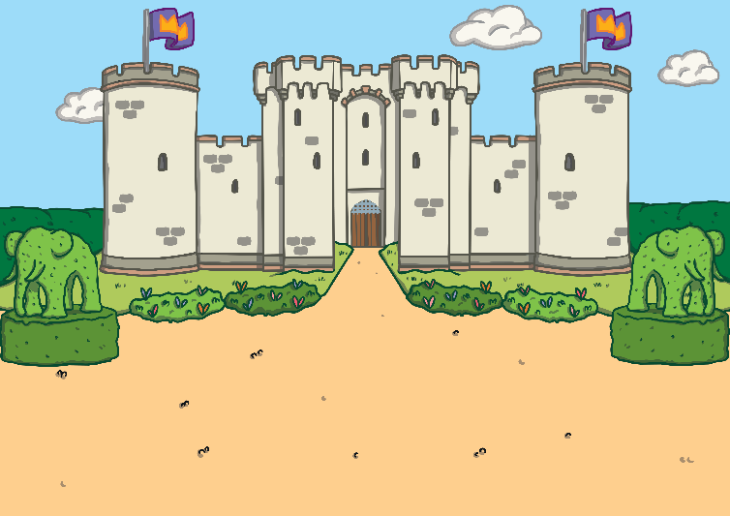
Which of These Start with I?
TRY AGAIN!
YES!

Slide 7
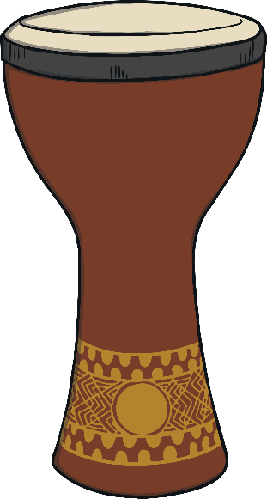
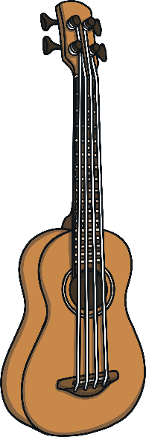
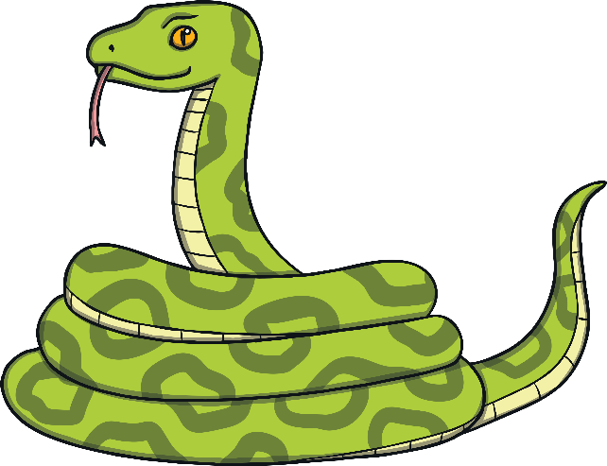
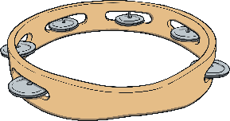
Which of These Start with I?
TRY AGAIN!
YES!

Slide 8

The Letter W Looks like This…
j
J
Can you draw it with your finger?

Slide 9
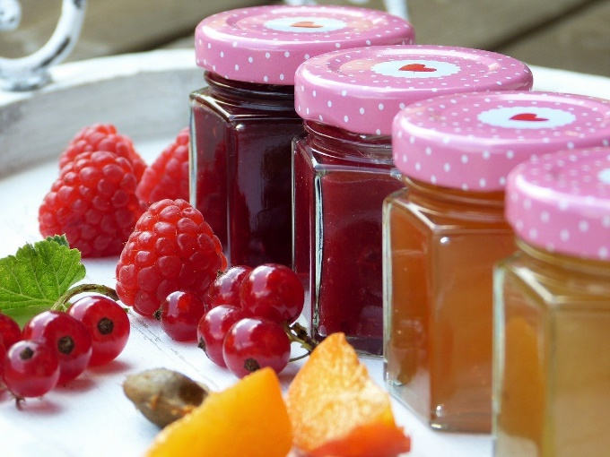
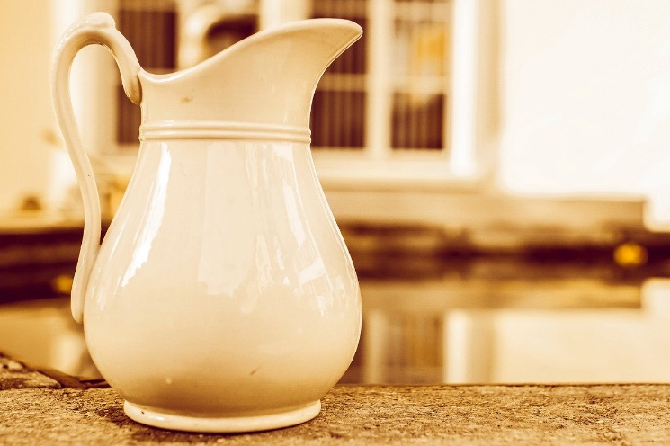
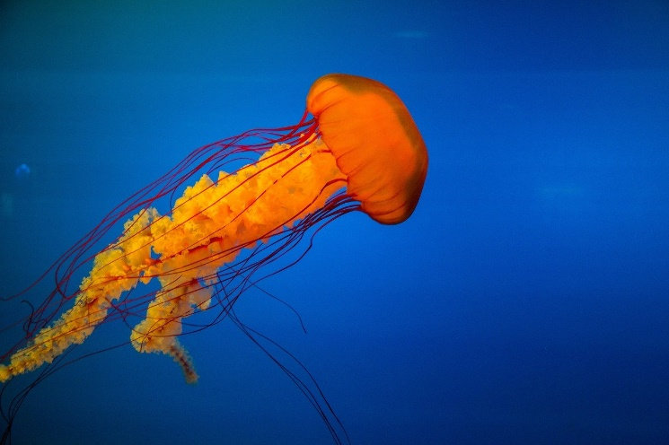
Some things that start with ‘j’ are…
Notes:
Jam, jellyfish, jug

Slide 10
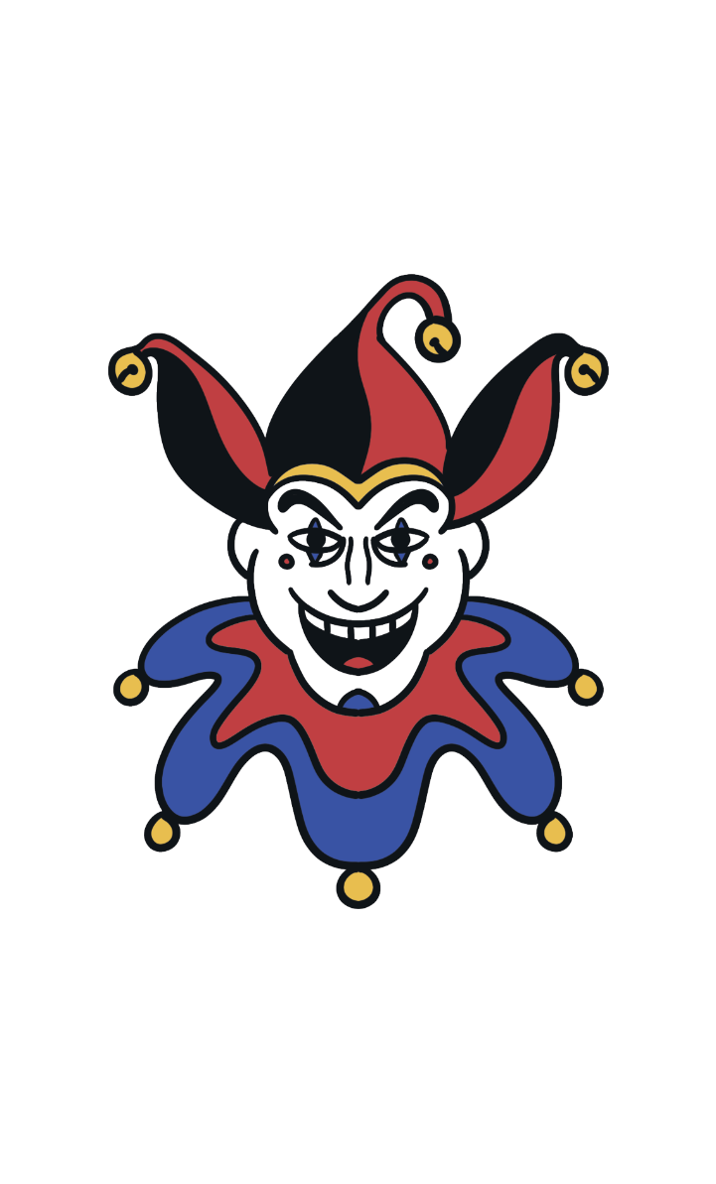
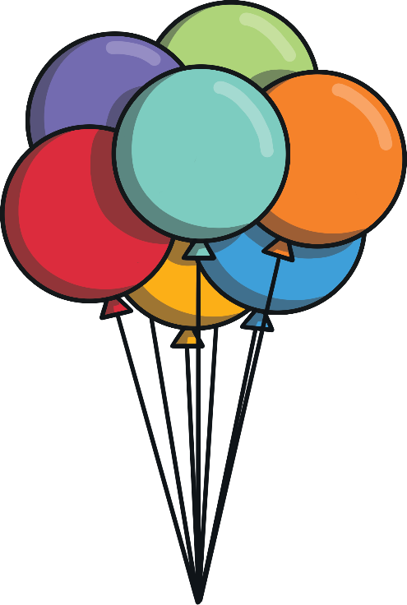
Which of These Start with J?
Try Again!
Yes!
Notes:
Pause briefly after the initial sound of each word to assist students to identify the sounds.

Slide 11
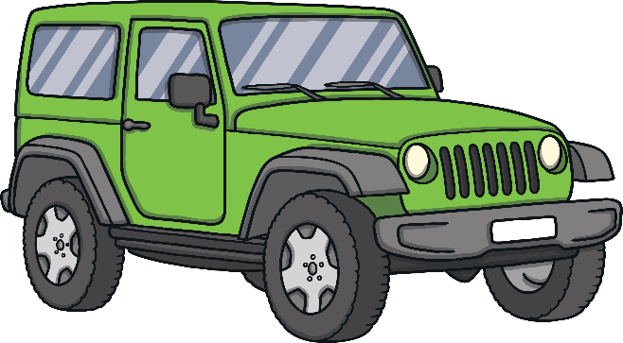
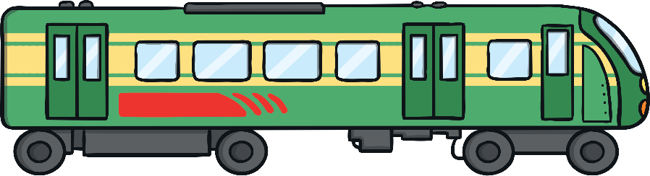
Which of These Start with J?
Try Again!
Yes!

Slide 12
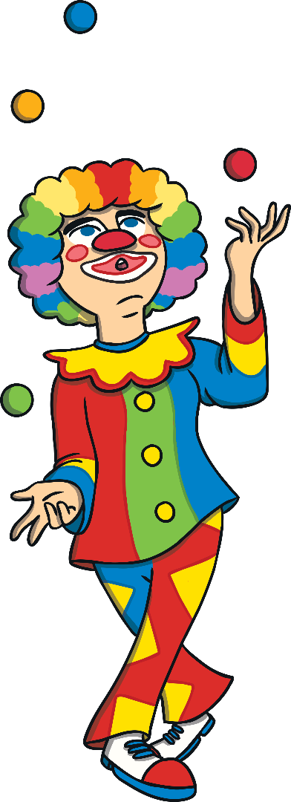
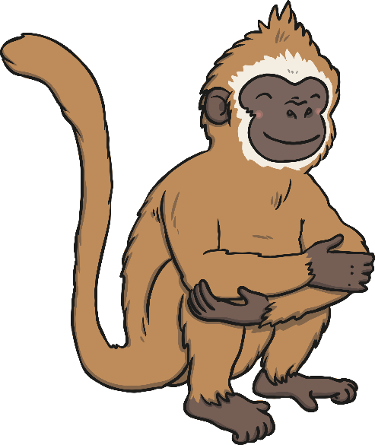
Which of These Start with J?
Try Again!
Yes!

Slide 13
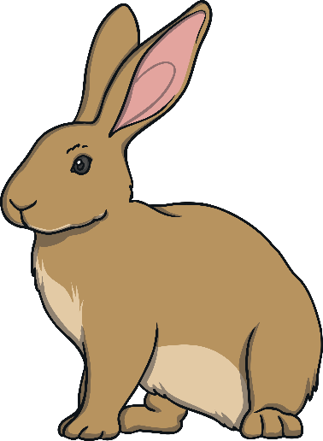
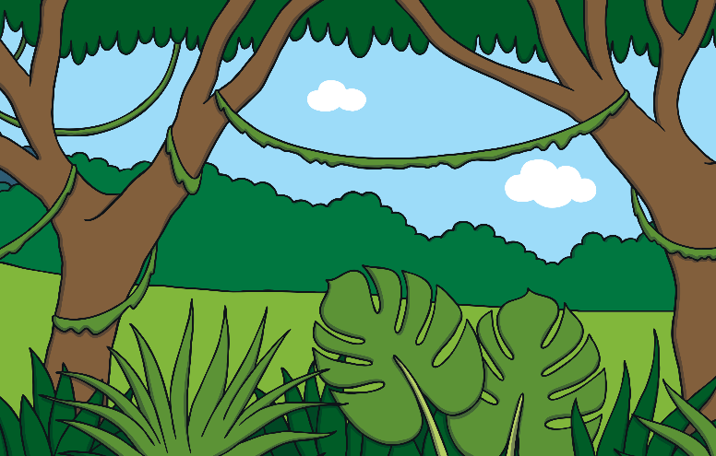
Which of These Start with J?
Try Again!
Yes!

Slide 14
Now have a go at the work sheets!

