Slide 1

I think I am pink.

Slide 2



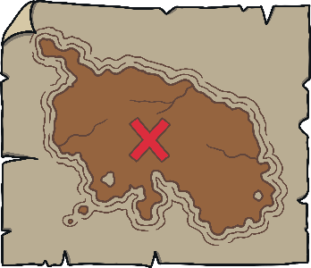









Revisit and Review
Let’s practise Sam’s Sounds and Tricky Words!
v
j
y
x
qu
ch
ng
w
zz
z
th
th
sh
she
me
we
he
be

Slide 3
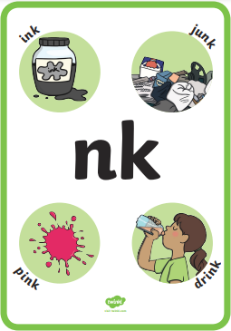

Slide 4
bank

Slide 5
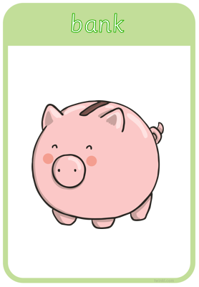

Slide 6
sink

Slide 7
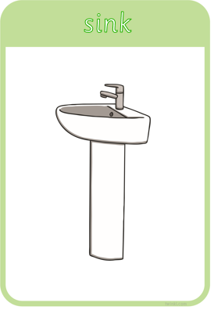

Slide 8
think

Slide 9
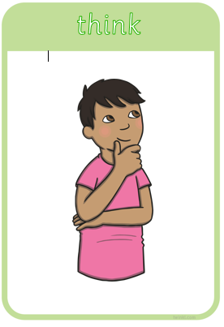

Slide 10
pink

Slide 11


Slide 12
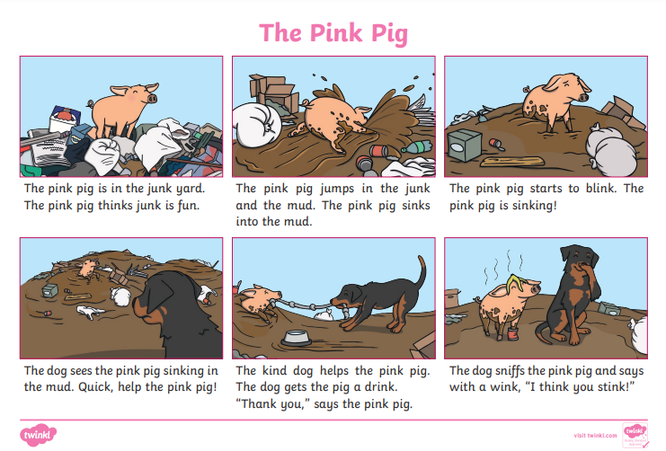

Slide 13
Extra challenge!
Can you write your own sentence with ‘nk’ words?
You could write about the pictures in the story.

