Slide 2
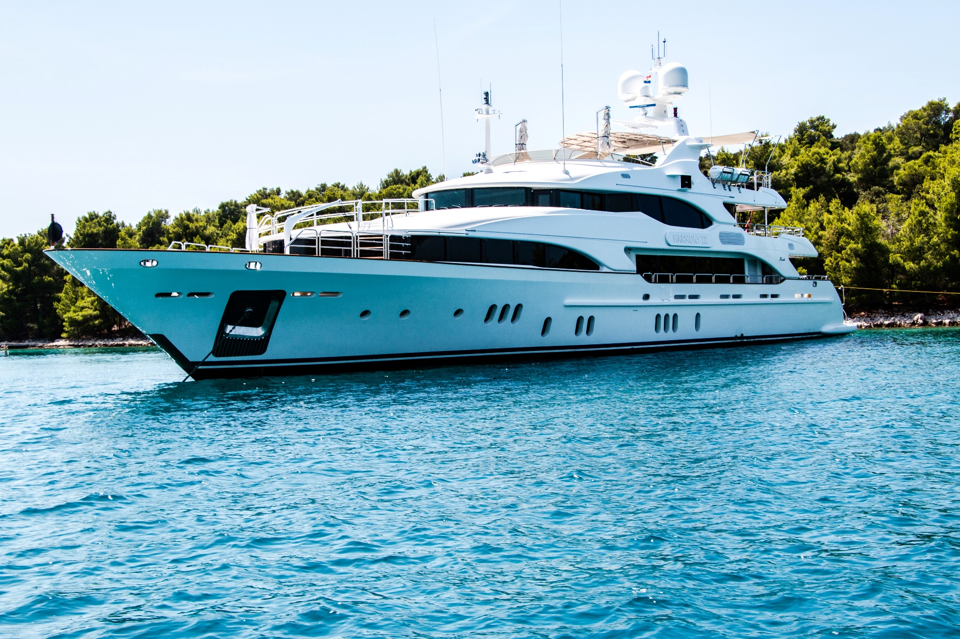
Yacht

Slide 3
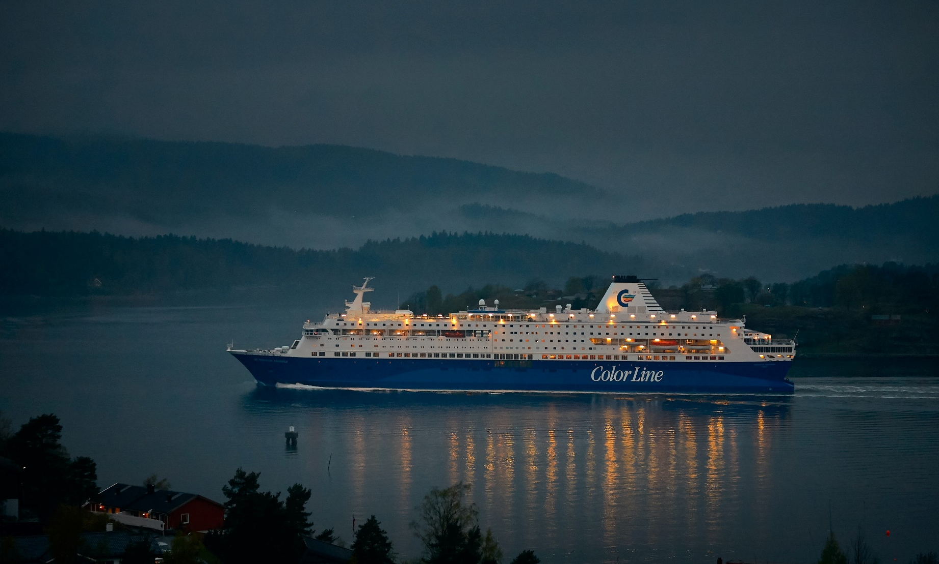
Cruise Ship

Slide 4
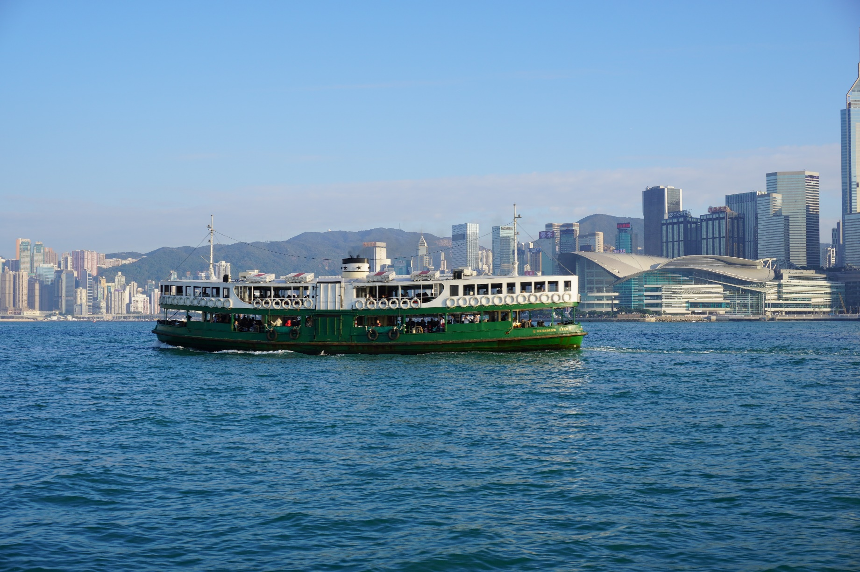
Ferry

Slide 5
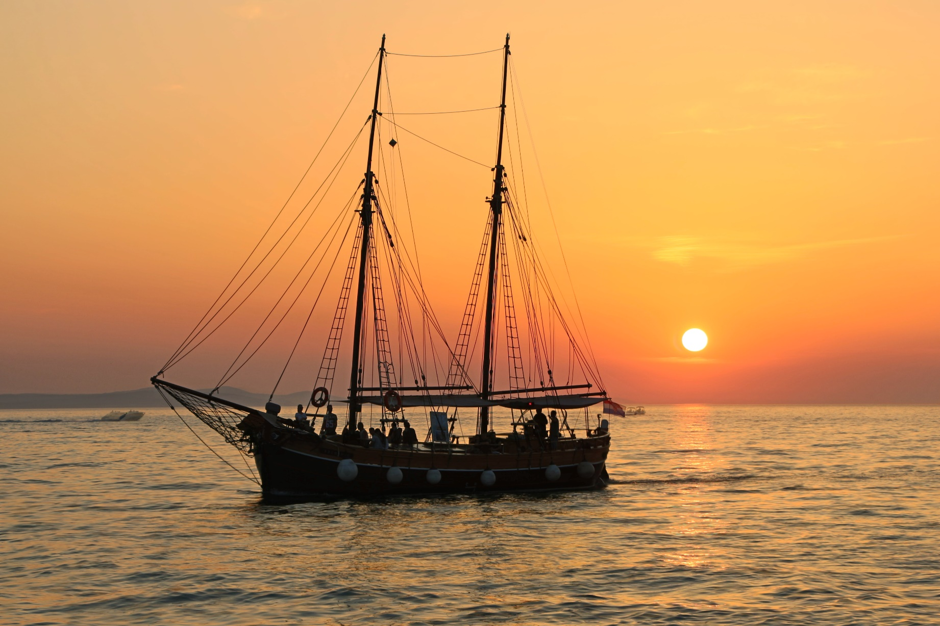
Ship

Slide 6

Kayak

Slide 7

Speed Boat

Slide 8
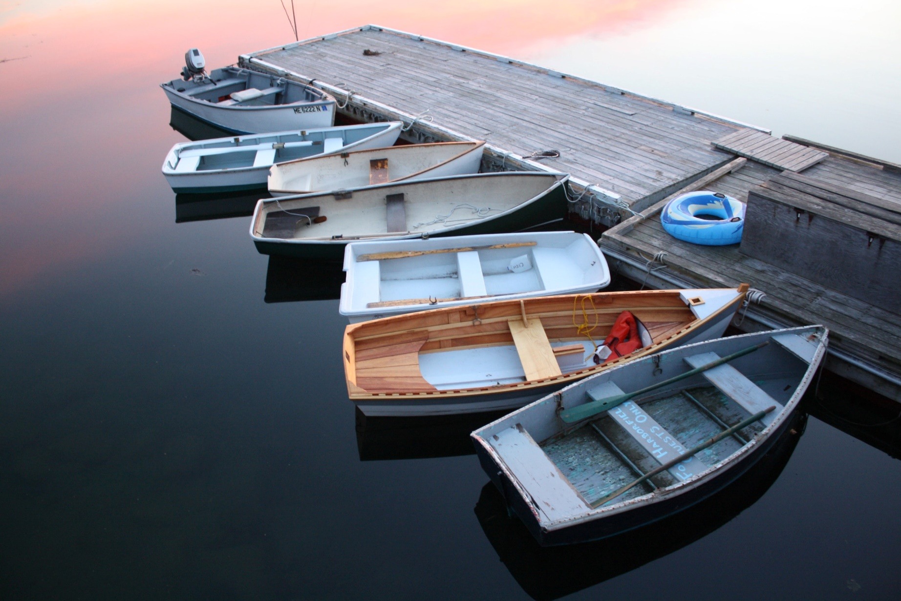
Dinghy

Slide 9
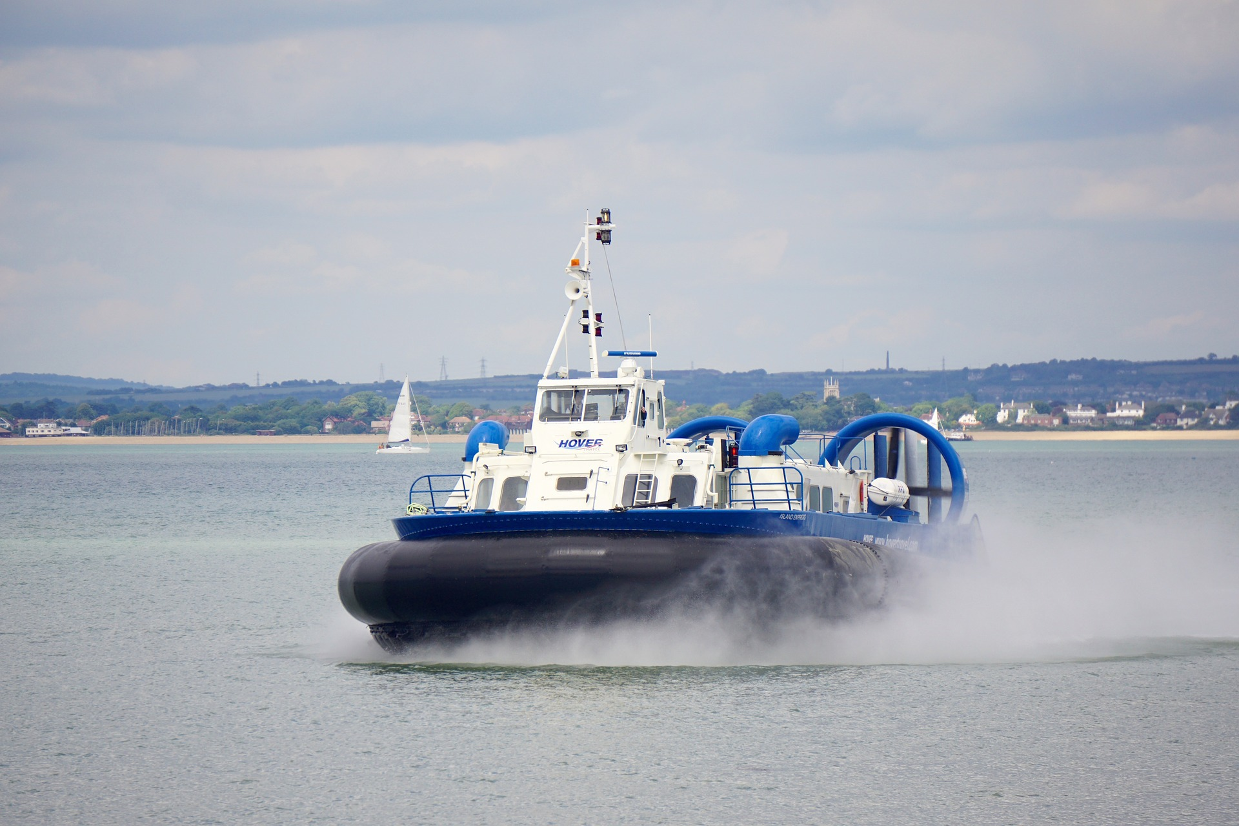
Hovercraft

Slide 10
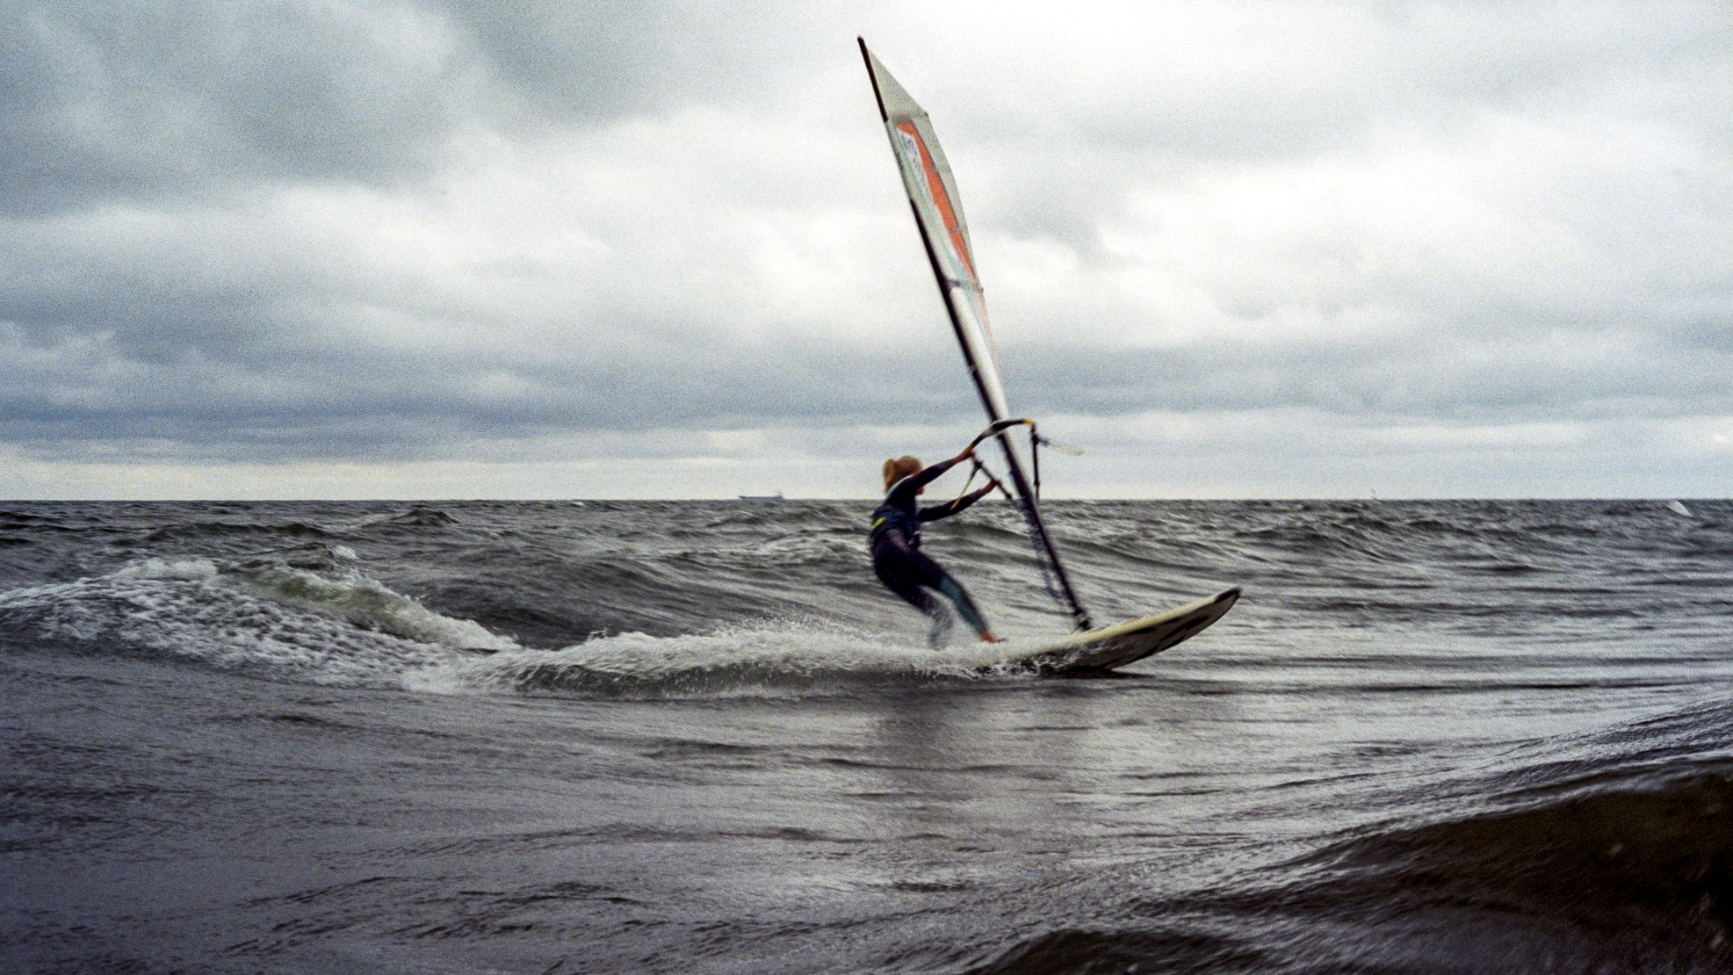
Windsurf

Slide 11

Canoe

Slide 12
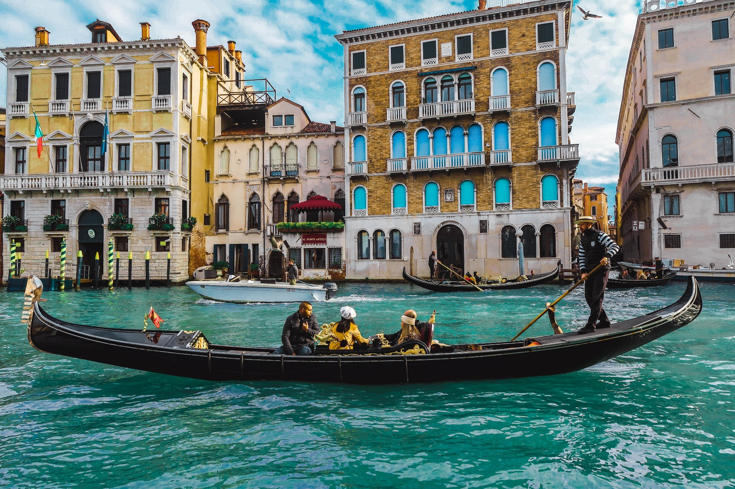
Gondola

Slide 13
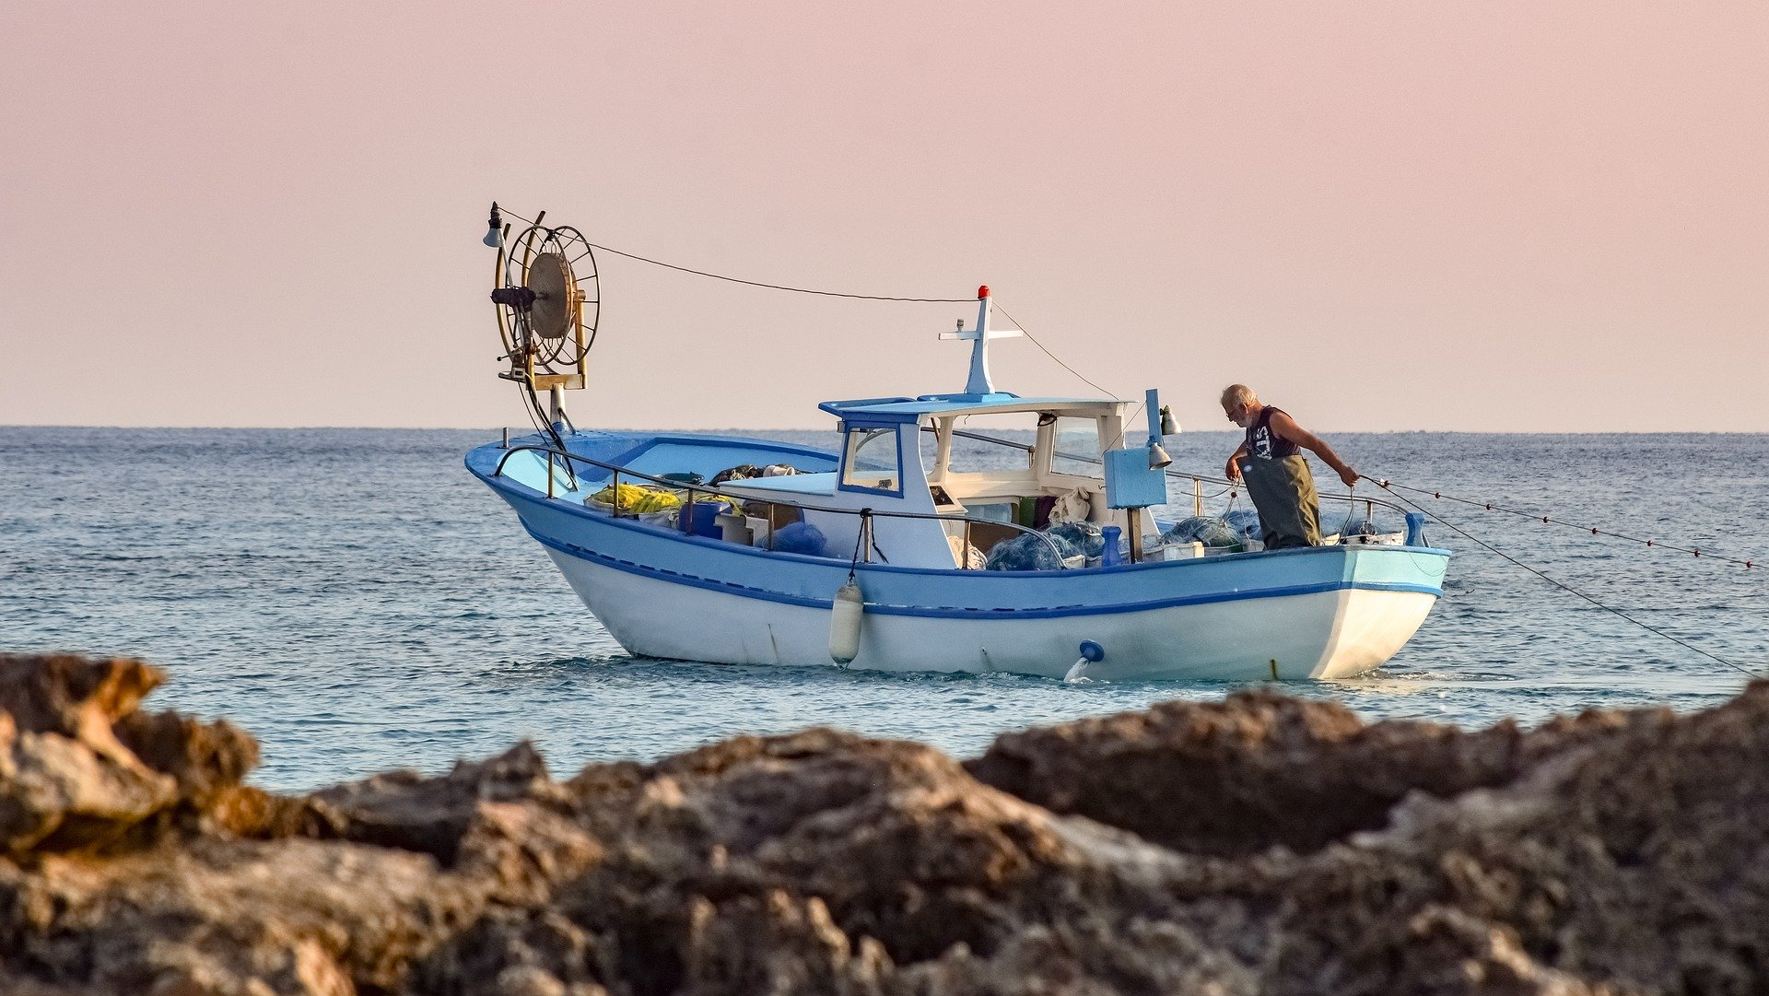
Fishing Boat

Slide 14
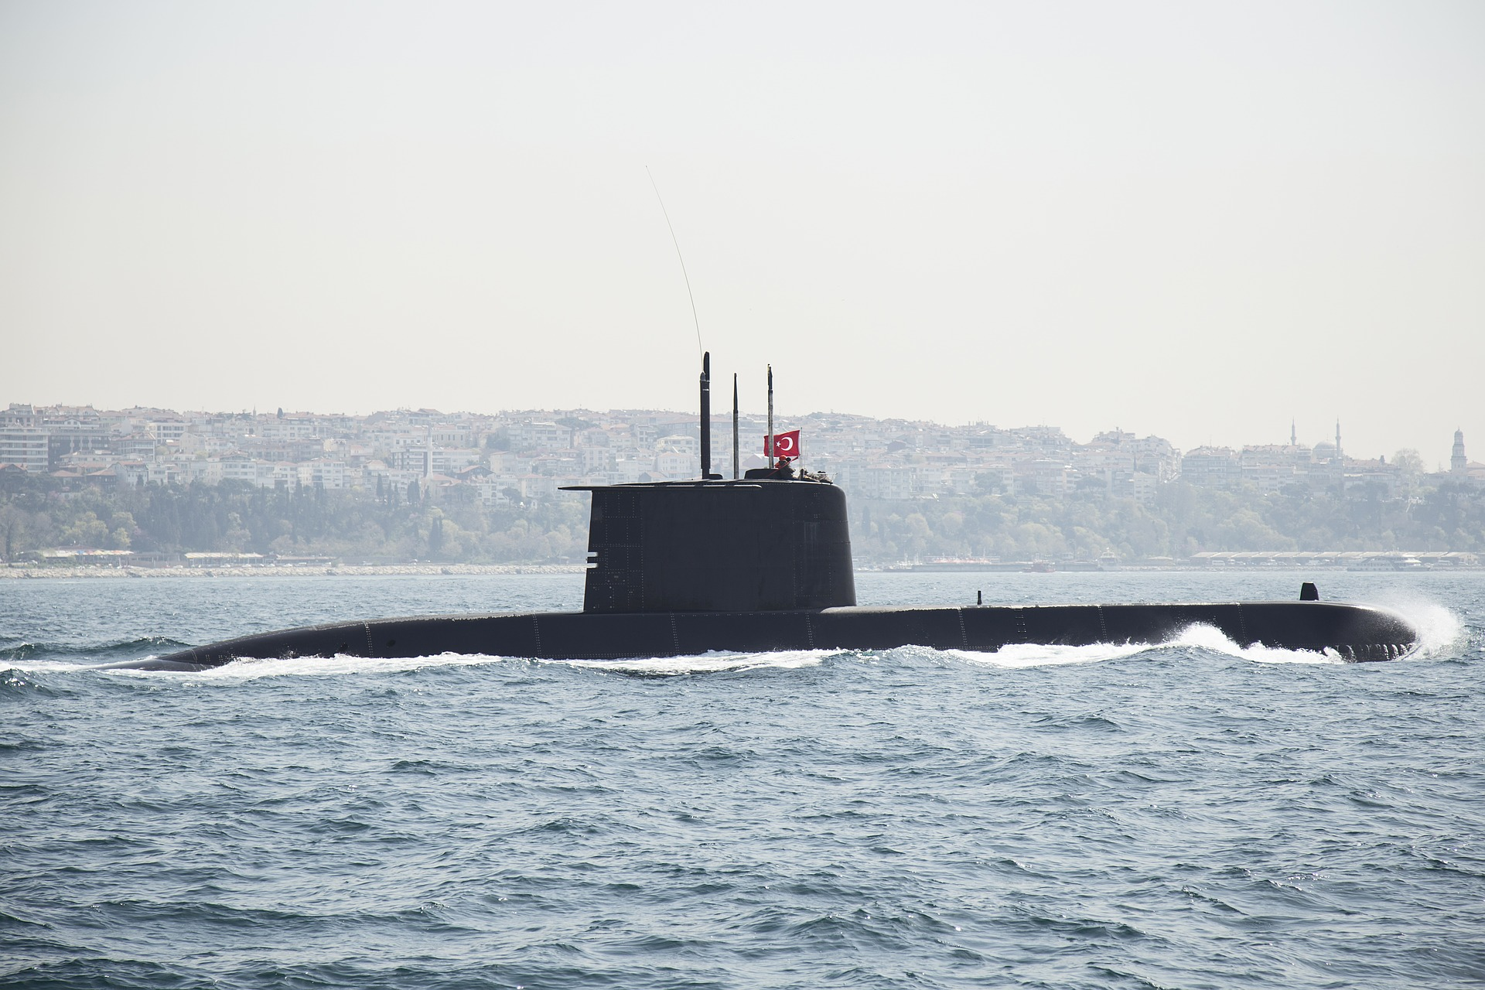
Submarine

Slide 15
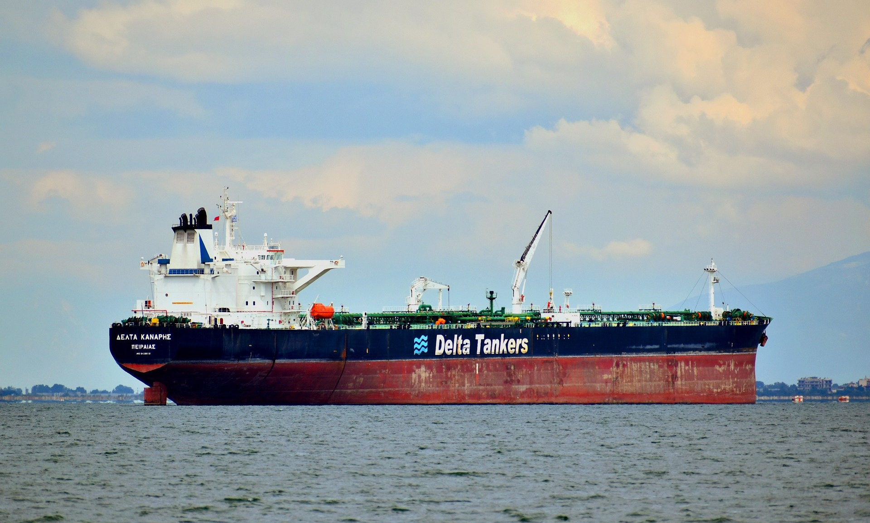
Oil Tanker

Slide 16

Rowing Boat

